Slide 1
Grid Network Services Architecture
(GNSA) draft-ggf-ghpn-netserv-2
Franco Travostino and Admela Jukan
jukan at uiuc.edu
June 30, 2005
GGF 14, Chicago

Slide 2
Outline
What’s new
Motivation
Structure
What’s next

Slide 3
What’s new
Draft revisited
  draft-ggf-ghpn-netserv-2
New structure of the document
  33 pages, including Figures
  6 Sections, and a number of subsections
New momentum
  Related to our interactions
  Related to other standard activities
  Related to the existing GGF activities
  Most importantly, related to the OGSA
New interests, …
  … with his/her convictions and enthusiasm - everybody’s welcome

Slide 4
Motivation
To make an important contribution to OGSA efforts
  Hence the name “GNSA” - Grid Network Services Architecture
To create a new structure
  Not only a relevant one, but also a “modular” one, so that many contributions can be easily integrated
To reflect specific discussions within GHPN
  From meetings, e-mail discussions, etc.
To … [more motivation]

Slide 5
New in the Structure
•(GNS-Arch) “GNS Architecture”
  To address the relationship with current services and applications forming the Grid infrastructure (OGSA).
  To address the issues of the GNS inter-service interplay.
(GNS-NCPExt) “GNS Network Control Plane Extensions” framework.
  To address issues of communication and signaling at the boundaries between Grid middleware (applications) and networks.
  The focus is on requirements for the necessary extension (only) of current control plane efforts (such as addressed IETF, OIF, ITU-T, etc).
• (GNS-Def) GNS definition and the functional characterization
  Abstract (generalized) definition of the functional requirements, albeit based on requirements, technical challenges and specific use cases.
• (GNS-Profile) GNS “Service Profiles”
  To address specific service profiles, to meet the needs of domains of interest, e.g., delay-tolerant, real-time.

Slide 6
New and Old Foci
•(GNS-Arch) “GNS Architecture”
(GNS-NCPExt) “GNS Network Control Plane Extensions” framework.
• (GNS-Def) GNS definition and the functional characterization
(GNS-Profile) GNS “Service Profiles”
      Network Information Service (a proxy to NM-WG)
      Network Monitoring Service (a proxy to NM-WG)
Grid Interface Design Principles
…..kept “as is”

Slide 7
Draft Structure and Status
Section 1: Introduction (1.5 pages)
Section 2 (to be discussed, extended): : GNS-Arch - basic architectural considerations and discusses the context of GNS within the OGSA.
Section 3 (much to be done): : GNS NCP-Ext addresses specific extensions of the existing control protocols to meet the Grid requirements.
Section 4 (much to be done): : GNS-Def, an abstract definition of the set of requirements that GNS is intended to address.
Section 5 (unchanged, and more to come): GNS-Profile - translates the functional requirements defined in GNS-Def into a specific set of capabilities.
Section 6 (unchanged): Some useful definitions of Web Services and Grid Services in the context of GNS interface design principles.

Slide 8
GNS-Arch
Motivate, define and think about
  How network services combine and yield a rich mediation function between grid applications, computational resources and legacy networks.
  How they fit into OGSA
The role of GNS
  To hide details of network heterogeneity and communication protocols to applications, and at the same time,
  To capitalize on specific properties and feedback of the underlying physical network infrastructure
The GNS supports the virtualizations of the underlying infrastructure and is tightly-coupled with the entities that it virtualizes.

Slide 9

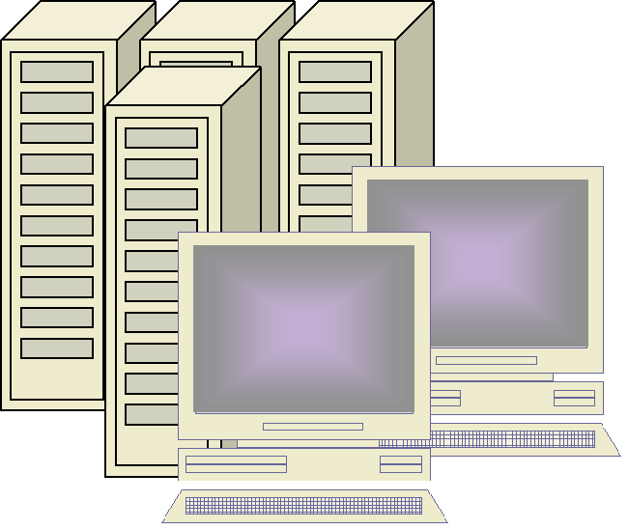
Positioning within the OGSA
Applications
Value-added SW
User domain Apps
User Frameworks
OGSA
Information Mgmnt
Execution Mgmnt
Optimization Security
Resource Mgmnt
Monitoring
Security
NCP
Ext
Data
Storage
Network (GNS)
CPU
Sensor
Network Control Plane (NCP)
Networks

Slide 10
Basic usage of GNS
Grid infrastructure is supported by GNS in different ways
  A service is queried.
  A service is discovered.
  A service is created (“on demand”).
  A service is modified (“on demand”)
Availability of services
  Centrally available, e.g., on a “Network Service Servers”
  Distributed locations network wide.
  Dynamically created services (e.g., Web services) - an application can request a service that has to be created for that application purpose and the duration

Slide 11
GNS and interactions with processes
Applications
Policy
App-1
App-2
App-3
(Globus)
Negotiation
Alert
GNS-1
GNS-2
GNS-3
GNS-n
Provision
Grid Network Service
Transfer
Networks

Slide 12
Feedback loops
Policy
Applications
(1) Demand
(e.g. Globus)
Negotiation
(2)
Alert, Provision, Transfer
Detect
Events
Supply
(3)
Networks

Slide 13
GNS vs. “NS”
Applications
Grid Network
Service (GNS)
(e.g. Grid Broker)
“Vertical”
Network
Service (NS)
Networks
Networks
Networks
Grid Network
Service (GNS)
Applications
(e.g. Grid Broker)
“Horizontal”
NS
NS
NS
Networks
Networks
Networks

Slide 14
GNS Network Control Plane Extensions (GNS-NCPExt)
- The Design Space
Applications
Time? Space? Ownership?
GNS-NCPExt
Application
Networking
Grid Resources
Bulk Data
Computing
Sensors
Storage
Instruments
CPU
Visualization
Grid resources
Wireless
Lambda
Multi-layer
Internet
Networks

Slide 15
New Foci to Develop
•(GNS-Arch) “GNS Architecture”
  Align with OGSA
(GNS-NCPExt) “GNS Network Control Plane Extensions” framework.
  Define the extensions
(GNS-Def) GNS definition and the functional characterization
  Start from scratch
(GNS-Profile) GNS “Service Profiles”
  Define more service profiles, align with “Use Cases
Grid Interface Design Principles
  ???

