Slide 1
Grid Network Services Use Cases:
Status Update
GHPN Research Group
Authors:
J. Austin, P. Clarke, T. Ferrari (Editor),
M. Fletcher, M. Gaynor, T. Jackson,
G. Karmous-Edwards, P. Kunszt, M. J. Leese,
J. Leigh, Paul D. Mealor, Inder Monga, Volker Sander
Draft-ggf-ghpn-netservices-usecases-2.7

Slide 2
Introduction
Motivation: collect quantitative and qualitative requirements from users and applications for identification and definition of Grid Network Services
Applications in latest draft:
  Visualization
  High Energy Physics File Replica Management
  Emergency Medical Technician with Integrated Wireless Sensors
  Distributed Aircraft Maintenance Environment (NEW)
  Grid Network Monitoring

Slide 3
Areas and Usecases
Path-oriented: connectivity offering advanced services with QoS
    Visualization sessions
    High throughput file transport with a deadline
    File replica management in HEP experiments (UPDATED)
    Emergency Medical Technician with integrated wireless sensors
    Distributed Aircraft Maintenance Environment (NEW)
Knowledge-based: collection and use of information about network performance
    Passively monitored data
    Administrative setup of schedules of measurements
    Grid Service optimization

Slide 4
Distributed Aircraft Maintenance Environment (DAME)
Contributors:
  Martyn Fletcher, Tom Jackson, Jim Austin, University of York
DAME:
  Grid-based, collaborative and interactive environment for remote analysis of vibration and performance data by various geographically dispersed users: local engineers and remote experts
  diagnosis environment built around a workflow system
  extensive set of data analysis tools and services for automated diagnosis for known conditions
  collaborative and interactive diagnosis and analysis environment when automated diagnosis is not possible

Slide 5
DAME: Actors
Actors:
  Maintenance Engineers (located at airports): carry out engine diagnosis and maintenance activities.
  Remote Maintenance Analysts (located at the data centre): provide technical advice, coordinate analysis and brokerage and use the DAME tools and services interactively
  Remote Domain Experts (located at the engine manufacturer’s site): act as a repository of knowledge, provide expert diagnostic advice on unidentified anomalies and use the DAME tools and services interactively.

Slide 6
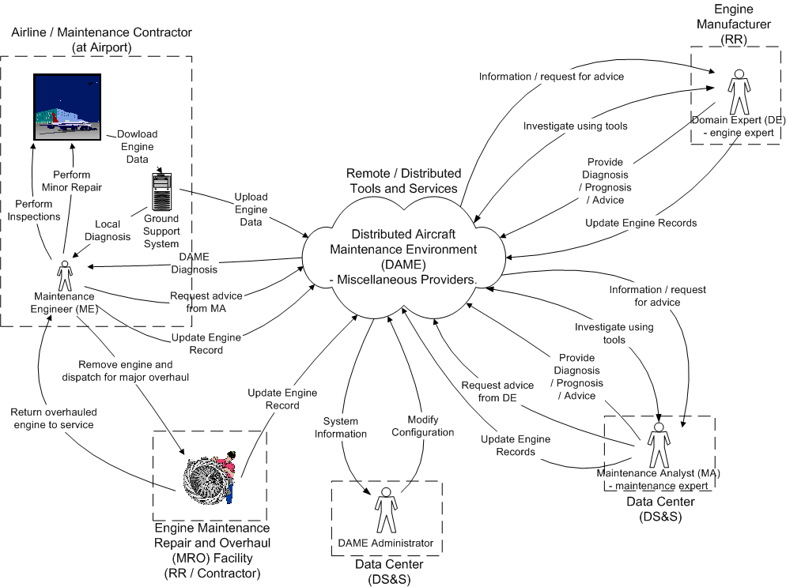
DAME: Interactions

Slide 7
Future work
Finalization of draft
Addition of new use cases if requested
Use case analysis as input to the network services draft

