Slide 1
Grid File System
Virtual Filesystem Directory Service
Specification
Manuel Pereira
IBM Almaden Research Center
mvp@almaden.ibm.com

Slide 2
Overview
Recent Activity and Discussions
Review of Service Operations
Outline of Service Objects
Refined Focus
Possible Usage Model
Open Issues

Slide 3
Recent Activity and Discussions
There have been two revisions of the specification document posted to the GridForge with corresponding messages to the mailing list since GGF11 (June, 6)
GFS F2F @ IBM Almaden (August, 6)
  Collected vendor expectations and input
    Plug-n-Play
    Use of existing protocols
    Clearly defined management and security interfaces
    No new clients
    Namespace management only
  Presented the status of the specification documentation
  Discussed ongoing and open issues
E-mail Discussions

Slide 4
Review of Service Operations
The fundamental description and interface of defined service operations has not changed
  list
  lookup
  create
  delete
  update
  move
Documentation for each of these operations were revised for enhanced clarity and specificity

Slide 5
Outline of Service Objects
Extended object oriented hierarchy
  Reply : ListReply and LookupReply
  Alias : PathAlias and EntryAlias
Modified key objects
  Entry
  VirtualDirectory
  Junction
  PhysicalJunction
Added mutator methods to applicable objects

Slide 6
Outline of Service Objects
Added new methods
  Physical Junction (PFN and PFSN)
    getChecksum()
    getChecksumType()
    getSize()
    isComplete()
    isReplica()
Clarified which members are used and which are ignored in certain operations
  Further explained refined details such as control of the lastmodified timestamp can be for administration or synchronization purposes

Slide 7
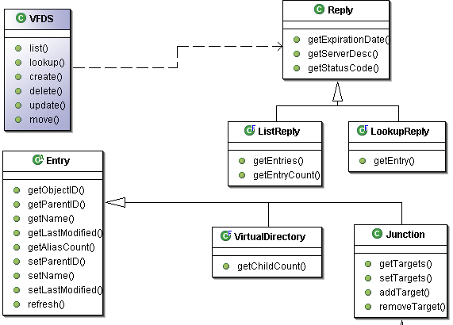
Outline of Service Objects

Slide 8
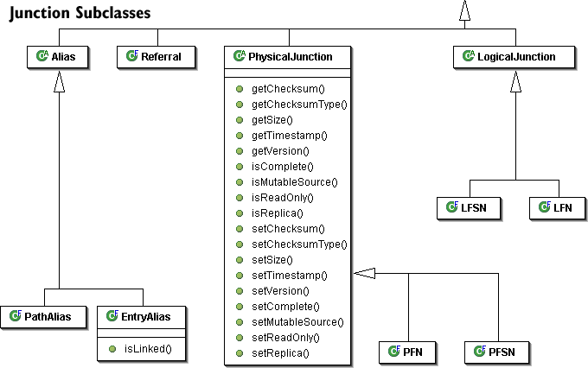
Outline of Service Objects

Slide 9
Refined Focus
Current focus is specifically scoped for exclusive namespace services
Items deferred for consideration in a later version of VFDS
  Access Control Lists (ACLs)
  File state (open, close)
  Locks
  Leases

Slide 10
Possible Usage Model
Admin Client
VFDS Server
CIFS
Protocol and Replica Selection
VFDS Client
NFS
Filesystem Client
GridFTP
Other

Slide 11
Possible Usage Model
Admin Client
GFS Server
VFDS Server
RLS
Selection Service
CIFS
User Service
ADF
(other)
NFS
GFS Client
Filesystem Client
GridFTP
Other

Slide 12
Previous Open Issues
Security
  Access Control Lists (ACLs)
Replication of Repositories
Backup
Consistency Issues between physical file data and namespace entries

Slide 13
Thank you!

