Slide 1

HealthGRID:
Confidentiality and Ethical Issues
Ir. B. Claerhout
D.Voets
– Custodix R&D –

Slide 2
Overview of the Presentation
Introduction
  Evolution in healthcare
Privacy
  A Definition of Privacy
  Privacy Protection Incentives
Security
  GRID Security
  HealthGRID Security Requirements
Privacy Enhancing Technologies
  Definition
  Privacy Protection in Practice
PETs and the HealthGRID
  Integrating GRID and PETs
  Synergy of PETs and GRIDs
  HealthGRID Issues
  Future Research
Conclusions

Slide 3
Evolution in Healthcare
Medicine, Genomics and ICT are developing in a symbiotic way.
Key Areas:
  Evidence Based Medicine
  Genomics, Proteomics, Toxicogenomics, Pharmacogenomics
  Medical Simulations
  Medical Imaging
  …
Require Collection , Storage, Processing of vast amounts of data.
Require dynamic interoperability.
  Introduction of GRID technology in healthcare is unavoidable and critical factor for further successful developments in e-Health.

Slide 4
Privacy Vulnerabilities
Domain of High Energy Physics (HEP) has been driving force behind development of GRID technology (tools and middleware)
  Lots of existing knowledge to be exploited for the HealthGRID
Use of GRID technology in healthcare introduces new requirements:
  Sensitive personal data of patients is treated
  Need for strict confidentiality and enforced privacy protection.
One of the many Challenges:
  Protection of the human (privacy) rights while maximizing research productivity and efficiency in data handling.

Slide 5
“a” Description of Privacy…
“Privacy encompasses the right to control information about ourselves, including the right to limit access to that information ... The right to privacy means the right to enjoy solitude, intimacy and anonymity. “
(Privacy on the Line, Whit Diffie and Susan Landau)
”From an evolutionary science viewpoint, the current trend toward the dissolution of individual privacy made possible by information technology could, in fact, prove to be a recipe for the end of the human species”
(IEEE Security&Privacy 2003, Michael Caloyannides)

Slide 6

Privacy Protection Incentives
Incentives for dealing with privacy issues:
  Research ethics
  Failure in protecting peoples’ privacy can have devastating consequences on business (e.g. public opinion, lawsuits)
  Regulation (Europe):
    Guidelines from Institutional Review Boards (informed consent)
    European Directive 95/46/EC
    (accepted as one of the world’s highest privacy standards)
    Member state implementations
  Regulation (others):
    Health Insurance Portability and Accountability Act (H.I.P.A.A.)
    Ontario Freedom of Information and the Protection of Privacy Act in
    Canada
Privacy best practices: Informed consent or other legal measures should not be considered a substitute to technical privacy protection techniques!

Slide 7
GRID Security Technology
GRID community has put a lot of effort into design of security measures.
Authentication and Authorization have been main points of focus.
Integration at the lower middleware level (CAS, VOMS)
  Uniformity (developer APIs)
  Interoperability (GLOBUS)
Implementations still at an early stage
Already useful for computational problems in healthcare
  Similar to problems in the classical GRID domain.
  Starting point for addressing confidentiality issues in HealthGRID.
  Further development of these security mechanisms is needed to address specific e-Health related requirements.

Slide 8
HealthGRID Security Requirements
HealthGRID aims to extend use of GRID technology beyond distributed computing.
Also aims to be a platform where different e-Health actors share and exchange large amounts of heterogeneous data.
At this point the integration of Medical informatics (MI) and BioInformatics (BI) into BioMedical Informatics (BMI) plays an important role.
The specific nature of genomic data introduces additional risks:
  Genetic data not only concerns individuals, but also their relatives.
  Genetic data can also give indications about future health or disease conditions.
  An individual’s genotype is almost unique and stable.
  The full extend of information contained in genomic data is not known yet.
  Genomic data is easily misinterpreted by non-professionals.

Slide 9
Safeguarding Confidentiality
Aproaches from conventional healthcare practice :
  Deployment of Classical Security Measures
    Authorization and Access Control
    Further development and implementation of existing GRID security technology.
    Taking into account strict restrictions in healthcare.
    ‘Privacy through Security’
  Use of Privacy Enhancing Techniques (PET)
    Eliminates/minimizes the collection of personally identifiable information.
    Superior approach
    ‘Security through Privacy’
  PETs should be seen as complementary to Security

Slide 10

Privacy Enhancing Techniques
“A coherent system of ICT measures that protects privacy by eliminating or reducing personal data or by preventing unnecessary and/or undesired processing of personal data, without loosing the functionality of the information system.”
(J. Borking)
Note that:
  With this definition, automated privacy negotiation or advertising techniques are excluded (P3P, WS-Privacy, EPAL).
  Suggested terminology: “Privacy Supporting Techniques” (PST), “Privacy Advancing Technology” (PAT), ”Privacy Negotiation Techniques” (PNT), …
  Coin them PxTs?
CEN/TC251 standardization effort on AURTAF
(Anonymity User Requirements for Trusted Anonymisation Facilities)
Similar ISO initiative is planned.

Slide 11
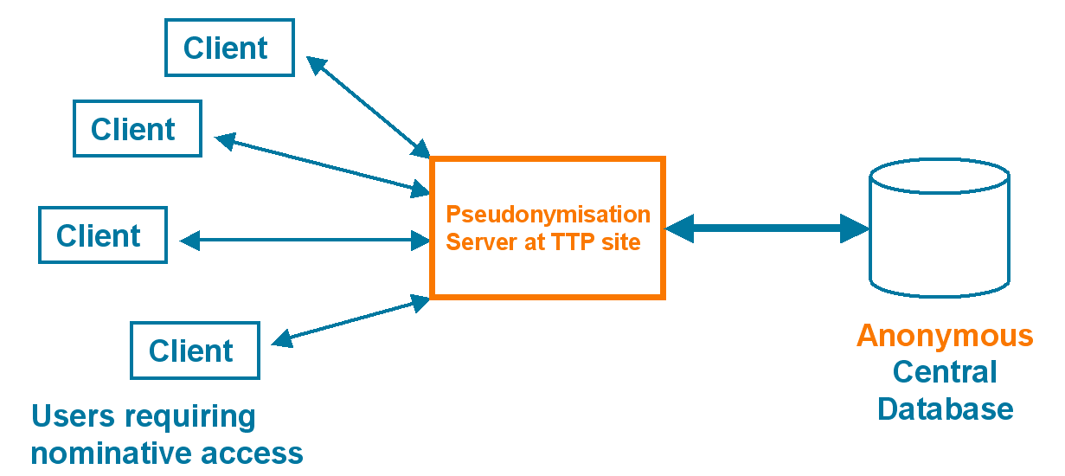
PETs: Privacy Protection in Practice
Applications of PETs are numerous:
  Clinical trials
  Disease management studies
  Exchange of sensitive (research) data
  Daily privacy protected handling of sensitive data
  (e.g. Medical records in hospitals, insurance companies, …)
  Market research studies
  Anonymous sharing of information
  …
In Healthcare PETs are still focused on “Medical Information” but are actively deployed!
e.g. Pseudonymisation services

Slide 12
Integration of PETs in HealthGRID
Active deployment of PETs in the HealthGRID could remove many barriers:
  GRIDs know no borders… personal data however do…
    Legal issues arise when processing (transporting) personal data cross-border
  GRID’s delegation principle introduces liability issues (see further)
  Collaborating organisations may not trust each other completely.

Slide 13
So where do PETs fit in the GRID?
In the application layer
  Pseudonymised Database as a GRID resource.
  Good starting point, easily portable from existing privacy aware medical data applications.
As part of the GRID (upper) middleware layer
  Policy management and advertising
  Standardisation of PET technology
  Privacy Protection ‘by default’
As a GRID service
  Pseudonymisation Service
  New developments and pilot projects will show what is needed.

Slide 14
Synergy of PETs and GRIDs
Privacy Protection and GRID can go hand in hand…
  Small “cells” (e.g. geographical area, hospital, …) of anonymous data can lead to an increased re-identification risk
  (i.e. privacy risk)
  A “virtual database service” (federation) combining several databases through distributed query techniques, can solve such problem
    by giving the illusion to the user that a single database is being accessed
    If provided through Trusted Third Parties
    (Privacy Policy Enforcing)
Virtual databases, policy advertising … are Grid topics

Slide 15
HealthGRID Issues
Use of heterogeneous resources
  How does a GRID user determine trustworthiness of a GRID resource?
  What about certification?
  As GRID is dynamic, not every resource is known in advance.
  Dynamic solution: policy advertising and negotiating
  Current efforts: WS-Privacy, WS-Policy, EPAL
  But how are policies assured/enforced?
Data replication
  Increases efficiency
  A replicated data source must:
    be equally trustworthy
    adhere to the same strict policies
  Must be handled autonomously

Slide 16
HealthGRID Issues (2)
Delegation
  Fundamental GRID concept.
  Far from obvious in the medical world.
  One remains responsible for rights passed on to others (resources), one becomes liable for actions performed on someone’s behalf
  Restricted Proxy Certificates are a good starting point.

Slide 17
Future Research
Policy Enforcing and Assurance on a Technical Level
  For security (authorisation policies)
  For data protection (privacy policies)
Auditing Mechanism (logging)
  Non-repudiation
  Legal framework
Encrypted Storage for medical data
Trustworthy federation of research databases.
  Small cells of de-identified data
  Decreased re-identification risk because of larger anonymity set.
From the world of Distributed Computing:
  Processing of Encrypted Data
  Privacy Preserving Data Mining

Slide 18
Conclusions
Privacy Enhancing Technology could solve some confidentiality issues of GRIDs in healthcare projects.
Security and Privacy are complementary concepts, rather than exclusive.
Integration of PETs inside the HealthGRID may stimulate PET standardisation.
GRID Effort should go to policy advertising and negotiation
  Further, one must be able to ensure policies on a technical level.
Further development and pilot projects will make clear:
  The additional security requirements of HealthGRID applications.
  On which level PETs are to be integrated.

Slide 19
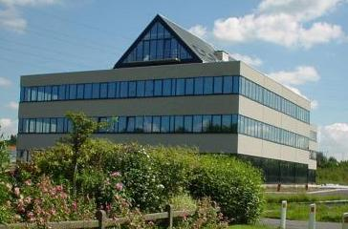
Thank you for your attention!
Custodix NV
Verlorenbroodstr. 120
B-9820 Merelbeke
Belgium
http://www.custodix.com/
or
info@custodix.com

