Slide 1
WS-Agreement Overview for OGSA
GRAAP-WG
Authors: Alain Andrieux, (Globus Alliance / USC/ISI), Karl Czajkowski, (Globus Alliance / Univa), Asit Dan (IBM), Kate Keahey, (Globus Alliance / ANL), Heiko Ludwig (IBM), Toshiyuki Nakata (NEC), Jim Pruyne (HP), John Rofrano (IBM), Steve Tuecke (Globus Alliance / Univa), Ming Xu (Platform Computing)
Chairs: Jim Pruyne, Volker Sander, Wolfgang Ziegler

Slide 2
Agreement Definition
An agreement defines a dynamically-established and dynamically-managed relationship between (two) parties. The object of the relationship is the delivery of a service by one of the parties within the context of the agreement. The management of this delivery is achieved by agreeing on the respective roles, rights and obligations of the parties. The agreement may specify not only functional properties for identification or creation of the service, but also non-functional properties of the service such as performance or availability.
Entities can dynamically establish and manage agreements via Web service interfaces.

Slide 3
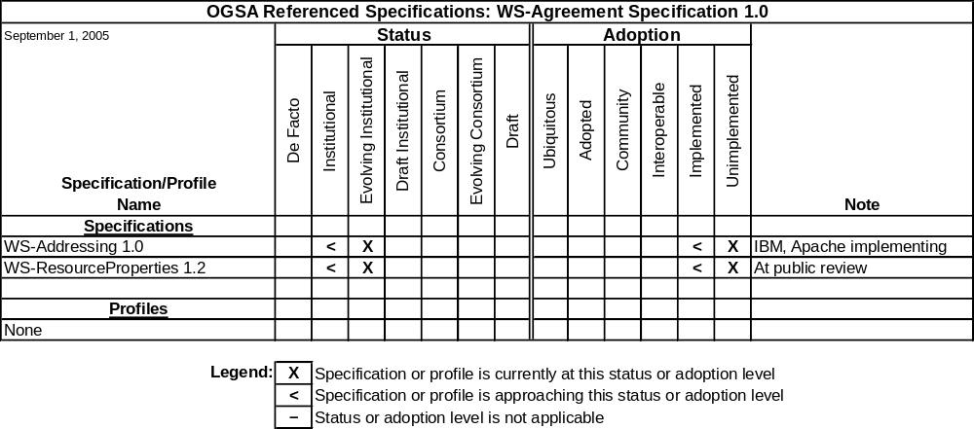
Roadmap Entry
In OGSA, it is expected that WS-Agreement v1.0 may be used in conjunction with JSDL. The OGSA EMS design team may define a Basic EMS profile referring to WS-Agreement v1.0, and in the future WS-Agreement may be used by other OGSA Profiles, including the proposed OGSA Basic Execution Management Profile.

Slide 4
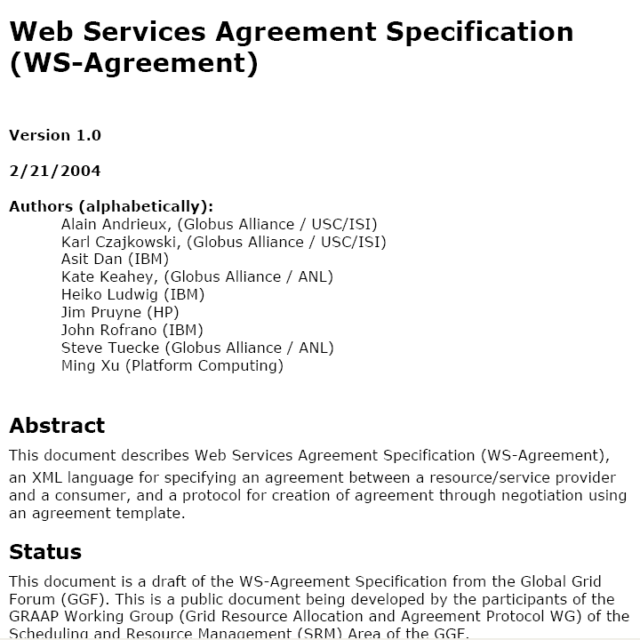
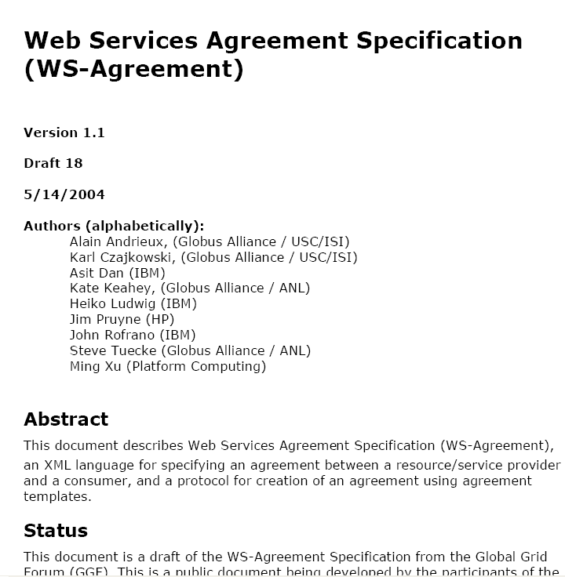
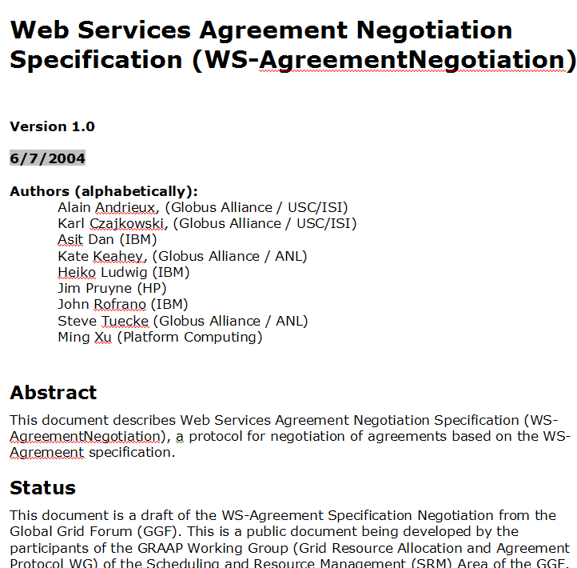
WS-Agreement no longer has Negotiation

Slide 5

Two-Layer Structure
Factory
Factory
Agreement
Agreement
create()
create()
Operations:
Operations:
Terminate()
Terminate()
Agreement
GetResourceProperty()
Agreement
GetResourceProperty()
...
...
Layer
Layer
Resource Properties:
Resource Properties:
inspect()
inspect()
Terms
Terms
Status
Initiator
Status
Related
Manager
Responder
Factory
Factory
create()
create()
Service
Service
Layer
Layer
Application Instance
Application Instance
foo
foo
()
Consumer
Consumer
Provider
Provider

Slide 6
Agreement Structure
Agreement
Name
Context
Terms Compositor
Service Terms
Guarantee Terms

Slide 7
Typical Agreement Lifecycle
Initiator
Responder
Four phases in the lifecycle:
  Exploration: a service provides templates describing possible agreement parameters
  Creation: Consumer fills in parameters, and makes an offer
  Operation: Agreement state available as a ResourceProperty
  Termination: Agreement destroyed explicitly or via soft state (termination time)
Get Template
Provider
Agreement
Context
Compositor
Service Description Terms
Guarantee Terms
Creation constraints
Provider
Agreement
Context
Create Agreement
Compositor
Service Description Terms
Guarantee Terms
Accept (EPR)
GetResourceProperties
Provider
Agreement
Context
Compositor
Service Description Terms
Guarantee Terms
Notes:
This is the general scheme of how things work. Upcoming slides will detail what actually goes into the document at each step. But, I hope this gives people a sense for the overall life-cycle to see what all the sub-steps in between look like.

Slide 8
Job Submission Example
Agreement Scope: Execution of a single job
Parties:
  Initiator: Individual with Job to be run
  Responder: Provider of job execution service
Terms:
  Service: Description of job to be run and execution environment (e.g. via JSDL)
  Guarantee: Deadline by which job will be completed

Slide 9
Batch of Jobs Example
Agreement Scope: Rights to execute a sequence of jobs
Parties:
  Initiator: Individual with Job to be run
  Responder: Provider of job execution service
Terms:
  Service: Description of execution environment
  Guarantee: Rate at which jobs may be submitted

Slide 10
End-to-End Bandwidth Example
Agreement Scope: Reserved bandwidth
Parties:
  Initiator: Entity which will claim bandwidth
  Responder: TelCo with WAN infrastructure or Broker
Terms:
  Service: End-Points, time-of-day for usage
  Guarantee: bandwidth, jitter, etc. with measurement parameters

Slide 11
(Relational) Data Access Example
Agreement Scope: Rights to make future queries
Parties:
  Initiator: Individual requiring data access
  Responder: Provider of data-set access
Terms:
  Service: Query types and allowed tables
  Guarantee: Query rate, response time

Slide 12
Arbitrary Web Service Example
Agreement Scope: Access to a specific web service
Parties:
  Initiator: Service consumer
  Responder: Service provider
Terms:
  Service: Service description (e.g. EPR + WSDL)
  Guarantee: Availability and performance metrics

Slide 13
Status
First round of public comments early this year, re-submitting within a week
  Comments will be greatly appreciated
GGF14 had presentations from 5 implementers
  Working toward shared scenario and terms for interop.
Beginning interactions to help others build on WS-Agreement by defining term schemas

