Slide 1
Web Service Transactions Specifications
Ian Robinson, Tom Freund
IBM Software Group

Slide 2
Topics
WS-Coordination
WS-AtomicTransaction
WS-BusinessActivity
  IBM: Developer Works – Web Services: Technical Library/Standards
  http://www-106.ibm.com/developerworks/library/specification/ws-tx/
  MSFT: Web Services Development Center
  http://msdn.microsoft.com/webservices
  BEA: Dev2Dev – WebServices
  http://dev2dev.bea.com/technologies/webservices/standards.jsp

Slide 3
The Problem – The need for Coordination
Web Services are self-contained business applications
  Based on industry standard technologies of WSDL and SOAP
  Provide a means for different organizations to connect their applications to conduct business across a network.
Currently lack the facility to ensure consistency and reliability.
Require a mechanism for all participants in a distributed application to achieve a mutually agreed outcome.
Activities may have large spectrum of different behaviors
  There is no one size fits all transaction model appropriate for all web-service-based applications.
  Trying to define one is more futile than herding cats.
    Need to consider ACID 2PC, open nested, compensation, long-running with reconciliation, client-session scoping, ....

Slide 4
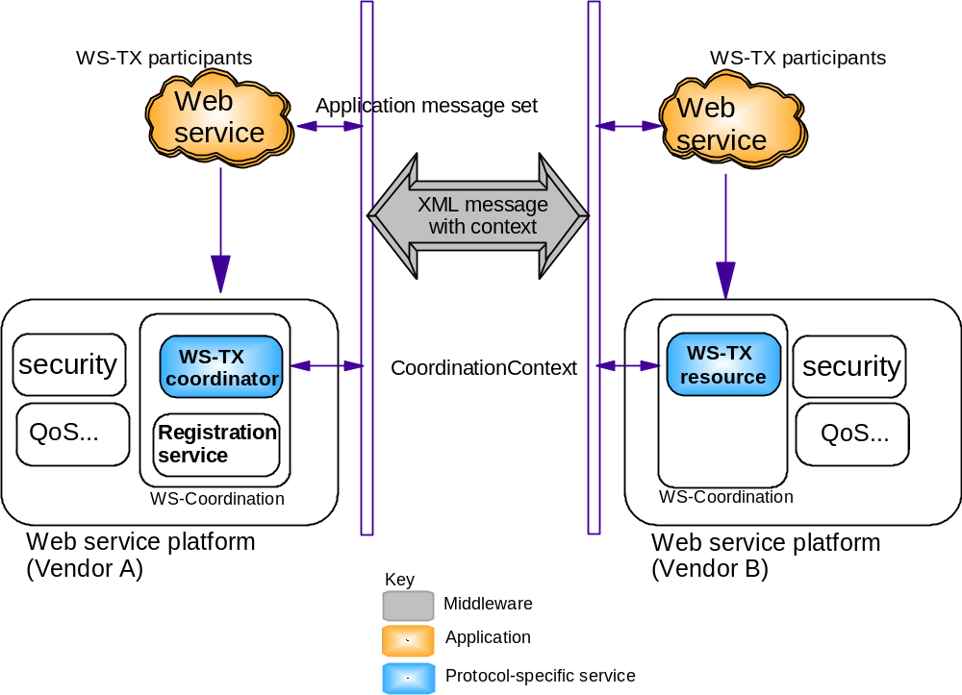
Architecture for distributed WebService Activities

Slide 5
Web service standards
Business
BPEL4WS
Processes
Transactions
Reliable
Quality
Security
Messaging
of Service
Coordination
WSDL, UDDI, XSD
Description
WS-Addressing
Other protocols
Messaging
XML
SOAP
Other services
Transports
Transport

Slide 6
Specifications
WS-C defines a framework for deploying coordination protocol sets
  Activation Service
  Registration Service
  Coordination Context
WS-AT & BA define coordination types for specific transaction models
  Atomic transactions where the results of operations are not made visible until the completion of the unit of work.
  Business transactions where the results of operations are made visible before the completion of the unit of work and need to be compensated rather than rolled back to undo the work.

Slide 7
Web Service Coordination (WS-C) specification

Slide 8
Elements of WS-Coordination
Roles – Coordinator and Resource
CoordinationType & Protocols
Endpoint Reference
Activation service
Registration service
CoordinationContext

Slide 9
Coordinator & Resource roles
In any transaction model built on WS-Coordination there are 2 essential roles that need to be fulfilled:
  The Coordinator produces agreement protocol messages during completion of the transactional activity and consumes agreement protocol messages received from Participants.
  The Participant consumes agreement protocol messages produced by the Coordinator and sends agreement protocol responses. Some coordination types may allow Participants to initiate the agreement protocol or resign their interest in further participation.
The Coordinator and Participant, and the protocols they support, are specific to a particular transaction model and are implemented by the provider of the specific transaction model, e.g. WS-AtomicTransaction.
Coordinators and Participants are Web service components specified in WSDL.

Slide 10
Coordination Types
A specific transaction model consists of a set of protocols and the consumers of those protocols.
  Each protocol describes a particular aspect of the overall behaviour, e.g. completion-initiation, agreement.
A protocol is the set of messages and responses supported by the coordinator and participants in the transaction
  A transaction model is defined by its protocols
A specific transaction model may support a completion protocol and 1 or more agreement protocols in its protocol set.
  For example, the WS-AtomicTransaction model supports:
    completion protocol: “Completion”
    agreement protocol: “2PC”

Slide 11
Protocol instance
C
P
P
C/P
P
P
There is one protocol instance per C-P pair

Slide 12
WS-Coordination services
Activation Service
  Invoked to create a new activity that supports a specified set of protocols.
  May be used to create a new activity or to import a received foreign activity (i.e. create subordinate coordinator and register with existing superior coordinator).
Registration Service
  Invoked to register a participant for one protocol supported by the Activity.

Slide 13
CoordinationContext
A CoordinationContext is propagated on all service invocations executed within the coordination scope (i.e. the transaction).
The CoordinationContext contains:
  Expires – expiration date of the context (optional)
  Identifier – uniquely identifies the coordination scope
  CoordinationType – identifies the transaction model
  RegistrationService:Address – Endpoint Reference of Registration service
  Extensibility element(s) – protocol-specific (optional)
CoordinationContext is not propagated with protocol messages.

Slide 14
Note on EPRs
A WS-Addressing Endpoint Reference (EPR) identifies the instance of a target service.
  WS-Addressing: http://www.w3.org/Submission/ws-addressing/
The Endpoint Reference is:
  Opaque
  Contains all the information needed to locate the target service instance
    Address
    “Key” of target instance - ReferenceProperties
Coordinator and Participant EPRs are exchanged during registration of a transaction participant.

Slide 15
CoordinationContext
<wscoor:CoordinationContext xmlns:wscoor=http://schemas.xmlsoap.org/ws/2004/10/wscoor
soapenv:mustUnderstand=“true">
<wscoor:Identifier>urn:activity16</wscoor:Identifier>
<wscoor:CoordinationType>
http://schemas.xmlsoap.org/ws/2004/10/wsat
</wscoor:CoordinationType>
<wscoor:RegistrationService>
<wsa:Address>
http://wsi.alphaworks.ibm.com:8080/wstx/services/Coordinator
</wsa:Address>
<wsa:ReferenceProperties>
<wstk:CtxID>myns:opaquetoken</wstk:CtxID>
</wsa:ReferenceProperties>
</wscoor:RegistrationService>
</wscoor:CoordinationContext>

Slide 16
CoordinationContext – SOAP binding
<soapenv:Header>
<wscoor:CoordinationContext xmlns:wscoor=http://schemas.xmlsoap.org/ws/2004/10/wscoor
soapenv:mustUnderstand=“true">
<wscoor:Identifier>urn:activity16</wscoor:Identifier>
<wscoor:CoordinationType>
http://schemas.xmlsoap.org/ws/2004/10/wsat
</wscoor:CoordinationType>
<wscoor:RegistrationService>
<wsa:Address>
http://wsi.alphaworks.ibm.com:8080/wstx/services/Coordinator
</wsa:Address>
<wsa:ReferenceProperties>
<wstk:CtxID>myns:opaquetoken</wstk:CtxID>
</wsa:ReferenceProperties>
</wscoor:RegistrationService>
</wscoor:CoordinationContext>
…
</soapenv:Header>

Slide 17
Basic Example
Application starts a coordination scope via Activation service
  Application specifies coordination type to be used by participants in negotiating the outcome of the activity.
  It typically registers for the completion protocol in order to be able to initiate completion.
  The endpoint reference for the completion protocol‘s Coordinator is returned to the application.
The application initiates a business invocation on a partner service.
  CoordinationContext is passed along with application messages
  The endpoint reference for the Registration service is contained in the CoordinationContext.
A Participant in the invoked domain may register for any of the protocols defined by the coordination type that are to be used in the completion of the activity

Slide 18
Activation Protocols
A
B
Application
Activation service
CreateCoordinationContext()
CreateCoorinationResponse()

Slide 19
Registration & Agreement Protocols
A
B
Requester
Registration Coordinator
Coordinator
Participant
Registration Requester
Responder
ApplicationRequest (with CoordinationContext)
RegisterRequest()
RegisterResponse()
ApplicationResponse
Agreement protocol

Slide 20
Syntax

Slide 21
Activation Service
<wsdl:portType name="ActivationCoordinatorPortType">
<wsdl:operation name=“CreateCoordinationContextOperation">
<wsdl:input message="wscoor:CreateCoordinationContext"/>
</wsdl:operation>
</wsdl:portType>
<wsdl:portType name="ActivationRequesterPortType">
<wsdl:operation name=“CreateCoordinationContextResponseOperation"> <wsdl:input message="wscoor:CreateCoordinationContextResponse"/>
</wsdl:operation>
</wsdl:portType>

Slide 22
CreateCoordinationContext Message
CoordinationType for supported protocols
<wscoor:CreateCoordinationContext>
<wscoor:CoordinationType … />
<wscoor:Expires … />?
<CurrentContext … />?
<!-- Extension Element -->*
</wscoor:CreateCoordinationContext>
Optional: Imported Context e.g. superior coordinator

Slide 23
CreateCoordinationContextResponse Message
CoordinationContext returned
<wscoor:CreateCoordinationContextResponse>
<wscoor:CoordinationContext>
<wscoor:Identifier>urn:activity16</wscoor:Identifier>
<wscoor:CoordinationType>
http://schemas.xmlsoap.org/ws/2004/10/wsat
</wscoor:CoordinationType>
<wscoor:RegistrationService>
<wsa:Address>uri</wsa:Address>
<wsa:ReferenceProperties>
props
</wsa:ReferenceProperties>
</wscoor:RegistrationService>
</wscoor:CoordinationContext>
</wscoor:CreateCoordinationContextResponse>

Slide 24
Registration Service
<wsdl:portType name="RegistrationCoordinatorPortType">
<wsdl:operation name=“RegisterOperation">
<wsdl:input message="wscoor:Register"/>
</wsdl:operation>
</wsdl:portType>
<wsdl:portType name="RegistrationRequesterPortType">
<wsdl:operation name=“RegisterResponseOperation">
<wsdl:input message="wscoor:RegisterResponse"/>
</wsdl:operation>
</wsdl:portType>

Slide 25
Register Message
Protocol to
register for
<wscoor:Register>
<ProtocolIdentifier />
<ParticipantProtocolService />?
…
</wscoor:Register>
Endpoint Reference of the
registered participant

Slide 26
RegisterResponse Message
<wscoor:RegisterResponse>
<CoordinatorProtocolService />
…
</wscoor:RegisterResponse>
Endpoint Reference of
the Coordinator
of the protocol

Slide 27
Coordination Faults
wscoor:InvalidState
wscoor:InvalidProtocol
wscoor:InvalidParameters
wscoor:NoActivity
wscoor:ContextRefused
wscoor:AlreadyRegistered

Slide 28
Web Service AtomicTransactions (WS-AT) specification

Slide 29
ACID transaction protocol set
Coordinator type: http://schemas.xmlsoap.org/ws/2004/10/wsat
WS-AT protocols
  Completion
    completion protocol used by application or middleware to initiate commitment processing
  Two-Phase Commit
    Durable Two-Phase Commit
      agreement protocol for participants managing durable resources such as databases
    Volatile Two-Phase Commit
      agreement protocol for participants managing volatile resources such as caches.

Slide 30
Usage scenario
WSa calls WSb in the scope of a WS-AT transaction
Persistent updates by WSa and WSb must be committed or aborted together, regardless of system or network failure.
Coordinated completion of participants is isolated from application logic.
atomic
transaction
Web service WSa
Web service WSb
Transaction
Manager
RDBMS
RDBMS
Transaction
Manager
App Server 1
App Server 2

Slide 31
Usage scenario
The WS-AT 2PC agreement protocol is used to coordinate the participants in the 2 web service environments.
A participant that manages a database could, for example, adapt the WS-AT protocol messages to XA flows.
atomic
transaction
Web service WSa
Web service WSb
2PC
2PC
Transaction
Manager
RDBMS
2PC
RDBMS
Transaction
Manager
App Server 1
App Server 2

Slide 32
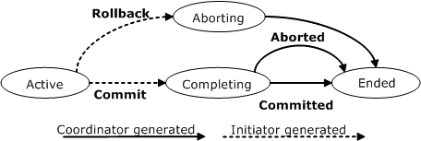
Completion protocol
Commit
Rollback
I
C
Committed
Aborted

Slide 33
AtomicTransaction: Completion Protocol
<wsdl:portType name=“CompletionCoordinatorPortType">
<wsdl:operation name=“CommitOperation">
<wsdl:input message="wsat:Commit"/>
</wsdl:operation>
<wsdl:operation name=“RollbackOperation">
<wsdl:input message="wsat:Rollback"/>
</wsdl:operation>
</wsdl:portType>
<wsdl:portType name=“CompletionInitiatorPortType">
<wsdl:operation name=“CommittedOperation">
<wsdl:input message="wsat:Committed"/>
</wsdl:operation>
<wsdl:operation name=“AbortedOperation">
<wsdl:input message="wsat:Aborted"/>
</wsdl:operation>
</wsdl:portType>

Slide 34
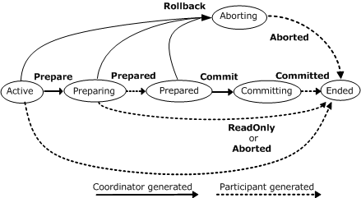
2PC Agreement Protocol
Prepare
Rollback
Commit
C
P
Prepared
ReadOnly
Aborted
Committed
Replay

Slide 35
2PC Agreement Protocol: Participant
<wsdl:portType name=“ParticipantPortType">
<wsdl:operation name=“PrepareOperation">
<wsdl:input message="wsat:Prepare"/>
</wsdl:operation>
<wsdl:operation name=“CommitOperation“>
<wsdl:input message="wsat:Commit"/>
</wsdl:operation>
<wsdl:operation name=“RollbackOperation">
<wsdl:input message="wsat:Rollback"/>
</wsdl:operation>
</wsdl:portType>

Slide 36
2PC Agreement Protocol: Coordinator
<wsdl:portType name=“CoordinatorPortType">
<wsdl:operation name=“PreparedOperation">
<wsdl:input message="wsat:Prepared"/>
</wsdl:operation>
<wsdl:operation name=“AbortedOperation“>
<wsdl:input message="wsat:Aborted"/>
</wsdl:operation>
<wsdl:operation name=“ReadOnlyOperation">
<wsdl:input message="wsat:ReadOnly"/>
</wsdl:operation>
<wsdl:operation name=“CommittedOperation">
<wsdl:input message="wsat:Committed"/>
</wsdl:operation>
<wsdl:operation name=“ReplayOperation">
<wsdl:input message="wsat:Replay"/>
</wsdl:operation>
</wsdl:portType>

Slide 37
Registration and Agreement protocols
A
B
Requester
Registration Coordinator
Coordinator
Participant
Registration Requester
Responder
ApplicationRequest
RegisterRequest()
RegisterResponse()
ApplicationResponse
Agreement protocol

Slide 38
2PC Completion
A
B
Coordinator
Participant
Prepare
Prepared
Commit
Committed

Slide 39
Volatile vs Durable 2PC
Two variants of 2PC
  One for volatile participants, e.g. cache
    http://schemas.xmlsoap.org/ws/2004/10/wsat/Volatile2PC
  One for durable participants, e.g. database
    http://schemas.xmlsoap.org/ws/2004/10/wsat/Durable2PC
During the Prepare phase, all volatile participants are processed before any durable participants.
Commit/Rollback message sent to all 2PC participants.
  Volatile participants are not guaranteed to receive notification of transaction outcome

Slide 40
Volatile and Durable 2PC
Coordinator
Volatile
Participant
Durable
Participant
Durable
Participant
Prepare
Prepared
Prepare
Prepare
Prepared
ReadOnly
Commit
Committed
Commit
Committed

Slide 41
Web Service BusinessActivity (WS-BA)
Specification

Slide 42
BusinessActivity Protocol Set
Coordinator types:
  http://schemas.xmlsoap.org/ws/2004/10/wsba/AtomicOutcome
    Mandatory
    All participants directed to complete in the same direction
  http://schemas.xmlsoap.org/ws/2004/10/wsba/MixedOutcome
    Optional
    Coordinator may direct some participants to Close and some to Compensate.
WS-BA protocols
  BusinessAgreementWithParticipantCompletion
    Participant completion notification
  BusinessAgreementWithCoordinatorCompletion
    Coordinator completion notification

Slide 43
Business Transactions: Background
Long-lived activity
Extended duration dictates interim results exposed
Additional mechanisms to reverse effects in case the encompassing activity fails, e.g. counter-effect:
  Compensation
  Reconciliation
  etc.

Slide 44
Business Activity Protocol
Simple protocols to facilitate wrappering of existing business processing and workflow systems to establish a mutually agreed outcome
Overall workscope = business activity
Participants are business tasks
A participant is considered a child task in the parent business activity for which it is registered

Slide 45
Business Activity Protocol
Additional Functionality
  A task may specify that it is leaving the activity prior to activity completion
    Exit (participant unregister)
  A task may declare its outcome before being solicited
    Completed (participant finished)
    Faulted (participant detected error)
  Exposed results need to be undone
    Compensate (reverse finished participant actions) business logic

Slide 46
Usage scenario
Business Tasks execute within the scope of a Business Activity
Updates are exposed before Business Activity completes
Business Activity
BA participant
BA participant
Business
Task
Business
Task
Web service WSa
Web service WSb
Runtime 1
Runtime 2

Slide 47
Usage scenario
Business Tasks execute within the scope of a Business Activity
Updates are exposed before Business Activity completes
Completed participants receive common outcome
Business Activity
Compensate
Compensate
BA participant
BA participant
Business
Task
Business
Task
Web service WSa
Web service WSb
Runtime 1
Runtime 2

Slide 48
Business Activity Protocol Sets
BusinessAgreementWithParticipantCompletion
  A participant registers for this protocol if it is the Participant that determines when it has completed its work and can notify the Coordinator.
BusinessAgreementWithCoordinatorCompletion
  A participant registers for this protocol if it is the Coordinator that determines when all processing for the Participant has completed.

Slide 49
BusinessAgreementWithParticipantCompletion
Agreement
Coordinator
Participant
Completed
Exit
Fault
Closed
Compensated
Canceled
Status
Exited
Faulted
Close
Compensate
Cancel
GetStatus

Slide 50
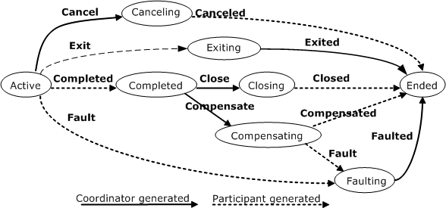
BusinessAgreementWithParticipantCompletion

Slide 51
BusinessAgreementWithParticipantCompletion Coordinator
<wsdl:portType
name=
“BusinessAgreementWithParticipantCompletionCoordinatorPortType">
<wsdl:operation name=“CompletedOperation“ />
<wsdl:operation name=“ExitOperation“ />
<wsdl:operation name=“FaultOperation“ />
<wsdl:operation name=“ClosedOperation“ />
<wsdl:operation name=“CompensatedOperation“ />
<wsdl:operation name=“CanceledOperation“ />
<wsdl:operation name=“GetStatusOperation“ />
<wsdl:operation name=“StatusOperation“ />
</wsdl:portType>
e.g.
<wsdl:operation name=“CompletedOperation“>
<wsdl: input message = “wsba:Completed”/>
</wsdl:operation>

Slide 52
BusinessAgreementWithParticipantCompletion
Participant
<wsdl:portType
name=
“BusinessAgreementWithParticipantCompletionParticipantPortType">
<wsdl:operation name=“ExitedOperation“ />
<wsdl:operation name=“FaultedOperation“ />
<wsdl:operation name=“CloseOperation“ />
<wsdl:operation name=“CompensateOperation“ />
<wsdl:operation name=“CancelOperation“ />
<wsdl:operation name=“GetStatusOperation“ />
<wsdl:operation name=“StatusOperation“ />
</wsdl:portType>

Slide 53
BusinessAgreementWithCoordinatorCompletion
Agreement
Coordinator
Participant
Completed
Exit
Fault
Closed
Compensated
Canceled
GetStatus
Complete
Exited
Faulted
Close
Compensate
Cancel
GetStatus

Slide 54
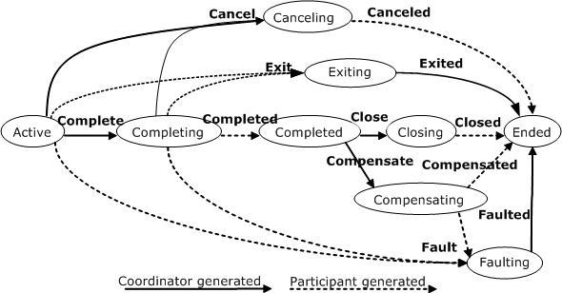
BusinessAgreementWithCoordinatorCompletion

Slide 55
BusinessAgreementWithCoordinatorCompletion
Participant
<wsdl:portType
name=
“BusinessAgreementwithParticipantCompletionParticipantPortType">
<wsdl:operation name=“CompleteOperation“ />
<wsdl:operation name=“ExitedOperation“ />
<wsdl:operation name=“FaultedOperation“ />
<wsdl:operation name=“CloseOperation“ />
<wsdl:operation name=“CompensateOperation“ />
<wsdl:operation name=“CancelOperation“ />
<wsdl:operation name=“GetStatusOperation“ />
<wsdl:operation name=“StatusOperation“ />
</wsdl:portType>

Slide 56
Registration and Agreement protocols
A
B
Requester
Registration Coordinator
Coordinator
Participant
Registration Requester
Responder
ApplicationRequest
RegisterRequest()
RegisterResponse()
ApplicationResponse
Agreement protocol

Slide 57
BusinessAgreementWithParticipantCompletion
A
B
Coordinator
Participant
Completed
Close
Closed

Slide 58
BusinessAgreementWithCoordinatorCompletion
A
B
Coordinator
Participant
Complete
Completed
Close
Closed

Slide 59
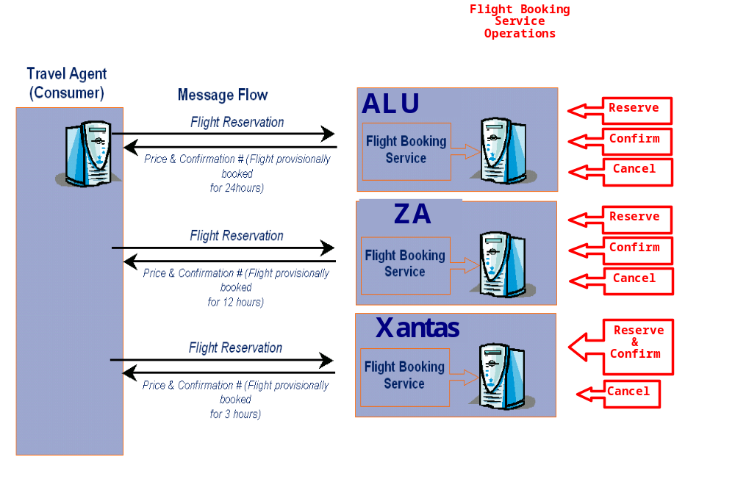
BusinessAgreementWithParticipantCompletion

Slide 60
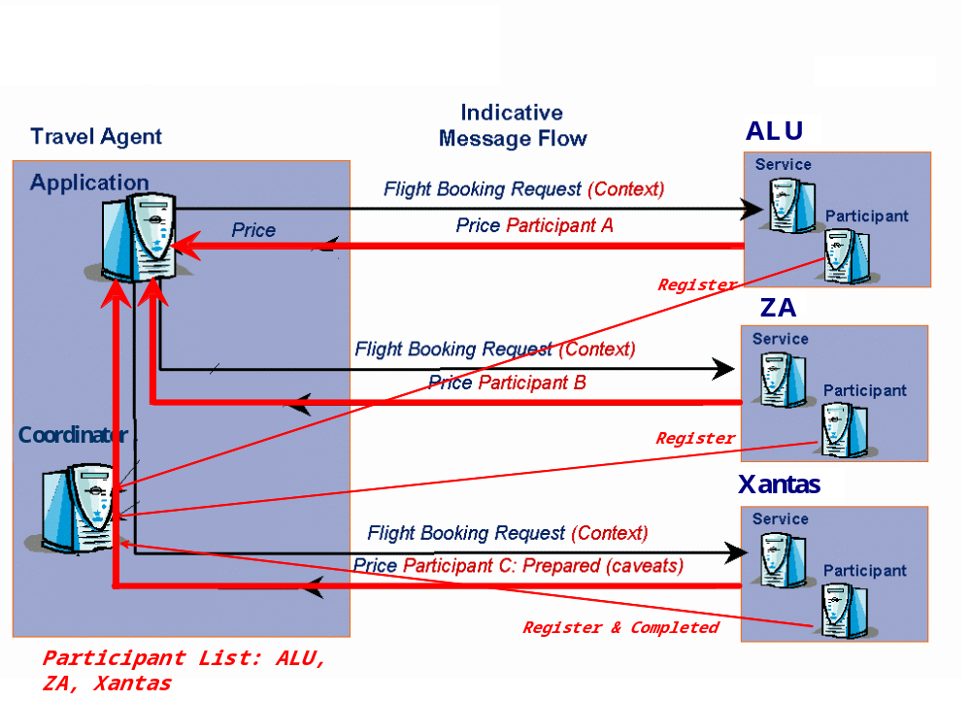

BusinessAgreementWithParticipantCompletion

Slide 61
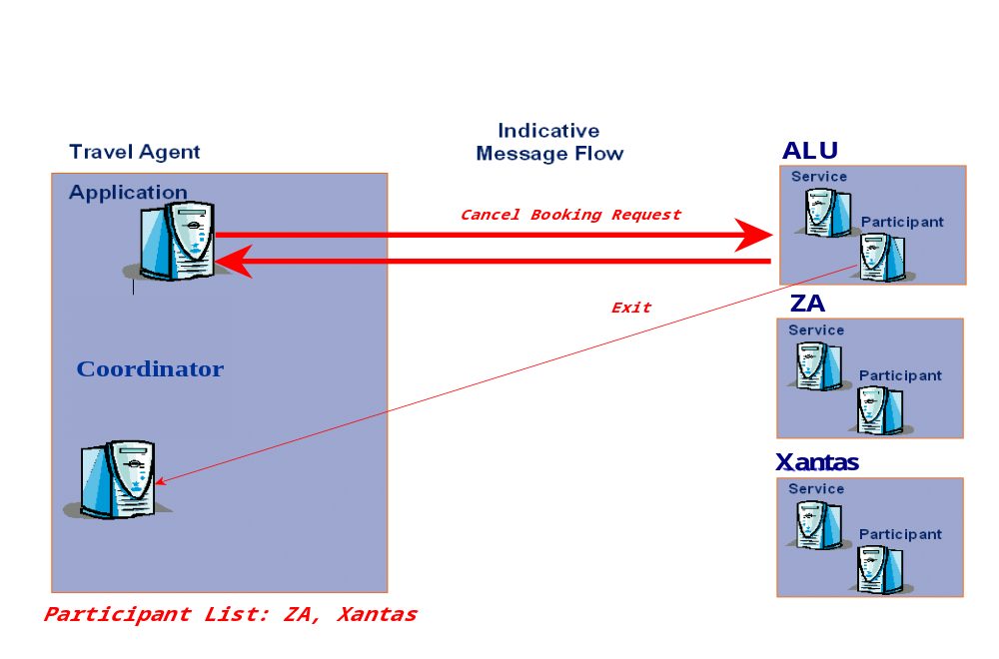
BusinessAgreementWithParticipantCompletion

Slide 62
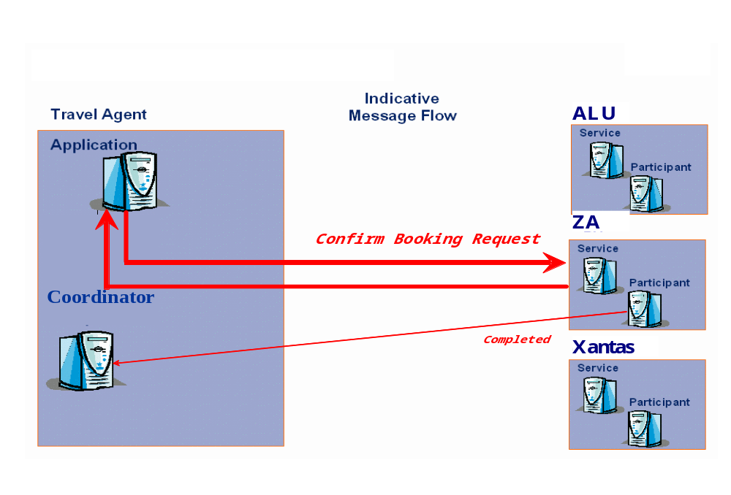
BusinessAgreementWithParticipantCompletion

Slide 63
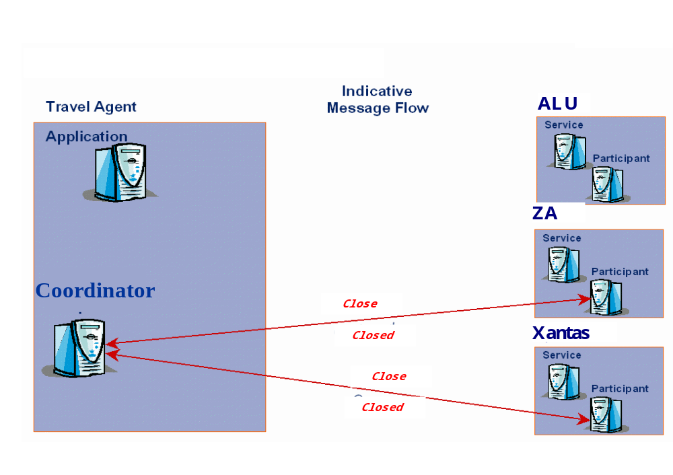
BusinessAgreementWithParticipantCompletion

Slide 64
End Of Document

