Slide 1
OASIS
Web Services Distributed Management
Technical Committee
Specification Overviews
Heather Kreger
OASIS WSDM TC co-chair
IBM
kreger@us.ibm.com
Title slide

Slide 2
Agenda
History and Members
Specification Roadmap
Web Services Platform Requirements
WSDM Management Using Web Services
  Foundations
  Capabilities
WSDM Management Of Web Services
Relationship to other standards organizations

Slide 3
Membership and History
Management Protocol TC was chartered and then rechartered as WSDM with a broader charter
CoChairs: Heather Kreger, IBM
Winston Bumpus, Dell, DMTF Pres
Broad representation by member companies
  Management – IBM, HP, CA, BMC, Amberpoint …
  Devices – IBM, HP, Dell, …
  Application Servers – IBM, BEA, SUN, Oracle...
  Customers – Mitre, …

Slide 4
Missions
Management USING Web Services (MUWS)
  Management application on a Web services platform
  Web services to describe and access manageability of resources
Management OF Web Services (MOWS)
  An implementation of Management Using Web Services for the Web Service as the IT resource

Slide 5
Enables
Enables (not define) Management Applications
  Events Management
  Problem Determination
  Performance Monitoring
  Capacity Planning
  Inventory & Topology
  State and Lifecycle management
  Change management
  Service Level Agreement monitoring

Slide 6
Management Using Web Services
Defines the representation of manageable resources as Web services, this includes the definition of:
  Generic manageability schemas and interfaces
  Interfaces that integrate existing managed resources into a Web services environment
This task requires a Web Services based distributed computing platform
  enables interoperability between managers and managed resources
  e.g. Policy, Notifications, Relationships, etc.
The WSDM TC should not develop the technologies that are broadly applicable to the Web services platform
The WSDM TC will develop technologies that are specific to solving the management problem

Slide 7
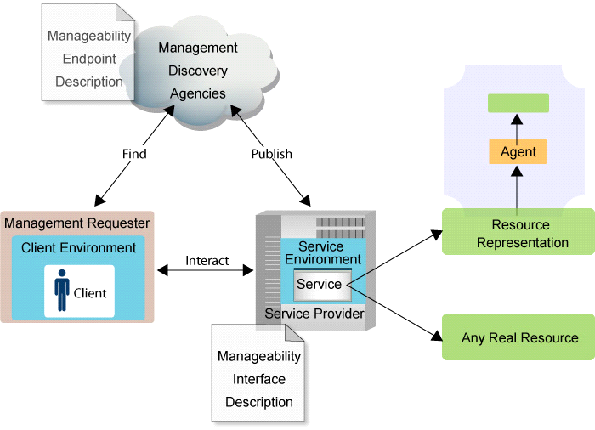
Web Services Architecture and the Manageable Resource

Slide 8
Management USING Web Services
Describe manageability of resources using WSDL PortTypes, WS-Resource Properties, Policies
  Manageability Capability portTypes:
    lifecycle, metrics, .. (WSDM)
  Resource Representation portTypes:
    Web service (WSDM), disk, etc ... (DMTF)
Common Web Services portTypes: Registry, Notification, Relationships, Collection, ..
Existing models (CIM, SNMP, OMI, etc.) are a source for attributes and operations for the schemas and portTypes

Slide 9

A Manager’s view
Policies
and
SLAs
Registry
CIM or SNMP
Manager
Manager
Web Service
printer
system
Agent
Application Server
PortTypes
Notes:
ws1 is a manageable web service
The little green bars are managability porttypes with ports
It shows a manager talking to the manageability porttype for the ws1
It uses the registry to find the ws1 and then talks to it directly
Then resourceA is dark green like the Resource PortTypes in the last chart, built on all the other portTYpes (hopefully) with a WS Port to access it and the manager talks to it directly finding it thru the registry
Then the B and C are the portTypes/Port for resourceB and C, they happen to go thru an agent (which is grey because we aren't defining it)
The green bars on top of the manager box are manager ports
It looks like the registry and boxes on top of the pink box are the same color (need to fix color)

Slide 10
WSDL makes the difference: Ports…
Mangeability Service directly to a Resource
<service name=“Application”>
<port name=“business” binding=“tns:businessBind”,
<soap:address location=“http://myco.com/myAppl”/>
</port>
<port name=“management” binding=“tns:manageBind”>
<soap:address location=“http://myco.com/myAppl”/>
</port>
</service>
Manageability Service thru an agent
<service name=“Application”>
<port name=“business” binding=“tns:businessBind”,
<soap:address location=“http://myco.com/myAppl” />
</port>
<port name=“management” binding=“tns:manageBind”>
<soap:address location=“http://myco.com/otherAgent/myAppl”/>
</port>
</service>

Slide 11
Management USING Web Services
Web services architecture replaces or ‘hides’ the traditional Manager/Agent architecture
Managers always ‘talk’ to the resource while the actual Port may be any number of agents
Web Services de-couples manageability INTERFACES
  from HOW you access the interface
  from WHERE you access the interface
  from HOW the interface is implemented
  from WHEN it was implemented

Slide 12
WHY Add in this new layer?????
Managers need access to manageability END TO END
  Across platforms, languages, applications, AND existing management technologies
  B2B Web services makes this worse!
  SLA Monitoring, WorkFlows, Work balancing, Utility computing, pay-per-Quality of Service…
  Standards are just starting, we’re developing technology to help us solve these up-coming challenges
Ubiquitous, low entry point infrastructure!
  HTTP & the Web
It’s JUST distributed computing, again
  so leverage Web services infrastructure for scalability, security, etc., don’t re-invent it

Slide 13
Web Services Platform
Management application requires a Web services platform with the following capabilities:
  XML, XML Schema
  WSDL
  SOAP
  WS-Addressing
  WS-Resource Framework
    Resource Properties
    Service Group (being debated)
  WS-Notifications
  WS-Security

Slide 14
Management Using Web Services
Management Foundations
  Meta information
    Additional descriptive information about interfaces
    resources, properties, operations, notifications
  Relationships
    Association between two IT resources
    Schema and query interfaces
  Management Event Format
    XML format, carry events from any source
  Discovery
    Creating manageable resources from traditional discovery engines
    Finding resources
    Introspection of manageability capabilities

Slide 15
Management Using Web Services
Future Web Services Platform Foundations Requirements
  Policy
  Negotiation

Slide 16
Management Using Web Services
Manageable Resource:
  Is a Web Service
    Described by WSDL, WS-Resource Properties, Meta information, Policies,
  Is a WS-Resource
  MUST support WSDM’s Identity capability required interfaces and properties (ResourceID, Name, Version).
  Advertises the properties/methods of the resource to be managed directly

Slide 17
Management Using Web Services
Capabilities
Set of descriptions to enable a management task
WSDL, WS-Resource documents, Meta Information, Policies
  Identity
  Metrics
  Operational State
  Configuration
  Correlatable Names
  Relationships

Slide 18
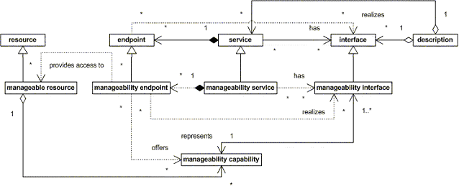
Web Services and Manageable Resources

Slide 19
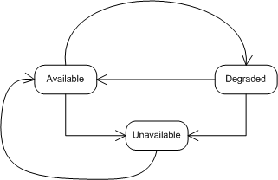
Capabilities – Operational State
Properties: Current State URI, Time Entered, State Model URI
Operations: Start, Stop

Slide 20
Capabilities - Metrics
Defining standard metric types/behaviors (collaboration with DMTF Metrics WG)
Each metric contains its Type, Time scope, ResetAt, LastUpdatedAt
  IntegerMetric
  DurationMetric
Properties: CurrentTime
Resource specific metrics
Operations: ResetAll (may not survive)

Slide 21
Management Of Web Services
Based on Management Using Web Services
Based on W3C Web Services Architecture Management Task Force work for
  States, Metrics, Endpoint
Capabilities
  Identification
  Metrics – ServiceTime, NumberRequests, NumberOfSuccessfulRequests, RequestsFailed,
  Operational State – Maps W3C state to WSDM state,
  Request State – Unique to Web service

Slide 22
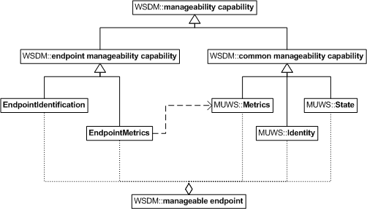
Capabilities for Web Services

Slide 23
WSDM Specification Roadmap
Initial contributions from HP (WSMF), IBM&CA (WS-Manageability)
WSDM 0.5 – April 2004
  Identification
  Metrics
  Operational State
  Successful Interoperability testing

Slide 24
WSDM Specification Roadmap
WSDM 1.0 – targeted for November, 2004
  Extend 0.5 capabilities with events and meta information
  Extend Operational State
  Extend Metrics
  Relationships
  Configuration

Slide 25
WSDM Specification Roadmap
WSDM 2.0 – targeted for November, 2005
  Updated for standardized versions of specifications in draft now
  Other candidates:
    Policy
    Provisioning
    TBD

Slide 26
Relationship to Other Standards Work
W3C
  WS Description WG
  WS Arch WG
DMTF
  Interop WG
  Utility WG
  State and Behavior WG
GGF
  OGSA Common Manageability Model WG

Slide 27
W3C
Web Services Architecture Working Group
  Defined requirements to provide for manageable Web Services Architecture Implementations: information, access, discovery
  Management Task Force
    Defining the manageability characteristics of the architectural elements of the Web Services architecture
    Published as a W3C Note
    Led by IBM: Heather Kreger

Slide 28
OASIS
WS-Security
  Secure management
Provisioning TC
  user/service provisioning

Slide 29
DMTF
Models real world managed objects. Large existing model
Application Working Group
Interoperability Working Group
  WS-CIM - Defining a Web Services access to CIM models and CIM/OMs
  CIM V3 is moving towards XML schema
State and Behavior WG
  State model for CIM
Utility WG
  Resource Profiles rendered as Web services

Slide 30
Global Grid Forum (GGF)
OGSA (and related WGs) should be able to use WSDM specifications for the base manageable resource
WSDM technologies should fit into the OGSA taxonomy

Slide 31
Resources
WSDM
  http://www.oasis-open.org/apps/org/workgroup/wsdm/
  Specifications: http://www.oasis-open.org/apps/org/workgroup/wsdm/documents.php
DMTF – http://www.dmtf.org
GGF – http://www.ggf.org
CMM – http://www.ggf.org

Slide 32
Copyright
© Copyright IBM Corporation 2003. All rights reserved.
IBM, the IBM logo, the e-business logo and other IBM products and services are trademarks or registered trademarks of the International Business Machines Corporation, in the United States, other countries or both. References in this publication to IBM products, programs, or services do not imply that they will be available in all countries in which IBM operates.
Product release dates and/or capabilities referenced in this publication may change at any time at IBM’s sole discretion based on market opportunities or other factors, and are not intended to be a commitment to future product or feature availability in any way.
Java and all Java-based trademarks are trademarks of Sun Microsystems, Inc. in the United States, other countries or both.
Microsoft, Windows, Windows NT and the Windows logo are trademarks of Microsoft Corporation in the United States, other countries or both.
All other trademarks, company, products or service names may be trademarks, registered trademarks or service marks of others.

