Slide 1

WSDM
A Web Services Stack for Management
Composing WS Standards
Heather Kreger (kreger@us.ibm.com)

Slide 2

Agenda
An Industry View: The Management Roadmap
WSDM Motivation
Web Services Foundation for WSDM
  WS-Addressing
  WS-Resource Framework
  WS-Notification
WSDM Overview
  Architectural concepts
  Management Using Web Services
  MUWS Capabilities
  Management of Web services

Slide 3
Management Using Web Services:
Roadmap, Strategy and Architecture
Paper authored by IBM, HP and CA and published on June 2, 2005
Characterizes challenges facing the IT systems management community
  Aligning IT resources management with Business Objectives
  Managing the increasing complexity of IT environment with solutions from many vendors
  Increasing the agility of the IT infrastructure and processes
  Leverage automation of management processes – minimize costs
Defines a architecture and roadmap for the evolution of management systems to address and support the challenges of emerging business environments.

Slide 4






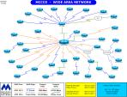
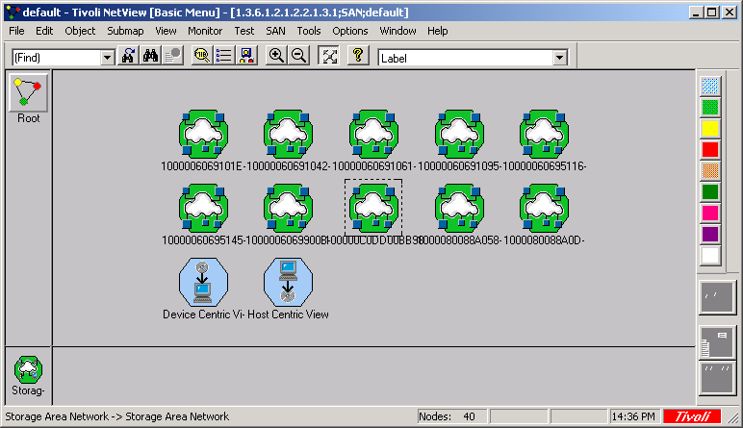

Customer Challenges
ATM
Tivoli
Event Console
Event Correlation
Teller
Home banking
SNMP
TEC
CIM
JMX
Logs
firewall
IBM
Zone
OpenView
topology
OV Plugin
Config Files
router
Novell
SNMP
IP
Cisco
zSeries
Dell
system
HP
pSeries
system
system
Tivoli Storage Manager
recovery
System
Operating system
SNMP
Operating system
CIM
Operating system
zOS
Operating system
HPUX
database
AIX
database
Linux
database
Windows
Database
Application Server
BMC Database
Manager
Application Server
Application Server
DB2
Application Server
Application
Oracle
Application
Sybase
Application
Application
“IF my Banking application is down,
then kill off HR and bring up banking”
CRM/SAP
WebSphere
NYSE
JBoss
BEA
Tibco
Bank
HR
Invest
.net
NetWeaver

Slide 5
Grids
firewall
firewall
Multiply the diversity of systems
Multiply the diversity of managers
Add Firewall and Security Issues
Add legal issues
And what manager can span all of this?
router
router
system
system
system
system
system
system
database
database
database
database
database
database
Application
Application
Application
Application
Application
Application
firewall
firewall
router
router
system
system
system
system
system
system
database
database
database
database
database
database
Application
Application
Application
Application
Application
Application

Slide 6
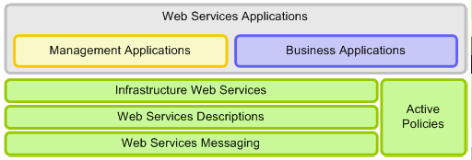
Foundation - Web Services Architecture
Common approach for manageability to simplify the integration of management solutions for existing systems and systems based upon emerging Service-Oriented Architectures (SOA)
Web services based architecture that supports, integrates, and unifies several management models and technologies in a way to manage any IT resource in a platform and language-neutral manner
Management is a Web services application, like other business applications – Management Integration

Slide 7
Foundation - Web Services Architecture
WS-MetadataExch
WS-Coordination
WS-Atomic Trans
WS-Res Properties
WS-Service Group
WS-Notification
WS-Security Policy
HTTP
XML
WS-Security
WS-RM
XML Schema
WSDL
WS-Addr
WS-Policy
BPEL
Examples of standards and specifications in progress

Slide 8
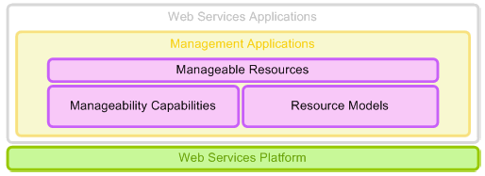
Resources
WSDM Identity
WSDM Metrics
WSDM Configuration
WSDM State
WSDM OpStatus
WSDM Relationships
…
CIM
TMF
OMA
SNMP
…
DMTF WS-CIM
WSDM MOWS
…
Standards already in progress,
More will evolve…

Slide 9
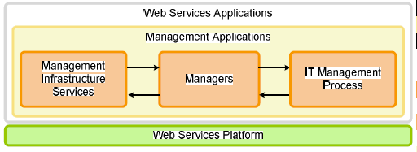
Managers
Examples of what may evolve in managers, what standards are needed is to be determined
Metering
Monitoring Svcs
Event Mediators
Metric Mediators
Inv.Scanning
Policy Enforcers
Policy Mgrs
Monitor
Provision
Configuration

Slide 10
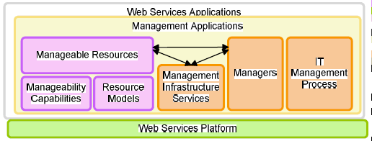
Management Roadmap - Architecture

Slide 11
Roadmap Summary
Provides a vision and architectural foundation for solving the needs of our customers to simplify the management of heterogeneous environments today and advanced management in the future
  Leveraging technology and standards for increased IT agility, reduce IT complexity, and automation of IT management processes.
  Web services as a technology foundation for management
Outlines a Journey
  Implementations based on web services standards are beginning to emerge
  Call to action for the Management Community
    Engage in the development and standardization of the architectural components
    Provide feedback on the paper including new ideas and technologies needed to make the strategy complete
For more information visit
  http://www-128.ibm.com/developerworks/webservices/library/specification/ws-mroadmap/
  http://devresource.hp.com/drc/resources/muwsarch/index.jsp
  http://www3.ca.com/technologies/CollateralList.asp?CCT=19505&ID=3339

Slide 12
Agenda
An Industry View: The Management Roadmap
WSDM Motivation
Web Services Foundation for WSDM
  WS-Addressing
  WS-Resource Framework
  WS-Notification
WSDM Overview
  Architectural concepts
  Management Using Web Services
  MUWS Capabilities
  Management of Web services

Slide 13
What motivated WSDM development?
Compelling customer need for Management software interoperability
  Among management software
  With resources
  With business applications and processes
Basis for advances in enterprise management
  Examples include Grid workload balancing, SLM, and policy-based management, …
Management interoperability milestone:
  OASIS WSDM 1.0 standard approved

Slide 14
A Common Platform for Management
Web Services & Management Requirements
OASIS WSDM
access to
manageable resources
description of
manageable resources
Focus on
manageability
DMTF
access to CIM
resource models
description of CIM
resource models
Focus on resource
models
GGF
access to virtual
resources
description of
virtual resources
Focus on grid
application
Multiple management standards communities need a common management platform of Web Services to access resources in a common way.

Slide 15
Agenda
An Industry View: The Management Roadmap
WSDM Motivation
Web Services Foundation for WSDM
  WS-Addressing
  WS-Resource Framework
  WS-Notification
WSDM Overview
  Architectural concepts
  Management Using Web Services
  MUWS Capabilities
  Management of Web services

Slide 16
Web Services Platform Standards
XML Schema – captures information model
SOAP – XML messaging
WSDL – describes message exchanges (e.g. operations)
WS-ResourceProperties
  Discover resource properties
  Get/set resource properties
  Value change notifications
WS-ResourceLifetime
  Know when a resource is/will be destroyed
  Destroy a resource
WS-ServiceGroup
  Query a group of resources
  Register a resource
WS-BaseNotification
  Subscribe to notifications
  Notify message wrapper
WS-Topics – description of notification messages and topic classification

Slide 17
Management Roadmap, WSDM, and Grid
WSDM MOWS
(Web Service)
WS-CIM
Grid Services
WS-Notification
WS-RF Resource Properties
WS-Addressing
WSDL
SOAP
XML
WSDM MUWS
CIM Model

Slide 18
WS-Addressing
EPR
refers to
known to
Web services
Application
Web Service
messages
w/ WSA & other
information in
the headers
endpoint
Notes:
Endpoint represents a resource which has XML representation (resource representable in XML).

Slide 19
Web services access to Resources
EPR
…
Policies
refers to
Schemas
known to
WSDL
Web services
Application
Resource
messages
with WSA & other
information in
the headers
endpoint
XML Representation
<x:Customer>
<x:Name>John Doe</x:Name>
<x:Address>…</x:Address>
</x:Customer>
WS-Resource
Notes:
Endpoint represents a resource which has XML representation (resource representable in XML).

Slide 20
A WS-Resource
<wsdl:portType name="Process"
wsrf-rp:ResourceProperties="process:ProcessProperties">
…
</wsdl:portType>
WS-Resource
C
<process:ProcessProperties>
<process:csName> xclock </process:csName>
<process:executionState> Suspended Ready </ …>
<process:handle> 2824 </process:handle>
<q:MayOrMayNotHaveSomeProperty> Red </…>
…
<wsrl:TerminationTime> 09 Nov 2005 09:45:29 GMT<…/>
</process:ProcessProperties>
A
<wsa:EndpointReference>
<wsa:Address>
http://some.org/AService
</wsa:Address>
<wsa:ReferenceParameters>
<tns:process> C </tns:process>
<wsa:ReferenceParameters>
</wsa:EndpointReference>
B
Notes:
The type of the resource properties document (e.g. the XML Schema definition of the root element) is declared in a wsrf-rp:ResourceProperties attribute of the portType for the WS-Resource. This provides a service requester with design-time information about resource property documents (instance documents) associated with the endpoint.
An example of a resource property document is shown for the resource identified as “C”.
A WS-Addressing EPR is a reference to a WS-Resource. It contains both the endpoint address of the Web service and information in the reference parameters that enable the WS-Resource to associate messages with a specific resource (e.g. “C”)

Slide 21
WS-RF Overview
Defines open framework for modelling and accessing stateful resources using Web services.
  An XML document describes the properties of a WS-Resource.
    A WS-Resource is a Web service that has an associated ResourceProperties document.
  WSDL messages are defined as a standard means through which properties are accessed.
  WS-Addressing EndpointReference is a means through which WS-Resources are referenced.

Slide 22
WS-RF outputs
A family of documents and specifications
Specifications
  WS-Resource
  WS-ResourceProperties
  WS-ResourceLifetime
  WS-BaseFaults
  WS-ServiceGroup
  WS-ResourceMetadata
Non-normative:
  WS-RF Requirements
  WS-RF Primer
  WS-RF AppNotes
WS-Resource
WS-Resource
Metadata
WS-Resource
Properties
WS-Resource framework
(WS-RF)
WS-Service Groups
WS-Resource Lifetime
WS-BaseFaults
Notes:
WS-Resource: defines terms such as “WS-Resource” and the embodiments of the “WS-Resource access pattern”
WS-ResourceProperties: defines how properties of a WS-Resource are declared in the WSDL and accessed through standard message exchanges
WS-ResourceLifetime: defines mechanisms (immediate and time-based) for destroying a WS-Resource (including the resource)
WS-BaseFaults: defines a standard XML type for all faults defined by the WS-RF specifications
WS-ServiceGroup: defines means for aggregating heterogeneous WS-Resources and for building collections of WS-Resources with queryable content
WS-ResourceMetadata: defines means for associating metadata with resource properties. This includes aspects such as mutability and content constraint.
WS-RF Requirements: Use cases, scenarios, requirements and non-requirements for WS-RF.
WS-RF Primer: Introductory material. The first WS-RF document anyone should read.
WS-RF AppNotes. Application notes for implementors. Fleshes out the normative specs and builds on concepts introduced in the Primer.

Slide 23
WS-Resource Framework
  Captures Common Patterns
  Referencing resources
  Accessing properties of a resource
  Destroying a resource
  Grouping services
  Registering for later notifications

Slide 24
WS-ResourceProperties
Offers a view of the properties of the resource
Presented via Web service as an XML document (accessible through various query types)
Properties document type associated with PortType
<GenericDiskDriveProp xmlns:tns="http://disk.com/diskDrive" >
<tns:NumberOfBlocks>22</tns:NumberOfBlocks>
<tns:BlockSize>1024</tns:BlockSize>
<tns:Manufacturer>DrivesRUs</tns:Manufacturer>
</GenericDiskDriveProp>

Slide 25
ResourceProperties Document and WSDL
ResourceProperties document is associated with the WSDL portType:
<wsdl:portType name="Process"
wsrp:ResourceProperties="process:ProcessProperties">
<wsdl:operation name="findHostingOperatingSystem"> …
<wsdl:operation name="GetResourceProperty">
<wsdl:input name="GetResourcePropertyRequest" message="wsrpw:GetResourcePropertyRequest" />
<wsdl:output name="GetResourcePropertyResponse" message="wsrpw:GetResourcePropertyResponse" />
</wsdl:operation>
<wsdl:operation name="QueryResourceProperties">…
<wsdl:operation name="Destroy"> …
</wsdl:portType>
@ResourceProperties provides meta-data to assist developers and tooling

Slide 26
WS-ResourceProperties Operations
GetResourceProperty (required)
Simple single resource property element getter
<wsrp:GetResourceProperty>
process:handle
</wsrp:GetResourceProperty>
<wsrp:GetResourcePropertyResponse>
<process:handle>1577 </process:handle>
</wsrp:GetResourcePropertyResponse>
GetMultipleResourceProperties (optional)
More sophisticated multiple property value retrieval
<wsrp:GetMultipleResourceProperties>
process:handle
process:executionState
</wsrp:GetMultipleResourceProperties>
<wsrp:GetMultipleResourcePropertiesResponse>
<process:handle>1577 </process:handle>
<process:executionState>Suspended Ready</process:executionState>
</wsrp:GetMultipleResourcePropertiesResponse>
QueryResourceProperties (optional)
Execute an expression on the resource properties document
<wsrp:QueryResourceProperties>
<wsrp:QueryExpression
Dialect="http://www.w3.org/TR/1999/REC-xpath-19991116">
boolean(/*/*[MemUsage<1024])
</wsrp:QueryExpression>
</wsrp:QueryResourceProperties>
<wsrp:QueryResourcePropertiesResponse>
true
</wsrp:QueryResourcePropertiesResponse>

Slide 27
WS-ResourceLifetime
Specify how WS-Resources are destroyed
Immediate Destruction
Scheduled Destruction
Standard notification of resource destruction

Slide 28
WS-ServiceGroup
A service group maintains information about a group of Web services (may be WS-Resources)
Not necessarily of the same type
No implied relationship
Can be extended to invoke operations on members of the group
Leverages WS-ResourceProperties
Allows expression of membership constraints

Slide 29
WS-BaseFault
Adds structure to WSDL error messages
Defines mapping to SOAP 1.2 faults
<BaseFault>
<Timestamp>xsd:dateTime</Timestamp> <OriginatorReference>wsa:EndpointReference</OriginatorReference> ?
<FaultCode FaultScheme="anyURI">xsd:string</FaultCode> ?
<Description>xsd:string</Description> *
<FaultCause>wsbf:BaseFault</FaultCause> *
</BaseFault>

Slide 30
WS-RF Status
Latest working drafts available from TC home page:
  http://www.oasis-open.org/committees/tc_home.php?wg_abbrev=wsrf
Committee drafts anticipated mid 2005 for:
  WS-Resource
  WS-ResourceProperties
  WS-ResourceLifetime
  WS-BaseFaults

Slide 31
WS-Notification: WS-BaseNotification
Three interfaces
NotificationProducer
NotificationConsumer
SubscriptionManager (subscription is a
WS-Resource)
Three roles
Subscriber
Producer
Consumer
Two ways to send notifications
“Raw messages” (based on policy)
“Notify” wrapper (default)

Slide 32
Base notification: subscribe message
<wsnt:Subscribe>
<wsnt:ConsumerReference>
wsa:endpointReference
</wsnt: ConsumerReference>
<wsnt:TopicExpression dialect = “xsd:anyURI”>
{any}
</wsnt:TopicExpression>
<wsnt:UseNotify> xsd:boolean </wsnt:UseNotify>?
<wsnt:Precondition> wsrp:QueryExpression </Precondition>?
<wsnt:Selector> wsrp:QueryExpression </wsnt:Selector>?
<wsnt:SubscriptionPolicy> {any} </wsnt:SubscriptionPolicy>?
<wsrl:InitialTerminationTime>
xsd:dateTime
</wsrl:InitialTerminationTime>?
</wsnt: Subscribe>

Slide 33
WS-BrokeredNotification
Broker (intermediary) permits
decoupling Publisher and Subscriber
Publisher need NOT be a Web service
Transparently reuses WS-BaseNotification interfaces and adds new ones:
  NotificationBroker (just one new property)
  RegisterPublisher

Slide 34
WS-Topics
Topics are used to represent and categorize items of interest for notifications
WS-Topics defines three topic expression dialects
  Simple Topic Expression (tns:t1)
  Concrete Topic Path Expression (tns:t1/t3)
  Full Topic Path Expression (tns:t1/*)
<wstop:topicSpace name="TopicSpaceExample1"
<wstop:topic name="t1">
<wstop:topic name="t2" messageTypes="xyz:m1 tns:m2"/>
</wstop:topic>
<wstop:topic name="t3">
</wstop:topic>

Slide 35
WSN Status
Latest working drafts available from TC home page:
  http://www.oasis-open.org/committees/tc_home.php?wg_abbrev=wsn
Committee drafts anticipated mid 2005 for:
  WS-BaseNotification
  WS-Topics

Slide 36
Agenda
An Industry View: The Management Roadmap
WSDM Motivation
Web Services Foundation for WSDM
  WS-Addressing
  WS-Resource Framework
  WS-Notification
WSDM Overview
  Architectural concepts
  Management Using Web Services
  MUWS Capabilities
  Management of Web services

Slide 37
Membership and History
WSDM charter in February 2003
Broad representation by member companies
WSDM 1.0 approved March 2005
Internal Interop April 2005
Public Demonstration June 2005

Slide 38
Web Services Distributed Management Missions
Use Web Services as the distributed computing platform to enable interoperability between managers and manageable resources
Management USING Web Services (MUWS)
  Web services to describe and access manageability of resources
  Management applications use Web services just like other applications use Web services
Management OF Web Services (MOWS)
  An application of Management Using Web Services for the Web Service as the IT resource
Notes:
Another word for ‘application of MUWS’ ?
Is ‘distributed computing platform’ too scarey
We are not defining management applications

Slide 39
What is WSDM?
Leverage Web services foundation to enable interoperability between managers and manageable resources
Management USING Web Services (MUWS)
  Web services to describe and access manageability of resources
  Management applications use Web services just like other applications use Web services
Management OF Web Services (MOWS)
  An application of Management Using Web Services for the Web Service as the IT resource

Slide 40

Scenario: Acme Manufacturing Systems Management
Manager discovers and introspects ACMEs IT manageable resources
Manager subscribes to resources for WSDM state changes
Server fails and WSDM Management Event Format notification is sent to Manager for state change (failed server)
Manager redeploys service to an under utilized server that is a member of the candidate server group
ServerUK
Supplier A
ServerNY
Acme
svc
Supplier B
svc
ServerLA
Supplier C
Manager
Using WSDM and WS Resource Framework Service Group, ACME managers discover manageable resources, introspect the resources.
WSDM and WS Resource Framework Lifetime support managers executing deploy and redeploy of services to other servers upon failure.
WSDM and WS Resource Properties enable standard expression of, introspection of, and access to metrics, configuration and operational state properties for services.
WSDM and WS Notification enable standard event messages in notifications when state changes that require action by managers

Slide 41
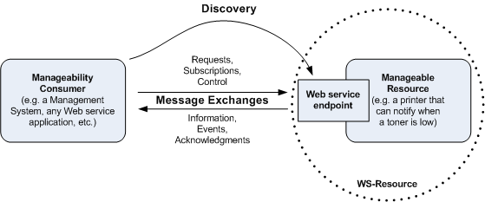
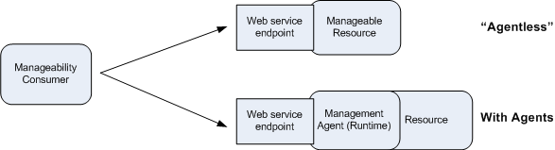
WSDM Architecture Principles
Focus on Resources
Isolation from implementation choices

Slide 42
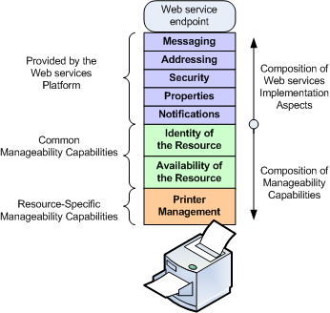
WSDM: Composability

Slide 43
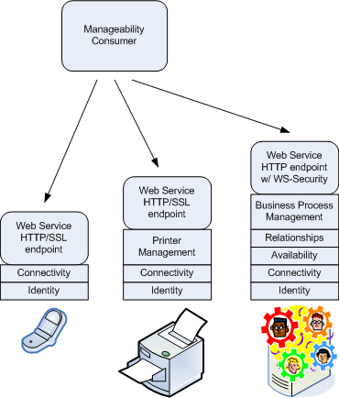
WSDM: Effects of composability

Slide 44








A Manager’s View
Policies
SLAs
Registry
Manager
CIM or SNMP Manager
Printer
System
Web Service
Application Server
Agent
WSDM Web Service Manageability Endpoint
Notes:
Points:
WSDM MUWS is used to talk to manageable Web Services defined using MOWS.
WSDM MUWS can be used b resources directly.
WDSM MUWS can be used to wrapper existing management facilities, protecting and leveraging existing investment, allowing incremental implementation of the architecture, and providing ‘integration’ of disparate management technologies.
Scenario:
Managers are able to use policy and resource registries to access and manage Web services and other IT resources.
Here a Manager finds resources using the registry.
Now the manager can manage the Web service using a WSDM MOWS manageable resource for the management of the Web Service. The service may provide some supply chain function to a business partners.
WSDM manageable resource Web services can be supplied directly by resources that have direct Web services support. For example, an application server, like WebSphere and Web Logic, obviously have Web services support and define a relatively complex set of management capabilities that they offer directly through their own Application Server Manageable Resource.
However, for printers and systems that may already be instrumented for management through an existing management technology or agent, the manager interfaces with a manageable resource Web service for the printer or system that acts as a bridge between Web services and WSDM protocols and those of the resource’s native instrumentation. Web services functions as an integration technology, wrapping existing resource instrumentation and exposing it using Web services to more clients over standard protocols. The Printer or system are not impacted by supporting these new Web services based managers. In fact, even existing managers using the existing instrumentation or agents are unaffected by adding this Web services bridge, the existing managers function as before.

Slide 45
Management Using Web Services
Profile on use of WS-Resource Framework and WS-Notification
Resource management model agnostic
Advice on advertising and discovering WSDM manageable resources
Standard management event format
Resource Identification
Captures common resource management aspects from models

Slide 46
Management Using Web Services (MUWS)
Management Foundations
  Meta information
    Additional descriptive information about interfaces
    resources, properties, operations, notifications
  Relationships
    Association between two IT resources
    Relationship expression schema and property
  Management Event Format
    XML format, carry events from any source
  Discovery
    Creating manageable resources from traditional discovery engines
    Finding resources
    Introspection of manageability capabilities

Slide 47
Management Using Web Services
Manageable Resource:
  Is a Web Service
    Described by WSDL, WS-Resource Properties, Meta information, Policies,
  Is a WS-RF WS-Resource
  MUST support WSDM’s Identity capability with properties (ResourceID).
  Advertises the properties/operations (message exchanges) of the resource to be managed

Slide 48
Management Using Web Services
Capabilities - Set of descriptions to enable a management task
WSDL, WS-Resource documents, Meta Information, Policies, Notification topics
  Identity, Description
  ManageabilityCharacteristics
  Metrics
  Operational Status, State
  Configuration
  Correlatable Names
  Relationships

Slide 49
Capabilities
Identity
  Defines standard means to determine if two resources are ‘the same’
    If same then resources are the same
    If different then resources are probably different, but may be the same, revert to correlatable properties
  Properties: ResourceId
Description
  Description of resource being managed
  Properties: Caption, Description, Version
ManageabilityCharacteristics
  Describes management abilities of resources
  Properties: ManageabilityCapabilities URIs

Slide 50
Capabilities – Correlatable Properties
Describes how to compare the properties of two resources to determine if the resources are ‘the same’, dialects incl. xpath & pbm.
Properties: CorrelateableProperties
<muws-p1-xs:CorrelatableProperties
Dialect=”http://docs.oasis-open.org/wsdm/2004/12/pbm”>
<pbm:MatchAny>
<pbm:Match>print:IPAddress</pbm:Match>
<pbm:MatchAll>
<pbm:Match>foo:Name</pbm:Match>
<pbm:Match>print:PrinterModel</pbm:Match>
<pbm:Match>print:Location</pbm:Match>
<pbm:Match>print:Owner</pbm:Match>
</pbm:MatchAll>
</pbm:MatchAny>
</muw-p1-xs:CorreletableProperties>

Slide 51
Capabilities - Metrics
Defines expression of standard metric types/behaviors (heavily influenced by DMTF Metrics WG)
Each metric contains its Type, Time scope, LastUpdatedAt, ResetAt
  IntegerMetric
  DurationMetric
Properties: CurrentTime
Resource specific metrics
Events: on metric changes (WSRP:ResourceChangeEvent wrapped in a WEF)

Slide 52
Capabilities – State
Defines how to indicate the current state and state transitions of a resource
Properties: Current State URI, Time Entered, State Model URI
Events when state transitions on state topic
Resource model defines the resource specific state models and semantics
May be several State capabilities extensionts
Future exploration:
  Tying Operations to state changes is being explored
  Mechanisms to convey the state model

Slide 53
Capabilities – Operational Status
Defines high level resource health indicator.
Properties: OperationalStatus - limited values for interop across models: Available, Unavailable, PartiallyAvailable, Unknown
Status transition Events when status changes on status topic
Resources responsible for expressing correct status according to how State maps to Operational Status

Slide 54
Capabilities – Configuration
Defines the properties which are settable and together compose a resource’s configuration
Properties: resource specific properties
Operations: from WS-ResourceProperties, setResource
Events: Property change event wrapped in WEF on Configuration topic.

Slide 55
Capabilities – Relationships
Defines schema to describe relationships and access relationships as resources when they have properties and behavior.
  Name, Type, Particpant (EPR, ID, Role)
  Access Endpoint Reference
Properties: Relationship
Operations:QueryByType
Events: Relationship created, Relationship deleted

Slide 56
Advertising
Defining standard events for resource factories to emit when resources are created or destroyed
Registry Advisory: If you have a manageable resource registry then you should expose them using Services Group interfaces with ResourceId and ManageabilityCapabilities content model
Listen for Advertisement and destruction events
Follow relationships on known resources
Discovery

Slide 57
WSDM Event Format
Defining extensible, standard format for management events, passed using WS-Notification
Contains common information fields:
  ReportTime, EventId
  Source – ResourceId, ComponentAddress
  Reporter – ResourceId, ComponentAddress
  Situation – SituationCategory, SuccessDisposition, Situation Time, Severity, Priority, Message, MessageId

Slide 58
Management Of Web Services
Simplification
  Use Web services for management of same
Unification
  Of manageability and operational capabilities
    Definition and usability
    Composability of management and operational sides
Integration of management and business
  Management gains visibility into business
  Business applications and processes can leverage manageability capability
Management model
  Identity, links to the managed service and managers, metrics, status, and request processing observations

Slide 59
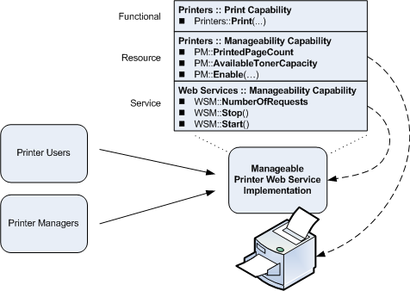
WSDM: Resources as Web services

Slide 60
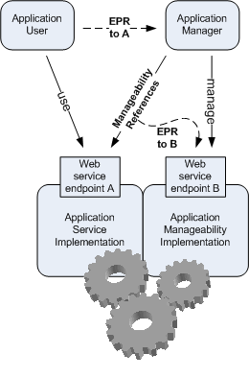
WSDM: “Where is your manager?”

Slide 61
Where are going
WSDM MUWS and MOWS V1
  March 2005
WSDM Next Gen line items being discussed now in WSDM TC
  Standard Versions of WS-RF / WS-Notification / WS-Addressing
  Reverse Protocol?
  Policy?
  Others?

Slide 62
Implementations are appearing
  Open Source Apache Implementation from HP and Globus
    http://incubator.apache.org/muse/
  HP, SOA Manager
    http://devresource.hp.com/drc/resources/lcm4ws_overview/index.jsp
  IBM, ETTK supporting WSDM 0.5 (April 2004)
    http://www.alphaworks.ibm.com/tech/ettk
    Update coming in ETTK 2.3 supporting WSDM 1.0 (April 2005)
  CA, CA WSDM
    http://www3.ca.com/Solutions/Product.asp?ID=4714

Slide 63
Relationship to Other Standards Work
W3C
  WS Description WG
  WS Arch WG
DMTF
  WIP and its WS-CIM subgroup
  Utility WG
  State and Behavior WG
GGF
  OGSA Common Manageability Model WG
OASIS
  Web Services Resource Framework
  WS-Notification
  WS-Security

Slide 64
Resources
WSDM Specifications: http://www.oasis-open.org/apps/org/workgroup/wsdm/documents.php
OASIS – http://www.oasis-open.org
DMTF – http://www.dmtf.org
GGF – http://www.ggf.org
W3C – http://www.w3c.org
Blackberry Demo –
http://www-128.ibm.com/developerworks/webservices/library/ws-blackberry/

Slide 65
Come to the Demo at 2pm!
HP/IBM interoperability demonstration of WSDM MUWS specification
3 different stacks! Apache MUSE, IBM ETTK, J2ME/ETTK
2 Demos!
  Blackberry (automation ready in 102K!)
  Weather Station Web services, (Managers on MUSE and ETTK interop with Web services on MUSE and ETTK)

Slide 66
Q&A

