Slide 1
WS-Agreement Use in CATNETs
Liviu Joita and Omer Rana
School of Computer Science and
Welsh eScience Centre, Cardiff, UK
o.f.rana@cs.cardiff.ac.uk

Slide 2
Agenda
WS Agreement for Service Selection
Implementation in CATNETS
Integration with Triana Workflow Engine
Notes:
This will be the agenda for today‘s talk. First, I will introduce the SOC and what will be needed to make it a sustainable business. Then, I motivate the service selection, and qhy this is a critical issue for SOA. This is followed by a SOTA of SS Techniques. A centralized and decentralized SS appraoch is then compared in a simulation, and finally I will resume the results and the lessons learned.

Slide 3
Service Selection in Grid Computing –
State-of-the-Art
Notes:
Summing up, the approaches with coordinator are on the left hand side, the ones without coordinator on the right side. The lower layer presents ordinal matching mechanisms, relying on technical parameters and the upper the economic approaches. In the boxes, the current representatives are shown.

Slide 4
Service Selection Mechanisms (1)
The service discovery process delivers a list of services, this are followed by service selection where one of these services is selected.
Centralized service selection with a central Resource Broker, that matches supply and demand via a mathematical optimization rule.
Example: Grids (Condor-G, DMR-broker, Nimrod-G Broker, DataGrid OptorSim, etc.)
Decentralized service selection without coordination, based on the local knowledge of the consumers (demand)
Example: File Sharing (Gnutella, FastTrack etc.)
Notes:
Several methods for SS are possible

Slide 5
Service Selection Mechanisms (2)
Service selection based on market principle –consider the scarcity of goods (based on prices) or technical parameters (based on performance metrics).
Manual selection includes performance metrics primarily – but may also include service description terms
Automated selection of services, based on prices
    Bilateral negotiations based on local knowledge
    Optimizer (Calculation of equilibrium prices)
    Auctions (Sealed vs. Open-outcry, Ascending vs. Descending, First price vs. Second price)

Slide 6
Integrating WS-Agreement with Prototype Application
1. Request
Client
Application Service Builder
8. Invocation
Master Grid Service
WS
ServiceInstance (GT4/JavaWS)
2. Requirements
WSAG
7. Service Reference
Application
Catallactic Access Point
5. Service instantiation
3. Service negotiation
ComplexService
Agent
BasicServiceAgent
ServiceFactory (GT4/JavaWS)
6. Service Reference
4. Resource negotiation
ResourceAgent
CATNETS Middleware
Resource (GT4/WSRF/.NETWS/JWS)
Base Platform

Slide 8
Data Mining Services
DataSet
Converter
Service B Instance
Mining
Service A Instance
Migrate
Convert
Data-Mining
Results
Execute
Resource Allocation
Output
Converter
Service A
Mining Service A
Resource Provider
CS Agent1
MS Agent1
R Agent1
(MGS)
Complex Service Agent
Converter
Service B
Mining
Service B
Resource Provider
CS Agent2
MS Agent2
R Agent2
Converter
Service C
Mining Service C
Resource Provider
CS Agent3
MS Agent3
R Agent3
Negotiation messages
Negotiation messages
Service Market
Resource Market

Slide 9
WS-Agreement in Catallaxy
The Agreement Template (AT) specifies the service description elements that are allowed by the factory which advertises it.
The Agreement Offer (AO) complies with the Agreement Template. Initially, the most important element is the amount MGS is willing to pay for fulfilling the application tasks via the service(s) and resource(s) bought from the Catallactic markets.

Slide 10
WS-Agreement Template Lite – Data Mining Service
<?xml version="1.0" encoding="UTF-8"?>
<wsag:AgreementTemplate AgreementID=“DataMiningTemplate-v001”
xmlns:wsag=“http://schemas.ggf.org/graap/2005/09/ws-agreement”>
<wsag:Name>DataMiningComplexService</wsag:Name>
<wsag:Context>
<wsag:AgreementInitiator>
<! -- can be a URI or a security identity of the initiator -->
NameOfTheInitiator
</wsag:AgreementInitiator>
<wsag:ExpirationTime>DateTime</wsag:ExpirationTime>
<wsag:TemplateID>DataMiningTemplate-001</wsag:TemplateID>
<wsag:TemplateName>DataMiningComplexService</wsag:TemplateName>
</wsag:Context>
<wsag:Terms>
<BasicServiceName>DataMiningBasicService
</BasicServiceName>
<NumberOfBasicServiceNodes>
</NumberOfBasicServiceNodes>
<BasicServiceConstraints>
<BasicServiceType>
</BasicServiceType>
</BasicServiceConstraints>
<Price>
</Price>
</wsag:Terms>
</wsag:AgreementTemplate>

Slide 11
WS-Agreement Offer Lite – Data Mining Service
<?xml version="1.0" encoding="UTF-8"?>
<wsag:AgreementOffer AgreementID=“DataMiningOffer-v001”
xmlns:wsag=“http://schemas.ggf.org/graap/2005/09/ws-agreement”>
<wsag:Name>DataMiningComplexService</wsag:Name>
<wsag:Context>
<wsag:AgreementInitiator>
<! -- can be a URI or a security identity of the initiator -->
NameOfTheInitiator
</wsag:AgreementInitiator>
<wsag:ExpirationTime>DateTime</wsag:ExpirationTime>
<wsag:TemplateID>DataMiningTemplate-001</wsag:TemplateID>
<wsag:TemplateName>DataMiningComplexService</wsag:TemplateName>
</wsag:Context>
<wsag:Terms>
<BasicServiceName>DataMiningBasicService
</BasicServiceName>
<NumberOfBasicServiceNodes>1
</NumberOfBasicServiceNodes>
<BasicServiceConstraints>
<BasicServiceType>J48
</BasicServiceType>
</BasicServiceConstraints>
<Price>100
</Price>
</wsag:Terms>
</wsag:AgreementOffer>

Slide 12
WS-Agreement Template – Data Mining Service (1)
<wsag:AgreementTemplate AgreementID=“DataMiningTemplate-v001”
xmlns:wsag=“http://schemas.ggf.org/graap/2005/09/ws-agreement”
xmlns:wsa=“http://schemas.xmlsoap.org/ws/2004/03/addressing”
xmlns:xsi=“http://www.w3.org/2001/XMLSchema-instance”>
<wsag:Name>Data Mining Service</wsag:Name>
<wsag:Context>
<wsag:AgreementInitiator>
<! -- can be a URI of the initiator or a security identity of the initiator -->
NameOfTheInitiator
</wsag:AgreementInitiator>
<wsag:ExpirationTime>DateTime</wsag:ExpirationTime>
<wsag:TemplateID>001</wsag:TemplateID>
<wsag:TemplateName>DataMiningComplexService</wsag:TemplateName>
</wsag:Context>
<wsag:Terms>
<wsag:All>
<wsag:ServiceDescriptionTerm wsag:Name="BasicServiceName" wsag:ServiceName="DataMiningBasicService">
<BasicServiceName>"BasicServiceInstance"</BasicServiceName>
</wsag:ServiceDescriptionTerm>
<wsag:ServiceDescriptionTerm wsag:Name="NumberOfBasicServiceNodes" wsag:ServiceName="DataMiningBasicService">
<NumberOfBasicServiceNodes>5</NumberOfBasicServiceNodes>
</wsag:ServiceDescriptionTerm>
<wsag:ServiceDescriptionTerm wsag:Name=“Price" wsag:ServiceName="DataMiningBasicService">
<Price>
</Price>
</wsag:ServiceDescriptionTerm>

Slide 13
WS-Agreement Template – Data Mining Service (2)
<wsag:ServiceDescriptionTerm wsag:Name=“BasicServiceConstraints" wsag:ServiceName="DataMiningBasicService">
<BasicServiceConstraints>
<BasicServiceType>
</BasicServiceType>
<CPUArchitecture>
</CPUArchitecture>
<Memory>
</Memory>
<Latency>
<min/>
<max/>
<Latency>
<BasicServiceConstraints>
</wsag:ServiceDescriptionTerm>
<wsag:GuaranteeTerm wsag:Name="StartTime"><wsag:ServiceScope>
<wsag:ServiceName> DataMiningBasicService </wsag:ServiceName>
</wsag:ServiceScope>
<wsag:ServiceLevelObjective>startTime IS_NOW</wsag:ServiceLevelObjective>
<wsag:BusinessValueList>
<wsag:Importance>
</wsag:Importance>
</wsag:BusinessValueList>
</wsag:GuaranteeTerm>

Slide 14
WS-Agreement Template – Data Mining Service (3)
<wsag:GuaranteeTerm wsag:Name="EndTime"><wsag:ServiceScope>
<wsag:ServiceName> DataMiningBasicService </wsag:ServiceName>
</wsag:ServiceScope>
<wsag:ServiceLevelObjective>endTime IS_BEFORE-UnitTime</wsag:ServiceLevelObjective>
<wsag:BusinessValueList>
<wsag:Importance>
</wsag:Importance>
</wsag:BusinessValueList>
</wsag:GuaranteeTerm>
</wsag:All>
</wsag:Terms>
<wsag:CreationConstraints>
<wsag:Item wsag:Name="BasicServiceName"> <wsag:Location>/wsag:Template/wsag:Terms/wsag:All/wsag:ServiceDescriptionTerm/basicServiceName</wsag:Location>
<!-- for each domain-specific service description <basicServiceName>, constrain the value of that element (i.e. reduce list of possible BasicServiceName) -->
</wsag:Item>
<wsag:Item wsag:Name="NumberOfBasicServiceNodes"> <wsag:Location>/wsag:Template/wsag:Terms/wsag:All/wsag:ServiceDescriptionTerm/numberOfBasicServiceNodes</wsag:Location>
<! --<numberOfBasicServiceNodes> is allowed, but must be within the range
<xs:minInclusive xs:value="1"/>
<xs:maxInclusive xs:value="5"/>
</wsag:Item>
<wsag:Item wsag:Name=“Price">
<wsag:Location>/wsag:Template/wsag:Terms/wsag:All/wsag:ServiceDescriptionTerm/price</wsag:Location>
<! -- <price> is allowed; no constrain on its value (amount of money pay for dedicated the period of service) -->
</wsag:Item>

Slide 15
WS-Agreement Template – Data Mining Service (4)
<wsag:Item wsag:Name=“BasicServiceConstraints">
<wsag:Location>/wsag:Template/wsag:Terms/wsag:All/wsag:ServiceDescriptionTerm/basicServiceConstraints</wsag:Location>
<! --<basicServiceConstraints> is allowed; no constrain on its value -->
</wsag:Item>
<wsag:Item wsag:Name=“BasicServiceType">
<wsag:Location>/wsag:Template/wsag:Terms/wsag:All/wsag:ServiceDescriptionTerm/basicServiceType
</wsag:Location>
<! --<basicServiceTypetype> is allowed; no constrain on its value (e.g. the type of data mining service where the job is executed) -->
</wsag:Item>
<wsag:Item wsag:Name=“Latency“><wsag:Location>/wsag:Template/wsag:Terms/wsag:All/wsag:ServiceDescriptionTerm/job:latency</wsag:Location>
<! --<latency> is allowed; but must be within a range (milliseconds) -->
<xs:minInclusive xs:value="2"/>
<xs:maxInclusive xs:value="10"/>
</wsag:Item>
<wsag:Item wsag:Name=“CPU">
<wsag:Location>/wsag:Template/wsag:Terms/wsag:All/wsag:ServiceDescriptionTerm/cpu</wsag:Location>
<! --<cpu> is allowed; no constraints on its value (minimum cpu speed) -->
</wsag:Item>
<wsag:Item
wsag:Name=“Memory“>
<wsag:Location>/wsag:Template/wsag:Terms/wsag:All/wsag:ServiceDescriptionTerm/memory</wsag:Location>
<! --<memory> is allowed; no constraints on its value (minimum MB memory) -->
</wsag:Item>
</wsag:CreationConstraints>
</wsag:AgreementTemplate>

Slide 16
WS-Agreement Offer – Data Mining Service (1)
<wsag:AgreementOffer AgreementID=“DataMiningOffer-v001”
xmlns:wsag=“http://schemas.ggf.org/graap/2005/09/ws-agreement”
xmlns:wsa=“http://schemas.xmlsoap.org/ws/2004/03/addressing”
xmlns:xsi=“http://www.w3.org/2001/XMLSchema-instance”>
<wsag:Name>DataMiningComplexServiceOffer</wsag:Name>
<wsag:Context/>
<wsag:Terms>
<wsag:ServiceDescriptionTerm wsag:Name="BasicServiceName" wsag:ServiceName=" DataMiningBasicService ">
<BasicServiceName>BasicServiceInstance</BasicServiceName>
</wsag:ServiceDescriptionTerm>
<wsag:ServiceDescriptionTerm wsag:Name="NumberOfBasicServiceNodes“ wsag:ServiceName=" DataMiningBasicService ">
<job:NumberOfBasicServiceNodes>1
</job:NumberOfBasicServiceNodes>
</wsag:ServiceDescriptionTerm>
<wsag:ServiceDescriptionTerm wsag:Name=“Price" wsag:ServiceName=" DataMiningBasicService ">
<Price>100</Price>
</wsag:ServiceDescriptionTerm>

Slide 17
WS-Agreement Offer – Data Mining Service (2)
<wsag:ServiceDescriptionTerm wsag:Name=“BasicServiceConstraints" wsag:ServiceName=" DataMiningBasicService ">
<BasicServiceType>J48
<BasicServiceType>
<CPUArchitecture>1GHz
</CPUArchitecture>
<Memory>1024MB
</Memory>
<Latency>
<min/>2
<max/>8
<Latency>
</wsag:ServiceDescriptionTerm>
<wsag:GuaranteeTerm wsag:Name="StartTime">
<wsag:ServiceScope>
<wsag:ServiceName> DataMiningBasicService </wsag:ServiceName>
</wsag:ServiceScope>
<wsag:ServiceLevelObjective>startTime IS_NOW</wsag:ServiceLevelObjective>
<wsag:BusinessValueList>
<wsag:Importance>2 <!-- 0 – low; 1 – medium; 2 – high -->
</wsag:Importance>
</wsag:BusinessValueList>
</wsag:GuaranteeTerm>

Slide 18
WS-Agreement Offer - DataMiningService (3)
<wsag:GuaranteeTerm wsag:Name="EndTime">
<wsag:ServiceScope>
<wsag:ServiceName> DataMiningBasicService </wsag:ServiceName>
</wsag:ServiceScope>
<wsag:ServiceLevelObjective>endTime IS_BEFORE-UnitTime</wsag:ServiceLevelObjective>
<wsag:BusinessValueList>
<wsag:Importance>2 <!-- 0 – low; 1 – medium; 2 – high -->
</wsag:Importance>
</wsag:BusinessValueList>
</wsag:GuaranteeTerm>
</wsag:All>
</wsag:Terms>
</wsag:AgreementOffer>

Slide 19
WS Agreement Implementation
Implementation in Triana workflow engine
Allow visualisation of Agreement Templates and Offers
Enable workflow to be paused until Agreement Offer has been confirmed

Slide 20
Reserve Slides

Slide 21
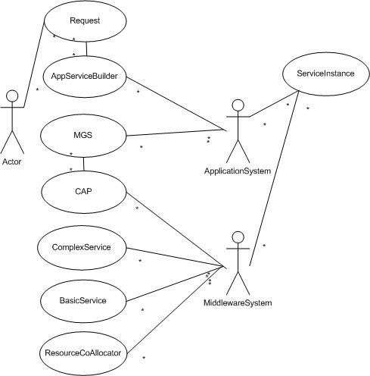
UML Use Case Diagram

Slide 22
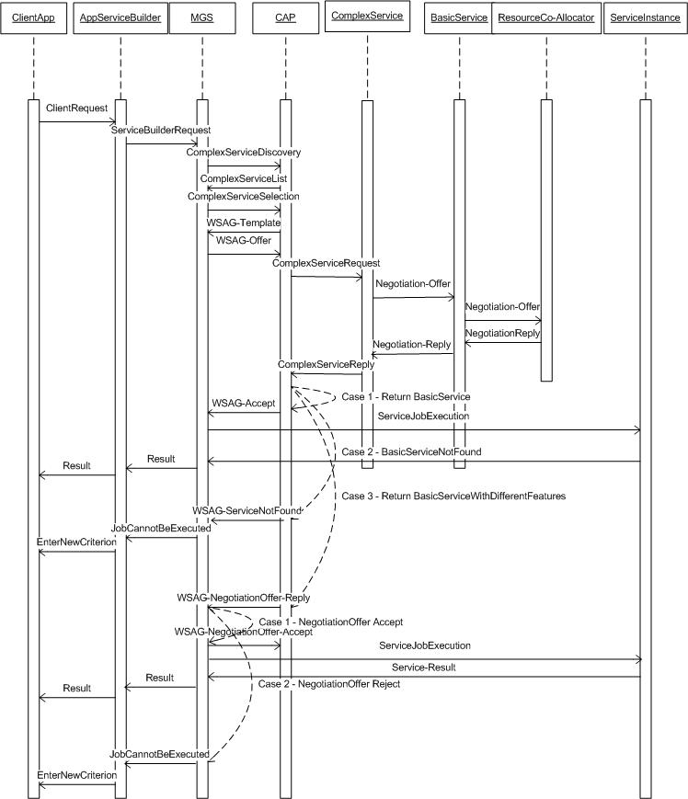
UML Sequence Diagram

