Slide 1
OGSA Data Replication Services Working Group
Ann Chervenak
GGF10
Friday, March 12, 2004

Slide 2
OGSA Data Replication Services Working Group
Co-chairs:
  Ann Chervenak, USC Information Sciences Institute
  Cecile Madsen, IBM
Web site:
  http://www.ggf.org
Mailing list
  orep-wg@ggf.org
  Subscribe by sending email to majordomo@ggf.org with body subscribe orep-wg

Slide 3
Recent Meetings and Agenda for GGF10
GGF8
  Steps toward a fully service-oriented Replica Location Service (RLS) Design
July 30-31, 2003 OREP Meetings
  Designing service-oriented RLS based on data services
  Extending ServiceGroups to provide policy support
GGF9
  More mature design/specification
GGF10
  WS-RF Issues for the RLS specification
  A prototype implementation of RLS specification

Slide 4
Outline
Brief review of OREP RLS design and specification
WS-RF Issues
Prototype implementation of RLS specificaiton
  Policy issues
  Initial performance numbers

Slide 5
Replica Location Services
Register existence of replicas of data items
  Replicas according to some semantic definition of replica, such as byte-to-byte copies, versions, etc.
Respond to queries about replicas
  Return identifier or locators for individual replicas
May enforce policies about replicas
  Authorization, maintaining semantic relationships, etc.

Slide 6
RLS Grid Service Design
Based in Part on OGSA Data Services
A data service represents and encapsulates a data virtualization, which is an abstract view of some data
  Service data elements (SDEs) describe key parameters of the data virtualization
  OGSI Grid Service Handles globally and uniquely identify data services
Data services inherit from OGSI Grid Servcies:
  Basic lifetime management capabilities, introspection of service data, Subscription/notification

Slide 7
RLS Design Extends
OGSI ServiceGroups
ServiceGroups are Grid services that maintain information about a group of other Grid services
A ServiceGroup contains entries for member services
  Entries are represented as Service Data Elements (SDEs) of the ServiceGroup
ServiceGroups are used in GT3 to implement:
  Service registries
  Indexes, such as for information services
We extend the ServiceGroupRegistration port type’s add and remove methods for RLS

Slide 8
Replica Location Grid Service Design
Data items are Grid services
Replicated data items are grouped together in a set
Want to expose these replica sets as services
Thus define a ReplicaSet Grid service as a virtualization of a set of replicas
This ReplicaSet is globally and uniquely identified by a Grid Service Handle
Effectively, a ReplicaSet provides a mapping from the locator (handle) of the ReplicaSet to one or more locators for member data services

Slide 9
Replica Location Grid
Service Design (Cont.)
Represent information about member data services as service data elements (SDEs) of the ReplicaSet service
ReplicaSet service data may include policy information for ReplicaSet
  E.g., replicas are byte-to-byte copies, have matching checksum, consistency is or is not maintained, etc.
A client may use standard methods to obtain information about replicaSet members and policies
  Inspection
  Subscription/notification

Slide 10
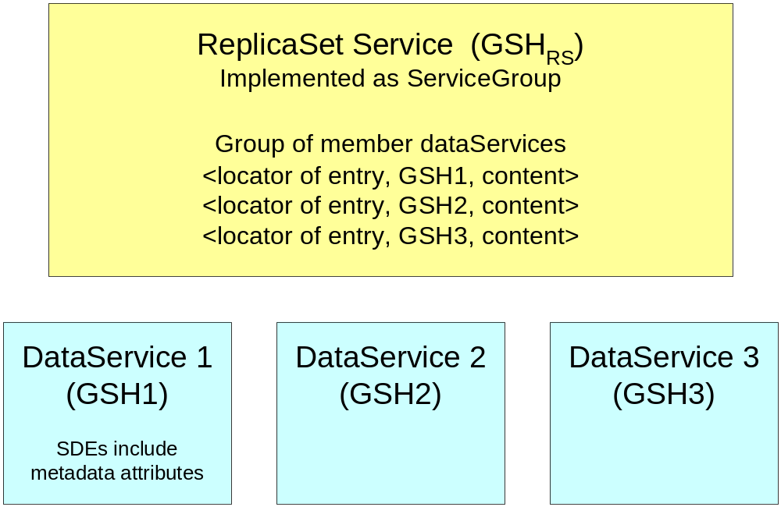
DataServices and ReplicaSet Services
Maps from GSH of ReplicaSet Service to GSHs of member replica DataServices

Slide 11
Policies in ReplicaSet Services
Authorization Policies
  Who is allowed to create a new ReplicaSet
  Who is allowed to add/remove entries from ReplicaSet
Semantic definition of replication
  Byte-for-byte copies (e.g., same checksum)
  Versions
  Copies synchronized within some time frame
  Same content in different formats
How and when replica semantics are enforced
  No enforcement (assume high level of trust)
  Continuous enforcement (maintain consistency)
  Enforce at time new member is added to ReplicaSet

Slide 12
Optional Indexes for ReplicaSet Services
A client may directly inspect a ReplicaSet
  Must respond to queries about its service data, including information about its members
Do not require separate RLS index services from a functionality perspective
Indexes may be useful for availability and performance reasons
  Aggregate information about data services that make up one or more replicaSet services
  Improve availability by answering queries about replicaSet members even if a particular replicaSet service is unavailable due to temporary failure
  Improve performance by allowing bulk query operations on indexes

Slide 13
Designing Indexes
These could also be implemented as ServiceGroups
ServiceGroupEntries would include:
  Locators to member ReplicaSet services
  Content fields that may include handles of data services that are members of the ReplicaSet

Slide 14
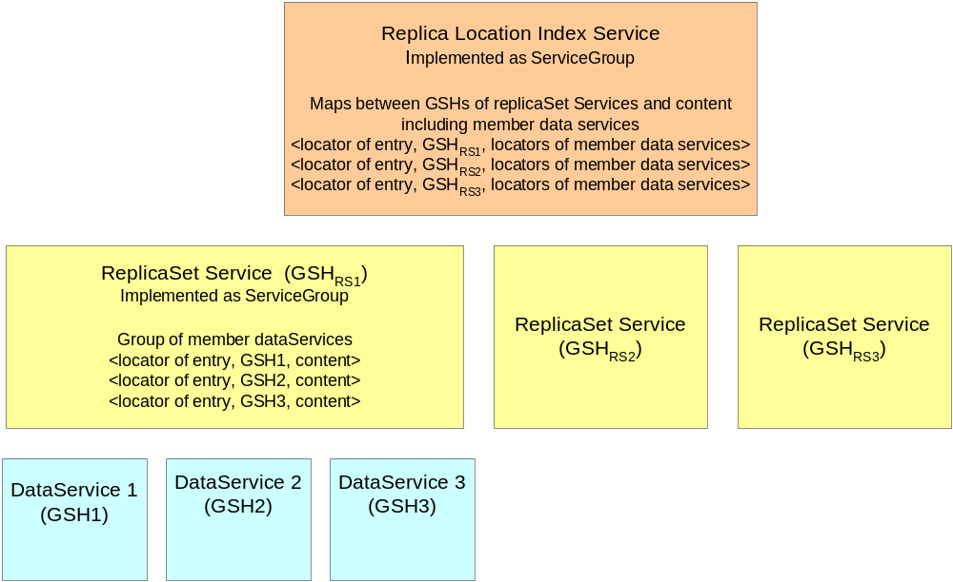
Replica Location Index Service

Slide 15
Scenario for Creating a New Replica and Adding it to a ReplicaSet
Client A invokes data factory port type on an existing data service to create a new derived data service that is a replica of the original
Client A invokes the add operation on the replicaSet
  The replicaSet enforces authorization, semantic and other policies
  If allowed, the new data service is added to the replicaSet service
The replicaSet service may send information about its membership to one or more aggregating indexes

Slide 16
WS-RF and the RLS Specification
Web Service Resource Framework (WS-RF)
  An emerging set of standards for specifying stateful resources in Web service environments
WS-RF standards are intended eventually to supercede the OGSI standards upon which the design of our Replica Location Service is based
In particular, we need to adapt to changes in:
  OGSA Data Services
  OGSI ServiceGroups

Slide 17
WS-RF Issues to Resolve for OREP RLS Specification
1) Data Services changing (Thursday DAIS session)
  Will still exist, but now stateless (no service data)
  Instead of Grid Service Handles, will have WS-Addresses
  Data Services will sit in front of one or more stateful WS-Resources
  WS-Resource properties document associated with a WS-Resource contains state, similar to old Service Data Elements
2) ServiceGroups will still exist but will change
  No specification yet
  Likely will group data services or WS-Resources

Slide 18
An RLS Grid Service Implementation
Prototype implementation in Globus Toolkit Version 3 (GT3) environment
Note that the prototype is a file-based implementation
The specification is NOT file-based
Intention is to generalize the implementation as Data Services become available

Slide 19
Implementation Features
1) Identifying replicated data items
  OGSA Data Services have not yet been implemented in the GT3 environment
  Our implementation uses file URLs as locators for data objects
  Thus, our implementation is file-based, although the specification is general and not limited to files
  When data services are eventually implemented, file URLs will be replaced by the Grid Service Handles or WS-Addresses of data services

Slide 20
Implementation Features (Cont.)
2) Replica Semantic Policies supported by RLS implementation
Policy 1
  GSI Authentication, Gridmap authorization at ReplicaSetFactory and ReplicaSet
  Require replicas to have same checksum as first member added to a ReplicaSet
  Enforce at time of addition
Policy 2
  GSI Authentication, Gridmap authorization at ReplicaSetFactory and ReplicaSet
  No other validation of members added to ReplicaSet
  Assumes a trusted environment

Slide 21
Implementation Features (Cont.)
Policy 1 requires verifying the checksum for the data file before adding it to a ReplicaSet
  Transferring file to local storage
  Performing the checksum calculation
  Determining whether the checksum matches the one required by the ReplicaSet service
  If so, adding the new member to ReplicaSet
  Deleting the temporary copy of the file
Overhead is proportional to the size of the file and can be substantial for large files, as shown in our performance results

Slide 22
Implementation Features (Cont.)
Alternative policy enforcement implementation would allow a client to assert a checksum value for the file
  ReplicaSet only needs to verify that the asserted checksum matches the checksum of master copy
  ReplicaSet must have sufficient trust relationship with the client to believe that the checksum assertion is valid
  We will implement an assertion-based RLS in the future

Slide 23
Implementation Features (Cont.)
When is policy enforced?
Our implementation only verifies checksum when a new member is added to a ReplicaSet
  Thereafter does not enforce consistency
Alternate policies could support stronger consistency
E.g., ReplicaSet must periodically check that its members are replicas according to semantic definition
  Could subscribe to be notified of changes in member data services
  Could perform verification on demand
  If ReplicaSet determines that members are inconsistent, it can remove non-complying members
More enforcement incurs additional overheads

Slide 24
Implementation Features (Continued)
3) ReplicaSet Authorization Policies
Each ReplicaSet determines whether a client is allowed to add or remove ReplicaSet entries
Restrictions based on a Globus grid-mapfile, which specifies the users allowed to add or remove ReplicaSet members
Limitation of current implementation: use a single grid-mapfile for all ReplicaSet instances
  May be preferable to have a grid-mapfile associated with each ReplicaSet instance or group of instances

Slide 25
Implementation Features (Cont.)
4) ReplicaSetFactory
To create a new instance of a ReplicaSet service, a client make a request to a ReplicaSetFactory
ReplicaSetFactory extends OGSI Factory service
ReplicaSet factory determines whether a client is allowed to create a new ReplicaSet instance
Uses standard Globus grid-mapfile
Only users whose DN (Distinguised Name) is contained in the grid-mapfile are allowed to create new ReplicaSet instances

Slide 26
Implementation Features (Cont.)
5) Port types
Extend ServiceGroupRegistration port type to modify add, remove methods
Add function (Policy 1) requires:
  Copying file from remote location to local storage
  Performing MD5 checksum
  Verifying match with ReplicaSet checksum
  Adding member if matches master copy checksum

Slide 27
Implementation Features (Cont.)
6) File transfer method
  GridFTP data transport
  Reliable File Transfer Service
7) Service data and associated methods
  numOfReplicas and GetNumOfReplicas method
  Checksum and GetChecksum method
  GetListOfReplicas: returns a list of file URLs for members of the ReplicaSet
8) Faults
  ReplicaAlreadyExists
  CopyException : due to file permission problems, failure of RFT, etc.
  FileTooLarge: ReplicaSet can configure a size limit

Slide 28
RLS Grid Service Performance:
Time to Add Member to ReplicaSet
File Size | Total Replica Additon Time at Client (seconds) | GridFTP Copy (seconds) | Calculate Checksum (seconds) | Additional Overhead (seconds)
100 MB | 19.32 | 9.75 | 3.02 | 6.55
500 MB | 74.22 | 48.15 | 17.77 | 8.30
1 GB | 143.39 | 97.89 | 38.14 | 7.36
2 GB | 276.34 | 188.5 | 78.89 | 8.95
4 GB | 543.15 | 376.37 | 158.01 | 8.76
10 GB | 1351.38 | 936.78 | 406.45 | 8.15
Transfer and checksum calculation proportional to file size; other overheads fairly constant

Slide 29
Performance Issues
Also in paper: RFT numbers
  For RFT in GT 3.0.2, RFT takes approximately 80% longer than GridFTP
  For RFT in GT3.2, RFT performance is very similar to GridFTP performance
Without checksum verification, adding a member takes about 5 seconds
  GT3 including GSI authentication

Slide 30
Performance Issues
File transfer and verification of checksum are costly operations, especially for large file sizes
By comparison, Policy 2 (no verification) takes 5 seconds to add a member to ReplicaSet
A policy alternative that would incur less overhead would allow a trusted client to assert a checksum
  Service need only verify that the asserted checksum matches the required checksum
Stronger enforcement of replica semantics (e.g., maintaining consistency) will incur more overheads
We will experiment with a variety of semantic and enforcement policies

Slide 31
Future Work on RLS Implementation
More extensive performance measurement of this implementation
  Remove operations
  Queries
  ReplicaSet creation operations
  Wide area performance
Will implement higher-level index described in OREP Specification to provide better availability and performance
Incorporate WS-Agreement in policy specifications
OREP Specification and our implementation will evolve to accommodate WS-Resource Framework

Slide 32
Summary of OREP Activities
Minimal changes in specifications for current meeting (GGF10)
Major work required between now and GGF11 to incorporate WS-RF changes
  Data Services
  ServiceGroups
Will schedule at least one intermediate face-to-face meeting in April or May
  Watch OREP mailing list for scheduling
Will continue with implementation

Slide 33
Future of OREP Group
OREP charter envisions a family of specifications
  RLS is low-level specification that groups together replicas
  Higher-level specifications would provide replica management, consistency, subscription, etc.
Inviting additional participants
Alternative is to allow OREP group to finish after RLS specification is complete
Question of whether a new working group would form an umbrella for current OREP and new Information Dissemination activities

