Slide 1
GLOBALGRIDFORUM.ORG
Grid Scheduling Architecture
RG
GGF10
Berlin
March, 2004

Slide 2
Agenda
  Overview
  Milestones
  Use-Cases
  Existing Components/Services
  Next Steps

Slide 3
GGF Intellectual Property
All statements related to the activities of the GGF and addressed to the GGF are subject to all provisions of Section 17 of GFD-C.1, which grants to the GGF and its participants certain licenses and rights in such statements. Such statements include verbal statements in GGF meetings, as well as written and electronic communications made at any time or place, which are addressed to any GGF working group or portion thereof,
Where the GFSG knows of rights, or claimed rights, the GGF secretariat shall attempt to obtain from the claimant of such rights, a written assurance that upon approval by the GFSG of the relevant GGF document(s), any party will be able to obtain the right to implement, use and distribute the technology or works when implementing, using or distributing technology based upon the specific specification(s) under openly specified, reasonable, non-discriminatory terms. The working group or research group proposing the use of the technology with respect to which the proprietary rights are claimed may assist the GGF secretariat in this effort. The results of this procedure shall not affect advancement of document, except that the GFSG may defer approval where a delay may facilitate the obtaining of such assurances. The results will, however, be recorded by the GGF Secretariat, and made available. The GFSG may also direct that a summary of the results be included in any GFD published containing the specification.

Slide 4
Charter
The goal of this research group is to define a scheduling architecture that supports cooperation between different scheduling instances for arbitrary Grid resources. Considered resources include network, software, data, storage and processing units. The research group will particularly address the interaction between resource management and data management. Co-allocation and the reservation of resources are key aspects of the new scheduling architecture, which will also include the integration of user or provider defined scheduling policies.
The group will begin with identifying a set of relevant use-cases based on experiences obtained by existing Grid projects. Then, it will determine the required components of a modular scheduling architecture and their interactions.
Services and protocols from other GGF groups are
considered as potential basic building blocks of
such an architecture and will be used wherever possible.

Slide 5
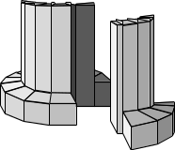
Grid Scheduling Architecture
Grid-
User
Grid-
Scheduler
Other Grid
Services
Local RMS
Local RMS
Local RMS
time
time
time
Schedule
Schedule
Schedule
Resource 1
Resource 2
Resource n

Slide 6
Documents to work on
Requirements of Coordinated Grid Scheduling
  Collect use cases
  Derive requirements
Architecture of Grid Scheduling
  Identify components/services
  Match existing components/services
  Define required interfaces/protocols for scheduling

Slide 7
Milestones for Requirement Document
GGF10:
Discussion on relevant and typical use-cases of Grid scheduling
GGF11:
First draft on requirements.
GGF12:
Presentation of a revised document for public comment.
GGF13:
Final document version.

Slide 8
Use Cases
Review existing GGF use cases
  OGSA: Grid Workflow, ...
  GRAAP: Reality Grid, ...
  other groups?
Contributions
  Migration Use Case (GridLab, K. Kurowski)
  Coordinated Simulation and Visualization (C3-Grid, R. Yahyapour)
  Knowledge Grid Scheduler (DEIS, A. Pugliese, D. Talia)
  Self-Organising GRM (A. Lazarevic, UK UCL, BT ExacT)
Other Projects
  DataGrid, EGEE
  Platform CSF

Slide 9
Coordinated Simulation and Visualization –
Resource Request
A specified architecture with
  48 processing nodes,
  1 GB of available memory, and
  a specified licensed software package
  for 1 hour between 8am and 6pm of the following day
    Time must be known in advance due to interaction.
A specific visualization device (VR) during program execution
Minimum bandwidth between the VR device and the main computer during program execution
Input: a specified data set located at a data repository
at most 10 GGF-$
  preference of cheaper job execution over an earlier execution.

Slide 10
Coordinated Simulation and Visualization –
Scheduled Allocation
time
Data
Data Access
Storing Data
Network 1
Data Transfer
Data Transfer
Computer 1
Loading Data Parallel Computation Providing Data
Network 2
Communication for Computation
Computer 2
Parallel Computation
Software License
Software Usage
Storage
Data Storage
Network 3
Communication for Visualization
VR-Cave
Visualization

Slide 11
Coordinated Simulation and Visualization –
Functional Requirements
Cooperation between different resource providers
Interaction with local resource management systems
Support for reservations and service level agreements
Orchestration of coordinated resources allocations
Automatic handling of accounting and billing
Monitoring
Failure Transparency

Slide 12
Job Migration - Motivation
Why do users need to migrate jobs?
  Running with short queues to complete jobs which take days
  Exploit resources in best way
    Cheapest
    Shortest throughput
    Most efficient
  Changing needs of application
    More/less memory
    More/less disk space
    More collaborative environment
Other reasons
  Resource brokers can make more effective use of systems they manage, e.g. move small jobs to accommodate large ones
  Make use of e.g. workstations when they are idle

Slide 13
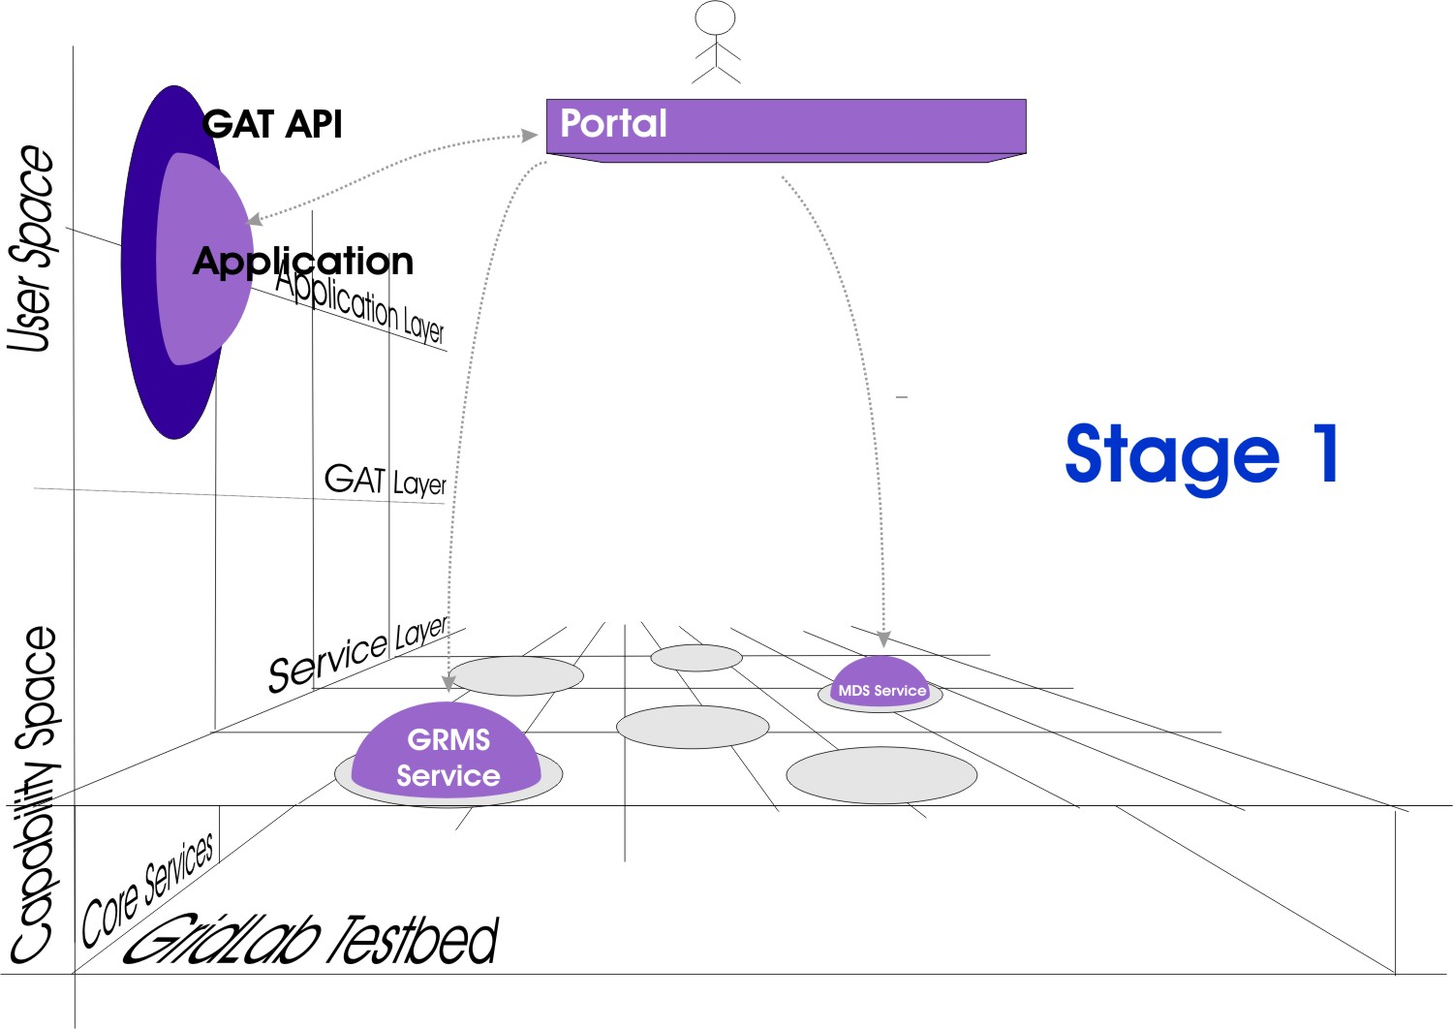
Migration Use Case –
Scheduling Process (1)

Slide 14
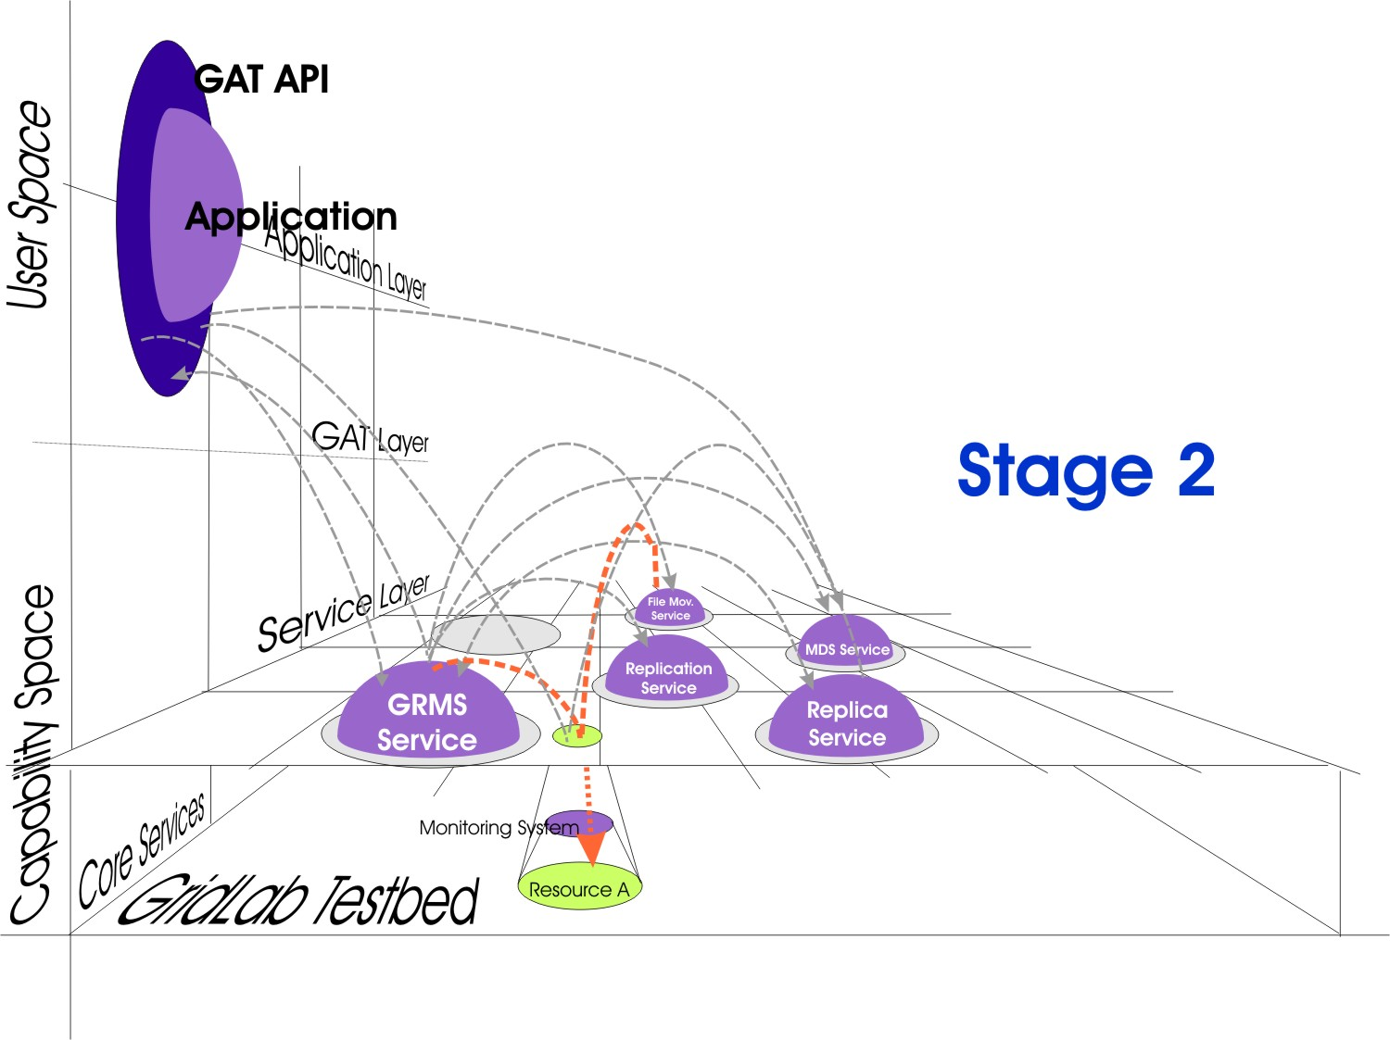
Migration Use Case –
Scheduling Process (2)

Slide 15
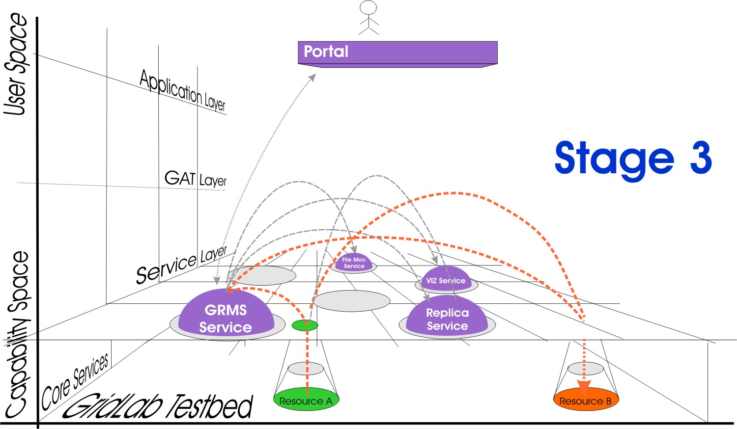
Migration Use Case –
Scheduling Process (3)

Slide 16
Use Case Template
Summary
Customers
Scenario(s)
Involved Resources
Functional Requirements
Workflow of Scheduling Process
Involved Scheduling Components/Services
Failure Considerations
Security Considerations
Performance Considerations
Use Case Situation Analysis
References
derived from OGSA Use Case Document

Slide 17
Milestones for Architecture Document
GGF10:
Discussion on the interaction of existing and currently services under development
GGF11:
Presentation of a first draft.
GGF12:
Presentation of a refined general architecture draft.
GGF13:
2nd draft document including an outline of the individual components.
Discussion on interaction of the
components.

Slide 18
Existing Services/Components
Relevant to scheduling architecture
  Information Service (GIR)
  Job/Workflow Description (JSDL)
  Requirement Description (JSDL, GRAAP)
  Resource Discovery (OGSA, WSRF)
  Reservation (GRAAP)
  Monitoring (OGSI/WSRF, DAMED)
  Job Execution (DRMAA)
  Security (GSI)
  Accounting/Billing (GESA)
  Local RMS (SA)
  Data Management (DAIS)
  ...
Liaison to groups?

Slide 19
Architecture Contributions
Knowledge Grid Scheduler (DEIS, A. Pugliese, D. Talia)
Self-Organising GRM (A. Lazarevic, UK UCL, BT ExacT)
…

Slide 20
Next Steps
Contact more groups to get more use-cases
Setup a team of editors
Regular teleconferences?
...
Join mailing list for discussion:
gsa-rg@gridforum.org

