Slide 1
Grid Transactions BoF
Torsten Steinbach, Dr. Can Türker
IBM Development Lab Boeblingen
GGF10 Berlin, March 2004
© Copyright notice
Most of the material of this presentation is copyrighted by IBM or by others. Please don’t use any of the material of this presentation without checking with the authors mentioned above. Thanks!

Slide 2
Agenda
Part I RG Founding
  Questions about transactions in a Grid
  Charter discussion
Part II Initial Discussion Contribution
  Grid transaction relevant specs
  Transactional processes in OSIRIS

Slide 3
Questions about Transactions in a Grid
For what purpose do we need transactions in a Grid?
What type of transactions do we know?
Do we need tradidional ACID transactions in a Grid and how do they match the Grid philosophy?
Do compensation based transactions provide the better and/or only alternative?
How to address isolation without locking?

Slide 4
The Need For Transactions in Grids
Transactions describe the transitions of states
  GGF proposes stateful resources
  This state is only scoped for a single resource!
E.g. DAIS allows to issue update requests
  Transactions are required to ensure consistency over distributed resources!

Slide 5
Transaction Categorization
By Transaction Scope:
  Per service invocation (nothing new)
  Per resource
    Transaction scope is within the resource!
  Spanning multiple resources
Two well-accepted transaction paradigms
  Traditional ACID (typically ensured by locking and/or versioning)
  Long-running transaction (compensation based)

Slide 6
Distributed ACID Transactions
Locks are typically placed in resource to ensure isolation
Two Phase Commit (2PC) protocol typically employed to ensure atomicity behavior
2PC is a blocking protocol !
  Resource is blocked between prepare and commit operations
ACID Transaction
1. Prepare
2. Prepare
4. Commit
3. Commit

Slide 7
Distributed “Business“ Transactions
Actually intented for long-running transactions
No locks held in resource
Semantic atomicity typically ensured by explicitly compensating changes in case of a failure
E.g. (“Hello World“ of business transaction):
Business Transaction:
Travel Booking
1. Reserver room
3. Book Flight
6. Compensate:
Cancel
reservation
5. Compensate:
Cancel
reservation
!
2. Reserve
Car
4. Fault: No more
flights available
Hotel Booking Service
Flight Booking Service
Car Rental Service

Slide 8
Concurrent “Business“ Transactions
ACID - What about the “I“ ??
With plain compensation there is only Dirty Read isolation!
  And even Lost updates are possible
Is this acceptable ?
  Resovlable by semantic concurrency control?
  (see later)

Slide 9
It‘s about a Tradeoff & Compromising
“Traditional ACID Transaction“
Compensation based
transactions
Do & Lock
Do & Commit
(Compensate)
?
Do & Commit
Do & Lock
T
T
(Compensate)
Do & Lock
Do & Commit
(Compensate)
Unlock all
Lost Update
Loosely coupled
Dirty Read
Tightly coupled
Isolated
Low impact on
application logic
Compensation logic
must be defined
Easy to rollback
Rollback has limitations

Slide 10
Approaches to Transaction Isolation for Compensation Based Transactions
Collaborative Locking
  Dedicated locking service (WS-Locking☺)
  Locking service reference propagated with each service invocation (mayby by extending coordination context ?)
  Services/Resources support the concept by aquiring and freeing locks in the service
Versioning
  Either as a QoS of resources
  Or via dedicated version registry service
Multilevel Transactions

Slide 11
Where to start with?
Stack of Transactional Specs
Transaction Demarcation
e.g.:
BPEL4WS
Transaction Protocols
e.g.:
WS Coordination
WS AtomicTransaction
WS BusinessActivity
Grid Services pariticipating in transactions
e.g.:
DAIS

Slide 12
RG Charter Discussion
Purpose of the group
Milestones & Deliverables
Working mode
Relationship with other groups

Slide 13
Purpose of the RG
Explore transactional approaches in Grids
Discuss to what extend traditional and existing transaction technology is appropriate for Grid systems
Formulate new requirements

Slide 14
Milestones & Deliverables
Informational Paper
  Editors/Authors?
Workshop at GGFxx
Evaluate and propose strategy to create/extend appropriate specifications

Slide 15
Working Mode
Mailing List
Phone Calls
Chairs? Secretary?
Meetings

Slide 16
Relationship With Other Groups
DAIS
Workflow
:

Slide 17
Initial Discussion Contribution:
Some Web Services Specs relevant to Grid transactions
... and some ideas

Slide 18
Stack of Transactional Specs
Transaction Demarcation
e.g.:
BPEL4WS
Transaction Protocols
e.g.:
WS Coordination
WS AtomicTransaction
WS BusinessActivity
Grid Services pariticipating in transactions
e.g.:
DAIS

Slide 19
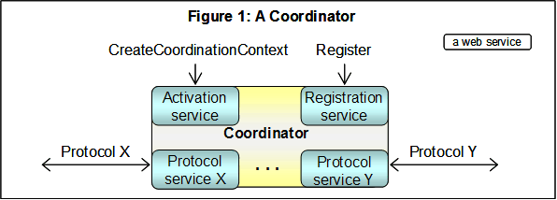
WS-Coordination
Coordination service (or coordinator) consists of the following component services:
  Activation service
    Enables an application to create a coordination instance/context
  Registration service
    Enables an application to register for coordination protocols
  Coordination type specific set of coordination protocols
Taken from
WS Coordination
Specification
All rights reserved

Slide 20
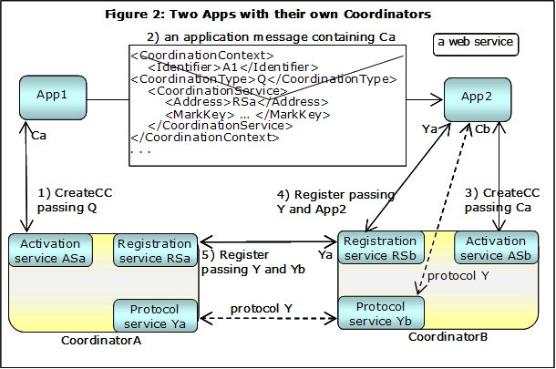
Coordination Example
Coordination context is sent with each service invokation
Taken from
WS Coordination
Specification
All rights reserved

Slide 21
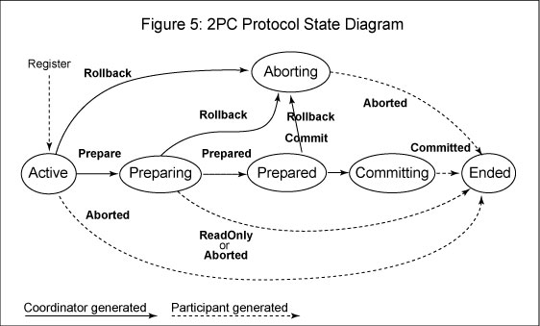
WS-AtomicTransaction
Specifies the coordination protocols for ACID style transactions
  Completion
  CompletionWithAck
  2PC
  Phasezero
  OutcomeNotify
http://schemas.xmlsoap.org/ws/2003/08/wsat/wsat.xsd | .wsdl
Taken from
WS AtomicTransaction
Specification
All rights reserved

Slide 22
WS-BusinessActivity
Intended for long running (business) transactions
State transitions are reliably recorded
  E.g., on stable storage or redundant systems
  Including application state and coordination metadata
Request messages are acknowledged
  So that problems are detected as early as possible
  Avoids executing unnecessary tasks.
  Detecting a problem earlier means fixing it is easier and less expensive
Response is defined as a separate operation instead of the output of the request.
  If the response is not received after a timeout, it is resent until a response is received

Slide 23
WS-BA Coordination Protocols
BusinessAgreementWithParticipantCompletion
  Nested scope participant registers for this protocol with its parent scope coordinator, to be managed
  A nested scope must know when it has completed all work for a business activity
BusinessAgreementWithCoordinatorCompletion
  Nested scope participant registers for this protocol with its parent scope coordinator, to be managed
  A nested scope relies on its parent to tell it when it has received all requests to perform work within the business activity
http://schemas.xmlsoap.org/ws/2004/01/wsba/wsba.xsd | .wsdl

Slide 24
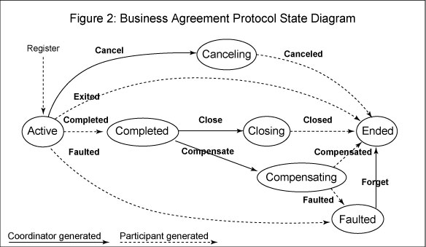
WS-BA Transaction Handling
Transaction Rollback is achieved via Compensation
  State diagram of
  BusinessAgreement
  WithParticipant
  Completion
  protocol
Need a tool to model business transaction demarction
        BPEL4WS
Taken from
WS BusinessActivity
Specification
All rights reserved

Slide 25
What Is BPEL4WS?
Web services composition language
  Composes Web Services
  And creates higher level Web Services
Builds on WSDL
  All external interactions of the business process occur through Web Service operations
What is a business process?:
  Potential execution order of operations from a collection of Web services
  The data shared between these Web services
  Which partners are involved and how they are involved in the business process
  Joint exception handling for collections of Web services

Slide 26
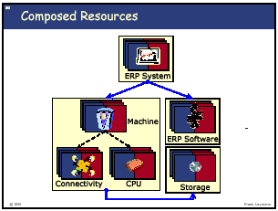
Why BPEL4WS is relevant
Has potential for being the “Grid Language“
  Programming language constructs
    Variables (“Container“)
    Flow control
    Exception handling
  Instead of methods/functions it calls Web Services
  Allows for modularization:
    A BPEL flow can be again a composite Web Service
      Aggregation
<receive>
<reply>
<invoke>
<assign>
<throw>
<terminate>
<wait>
<empty>
<sequence>
<switch>
<while>
<pick>
<flow>
<scope>
<compensate>

Slide 27
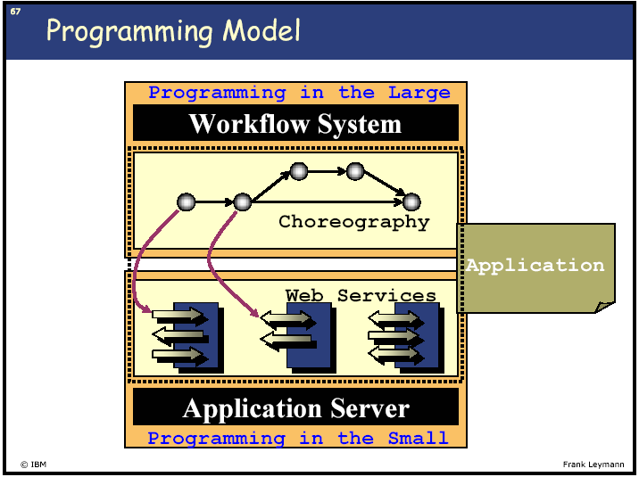
The Mission of BPEL4WS in a Grid

Slide 28
DAIS & BPEL4WS
Choreographing the access to disparate data services can be modeled as a BPEL flow
  A complex Data Grid Query is written in BPEL
  This BPEL takes the role of the Access Plan in conventional database systems

Slide 29
BPEL4WS Transactions Demarcation
Scope construct allows to group activities
To delineate process execution sections
    <Scope standard-attributes>
    <faultHandlers>? . </faultHandlers>
    <compensationHandler>?
    <Process>
    </compensationHandler>
    Activity
    </Scope>

Slide 30
Distributed ACID Transactions
According to X/Open Distributed Transaction Processing Specifications:
Application Program (AP)
RM Interface
(e.g. JDBC or DAIS)
TX
Resource
Managers (RM)
Transaction
Managers (TM)
XA
e.g. database

