Slide 1
OGSA Data Architecture
Dave Berry, NeSC
Andrew Grimshaw, U. Virginia

Slide 2
Process overview
OGSA v1.0, GGF11 (GWD-I)
Query
Services
DAIS-WG?
Data Design Team
(OGSA-WG)
Created GGF10
Replication
Services
OREP-WG?
Use Cases
Capabilities
Architecture
Remote File
Access
GFS-WG?
OGSA Use Cases
(v2.0, GGF10)
(v??, GGF??)
OGSA v??
(GWD-R)
Notes:
Initial group shows flow of work from use cases to detailed definition.
Second through fourth groups show the documents describing the first three stages. Black font means published documents; Grey font means still to be written.
Fifth and sixth groups show the groups working on the various activities. WGs have a question mark in case they don’t sign up to this.

Slide 3
Use Cases
OGSA Use Cases document
  Service-Based Distributed Query Processing using OGSA and OGSA-DAI
Informal presentations (to be written up)
  Business Intelligence & Customer Data
  Data Grid Provisioning Data to Cluster-Based Analytical Application
  Physics Analysis
  Medical Imaging
  Data Distribution
  Background Data Capture & Processing
  Data Warehouse Processing
  MIS Reporting,Analysis and Interpretation
  OLTP – Sales Order Entry

Slide 4
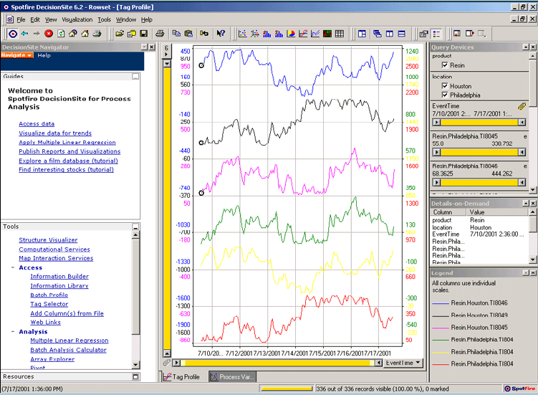
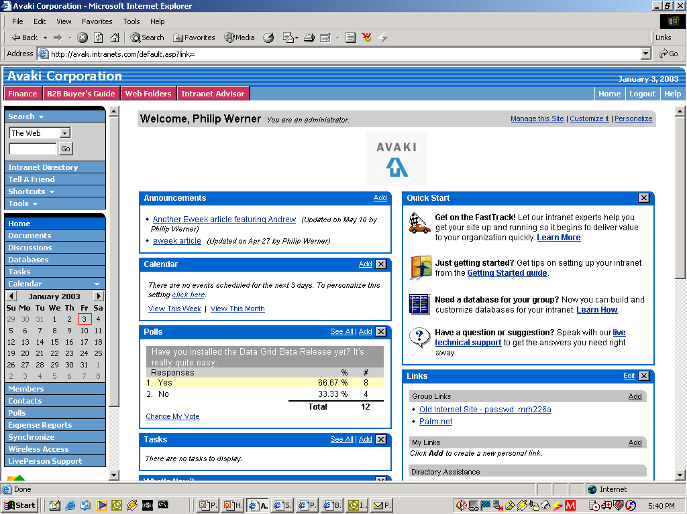

Business Intelligence &
Customer Data
Customer Data
Customer Order Information
Oracle
SAP
DB2
Siebel
SQL
Stored
Procedure
XSLT
XML
XSLT
Results
XML
Results
XML
Data Grid
Company wants real-time integrated view of customer buying behavior
Data resides in various distributed CRM & ERP systems
Grid allows developers and apps to access and integrate customer data sources together in real time--across many distributed databases
Customer
Support
Web-based
Dashboard
(Identifies Likely
Buyers of New Product)
VP Marketing
Notes:
Here’s an example of how a company can use Avaki Data Grid to integrate data from multiple systems. In this case, a large, distributed insurance company has customer, policy, and claims data in a number of individual systems that support different product lines. Marketing specialists and other business managers need integrated views of this information that will help them enhance the company’s marketing strategy, such as: all the different policies held by a single customer, all the different customers from a single geographic location, and so on.
This diagram shows two systems that have customer data. In this case, Avaki is used as a netural integration layer that can take data out of both the Oracle and DB2 databases that are supporting two different applications, and also some data out of a file server, and combine all this data for use by a marketing dashboard and a business intelligence application. XSL transformations are used to provide the data in a particular XML format that is used by the application.
In the data grid, an architect can specify the sequence of transformations and updates that ultimately create the views of the data required by the business analysts. In this case, no intermediate data mart or data warehouse is needed.
By deploying a data grid, the company has eliminated the need for users to access remote databases directly. Instead, users sign onto their local systems and are automatically able to access data via the data grid. This saves significant time for the DBAs who manage each database; they no longer have to manage remote user access, and need only specify who should have access to the data objects that represent their data. Data is not moved and does not leave their control.
The IT organization, which thought it might have to create a data warehouse, now has a low-overhead infrastructure for making data available to users and applications for analysis. With this infrastructure in place, data owners and developers can meet requests for additional data more quickly.
Through the data flow definitions and cache configurations, architects can “dial” the freshness of the data to meet business requirements. Static reference data does not need to be updated at all, while customer data is updated frequently enough to show recent selling trends. As a result, the organization has fresher, more accurate data from which to make important business decisions.

Slide 5

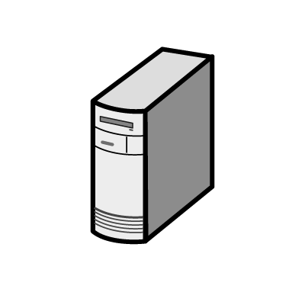
Data Grid Provisioning Data to Cluster-Based Analytical Application
R&D
West Coast
Engineering
East Coast
QA/Testing Outsourcer India
Data Grid
Data Grid
Data Grid
Company has centralized HPC cluster running compute-intensive applications
Source data for analyses distributed among 3 global sites, one of them an external partner
Highly manual data-sharing processes increase costs/errors, and hinder time-to-results
Grid enables secure, automatic provisioning of remote data to HPC cluster—feeding CPUs more data faster
Headquarters
Illinois
Forward Proxy Data Caches of Remote Data
Data Grid
Analytical
Applications
Centralized
Compute Cluster

Slide 6
Physics Analysis
Analyzing HEP data involves
  A (group of) researchers with an algorithm
  A set of selection criteria on metadata to identify the data to be analyzed
Metadata Catalogs
  Identify a dataset based on a metadata query
Data is stored in files.
  The user navigates in a logical namespace, like a local filesystem
  The algorithm may need to access files based on the calculation, so the dataset that the analysis runs on is not always fully determined by the metadata query
  Might need to access data that is initially remote (co-locating data and computation is not always possible as a preparatory step)
  Large number of data files to be managed (10¹²)

Slide 7
Medical Imaging
Diagnosing based on sensitive patient data
  Users: a (group of) doctor(s)
  Retrieve an image, run algorithm, examine result and write diagnosis, maybe re-run another algorithm.
Secure Data Retrieval
  Patient data is sensitive, needs to be kept anonymous at all times
  Site admins are not trustworthy – strip or encrypt patient data from image
  Image in database or secure data store ready for retrieval
  Replication of data not always allowed
High security needs
  Strong authorization
  Fine-grained access control mechanisms
  Leaking patient information results in prosecution.

Slide 8
Data Distribution
Trigger-based Data Distribution
  Users: a (group of) scientists
  Have automatic delivery of data at many sites based on some criteria
Trigger may be
  An Event in the local Store, Catalog, Monitor, …
  Cron-like events

Slide 9





Background Data Capture & Processing
Data Sources
Raw & Existing Data Processing
Data
Streaming
Reference Data
Archive
Multi-stage
Processing
Staging
Processed
Data
Bulkload of
raw data
Audit Trail
Temporary
Storage & staging

Slide 10
Data Warehouse Processing
Reference Data
Data Warehouse
Staged
Data
Summarised
Data
Operational systems
Local/ remote
replication
Local/Remote extraction
Deliver & load
Insert
Extract
Validation
Merging
Transformation
Detailed
Data
Archive
Aged
Data

Slide 11


MIS Reporting,Analysis and Interpretation
Specification
& result review
Reports
Temporary Data
Data
Manipulation
Extraction and integration
Summarised
Data
Data in
operational systems
Remote
Data
Detailed
Data
Drill down to detail
Data Warehouse

Slide 12
OLTP – Sales Order Entry
Delivery
notification
Enter customer information
Order Entry
Delivery
notification
Receive
order from
Customer
Enter
new/update customer
information
Create/ modify
order
Enter/ modify
item lines
Submit
order
Validate
address
Validate
product & price
Adjust
inventory
Validate
product & price
Check
inventory
Check
inventory
Distributed
Transaction
Sub-second responses
1000’s of concurrent:
- users
- processes
field level validations
small insert/update transactions
Local
data
Check customer
credit rating/
validate card
Adjust
inventory
External
data

Slide 13
Capabilities
OGSA v1.0
  Types of data resource
  Data virtualisation
  Functional capabilities

Slide 14
Types of Data Resource
Flat files
Streams
DBMS
  Relational, XML, OO
Catalogues
Derivations

Slide 15
Data Virtualisation
Abstraction
Federation
Transformation
etc.
Client
Client API
Data
Service
Implementation
Data Service API
“Primitive”
Data Sources
Other Data
Services

Slide 16
Functional Capabilities (1)
Virtualisation,
  Transparency
  Layered interfaces (for “under the hood” access)
Interface to “legacy” APIs
Data Management
  Transfer, caching, replication, …
Queries
  SQL, XQuery, Regexp, …
  Synchronous / asynchronous
  Deliver results to client or third-party

Slide 17
Functional Capabilities (2)
Transformation
Update
Security mapping
Data resource configuration
Metadata management
Provenance

Slide 18
Architecture
Key non-functional properties?
  Scalability in several dimensions
    e.g. large data sets, large number of data sets, size of data flows
  Support for multiple/variable levels of coherency
    for replicated/federated data
  Composability
    minimising unnecessary movement of data
Notes:
These are taken from the most recent design team telcon.

Slide 19
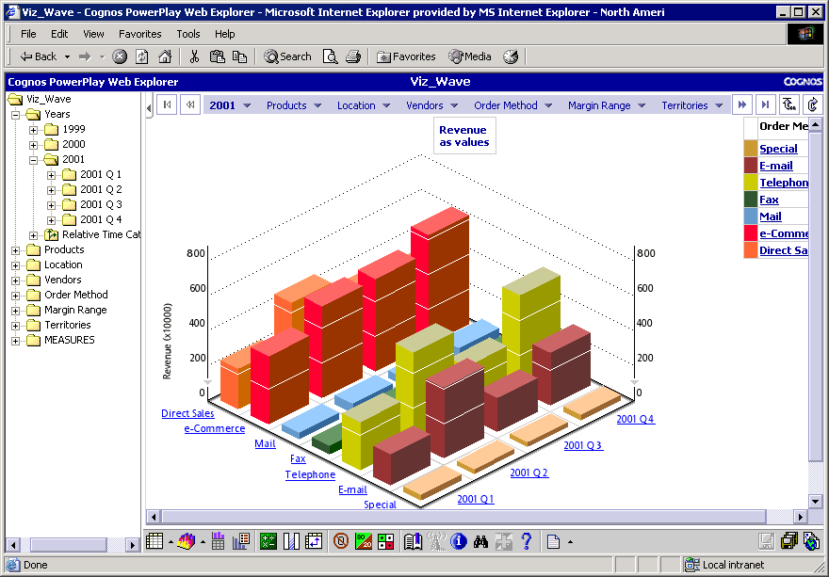
Three Layer Architecture
ETL
Data
Catalog
Access
Profiling & Quality
XML Mapping
Integration
Development Tools
Metadata Registry
Provision
Distributed Query
DATA GRID
Additional & 3rd Party Data Integration Capabilities
Core “Data Service Layer”

Slide 20
EGEE Data Service Interfaces (1)
Storage Element
  SRM interface (GSM-WG)
    Manage a Storage Resource
    Space reservation
    Put and retrieve files using various protocols
  Posix-like File I/O
    Most posix-compliant feature support
    Abstraction over existing MSS IO mechanisms
File Catalog
  Management of the logical namespace
Replica Catalog
  Tracking of file replicas
Metadata Catalog
  Application metadata

Slide 21
EGEE Data Service Interfaces (2)
Data Catalog
  Added functionality by orchestration of the 3 catalogs (providing transaction safety)
File Transfer Service
  Reliable Transfer of files between two sites
  Pre- and post-processing hooks
File Placement Service
  Transfer and register files
  Orchestrate File Transfer and Data Catalog services
Data Scheduling Service
  Event-based data transfer, using File Placement Service

Slide 22
Questions?

