Slide 1
GSA Use Case -
GRASP: Grid Resource Allocation Services Package
Jaegyoon Hahm
Supercomputing center, KISTI

Slide 2
Grid Resource Allocation Services Package
GRASP is
  A package of Grid services which are related to resource allocation process in Grid
  A tool for users to submit jobs easily to Grid environment
Main Features
  Resource brokering
  Co-allocation (cross-site MPI-based job execution)
  Fault tolerant job execution system
  OGSI-compliant (based on OGSI implementation of GT3)
Notes:
GRASP stands for Grid Resource Allocation Services Package.
I think you might guess it from the name,
GRASP is a package of Grid services which are related to resource allocation process in Grid.
And the services are developed based on OGSA.
And we hope that GRASP would help users to submit their jobs easily to Grid environment.
For this reason, we have developed collective layer services as well as resource layer services.
Features of GRASP is
Resource brokering,
Global scheduling,
Co-allocation,
And fault tolerant job execution.
Especially, we made it possible for mpi job to be run on multiple resources crossing resource boundary.
And we have developed the services based on OGSI implementation of GT3.

Slide 3
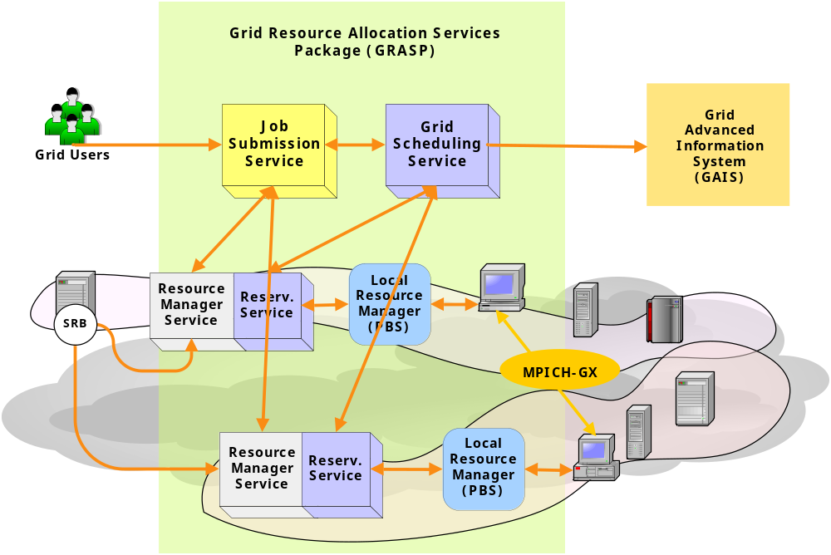
GRASP Architecture

Slide 4
GRASP Services
Job Submission Service
  Job submission
  Co-allocation
    Job type: HTC, HPC, and Hybrid type
    Coordinate MPICH-GX initialization
  Job monitoring & controlling
  Fault tolerance for a MPI-based job
    Central management among resources joining a computation

Slide 5
GRASP Services
Grid Scheduling Service
  Resource discovery
  Queuing & Scheduling
Resource Manager Service
  Gridifying of computing resources
  Immediate reservation
  Fault tolerance for a MPI-based job
    Detection and handling of the faults of the computing nodes and subjob processes

Slide 6
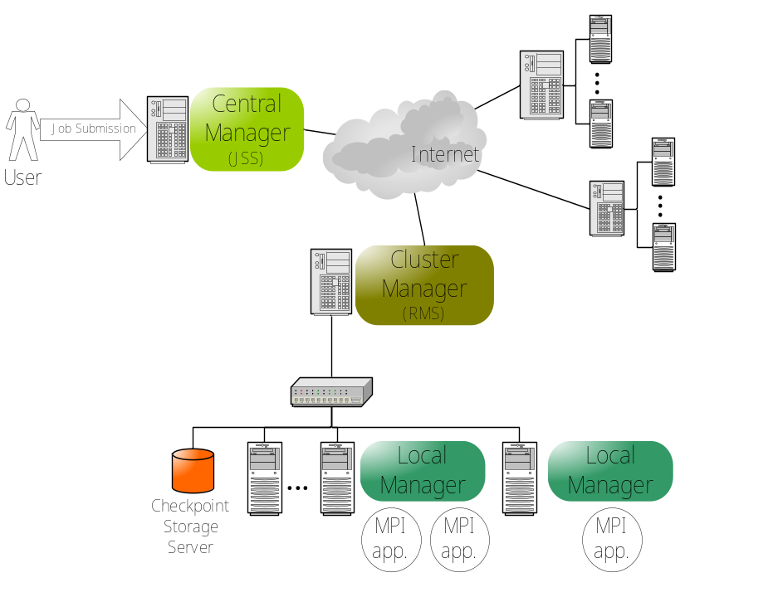
Fault Tolerant Job Execution System
Fault Tolerant System
  Automatically resume the job which stop abnormally
  Hierarchical job recovery mechanism
Notes:
Fault tolerant system is for automatic resumption of the job shich stop abnormally.
When the job stops while running on a cluster, it detects the fault, and move the code to another computing node,
And resume running of job.
It uses check pointing mechanism to save the state of the job.
And if whole cluster died, and job stops, it can select another resoruce and move the jobs, and resume.

Slide 7
Thank You

