Slide 1
Overview of OGSA Information Services
Abdeslem DJAOUI
Rutherford Laboratory
OGSA-WG session #1, GGF11
June 7, 2004

Slide 2
What do we mean by information
The term is used generically to refer to
  Any data used for the following:
    Discovery
    Monitoring
    Logging
  Any data related to:
    Resources (storage, networks, …)
    Services
    Applications
Does not cover higher capabilities (e.g. accounting, auditing, …)

Slide 3
Design work over last 6 months
Many common features identified early
  Proposed services could build on top of common features
  Factoring out exercise
Difficulties appeared
  Semantics are harder to factor out than technicalities
  Legacy systems must be supported
Many OGSA information services
  Promote generality when possible

Slide 4
Models and concerns
Producer/Consumer paradigm:
  One or more producers wish to send information to one or more consumers
  One or more consumers wish to obtain information from one or more producers
Many implementation Data models/Query languages:
  XML/Xpath Xquery
  Relational/SQL
Interoperability concerns:
  message schema
  Producer/consumer description and discovery

Slide 5
Additional properties
Security
QOS
  Reliable delivery
  Availability
  Performance
  Scalability

Slide 6
Relation of information services to rest of OGSA
Make use of:
  WS-Notification
  Data access, distributed query processing
Used by:
  Execution Management Services
  problem determination services
  resource reservation services
  resource usage services
  application monitoring services

Slide 7
WS-Notification: pub/sub model + topics
DIRECT NOTIFICATION:
Information flow
NotificationProducer
Topics
Distributes messages
Subscriber
Subscription
NotificationConsumer
Receives messages
BROKERED NOTIFICATION:
NotificationBroker
    Possibly additional capabilities (finder service)
    Possibly added value functionality (Topic transformations)
Subscription
Subscriber
PublisherRegistartion
Publisher
NotificationConsumer
Receives messages

Slide 8
What’s missing from WS-N
Ability to subscribe/Query old (historical) data.
Deal with case when client consumer is not a web service (similar to publisher/NB/ PublisherRegistration)
How consumers, producers and NotificationBrokers find each other.
QoS

Slide 9
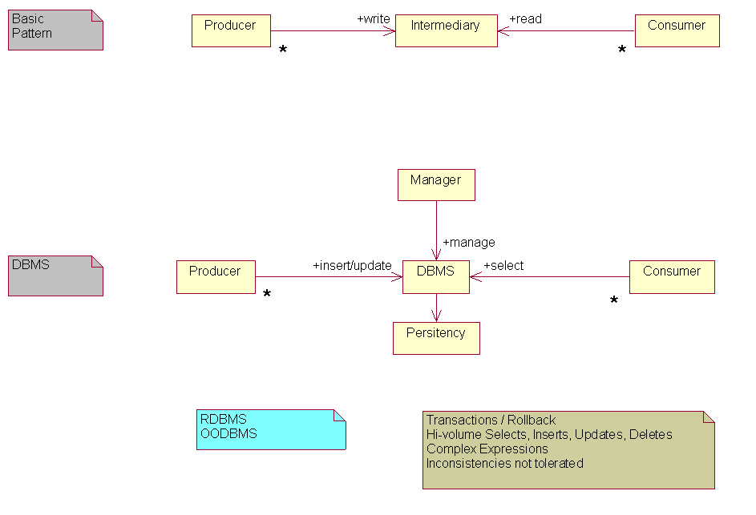
Producer-Intermediary-Consumer pattern

Slide 10
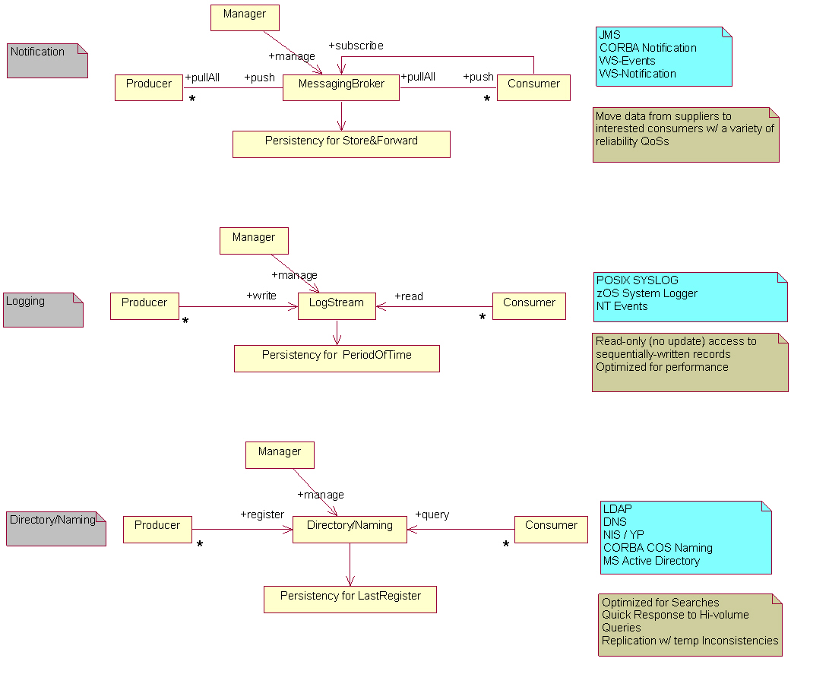
Infrastructure capabilities

Slide 11
Basic Information services
Discovery (services and resources):
  Registry (UDDI)
  Index (Google)
  P2P
Logging
  Message exchange optimised for performance and log records kept in a persistent store for a period of time
Message delivery
  Message Broker/Notification
  One time query/response
Monitoring
  Information carries a timestamp
  High performance/high update rates desirable

Slide 12
More General Info Services
Being limited to a single capability can result in a very specialized service applicable a subset of information use cases.
Analysis of the OGSA use cases reveals that a service that is based on a combination of capabilities is often desirable (see scenarios in OGSA document)
Both directory and notification capabilities are relevant for Grid Monitoring Architecture (GMA) for example.

Slide 13
How GMA separates information discovery from transfer
GGF document GFD-1.7
Directory:
Registry
and Schema
Producer
metadata
Consumer
metadata
Producer:
sends
Messages
Messages directly from P to C
Consumer:
Receives
Messages
C
P

Slide 14
Other OGSA services may extent or use information services
Service A extents or uses producer service
Service C extents or uses consumer service
Service B extents both producer and consumer service
A
B
C
OGSA
Services
extent
use
Platform
Services
Producer
Intermediary
Consumer
WSRF/WS-Notification

Slide 15
Summary
OGSA information services address the following capabilities (or a combination of them): Discovery, message delivery and Logging
Defining services for basic capabilities only, could result in a set of fragmented info systems able to answer only a limited number of use cases
  GMA based information services can be seen as:
      discovery (producer consumer finder) part
      message delivery/brokering part
OGSA-wg need to address
  Technical interoperability
    Standard schema
    Producer/consumer descriptions and discovery
  Semantic interoperability

Slide 16
Related activity in GGF
Logging-WG
Information Dissemination-WG
DAMED-WG (Discovery And Monitoring Event Description)
CGS-WG (CIM-based Grid Schema)
RGIS-RG (Relational Grid Information Services)

