Slide 1
OGSA Security Services
OGSA-WG Architecture
GGF11
June 7, 2004
Frank Siebenlist (ANL)
Takuya Mori (NEC)

Slide 2
OGSA Security Services Section
Outline
Introduction
Objectives
Model
Functional Capabilities
OGSA Services interaction
Where are we?
Next Steps
Summary

Slide 3
OGSA Security Services Introduction
OGSA Security
  Make interactions between OGSA-compliant components “secure”
  ???
OGSA Security and Web Services Security
  Same requirements – different focus
Focus on requirement from the OGSA use cases
  Grid applications are all about collaborations
  … across organizational boundaries

Slide 4
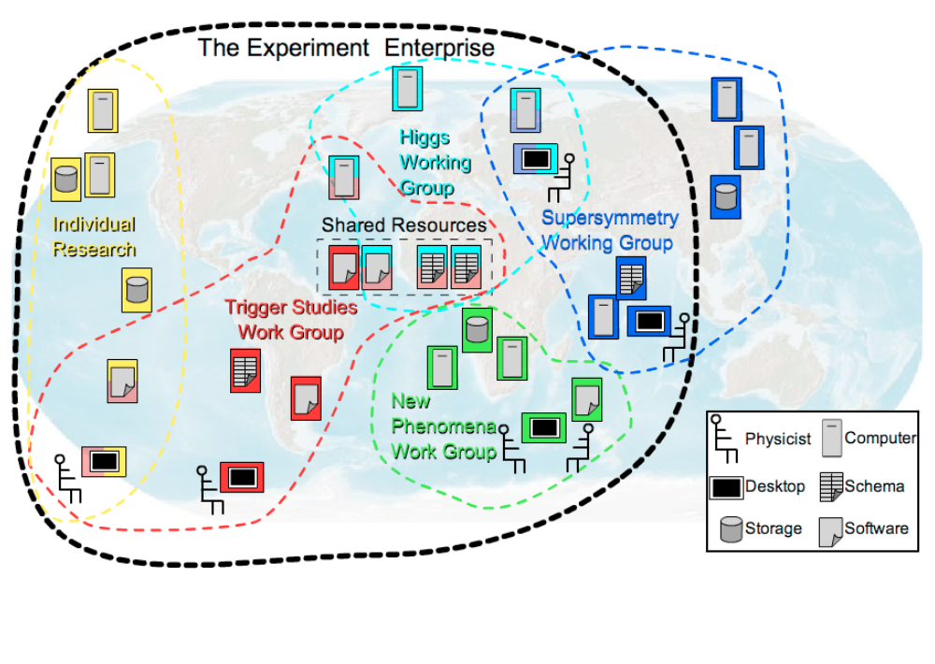
Objective:
Enable Cross-Organizational Collaboration

Slide 5
OGSA Security Services Objectives
It’s all about “Policy”
  (Virtual) Organization’s Security Policy
  Security Services facilitate the enforcement
Security Policy to facilitate “Business Objectives”
  Related to higher level “agreement”
Security Policy often delicate balance
  More security ⬄ Higher costs
  Less security ⬄ Higher exposure to loss
  Risk versus Rewards
  Legislation sometimes mandates minimum security

Slide 6
Security Services: Model
Lowest level: cryptographic primitives
  Public keys – shared secrets
Highest level: policy in natural language
  Policy expressed in as high an abstraction level as possible (names/groups/roles/…)
Facilities to map/translate/federate primitives in to higher levels of abstraction
  Key => name => group/role
  Name => name
  Group/role => group/role
  Keys => … => name/role used in policy expression
  to determine compliance and to enforce that policy

Slide 7
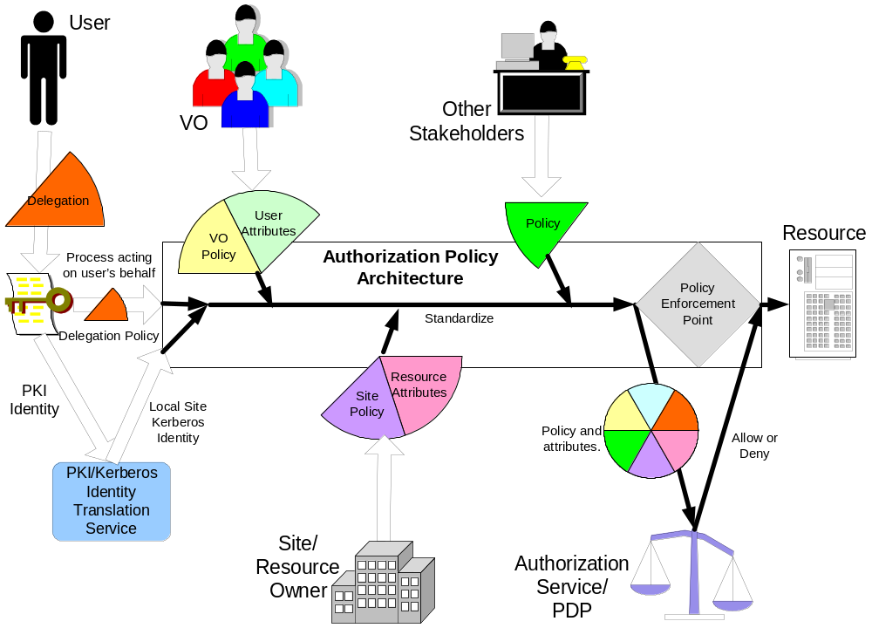
Policy Decision and Enforcement Example

Slide 8
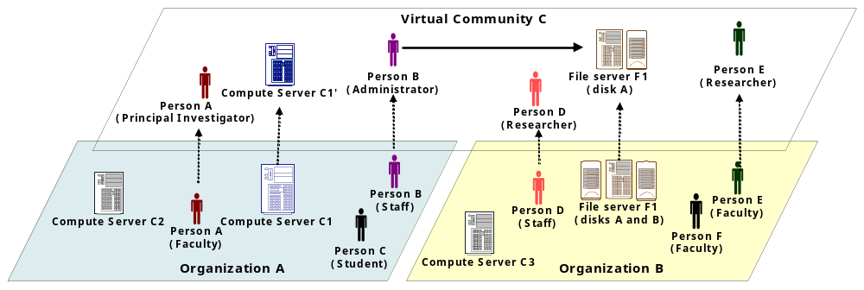
Virtual Organization Concept

Slide 9
Agreement ⬄ VO Security Policy
(Business) Agreement
Dynamic
VO Security Policy
Price
Cost
Obligations
QoS
T&Cs
……………
Security
……………
members
resources
roles
Attribute mgmt
Authz mgmt
Static Initial
VO Security Policy
trust anchors
(initial) members
(initial) resources
(initial) roles
Access rules
Privacy rules

Slide 10
Functional Capabilities
Authentication service:
An authentication service is concerned with verifying proof of an asserted identity.
Identity mapping service:
The identity mapping service provides the capability of transforming an identity that exists in one identity domain into a identity within another identity domain.
Authorization service:
The authorization service is concerned with resolving a policy based access control decision.
Credential Conversion service:
The credential conversion service provides credential conversion between one type of credential to another type or form of credential.
Audit service:
The audit service is responsible for producing records, which track security relevant events.
Profile service:
The profile service is concerned with managing service requestor’s preferences and data which my not be directly consumed by the authorization service.
Privacy service:
The privacy service is primarily concerned with the policy driven classification of personally identifiable information (PII).
VO Policy service:
The VO policy service is concerned with the management of policies.
…

Slide 11
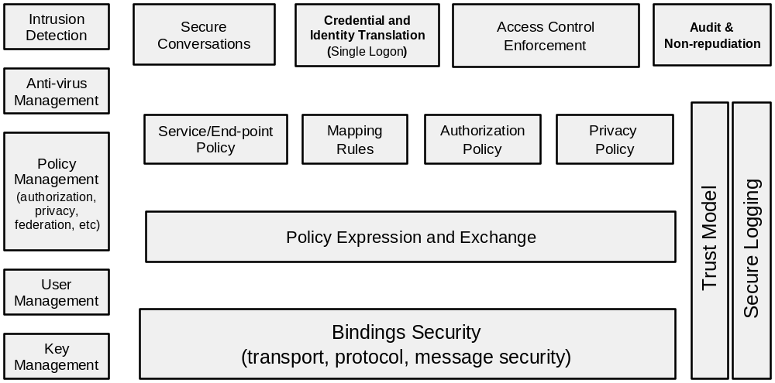
Security Components

Slide 12
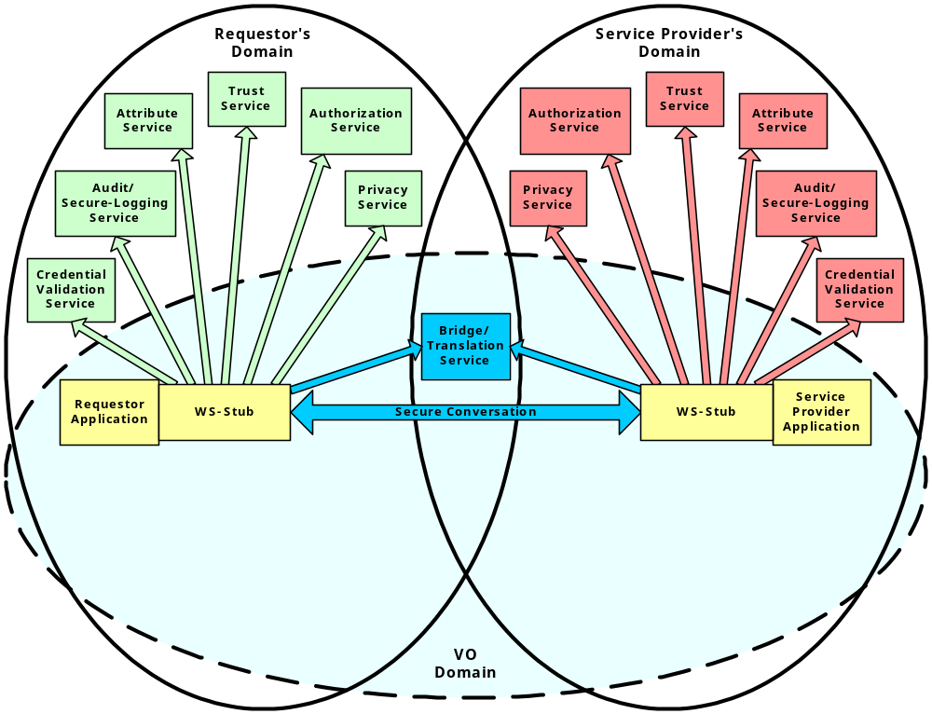
OGSA Security Services call-outs

Slide 13
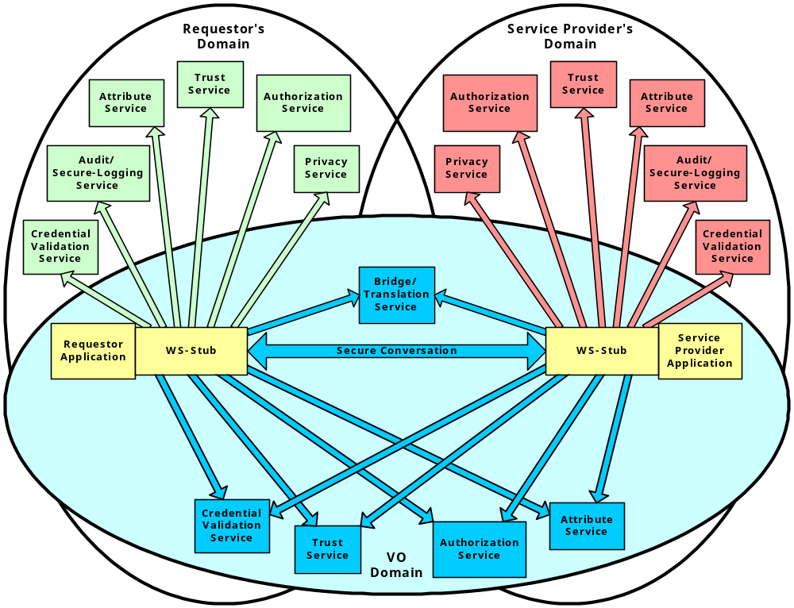
OGSA Security Services with VO

Slide 14
OGSA Services Interaction
All OGSA services layered on Security Services
  All interactions are subject to policy enforcement
OGSA Security Services leverage other Services
  Use of registries/databases/QoS/discovery/migration/
  meta-data-publication/fail-over/mirroring/provisioning/etc.
Security Policy derived from higher level agreements
  Enforcement is means to meet “business” objectives
New agreements subject to governing security policy
  existing access restriction override any new agreement
Security Services can not be seen in isolation!

Slide 15
Where are we?
State of WS Security and “friends”
GGF OGSA Security related WGs
Next steps

Slide 16
WS Security
Current/proposed WSS-specs
WS-Secure
Conversation
WS-Federation
WS-Authorization
WS-Policy
WS-Trust
WS-Privacy
WS-Security
standardized
SOAP Foundation
proposed
promised

Slide 17
WS Security
(confusing picture)
WS-Privacy
WS-Authorization
WS-Federation
Liberty Alliance
WS-Secure
Conversation
WS-Policy-*
WS-Trust
XACML
SAML
WS-Security
standardized
In progress
SOAP Foundation
proposed
promised

Slide 18
OGSA Security WG
Charter:
  The Open Grid Services Architecture (OGSA) is a proposed Grid service architecture based on the integration of Grid and Web Services concepts and technologies.
  The purpose of the OGSA Security WG (OGSA-Sec) is to enumerate and address the Grid Security requirements in the context of the OGSA. The primary outcome will be two documents:
  "The Security Architecture for Open Grid Services":
    This document will describe a security architecture intended to be consistent with the security model that is currently being defined for the Web Services framework used to realize OGSA's service-oriented architecture.
  "OGSA Security Roadmap":
    This document is a roadmap enumerating a set of proposed specifications to be defined in the Global Grid Forum in order to ensure interoperable implementations of the OGSA Security Architecture.

Slide 19
OGSA Authorization WG
Charter
  The objective of the OGSA Authorization WG is to define the specifications needed to allow for basic interoperability and pluggability of authorization components in the OGSA framework.
  There are a number of authorization systems emerging in the Grid today (Akenti, PERMIS, CAS, VOMS, Cardea, etc.), these specifications will allow these solutions to be interchangeably used with middleware that requires authorization functionality.
  Leverage authorization work that is ongoing in the Web services world (e.g. SAML, XACML, the WS Security suite) and define specification for how these should be used for Grid services.
  Documents:
    Attributes used in OGSA Authorization
    OGSA Authorization Requirements
    Use of SAML for OGSA Authorization

Slide 20
OGSA Security Policy Timeline
VOMS
PERMIS
Akenti
CAS
…
(WSRF)
Authz Svc
Attribute Svc
…
Gridmap file
…
Authorization services
Policy expression
Restricted PC
SAML assertions
WS-Trust
XACML
XrML
…
Authz Policy Language
WS-Agreement
JSDL, Scheduling
…
ProxyCerts
…

Slide 21
Current activities
VO use case example drill-down
  Digital Library
Logging Services
  Important secure logging and audit component
Wednesday 2:30pm: Security use case session
  Use cases that favor the use of bare keys over X.509 certs
  Use cases and requirements for One-Time-Password deployment

Slide 22
OGSA Security: Summary
OGSA Security requirements are “complex”
  Dynamic VO context & life-cycle management
  It’s all about Policy, policy, policy, policy
Web Service Security standards issues
  Not moving fast enough…
OGSA Security efforts need help
  More active participation very welcome…

