Slide 1
GIRAF
Grid Integrated Radius Authentication Fabric
A Whole Bunch of People
GGF-11
June 9, 2004

Slide 2
ESnet PKI One Time Password Support
Grid response to One Time Password Initiative
What can ESnet do to help?
We have capabilities / resources that can help
We have specific expertise to address critical technical, policy, and “social” issues
Notes:
Frame the problem

Slide 3
ESnet PKI team
DOEGrids CA
  Built
  Deployed
  Operate
3 FTE + support
PKI for Office of Science projects
  Primarily Grid ID’s
  Other uses
Federation – community

Slide 4
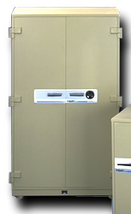

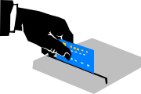
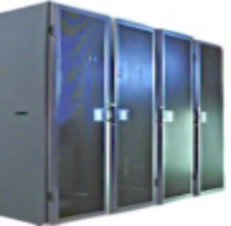
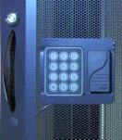

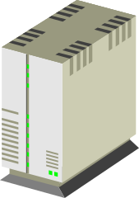
DOEGrids Security
Offline Vaulted Root CA
Grid User
PKI Systems
Hardware Security Modules
HSM
Fire Wall
Internet
Access controlled racks
Secure Data Center
Building Security
LBNL Site security
Intrusion Detection

Slide 5
Features In Depth
LDAP
  Directory of accounts (certificates)
Hardware Security Module
  Move private key to “hardware” domain
  Unique expertise
Support Multiple CA Profiles
  DOEGrids: conventional PKI
  NERSC: Long Term Credential Store CA
  ESnet SSL: Classic SSL server certificates
Statistics
    http://www.doegrids.org/pages/DOEGridsCAStats.html

Slide 6
Federation and Community Leadership
Manage & host DOEGrids Policy Management Authority
  Sets policies for certification in DOEGrids
  Manages membership and domain of services
  Office of Science participating programs have “stake” in CA!
International Grid Federation (see supporting slides)
  Work to establish Asian Pacific Policy Management Authority
  Member of European Data Grid and joined new EGEE Federation
  Joined TERENA Top level CA registry
Experimental OCSP service
  Demonstrate improved certificate validation techniques
  Demonstrate improved delivery of certificate services
Provide NERSC PKI with a secure CA (see supporting slides)
Global Grid Forum – Grid Standards organization

Slide 7
NERSC PKI (2)
To get NERSC PKI accepted Internationally, ESnet established a new process for evaluating CAs
  Draft GGF document on CA profiles
    First submission scheduled for next Global Grid Forum
  Identifies 3 known CA profiles
    Classic PKI (i.e. DOEGrids)
    Large site integrated proxy services (SIPS)
    Credential stores (i.e. NERSC)
  EU Grid Policy Management Authority will contribute to Document.
Service Level Agreement
  Establishes clear operational requirements
Certificate Policy/Certification Practices Statement
  Helping NERSC to produce an internationally approved set of policies and procedures for their CA
Peer with international community
  Establishing NERSC as a full member of the International trust community.

Slide 8
The Grid vs One – Time Password
Why is this an issue for Grids?
What needs to be done?
Some assumptions
  PKI is essential for Grids
  Grids are/will provide value to DOE science
Let’s look at Grid authentication today:

Slide 9
DOEGrids cert workflow
Notes:
This happens exactly ONCE

Slide 10
Certification Process
RA
5. Process CA
DOEGrids CA
4. Notify Approver
Note: This process occurs exactly ONCE
3. Signing Request
6. Certificate / Rejection
1. Generate
7. Export / store / use
Key Generator
Local Storage
2 Key pair
Subscriber

Slide 11

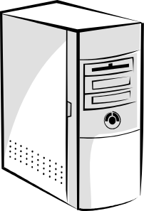

Certificate Request Workflow
1
3
RM Agent
2
4
6
5
7
Subscriber
Registration Manager
PKI1.DOEGrids.Org
Certificate Manager
1. Subscriber request Certificate
2. A notice request has been queued
3. The RA for the Subscriber reviews request – approves or rejects request
4. The Signed Certificate Request is sent to CA.
5. CM issues certificate
6. RM sends Email notice to Subscriber
7. Subscriber picks up new certificate

Slide 12
Grid Authentication Workflow

Slide 13
Grid Proxy Init and Grid Job Execution
Grid Proxy Init
Grid Service
1 Authenticate
2 Ptr to proxy cert
Generate new key pair
3 Execute
4 Receive Job Results
Key Generator
Enable private key
Key Store
Return
Sign Proxy pub key

Slide 14
Gridlogon Response
Notes:
Architectural slide

Slide 15
Grid LOGON
CA
(PDP and PRP)
4a Signing Request
5a Store Long Term Cred
PEP
Manage
Long term
Creds
Long Term Cred
Authentication
Services
2 Ask AuthN
PAM
4 AuthN ok
Manage
myProxy
MyProxy
Credentials
3 Look up
Auth
DB
1 Log in
1A Get Long Term Cred
5 Receive Proxy Cert
PDP and PRP
7 Execute
6 (Opt) Store Proxy

Slide 16
OTP – Token Authentication Workflow

Slide 17
5 Ret user auth info
6 check
OTP Auth
Server
Auth
DB
OTP – Token Authentication Workflow
4 Ask OTP server
7 Return Auth info to Radius
Radius Authentication Server
Application (or NAS)
2 Pass to radius
3 Look up
Radius
Client
8 Return AuthN/Z
OTP
Gizmo
Auth
DB
9 Customer
1 Password dialog
Notes:
http://portmasters.com/tech/docs/radius/securidconfig.html#6583
When SecurID is used with RADIUS, a connection proceeds as follows:
1. A remote user initiates a connection by dialing in to the PortMaster.
2. The PortMaster prompts for the user's username and password.
3. The user enters a username. At the password prompt, the user enters a PASSCODE (PIN followed by the currently displayed number on the token).
4. The PortMaster forwards this information to the RADIUS server for authentication.
5. The RADIUS server examines the users file, scanning for the appropriate username. When the profile is located, it is examined to determine the user's authentication method.
6. When the RADIUS server discovers that the authentication method is SecurID, it forwards the username and PASSCODE to the ACE/Server for authentication.
7. The ACE/Server examines its database for the username and serial number of the user's token. It uses the serial number to verify the PASSCODE entered by the user. It also verifies that the time on the token is synchronized with the ACE/Server.
8. The ACE/Server sends the result of the database lookup (identity verified or not verified) to the RADIUS server.
9. If the user's identity was verified by the ACE/Server, the RADIUS server sends an access-accept message to the PortMaster along with the additional information from the RADIUS user profile. If the ACE/Server rejected the user's PASSCODE, the RADIUS server sends an access-reject message to the PortMaster.

Slide 18
Evolution
OTP initiative accelerates evolution that was happening anyway:
“OUTSOURCING” PKI services
  In Grid Logon, see outsourced Authentication
  ESnet proposals
MULTIPLE CA profiles
  On-demand proxy certs (SIPS)
    KCA
Generalizing CA interfaces
RADIUS
  For backend AAA
  Obvious issue for Grid firewall traversal
Other

Slide 19
ESnet Proposal
Also a use case….

Slide 20
ESnet Root
CA
ESnet Proposal
OTP
Services
Sign Subordinate CA
3 OTP verification
HSM
4 Sign Proxy
Subordinate
CA
Engine
OCSP
2 Ask AuthN; hint OTP
ESnet
Radius
PAM
4. Auth OK;
Namestring
Manage
myProxy
MyProxy
Credentials
SIPS
Auth
DB
1 Log in
5 Receive Proxy Cert
7 Execute
6 (Opt) Store Proxy
Notes:
Condensed some OTP steps;
Assume same
No long term cred storage, adds no value at this point
SIPS – Site Integrated Proxy Services

Slide 21
Grid Job Workflow
OCSP
2 Cert valid?
Grid
Application
3 Yes/No
4: Processes
MyProxy
5a Refresh
[How TBD]
0 Fetch Proxy
(OTP Login)
1 Execute
7 Receive Results

Slide 22
ESnet Proposal Components
ESnet Radius service
SIPS – Site Integrated Proxy CA
  Variant (subset) of “Grid logon”
Distributed HSM management
  Extension of current system
OCSP – Real time Certificate Validation
  Already in development
OTP services – federated management
  Optional

Slide 23
Project Outline
Feasibility study – Focus on RADIUS component
  Simple:
    One OTP product
    RADIUS service
    One simple Application: login, sshd, ?
  Complex:
    Multiple OTP products -or-
    Multiple servers of one OTP product
    HA configurations
    Geographical dispersion
    Firewall component (see end)
ESnet proposal – pilot project

Slide 24
Project Development
Collaboration
  “Globus”
    PAM interface & specification
  CA development
    Credential store integration; from Globus?
    SIPS
    Vendor
  Front line site
    Deployment and DBMS requirements
  ESnet
    RADIUS integration
  Vendors

Slide 25
ESnet Radius

Slide 26
ESnet Radius
Multi-vendor
Support
Ace/Server
OTP
Radius
Server
Site
(legacy)
Radius
mike@esnet ok? Use OTP
Radius
Proxy
Ace
Slave
Radius
Client
Yes; cn=Mike Helm 12345, …
Implied Radius
Server authentication
Auth
DB

Slide 27
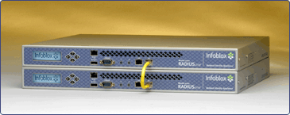
ESnet Radius (2)
Appliance
Dedicated Hardware
Minimal ports open
High Availability
Geographical dispersion

Slide 28
ESnet Radius (3)
Data Model
Sites manage data
ESnet manages infrastructure & “transport”
Partition RADIUS server
  Sites manage/federate populating user db
  Only Grid data (name) provided to grid app
    For now?

Slide 29
ESnet Radius (4)
Authorization / Custom Info
Namespace support is critical in Grids
RADIUS must return subject name for SIPS CA
Options for subject name
CN=name, basename= site related
Example: CN=mike, ou=people, dc=es, dc=net
*CN=name, basename= DOEGrids
similar to existing model
Example: CN=mike@es.net, ou=people, dc=doegrids, dc=org

Slide 30
ESnet Radius (5)
What does login look like to customers?
Because we are forwarding (proxying for) multiple authentication domains, login users will need to specify their realms, eg
mike@es.net
Login may look much like Windows domain login
Local name + realm (domain) == unique account name

Slide 31
ESnet Radius (6)
Why provide an ESnet radius “layer”?
Consistent interface to SIPS CA’s
Separate CA’s from interoperability issues
Manage mutual authentication between
Radius Client (PAM) and Server
Support related infrastructure

Slide 32
ESnet RADIUS
(Summary)
ESnet RADIUS – Authentication Router
Deploy as many units as needed
  One or more per site
ESnet provides a “transport layer” but sites manage most of the data content directly
Routers should present identical data everywhere (federation), but could proxy for other RADIUS servers, proxy between
RADIUS servers could be used to support other site infrastructure

Slide 33
SIPS

Slide 34
ESnet Root
CA
SIPS
Sign Subordinate CA
HSM
4 Sign Proxy
Subordinate
CA
Engine
OCSP
2 Ask AuthN
PAM
4. Auth OK;
Namestring
Manage
myProxy
MyProxy
Credentials
SIPS
1 Log in
5 Receive Proxy Cert
7 Execute
6 (Opt) Store Proxy
Notes:
Condensed some OTP steps;
Assume same
No long term cred storage, adds no value at this point
SIPS – Site Integrated Proxy Services

Slide 35
SIPS (2)
Site Integrate Proxy Services
Storing long term credentials is unattractive
  Security headache
  Little utility; can factor out
  More appropriate in non-Authentication context
“MyProxy” may be useful – short term cache
  NB: “MyProxy” means “storage for short term credentials”

Slide 36
SIPS (3)
SIPS mini-CA
  Issues proxy or proxy like short term certs
  Cert signed by ESnet root CA
Hardware Security Module
  See below
OCSP
  Real time & local certificate validation

Slide 37
Hardware Security Module
HSM
Grid Logon, or SIPS:
  Online, 24x7, unattended CA!
Good relationship with vendor
Network based HSM management:
  Network sharable device
  http://www.ncipher.com/nethsm/index.html
  Network based management:
  http://www.ncipher.com/remoteoperator/index.html
  Remote Operator provides the ability for security personnel to present a smart card to their local HSM and have it recognized at a remote unattended HSM.
Notes:
Point here is we can reconfigure and manage the
HSM’s ourselves from ESnet, or, in appropriate cases, share management with local sites.

Slide 38
OCSP
Online Certificate Status Protocol
OCSP: A simple certificate validation service
  RFC 2560: http://www.ietf.org/rfc/rfc2560.txt
    Valid/invalid/unknown responses
  Alternative/synergize with lists of revoked certificates
  Soliciting requirements for upcoming GGF draft document
  Support physics grids
  Pilot effort includes all European and US revocation lists
  Pioneer the concept of “outsourcing” CA services
Notes:
Checking validity of certificates is considered essential by security professionals
Physics grids (ATLAS, CMS, D0, BABAR &al) REQUIRE revocation checking
NERSC and DOE Science Grid are going to require revocation checking
Looking for requirements & operational considerations from interested parties

Slide 39
Federated OTP
Implicit Assumption: Sites will “trust” other sites’ OTP authentication
  Federation issue
  Cross acceptance of proxy certs
If a federated acquisition makes sense
If a common solution makes sense
ESnet can support certain backend, acquisition, and management functions; this makes some of our job easier
Front line “fulfillment” functions should not be managed by ESnet: token support, deployment, configuration, help desk, &c

Slide 40
Put It Altogether!
DOE Site2
ESnet
Radius
ESnet
Radius
SIPS
CA
ESnet
Radius
SIPS
CA
SIPS
CA
DOE Site1
ESnet
Radius
ESnet
Radius
SIPS
CA
ESnet
SIPS
CA
Collab Site1
AOA

Slide 41
Put It Altogether
The ESnet RADIUS servers replicate their data amongst each other
  Master-slave configuration developed from pilot
SIPS or GRIDLOGON
  Instances of a single, distributed CA?
  Locally managed CA infrastructure?
  (This is another part of the project!)

Slide 42
ESnet RADIUS & SIPS
One RADIUS service – or MANY?
Is this many SIPS CA’s –
  Or just ONE CA with multiple instances?
  Cloned CA feature available from vendor about 01 Jan 2005

Slide 43
Federation Work Needed
Cross site OTP / token acceptance
CA profiles
  A profile of the DOE type CA is needed
  Process
  Certificate Policy changes
    Additional certificate extensions
Site issues
  Integration / Exposure of site authentication information
  Classic federation problem

Slide 44
Standards Bodies
(GGF and others)
Gridlogon
OTP requirements
CA profiles
  Addition of this CA type
Federated Identity
Proxy certificate requirements

Slide 45
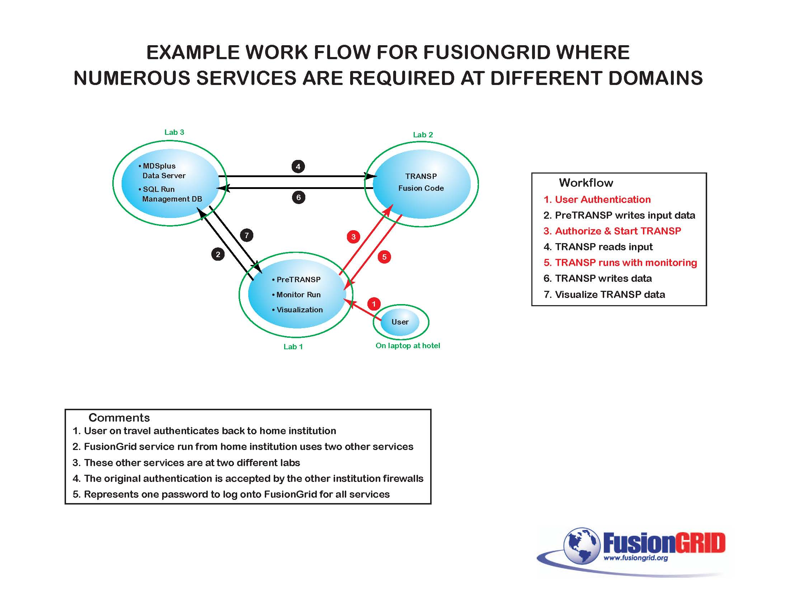
Fusiongrid workflow

Slide 46
Fusiongrid workflow (2)
Firewalls
Delegation
Isn’t somebody working on this?
  EAP + X.509 -> RADIUS AuthN? Proxy certs?
  MPLS VPN or? Grid networking
    Need help understanding issues
Explore some basic issues/operations

Slide 47

IP Disclosure

Slide 48
Other Options
This is a new initiative; requirements may shift, adding new complexity or removing unnecessary components
Many other configurations are possible
We will respond appropriately to these changing needs

Slide 49
One Time Password Infrastructure
Call Center

Slide 50
The Reality Slide
Much new work needs to be done
We are ready willing & able to help
ESnet needs additional support to meet these needs
Additional middleware needs to be developed (“Globus” support)
Sites need support to manage this process
24 x 7 infrastructure!

Slide 51
On going research: OTP & Secure Password Protocol Integration
(Frank Siebenlist, Globus)
On going research: OTP & Secure Password Protocol Integration
Secure Password Protocol:
  Shared secret (OTP) not revealed in protocol
  Mutual authentication
  Includes key-exchange
Advantages:
  “Provable” secure
  No need for server key/cert
  Resistant against MITM attacks
  Possible SSH-forwarding schemes
Ongoing work:
  LBL’s security&crypto group with Globus
  Implementation of protocol for SSL/SSH/OGSA-GT

