Slide 1
Grid Services for Collaborative Science
Kate Keahey
Argonne National Lab

Slide 2
Grid Services for Collaborative Science
Most scientists don’t care
  Portals, GUIs, etc.
  Familiar tools
    Matlab, commercial database infrastructure, etc.
  Community-specific interfaces
    MDSplus, etc.
The few that do…
  Build the layer between those interfaces and Grid software
  This layer is often community-specific but generic tools have also been developed

Slide 3
Who Uses Grid Services for Science?
A story of two projects
  NEES Grid
  Fusion Grid
No other stories
  Why not?
Thanks to Laura Pearlman, Rob Gardner and others who talked to me on the subject

Slide 4
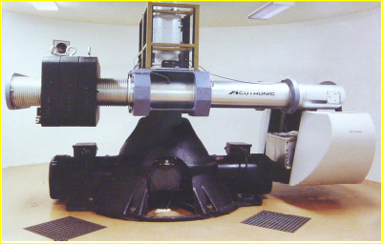
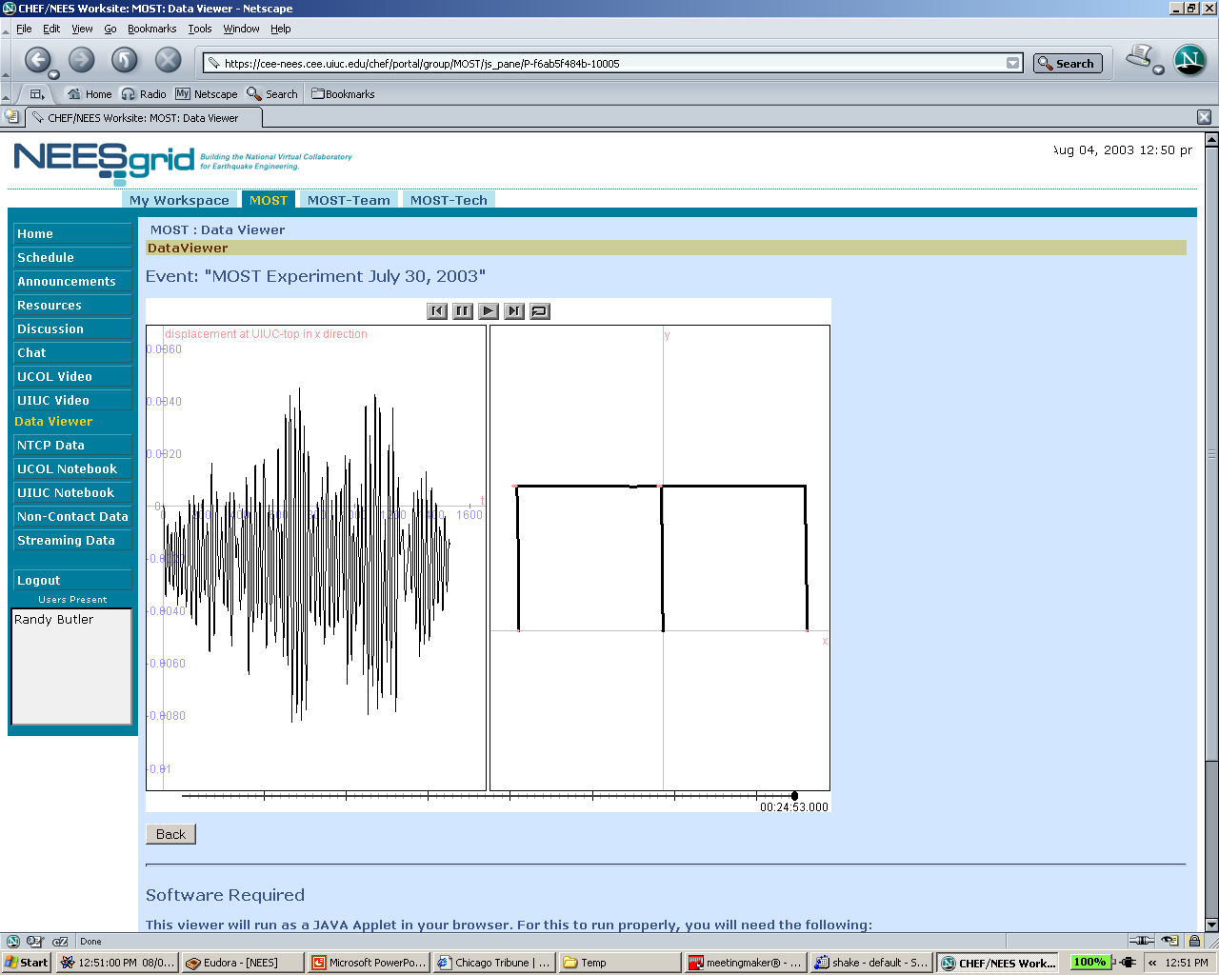
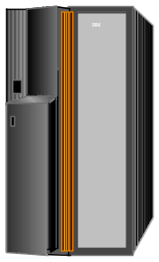
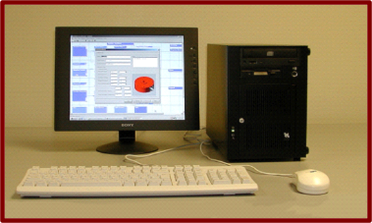
NEES Grid Interactions
Grid Operations Center
Grid Data Repository
Internet Fabric and Operations
Control and Data
Telepresence Equipment
(Acitve PI)
Teleobservation Equipment
Computational Models
Physical Experiment
Remote Lead Investigator
Computations
Passive Collaborator

Slide 5
Grid Service Usage (NEES)
State: Service Data Elements
  Currently used to represent information about transaction
  Planned: using SDEs to distinguish many diverse instruments
  Discovery of instrument capabilities
  Introspection has potential to make larger and more diverse experiments possible
Notifications
  Allow a client to subscribe to “the latest transaction” in the system
Notes:
using SDEs to distinguish between them
What device is this an interface to?
Shake table, camera …
What are the capabilities of this device?
Movable/static camera

Slide 6
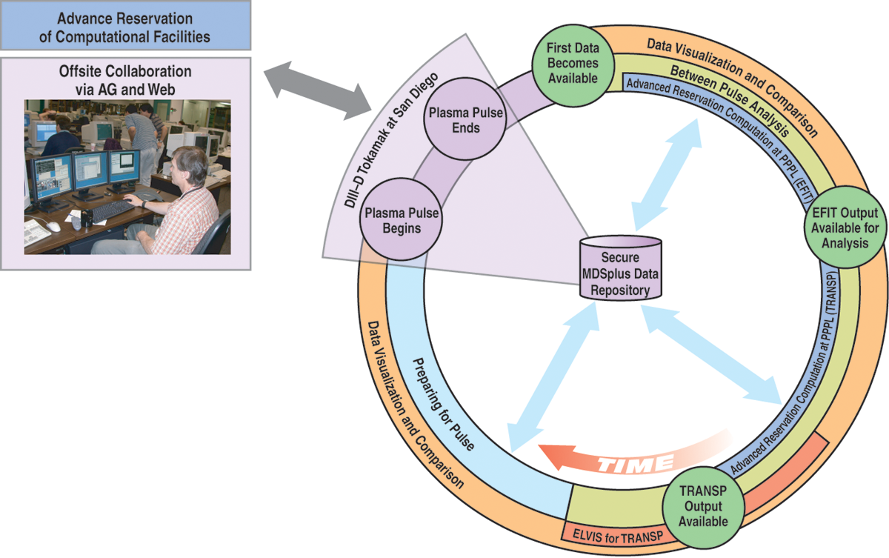
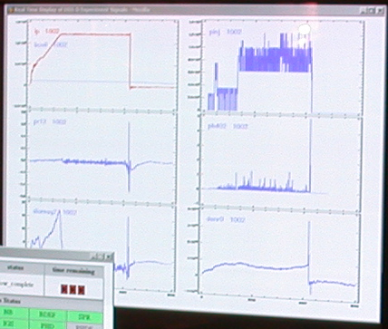
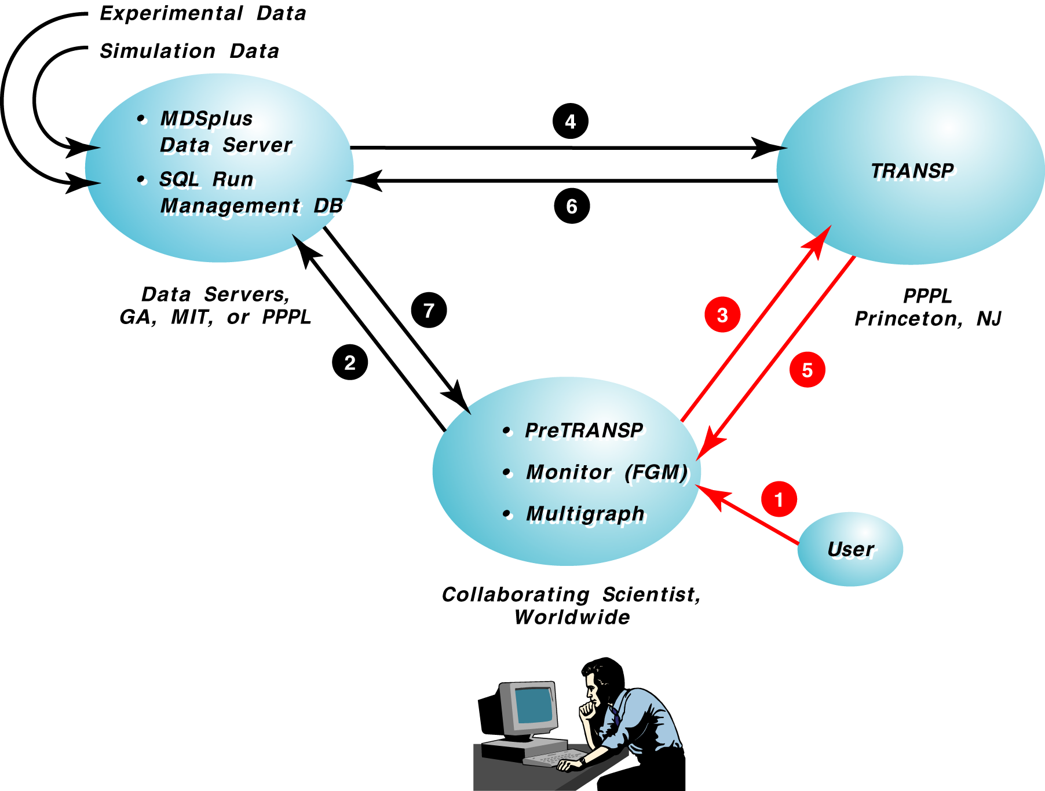
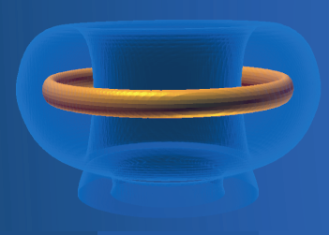
The National Fusion Collaboratory

Slide 7
Grid service Usage (NFC)
Agreements for between-pulse execution
  Providing quality of service is key
  Dynamically created application-level agreements
    “whenever I run a certain configuration of EFIT tomorrow between 9am and 5pm I want it to run as fast as possible and no longer than 4 minutes”
  E2E agreements
    Combining job execution, data transfer, and resource reservations
  Late binding
    Agreement claiming is triggered by event: experimental data becomes available
  Agreements versus prediction
    Confidence levels and guarantees
Prototype implementation
  Loosely compliant with the WS-Agreement spec
  Used in an experimental “mock up” in November 2003
  Probably too early for feedback from the community
Future
  Adaptive capabilities to meet the provisioning target

Slide 8
Potential of Grid Services in Scientific Community
There is a large investment in the Grid infrastructure in the scientific community
  Grids have been used for a long time
  There has been a huge investment in the “above Grid” layer
    Many projects are only now producing results
The requirements are “large”
  Petabytes of data
  Thousands of users and jobs
Adopting Grid Services model
  Grid service implementations MUST provide features that are at least as good as the pre-service infrastructure
    Reliability, scalability, performance
  It would be good if it went one step further
    Better reliability, scalability, performance
    Richer service functionality

Slide 9
Conclusion
The proof is in the pudding

