Slide 1
Exploring Opportunities in OGSA
Panel Discussion
GGF 12, June 7,2004
Hawaii
Jeffrey Frey, IBM - Moderator

Slide 2
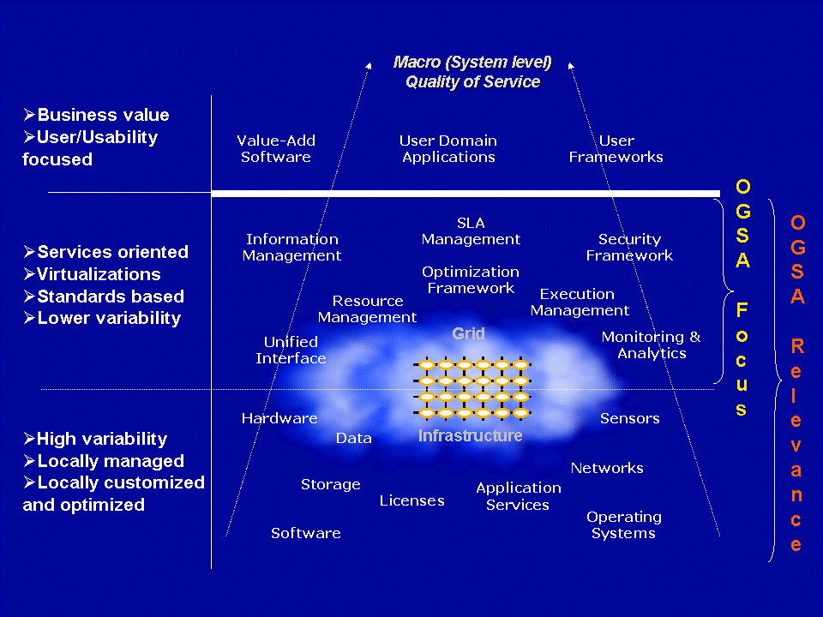
OGSA Context

Slide 3
Industry Standardization is Key
  Interoperability and Portability
  Component Plug Replacement
  Inherent Heterogeneity
  Integration and Federation
  GGF, OASIS, DMTF, W3C, …
Service Oriented
  WSDL Interfaces
  Dynamic Deployment and Discovery
  Loose Coupling, Late Binding, Service Brokers
  Negotiated, Agreement Based Interaction
Role of Service Level Management
  Central to the Management Infrastructure
  Dynamic, Policy Driven Resource Management
  Service Level Agreement
Relationship to Grid Computing
  Not the type of application, its the managed infrastructure
  Optimistic Coherency and State Change Tolerant
  Dynamic Resource Discovery, Allocation, Reservation, and Scheduling
  Management across Organizational Boundaries
The Utility Compute Model
  Service Offerings
  Contracting, and Subscription
  Metered Usage, Rating, and Billing
  Hybrid Hosting Models
  Multiple Service Offerings on a Shared Infrastructure

Slide 4
Panel Objectives
The aim of this panel is to explore various aspects of OGSA and how they contribute to improved (in terms of quality of service) and enhanced (in terms of functionality) of services deployed in the Grid.
Each panelist will give a short presentation on how one or more aspects the OGSA model can be exploited to provide services in the given domain. The perspective will be that of a provider of end user services, with an emphasis on how the underlying OGSA model contributes to the end user's experience.
10 Minutes per Presentation
30 Minutes of Open Question and Panel Discussion

Slide 5
Our Panel
Resilient Data Centers : Toshiyuki Nakata (NEC)
Execution Management : Ravi Subramaniam (Intel)
Data Management : Malcolm Atkinson (Edinburgh)
Collaborative Research : Kate Keahey (ANL)
Utility Computing : Jeffrin Von Reich (HP)

