Slide 1
What is needed on Grid PKI？
(Naregi: National Research grid Initiative in JAPAN)
Naregi
  Organized by governmental sector (National Institute of information )
Naregi PKI service
  Start this march
  (Currently) Single PKI domain architecture
  Issue certificates for Globus and Unicore separately.
  Initially based on GGF CP/CPS references （GFD-C.16 June 1,2003 )
Issues
  Different policy but user requests “common one certificate”
    Globus and Unicore
  Different organization （multiple PKI domain )
    Different identification and authentication policy to issue the certificate
  Certificate Profile
    CA certificate
    Globus certificate
    Unicore Certificate

Slide 2

Unicore vs. Globus
UNICORE (GFD.18 An Analysis of the UNICORE Security Model)
  authenticate users, UNICORE Gateways, the NJS (for distributing sub- sign jobs, and sign software
Globus
  PKI is used for user authentication through proxy certs.
PKI architecture
  UNICORE PKI is initially designed one PKI domain containing single CA and multiple RAs
U-CA
G-CA
U&G
U&G
CA
U＆G
Cert
U
Cert
G
Cert
U
Cert
G
Cert
End
Entity

Slide 3
Issue : Keyusage？
GGF Certificate Policy Model（June 1,2003)
  Applicability : “to promote wide use of public key certificates in many different application” S/MIME, IPSec, SSL/TLS
  Key usage : must be critical (but what value is?)
DOE Grids （December 15,2002）
  Applicability : Person certificate “signing of Globus proxy certificates” , ”may be used for other activities such as e-mail signing and encryption. Server certificate “ for TLS/SSL.
  Key Usage: “critical”, Digital signature, Non repudiation, Key Encipherment, Data Encipherment
For purpose of UNICORE code-signing, why not use
“extent-key-usage , code-signing” {id-kp,3} specified in RFC3280.

Slide 4
Issue: Certificate/CRL Profile?
Need the CP/CPS reference model
Key usage as described
CA certificate profile
User cert for globus needs “another keyusage or policy” due to create proxy cert.

Slide 5
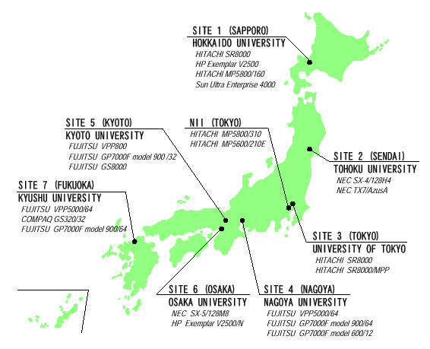
Issue : Multiple PKI domain?
Currently Naregi has single PKI architecture
In future, needs multi-domain PKI
  Which architecture is desirable?
  How interoperable between multi-PKI domain
    It is impossible to establish single CA
    Multi trust point for user ?
    Single trust point and cross certification?
    (Bridge or root)
  What is restrictions or
  conditions for interoperability?

