Slide 1

CSF

Slide 2

CSF – Community Scheduler Framework
Not a Platform product
  Contributed enhancement to The Globus Toolkit
Standards compliant
  WS-Agreement specification under development
  Developed with the latest version of OGSI
  Enables other Platform products with OGSI compliance
Extensible, Open Source framework for implementing meta-schedulers
Provides basic protocols and interfaces to help resources work together in heterogeneous environments
Notes:
See the CSF whitepaper from Platform.

Slide 3


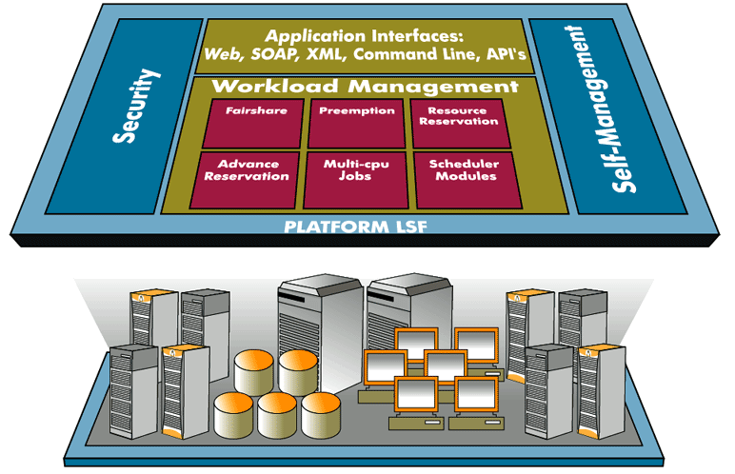
CSF Architecture
Platform LSF User
Meta-
scheduler
Plugin
Globus Toolkit User
LSF
Grid Service Hosting Environment
Meta-Scheduler
Global Information Service
Job Service
Reservation Service
Queuing Service
GRAM SGE
GRAM PBS
RM Adapter
RIPS
RIPS
RIPS
RIPS = Resource Information Provider Service
Platform LSF
SGE
PBS

Slide 4
Global Information Service
Rsrc Info Req
ClusterInfo Req
Data Store Req
Data Load Req
Global Information Service
Index Service
Registry
SD
Aggregator
SDProvider
Manager
Data
Storage
Rsrc, job rsv info
Rsv Info
Job Info
Data Store Load
Cluster Register
RIPS
RIPS
DB

Slide 5

Virtual Organizations
User of VO “A”
User of VO “B”
Community
Scheduler
Community
Scheduler
Virtual
Organization “A”
Virtual
Organization “B”
Organization 1
Organization 3
Organization 2

Slide 6
CSF Grid Services
Job Service creates, monitors and controls compute jobs
Reservation Service guarantees resources are available for running a job
Queueing Service provides a service where administrators can customize and define scheduling policies at the VO level and/or at the different resource manager level
Defines an API for plug in schedulers
RM Adaptor Service provides a Grid service interface that bridges the Grid service protocol and resource managers (LSF, PBS, SGE, Condor and other RMs)

Slide 7

GT3 Job Submission / Architecture
MMJFS = Master Managed Job Factory Service
MJS = Managed Job Service
Blue indicates a Grid Service hosted in a GT3 container
MJS for LSF
MMJFS
LSF
RIPS
Site A – MMJFS on node1
managed-job-globusrun
MJS for PBS
managed-job-globusrun
MMJFS
PBS
managed-job-globusrun
RIPS
Site B – MMJFS on node2
MJS for SGE
Index Service
MMJFS
SGE
RIPS
Site C – MMJFS on node3

Slide 8
GT3 + CSF Architecture
RM Adapter
for LSF
Queuing
Service
LSF
RIPS
Job
Service
Site A
Reservation
Service
RM Adapter
for PBS
Index Service
PBS
RIPS
Site B
Virtual Organization
MMJFS/MJS
SGE
RIPS
Site C

Slide 9
Plug-in Scheduling Interface
Implement four call-back functions and plug-in!
Scheduler Modules
Scheduler framework API
Queuing Service
_{Resource}
_{Job Ctrl Actions}
Reservation Service
Job Service
Notes:
The scheduler is going to take on a new look.

Slide 10
Queue Service
In CSF, Job Service instances are “submitted” to the Queue Service for dispatch to a resource manager.
The Queue Service provides a plug in API for extending the scheduling algorithms provided by default with CSF.
The Queue Service is responsible for:
  loads and validates configuration information
  loads all configured scheduler plugins
  calls the plugin API functions
    schedInit() after loading the plugin successfully
    schedOrder() when a new job is submitted
    schedMatch() during the scheduling cycle
    schedPost() before the scheduling cycle ends, and after scheduling decisions are sent to the job service instances

Slide 11
CSF Source Forge project
You too can participate.
You can contact me (csmith@platform.com),
or check out http://sf.net/projects/gcsf
Recent enhancements
RM adapter for GT2 GRAM
Jobs can be sent to remote MMJFS
Jobs can be assigned to multiple sites when scheduling

