Slide 1
Status of OGSA Information Services
Abdeslem DJAOUI
Rutherford Laboratory
OGSA-WG Information Services Design Team session, GGF12
Sept 21, 2004

Slide 2
Content
Overview of OGSA V1 Information services
Active team members
Related WGs
Activities since GGF11
Outline of V2 work
Schedule until GGF13

Slide 3
V1 Information services
Scenarios
    Directory service (UDDI-like)
    Logging for purpose of problem determination, usage metering, failure recovery, transaction processing, and security
    Allocating Grid resources for job execution and monitoring job and resource status
Capabilities
    Naming
    Discovery
    Message delivery
    Monitoring
    Logging

Slide 4
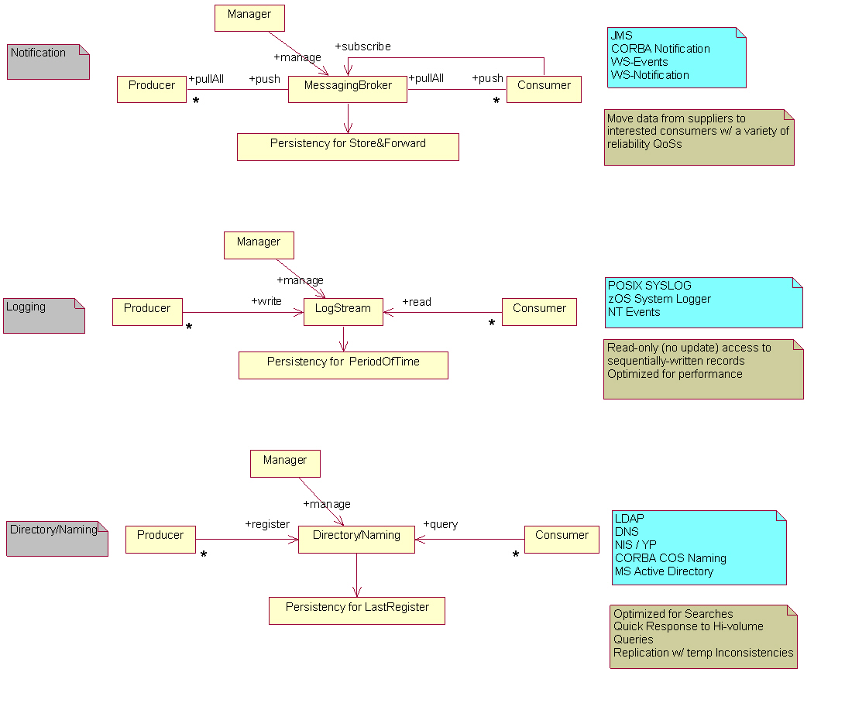
Basic Information systems

Slide 5
Active team members
Bill Horm – IBM
    Information services design
    Logging
Andrew Grimshaw - UVa
    Naming
Hiro Kishimoto - Fujitsu
    Information services design
Steve Fisher – RAL
    Discovery
    Monitoring
Abdeslem Djaoui - RAL
    Information services design
    Discovery
    Monitoring
    Liaison with InfoD WG

Slide 6
Related WGs
Logging (Bill’s BoF)
InfoD – Information Dissemination
    InfoD has roots in Data area
    Seems to be an appropriate WG for specifying discovery/monitoring/message delivery capabilities
How about ISP (Information systems and performance) groups?
    CIM based Grid Schema
    Discovery/Monitoring Event Description
    Grid Information Retrieval
    Grid Benchmarking
    Network Measurements for Applications

Slide 7
Activities since GGF11
Naming: AG
    Naming teleconferences
Architecture discussion
    AD active in discussions on relationship of InfoD to OGSA information services – attending teleconferences
    “Since information is data, should data and information be combined in OGSA?” Susan Malaika - IBM
Extending InfoD specifications to cover discovery/monitoring/message delivery capabilities
    SF has submitted our Discovery/Monitoring scenarios to InfoD

Slide 8
Outline of V2 work
Logging service
Producer/Consumer services
Registry?
Schema?
Naming?

Slide 9
Schedule until GGF13
Overall architecture
    Are requirements/capabilities of ISP groups covered in OGSA V1?
    Relationship to WSDM monitoring/discovery/schema
V2 service specifications
    Need more involvement
    More of a bottom-up approach than top down approach is necessary

