Slide 1
Secure Grid
Naming Protocol
(SGNP)
19 February, 2002
Global Grid Forum 4
Toronto

Slide 2
SGNP Author Group
Joshua Apgar, Avaki Corporation
Andrew Grimshaw, GGF Steering Group, Avaki Corporation
Steven Harris, Avaki Corporation
Marty Humphrey, University of Virginia
Anh Nguyen-Tuong, Avaki Corporation

Slide 3
Names are everything
      - Oscar Wilde

Slide 4
High-Level Goals
Agree on fundamental assumptions regarding the Grid environment
Describe the SGNP philosophy/approach
Walk through SGNP Specification
Answer initial questions
Elicit preliminary feedback
Establish roadmap for carrying the conversation forward
  Step One: Spec submitted to GGF
  Step Two: Today’s BOF session
  Step Three: Reference implementation functioning today, to be made available to the community on March 18
  Steps Four, etc ?

Slide 5
Introduction: The Grid Environment
Grids are increasingly composed of a very large number of resources that need to be named, identified, and authenticated
Grids may contain resources managed/owned by multiple, mutually-distrustful organizations
Each organization may have its own security requirements, usage policies, and administration requirements
Resources may be geographically separated
The resources and the network may be faulty
Over time, a resource may be migrated to a different network address, machine, or administrative domain

Slide 6
Grid Naming: Why Is It So Important?
Issue: Multiple, conflicting namespaces
Issue: Multiple levels of heterogeneity (platform, OS, system configuration)
Today’s Grid problems demand a single, unified namespace
Extended-enterprise and multi-organizational Grids introduce steep security challenges
Grids require reliable communication among resources and services, in the face of many communications challenges
The coming wave of commercial Grids will require enormous scale
Issue: Multiple participants, with detailed,
organization-specific, often conflicting
security requirements and priorities
Issue: Resources and services may …
  Migrate while communicating
  Fail and be restarted
  Be replicated
  Be managed by multiple computing platforms
Issue: Grids will be comprised of billions, even trillions of named resources and services

Slide 7
Grid Naming: Why Is It So Important?
Issue: Multiple, conflicting namespaces
Issue: Multiple levels of heterogeneity (platform,
OS, system configuration)
Issue: Multiple participants, with detailed,
organization-specific, often conflicting
security requirements and priorities
Issue: Resources and services may …
  Migrate while communicating
  Fail and be restarted
  Be replicated
  Be managed by multiple computing platforms
Issue: Grids will be comprised of billions, even
trillions of named resources and services

Slide 8
Grid Naming: How SGNP Addresses the Issues
Issue: Multiple, conflicting namespaces
Issue: Multiple levels of heterogeneity (platform, OS, system configuration)
SGNP provides a single, unified namespace, spanning multiple locations and administrative domains
Issue: Multiple participants, with detailed,
organization-specific, often conflicting
security requirements and priorities
SGNP enables secure authentication among resources and services without requiring a central trusted authority. Identities are attached to names!
Issue: Resources and services may …
  Migrate while communicating
  Fail and be restarted
  Be replicated
  Be managed by multiple computing platforms
SGNP’s location transparency enables the migration of resources and services to support binding and re-binding, even if resources move, fail, etc.
Issue: Grids will be comprised of billions, even
trillions of named resources and services
SGNP’s architecture provides for arbitrary scalability of the system

Slide 9
SGNP Introduction: Defining the Terms
“Grid Resource”
  A named computational element (a machine, process, file, application, user, etc) that operates in a Grid environment, has a defined interface, and provides service to, or makes use of, other Grid Resources
“Communicate”
  At minimum, the ability to move byte vectors (messages) from one endpoint to another. A higher-level definition implies that, in addition to simply moving data from one endpoint to another, an action can be caused at the other end (a procedure call, for example)
“Securely”
  Implies that identity and mutual authentication between endpoints can be established and attacks on the integrity of the data (snooping, replay, tampering) can be thwarted. Does not imply that mutual authentication between all pairs of Grid Resources is required
“Binding”
  A set of protocols and endpoints for a Grid Resource

Slide 10
SGNP Introduction:
Communication Between Grid Resources
SGNP allows two Grid Resources, A and B, to securely communicate even if….
  A or B moves
  A or B is replicated
  A or B fails and is restarted, perhaps with another address
  A and B are on different architectures or operating systems
  A and B are in different organizations with different security policies
  There are trillions of endpoints, potentially moving about from place to place at a very high aggregate rate
Domain 3
A
Domain 1
A
Domain 2
A
B

Slide 11
SGNP Overview
SGNP is a two-layered naming scheme for obtaining Bindings to Grid Resources
Within SGNP, all Grid Resources have an identity
  These names are Location-independent Object IDentifiers (LOIDs)
  Guaranteed globally unique
  Immutable for the lifetime of the resource
  Physical addresses determined by associating a LOID with one or more communication protocols and network endpoints
  Identity and security information indelibly linked to form the logical name
  Identity does not necessarily depend on trusted CA’s or third parties
SGNP describes the specific protocol by which LOIDs are resolved to Bindings

Slide 12
SGNP:
Detailed View

Slide 13
Outline: SGNP Elements
Data Types
  LOID
  Binding
Grid Resources
  Grid Naming Service
  Resolver Hierarchy
Protocols
  Bind Protocol
  Rebind Protocol

Slide 14
SGNP Data Types: LOID
LOID: Immutable name of a Grid Resource, containing the Grid Resource’s security information
Uniqueness achieved by …
  Uniquely assigning a DomainResolverID to an administrative domain, and
  Requiring that the tuple (BindingResolverID, ObjectID) be unique within that domain
  Simple mechanism for assigning the DomainResolverID field: Use the existing domain name infrastructure (example ibm.com, platform.com)
A LOID can be represented as a Uniform Resource Identifier (URI) with the following format:
LOID://<LOIDType>/<DomainResolverID>/<BindingResolverID>/<ObjectID>/<SecurityInfo>

Slide 15
SGNP Data Types: LOID
Field Name | Description
LOIDType | This field differentiates between different types of LOID and supports the requirement of extensible naming. This field accommodates future extensions to the naming protocol
DomainResolverID | This field identifies the Domain Resolver that has ownership of the Grid Resource
BindingResolverID | This field identifies the Binding Resolver within a Domain that has ownership of the Grid Resource Binding
ObjectID | This field identifies a Grid Resource Binding within a Binding Resolver
SecurityInfo | This field contains the security information for a Grid Resource (base 64 encoded). One approach is to use an RSA Public Key

Slide 16
SGNP Data Types: Binding
A Binding is the collection of network endpoints and communication protocols that a Grid Resource currently supports
Easily represented as a Web Service Definition Language (WSDL) document
  Protocols supported are represented as WSDL <binding> tags
  Network endpoints supporting these protocols represented as <port> tags
Note: Data contained in a Binding may become invalid
Rebind Protocol allows a client to get an updated binding for a given Grid Resource

Slide 17
SGNP Grid Resources: Grid Naming Service
Clients of SGNP interact via an instance of Grid Naming Service (GNS)
GNS is a Grid Resource with a LOID and a well-known Binding
A client can use this Grid Resource to obtain a Binding to another Grid Resource for which it knows the LOID
An implementation of GNS provides at a minimum the following methods:
  LOID addBinding(Binding newbinding)
  Binding lookupBinding(LOID id)
  Binding lookupBinding(LOID id, Binding oldbinding)
  void updateBinding(Binding newbinding, LOID id)
Implementation of the GNS may require messages to be signed by the source LOID’s private key – basis for access control

Slide 18
SGNP Grid Resources: Resolver Hierarchy
GNS obtains the Binding by traversing the Resolver Hierarchy
Resolvers: Tree of Resources to resolve increasingly specific portions of LOIDs
  Grid Resources in this tree are collectively known as the Resolver Hierarchy
  Each level in the hierarchy represents a smaller administrative domain
A valid Resolver Hierarchy must have at least one Resolver of each type
  LOIDResolver
    Has a well-known Binding, maintains the authoritative mappings from DomainResolverID to DomainResolver Bindings
    Logically the root of LOID space, providing administrators with a single integration point for merging domains
  DomainResolvers
    Maintain mapping of BindingResolverID to BindingResolver Bindings
    Logically represent the portion of LOID space that is owned by a single administrative domain
  BindingResolvers
    Maintains authoritative mappings from ObjectID to Grid Resource Binding
    Logically represent a single repository for Bindings

Slide 19
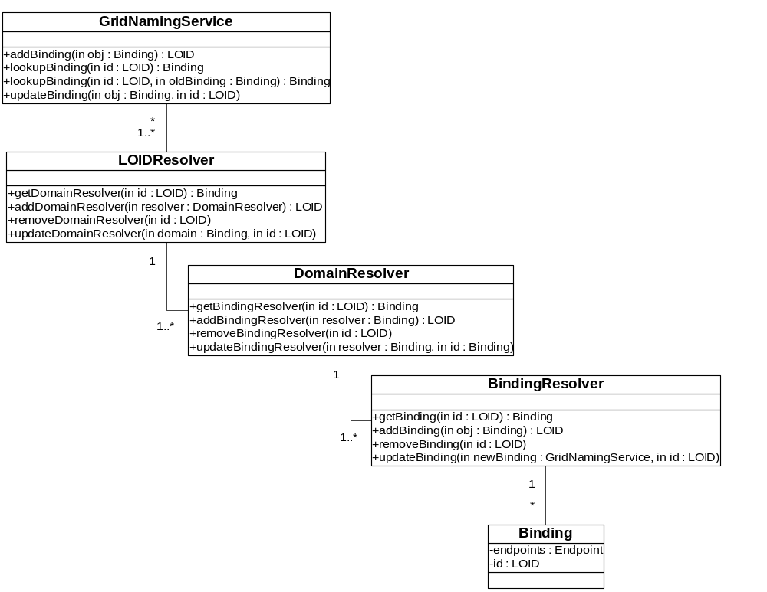
SGNP Grid Resources: Resolver Hierarchy
UML Class Diagram of the
Resolver Hierarchy

Slide 20
SGNP Protocols
Binding Protocol
  Details mechanism the GNS will use to resolve a LOID to a Binding
Rebinding Protocol
  Provides a mechanism for a client to obtain a new Binding to a Grid Resource in the event that the client’s current Binding to the Grid Resource proves invalid

Slide 21
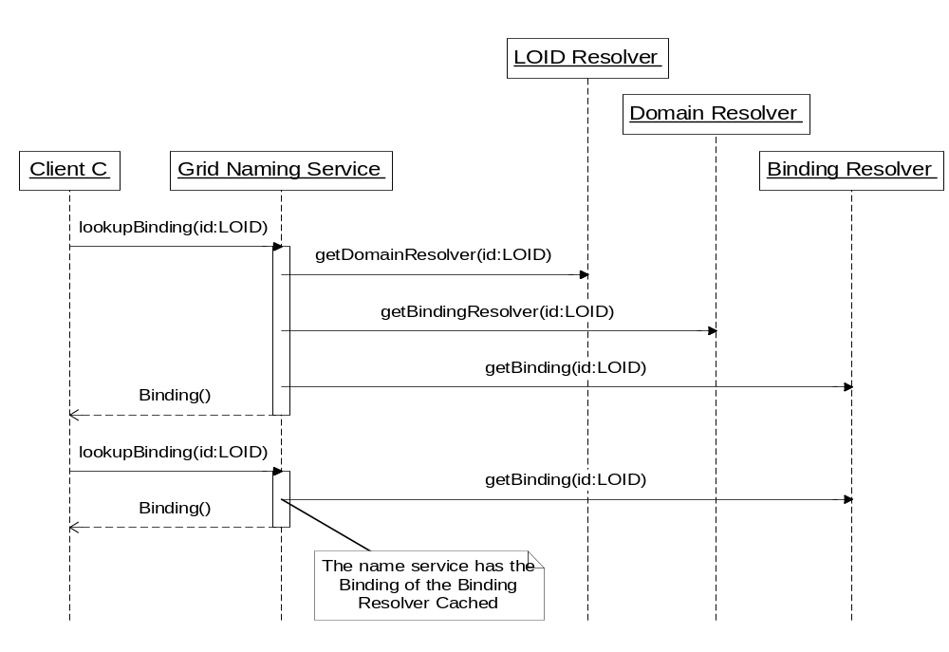
SGNP Protocols: Bind Protocol
UML Sequence Diagram of the Bind Protocol showing caching of the BindingResolver Binding

Slide 22
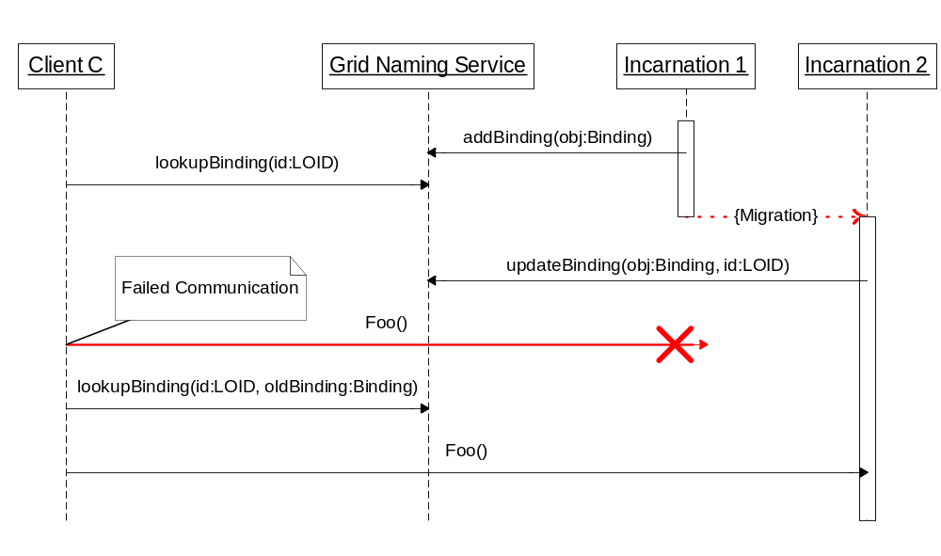
SGNP Protocols: Rebind Protocol
UML Sequence Diagram of the Rebind Protocol showing rebinding after object migration

Slide 23
Relationship to Communication Protocols
Expectation: Communications protocols built on top of SGNP will provide access that is transparent with respect to
  Location
  Migration
  Replication, and
  Failure
For example: Protocol provides a stub that wraps a Binding and provides automatic rebind semantics
Communications “wrapper” layer can use the SGNP protocols to mask failure, and provide the client with uninterrupted service
SGNP reference implementation: Employs JAVA Proxies to insert an automatic rebind layer between client code and the RMI stub

Slide 24
SGNP:
Demonstration

Slide 25
Discussion and Next Steps
Overall comments
Questions
Points of integration, current/prospective GGF efforts
  Working Group(s)
  Document set
Dependencies and interrelationships
Next Steps

Slide 26
Appendices

Slide 27
Security Information in LOIDs: Why?
Numerous trust challenges in grid environments
  Heterogeneity
  Multiple, possibly distrustful policy domains
X.509-based PKI alone has some limitations
  Scaling issues
  Presupposes a set of social/operational arrangements
  TLS incurs run-time overhead
What’s needed without SGNP
  If CA-based, requirement to establish trust relationships between all CAs
  If Kerberos-based, requirement to establish cross-realm trust

Slide 28
SGNP Core Requirements
Scalable naming
  No bottlenecks created around creation of LOIDs, association of LOIDs to Bindings, resolution of LOIDs to Bindings
Scalable secure identity
Scalable administration – Mechanisms for…
  Division of a name space into multiple administrative domains
  Merger of multiple administrative domains into a single domain
  Federation of multiple administrative domains
  Locally generating globally-unique LOIDs
  Identifying the administrative domain that issued the LOID
Location-, migration-, replication-, and failure-transparent naming
  Migration of a Grid Resource to another address, perhaps supporting different protocols
  Replication of a Grid Resource (dynamic creation and destruction)
  Quiesceing, failing, stopping/starting of a Grid Resource, possibly with a different physical address
Support for long-lived names
  May include migration, reactivation, organizational restructuring, etc.
Extensibility and upgrade path

