Slide 1
OGSA Logging Services mini-BOF
Junichi Toyouchi (Hitachi) / Bill Horn (IBM)
GGF 12
September 21, 2004

Slide 2
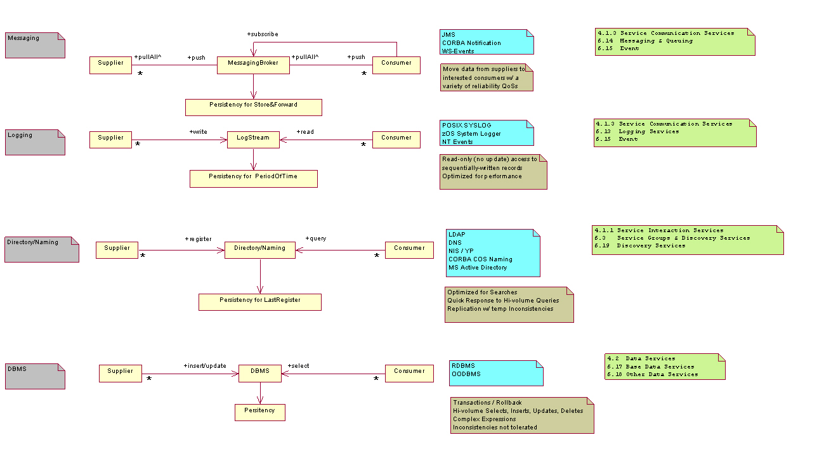
Taxonomy: Information Systems

Slide 3
OGSA Logger System Design Sessions
Summary
Goal:
  Words for OGSA document describing:
    requirements for a Logger system
    its relationship to other OGSA systems
Methodology:
  Analyze existing log systems, attempt to abstract
    reflecting traditional requirements
  Define Service-oriented view of logging (interfaces in UML)
  Test design with OGSA use cases (PD, metering)
  Propose requirements & (rough) interfaces for OGSA document
  Gather feedback and then iterate (goto 2)
Use cases:
  … rooted in traditional OS

Slide 4
OGSA Logging Services
Relationship to other OGSA Systems
* Problem Determination – Message Log / Trace Log
  - All services should exploit Log Services for Problem Determination (PD).
Usage Metering – Metering uses log for serialization & persistence of usage metrics
Policy – Log services are driven by policy
Security – Secure logs are an important (and open) topic
  - E.g., confidentiality, integrity for audit, non-repudiation, …
* Messaging Fabric – Log should coexist with monitoring fabric
* Events – Log artifacts and Message artifacts should conform to the same schema
* will say more during this presentation

Slide 5
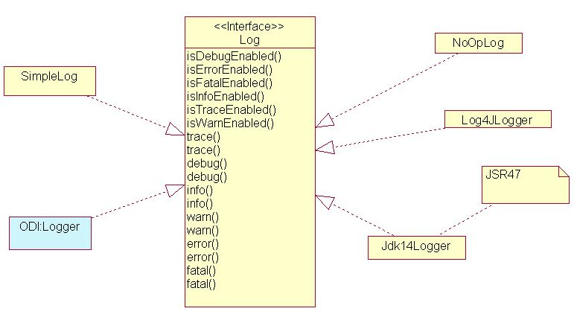
Logging “Best Practice”: Jakarta Commons Logging
“To use the logging SPI from a Java class, include the following import statements:
  import org.apache.commons.logging.Log;
  import org.apache.commons.logging.LogFactory;
For each class definition, declare and initialize a log attribute as follows:
public class CLASS
{
private static Log log = LogFactory.getLog(CLASS.class);
... ”

Slide 6

Relationship: Logging / Messaging Brokers: Metrics
Billing & Settlement
Resource Monitor
audit access
(readCursor)
to metrics used for
chargeback
(other metrics filtered)
asynchronous access
(push)
to process & disk
metrics
(other metrics filtered)
Logging
Notification
Broker
process metrics
(per process)
disk metrics
(sampled)
application metrics
(per invocation)
other metrics

Slide 7
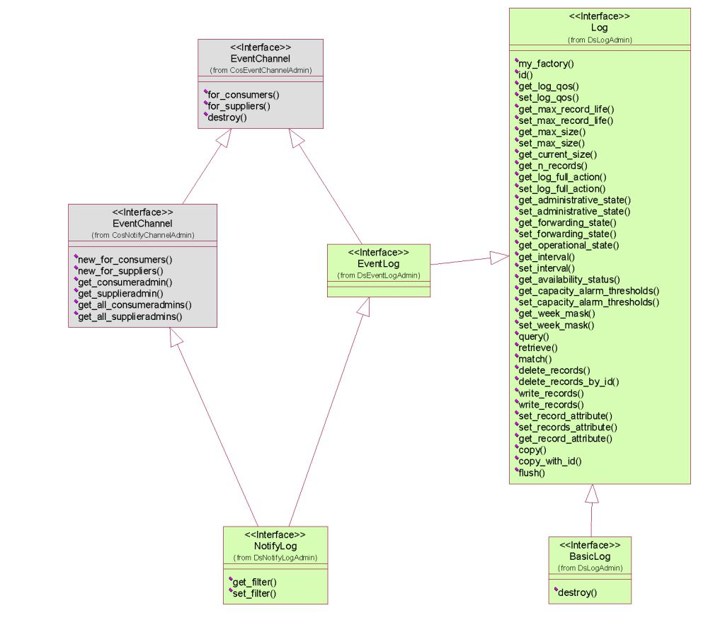
CORBA Log
Channel
Channel & Log
Log

Slide 8
OGSA Logger System: Requirements
Abstraction of Legacy Logger Systems
- eg NT events, UNIX syslog, zOS System Logger, …
Persistency
- fundamental requirement
Support for Sequential Record Input and Output
- sequential I/O with record granularity
Ordering of Log Records
- (at least a partial) ordering based on timestamp
Broker
- concurrent access by multiple suppliers & multiple consumers
Stateful Read Cursor
- not invalidated by concurrent reads / writes
Robust
- eg PD logging is critical when systems come under extreme stress
Performance
- eg PD logging in a transaction environment
Merged Log
- support for underlying mechanisms that permit the merging of multiple log streams
Synchronous and Asynchronous Write Semantics
- with: ack, callback for ack, and fire & forget
Deletion of Log Records
- time-stamp based deletes
Coexistence w/ Messaging Fabric
- log-type persistency for the fabric
Standard Set of Specialized Logstreams
- Secure Logs
  ie security QoSs unique to log, eg: confidentiality, integrity for audit, who accessed and when, non repudiation
- Globally Ordered Logs
- Circular Logs
- Duplexed Logs (reliability QoS)
- Compressed Logs

Slide 9
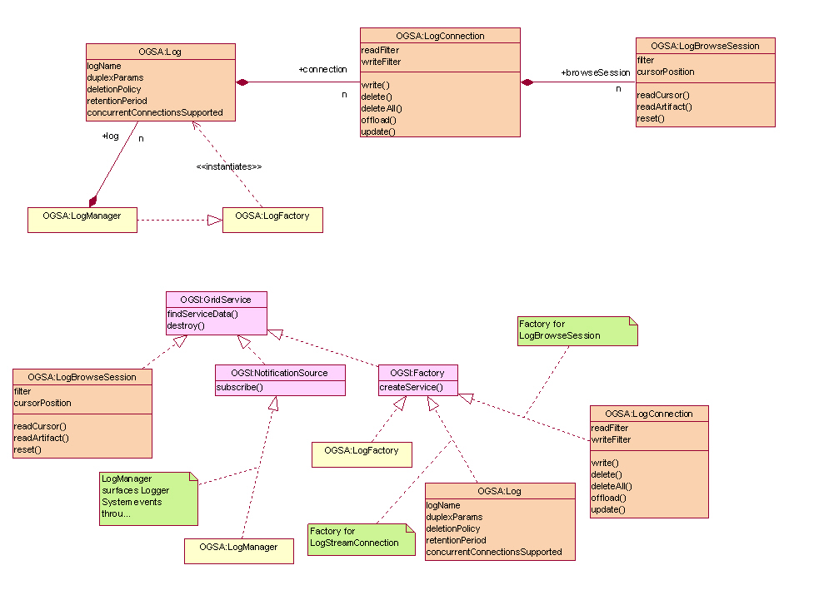
Service Oriented View of a Logger System

