Slide 1
OGSA
Status and Future
GGF12 , September 22nd, 2004
Ian Foster and Hiro Kishimoto
OGSA-WG co-chairs

Slide 2
GGF Intellectual Property Policy
All statements related to the activities of the GGF and addressed to the GGF are subject to all provisions of Section 17 of GFD-C.1, which grants to the GGF and its participants certain licenses and rights in such statements. Such statements include verbal statements in GGF meetings, as well as written and electronic communications made at any time or place, which are addressed to any GGF working group or portion thereof,
Where the GFSG knows of rights, or claimed rights, the GGF secretariat shall attempt to obtain from the claimant of such rights, a written assurance that upon approval by the GFSG of the relevant GGF document(s), any party will be able to obtain the right to implement, use and distribute the technology or works when implementing, using or distributing technology based upon the specific specification(s) under openly specified, reasonable, non-discriminatory terms. The working group or research group proposing the use of the technology with respect to which the proprietary rights are claimed may assist the GGF secretariat in this effort. The results of this procedure shall not affect advancement of document, except that the GFSG may defer approval where a delay may facilitate the obtaining of such assurances. The results will, however, be recorded by the GGF Secretariat, and made available. The GFSG may also direct that a summary of the results be included in any GFD published containing the specification.

Slide 3
Status and Future Session Outline
What is OGSA?
Architecture v1 doc status
Architecture v2 doc plan
Roadmap document status
Future plan
Summary

Slide 4
What is OGSA
Open service-oriented architecture based on Web services for addressing Grid scenarios
Component-oriented architecture
  Interchangeable components
Meta OS functionalities
  Distributed and heterogeneous environment
A rendering of these functions, based on Web service architecture and specifications
A GGF’s flagship architecture

Slide 5
OGSA Formation
OGSA-WG
  Designs overall architecture
  Integrates and adjust design-teams’ output
OGSA-WG design teams
  Informal domain expert groups within OGSA
  May include co-chairs of other WG/RGs
  Output is included in OGSA specification
Relation to other WG/RGs
  Explain OGSA’s approach and get feedback
  Consign specification design work
  Two way street: OGSA-WG willing to receive innovative ideas and reflect in OGSA architecture

Slide 6
OGSA History
Announced at GGF4 (’02/2)
WG created (’02/9)
7 interim F2F meetings
OGSA Usecase document at GGF10 (’04/3)
  Public comment period completed
Declared as GGF’s flagship architecture at GGF10 (’04/3)
OGSA document v1 at GGF11 (’04/6)
  First version as informational document
  Companion OGSA Glossary document
  Public comment period completed
OGSA roadmap draft at GGF12 (’04/9)

Slide 7

Cataloging
Provisioning
VO
Mgmt
Context Services
Data
Services
Integration
Policy
Mgmt
Access
Information Services
Context
Services
Execution Mgmt Services
Data
Services
Info
Services
Trouble-
shooting
Event
Mgmt
Discovery
Logging
Application
Mgmt
Workflow
Mgmt
Workload
Mgmt
Execution
Planning
Job
Mgmt
Execution
Mgmt
Services
Infra
Services
WSRF
WSN
WSDM
Naming
Infrastructure
Services
Reservation
Configuration
Deployment
Provisioning
Rsrc Mgmt
Services
Self Mgmt
Services
Security
Services
Resource Mgmt Services
Heterogeneity
Mgmt
Authentication
Self
Mgmt
Services
Optimization
Authorization
Security
Services
Service Level
Attainment
Integrity
QoS
Mgmt
Boundary
Traversal

Slide 8
Status and Future Session Outline
What is OGSA?
Architecture v1 doc status
Architecture v2 doc plan
Roadmap document status
Future plan
Summary

Slide 9
OGSA v1 Document and Glossary
“The Open Grid Services Architecture, Ver. 1.0”
  https://forge.gridforum.org/projects/ogsa-wg/document/draft-ggf-ogsa-spec/en
  Informational document, not recommendation
    Explains our current thinking on required capabilities, for discussion
    Depends on emerging specifications (e.g., WS-RF, WS-Notification)
    Insufficient to develop actual implementation
“The Open Grid Services Architecture Glossary of Terms”
  https://forge.gridforum.org/projects/ogsa-wg/document/draft-ggf-ogsa-glossary/en
  Companion document specifying OUR definitions of overloaded terms

Slide 10
Public comments summary
OGSA specification v1
  Tracker submissions: 9 persons
    And a detailed review up to section 3.5 (not included)
  Comment breakdown: 40
    General approval: 2
    Editorial: 17
    Minor: 21
      Revise/add explanation 14
      Terminology 7
  Submit your comments by the end of GGF12
    Public comment tracker, ogsa-wg list, or authors
OGSA glossary v1
  Submissions: 6 persons
  Add or refine definitions

Slide 11
Status and Future Session Outline
What is OGSA?
Architecture v1 doc status
Architecture v2 doc plan
Roadmap document status
Future plan
Summary

Slide 12
Goals for OGSA v2 document
Refine statement of required capabilities
  Based on work of other WGs & other standards bodies
  Based on experience of early adopters
Define specific interfaces (operations & behaviors) for capabilities identified in v1
  Either in collaboration with existing WGs …
  Or as input to future WGs
Series of documents
  Delivery in one year (root docs)
  Informational docs and recommendation docs

Slide 13
Design team
Informal domain expert groups within OGSA
May include co-chairs of other WG/RGs
Output is included in OGSA specification

Slide 14
OGSA Design Team
Cataloging
Provisioning
VO
Mgmt
Integration
Data Service
design team
Policy
Mgmt
Access
Information Service design team
Context
Services
Data
Services
Info
Services
Trouble-
shooting
Event
Mgmt
Discovery
Logging
EMS design team
Execution
Mgmt
Services
Infra
Services
Application
Mgmt
Workflow
Mgmt
Workload
Mgmt
Execution
Planning
Job
Mgmt
WSRF
WSN
WSDM
Naming
naming design team
OGSA-WG
Reservation
Configuration
Deployment
Provisioning
Rsrc Mgmt
Services
Self Mgmt
Services
Security
Services
Self Mgmt design team
Resource Mgmt design team
Heterogeneity
Mgmt
Authentication
Security Service
design team
Optimization
Authorization
Service Level
Attainment
Core (roadmap) design team
Integrity
QoS
Mgmt
Boundary
Traversal

Slide 15
Design team status
Data Area WGs
  Working well: a series of joint phone calls
Security
  Frank Siebenlist provides connectivity
Execution Management Services
  Communication needs to be improved
Management
  Fred Maciel coordinates with CMM, WSDM

Slide 16
OGSA v2 Definition Process
“top down” and “bottom up” worlds are to be coordinated
OGSA-WG is concerned with defining requirements and overall architecture: the lighthouse towards which others may steer.
WGs within GGF or other bodies may/will be formed to develop specifications that speak to requirements identified by OGSA-WG.
The steps by which a technical specification may become identified as “OGSA compliant” remains to be clearly defined.
  A key requirement might be identification as a “recommendation” in the sense that there are two or more interoperable implementations.

Slide 17
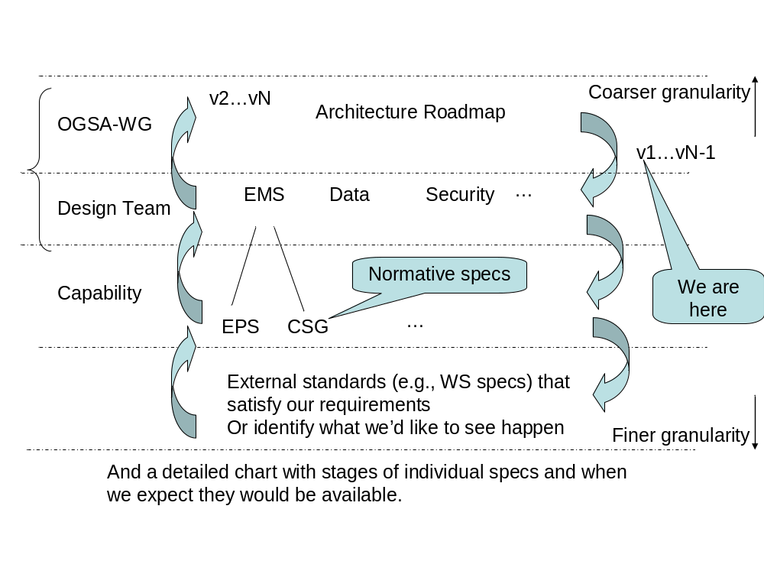
OGSA v2 Definition Process

Slide 18



OGSA v2 Doc Process and Deliverables
Root
Documents
Usecase doc
Architecture v2
Glossary
Design team
Documents
Service descriptions
Scenarios
Domain expert
WGs create
Specifications
GGF Recommendation documents

Slide 19
OGSA v2 Deliverables
Root documents
  Existing usecase v1 document (tier 1)
  Revise OGSA document v1
  Also update OGSA Glossary doc
Design team documents
  Service Description describes the services in the area in natural language, listing the interfaces and operations defined by each service.
  Scenarios demonstrates how these services can implement the use cases, using a combination of natural language and UML.
Expert WG document
  Specify the services using a mixture of WSDL and natural language
  GGF Recommendation documents.

Slide 20
Status and Future Session Outline
What is OGSA?
Architecture v1 doc status
Architecture v2 doc plan
Roadmap document status
Future plan
Summary

Slide 21
Why a Roadmap?
Many GGF participants have bought into the notion that OGSA can serve as an overarching architectural framework for different GGF activities. They now want to understand what this framework implies for their work.
Developers and users want to know “what they can expect when” in terms of standards, so that they can make plans for product developments and technology acquisitions.
Arguably the credibility of OGSA, GGF, and Grid as a whole depends in part on a coherent answer to this question.

Slide 22


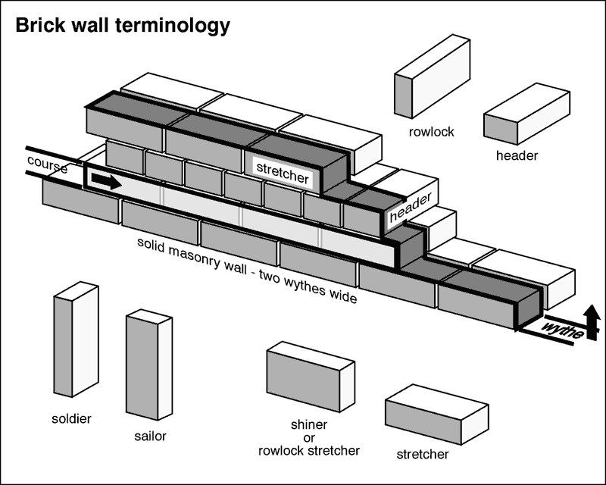
Roadmap Must Prioritize
OGSA
Today
Where we want to go
OGSA
Tomorrow
How we get there

Slide 23
Defining a Roadmap: Challenges
Coordination with other relevant activities
  E.g. in the Web services community
The danger of premature standardization
  Without adequate experience &/or buy in from users
OGSA design team remains fairly small
  What perspectives have not been considered?
  We can’t do everything!
Believing that we can define the entire future of distributed computing
  We don’t want a grander castle, we want some simple furniture

Slide 24
Goals for Roadmap
Define priorities for OGSA interfaces, based on community input
Identify dependencies among interfaces
Document community requirements for timing of various interfaces
Delivery of first draft at GGF12, final in GGF13 (’05/03)
  First draft is in GridForge

Slide 25
Current contents of the roadmap doc
1 Introduction
2 OGSA: Goals and Status
3 The Standards Landscape
4 OGSA Definition Process
5 Dependencies and Priorities

Slide 26
The Standards Landscape
The roles of GGF, OASIS, W3C, DMTF, IETF
Products that may be expected from each of these groups in the coming 1-2 years, and their relevance to OGSA
Approaches that may be taken to facilitate coordination

Slide 27
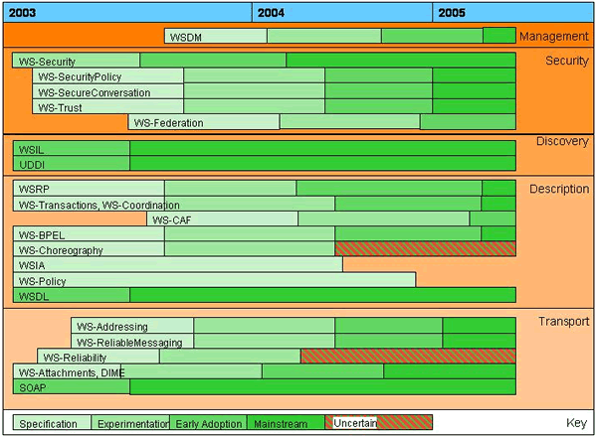
A Perspective on SOA Specifications

Slide 28
OGSA-Relevant Activities
OASIS
  WSRF and WS-Notification
  WS-Security, etc.
  WSDM
DMTF
  Utility Computing
  CIM
  Server management
W3C
  WS-Addressing
  Various others

Slide 29
Dependencies and Priorities
What specifications:
  are most important? need to be done before others?
  do we have the expertise to develop?
  are “users” ready to accept?
  are not being done by others?
Answers to these questions will help us define
  what we should do first
  where we need to influence external activities
  where we need to broaden our expertise
More specifically:
  What can/must we do in the next 6 months? 12?
  What can’t we do in the next 6 months? 12?

Slide 30
One Approach: Six Month Tasks
Ideally, we can identify “modules” such that
  First ideas can be developed fast (6 months?)
  Are directly relevant to practical problems …
  … and will be implemented to provide experience
  Contribute to overall goal
E.g., things like
  Job submission
  Accounting & auditing
  Delegation
  Storage resource management
  DAIS
Your input is welcomed here

Slide 31
Next Steps
Design team activities
OGSA v2 series document
  More feedback and refinement
  First draft available at GGF13
Roadmap document
  More feedback and refinement
  Submission at GGF13

Slide 32
Summary
OGSA is an open service-oriented architecture based on Web services for addressing Grid scenarios
Strengthen collaboration with related WG/RGs by means of design teams
  Join OGSA design team sessions today
Wider cross Standards Organizations collaboration is the KEY
Informational roadmap document needs your input

