Slide 1

New open source CA development as Grid research platform.
National Research Grid Initiative in Japan
Takuto Okuno.

Slide 2
About NAREGI PKI Group (WP5)
WP6：Grid-Enabled Apps
WP3：Grid Visualization
WP3：Grid PSE
WP2：
Grid Programming
- Grid RPC
- Grid MPI
WP3：Grid Workflow
WP1：
Grid Monitoring & Accounting
WP4：
Packaging
WP1：
SuperScheduler
（Globus,Condor,UNICORE➔OGSA)
WP1： Grid VM
WP5：
High-Performance & Secure Grid Networking
Notes:
okuno: Before describing NAREGI Authentication Service, I would like to introduce NAREGI PKI working group. NAREGI is national grid research project in Japan. Currently, it has six different working area to study and develop the grid system.
NAREGI PKI working group is included in WP5, high-performance & secure grid networking. We are usually discussing about security of grid networking which contains technical issue and operation policy issue. So, we have developed the CA server software and user registration system for issuing grid host and end user certificates. Of course, the CA operation and user registration process are defined in NAREGI CP/CPS.

Slide 3

NAREGI Authentication Service Perspective
To develop CA and RA server software that supports grid environment.
To develop CA/RA policy and authentication service policy satisfied with basic assurance level by GGF.
To experiment the operation of PKI authentication service (CA server software and CP/CPS) for UNICORE and Globus grid environment.
To consider multi domain policy, and create an authentication mechanism for such environment.
It was necessary for developing new CA software
to satisfy our functional and security requirement.

Slide 4


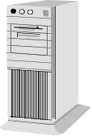
NAREGI Registration Sequence
User site
NAREGI site
End user
Host administrator
Site Administrator (LRA)
CA Administrator
LicenseIDs
Request
1. Prepare LicenseIDs
Issue
LicenseIDs
Telephon, Mail
and so on.
Account Request
Account Registration
2. User registration
Certificate
Request
Issue a
LicenseID
Might be
face to face.
3. Submit a licenseID and
request to issue a certificate
4. Request to revoke a certificate
5. Request to update a certificate
RA Server
Apply certificate
operation
Accept a user request
(issue,revoke,update)
Via command line or WEB (Online)
6. grid-mapfile generation
Download a base grid-mapfile and generate mapfile for local site
base grid-mapfile
publish
Notes:
okuno: this is the PKI registration service sequence. NAREGI site has the CA server and the RA server. Normally, a CA administrator processes initial registration. On the first, a site administrator needs to contact with CA administrator. This might be done by telephone, Mail or email. A site means somewhere university or research laboratory. When the CA administrator receive a site registration, he need to check and verify that organization. If the organization passes this verification, CA administrator returns License ID list, that is used by user certificate request. Then initial registration finished.
Second step, a site administrator starts account registration business for local site grid system. End user or a host administrator contacts with a site administrator by telephone, email or face to face. Then, a site administrator checks user identity and decide that license ID could be paid for him. If it is so, end user could get a license ID.
On the next step, end user can connect online RA server via command line or http (WEB). At the first time connection, a license ID is required. If a license ID is correct and not used already, authentication will be finished successfully. End user can proceed next step. After all, he inputs his name, and maybe email address to generate a certificate signing request. Of course, this means user public key pair is generated his local machine. Then, a CSR would be submitted to the RA server and the RA server hooks up its request to the CA server. The CA server issues a certificate automatically and return it to the RA server. Finally, end user can receive his own certificate.
When end user has own certificate, he can connect the RA server via SSL client authentication. then, certificate update and revocation could be done.
There is optional service included in NAREGI CA. That is automatic grid-mapfile generation. The RA server has mapping information between end user subject DN and license ID. This mapping can be published ‘global’ grid-mapfile on the WEB site. If local site download this file, system can generate local grid-mapfile automatically, because local site has license ID and local account name information. This could be done by “gridmapgen” module in NAREGI CA.

Slide 5
NAREGI CA – roadmap & function layer
Development in 2003
in 2004 - 2005
After 2005
Service Interface for VO Management
Command
User Interface
Web
User Interface
Service Interface for
Account management
ＸＫＭＳ
LCMP
RA
Web Service Interface (Java API)
based on AiCA (Open Source)
CP/CPS
Extended Authentication Policy
(multi domain)
Authentication Policy
(single domain)
NAREGI AUTHENTICATION SERVICE
NW Infrastructure
Notes:
okuno: This is illustration of the NAREGI CA development roadmap and functions. Authentication policy and CP/CPS are actually software requirement definition. Each CA server components included in the NAREGI CA are developed to satisfied with these requirement.
Last year, we designed certificate management protocol and implemented CA/RA server modules. After that, we have started trial CA operation for NAREGI grid environment since march, 2004.
LCMP, which is Lightweight Certificate Management Protocol , is our original protocol for managing CA and RA server. As you know, there is CMP (Certificate Management Protocol) defined in RFC2510 and 2511. This CMP is originally developed for Entrust Authority. Therefore, there are many entrust specific definitions and its CMP header and body, protocol sequence are kindly “heavy”. So, we had decided to create more simple and lightweight certificate management protocol for our CA server, such as called LCMP. You may notice that “lightweight” is used in other protocols like LDAP. Actually, our LCMP ASN.1 format and protocol sequence are very similar to LDAP’s.
Most of server components uses LCMP and their communication is established on SSL client authentication. So, server operation is securely controlled from remote environment. WEB enroll cgi and RA daemon on the RA server could have their own operator certificate (and private key). Then, the CA server can configure operator’s access right on each certificate, crl and profile operation.

Slide 6

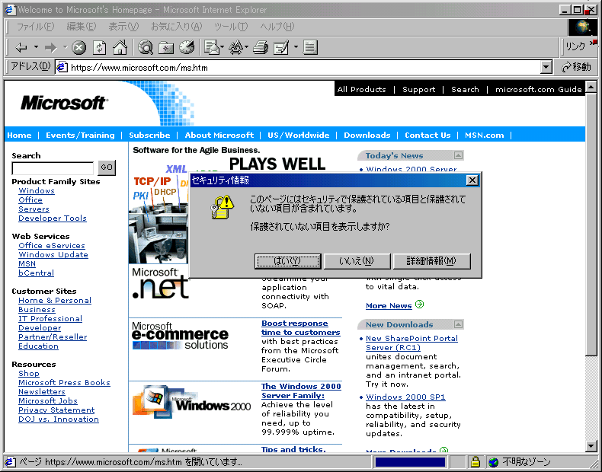


NAREGI CA – server components
LDAP Server
Collaborate with Grid Service, S/MIME, Group ware and so on.
LDAP
RA Server
CA Server
email
certreq
aienroll
LCMP
aicrlpub
airad
aicad
enroll (apache CGI)
HTTP
WEB
LCMP
gridmapgen
LCMP
email
User
CA management tools
aica
PKI utilities
certview
certconv
CA Administrator
Notes:
okuno: this slide describes CA and RA server component relation ship. All module could be executed on the same machine or separated server machines. Main CA server module is “aicad” which works as daemon. Issuing a certificate or a CRL, and managing issued certificates or certificate profile information are provided by this daemon.
(((CRL publisher, which module name is “aicrlpub”, has the same function as its name. It can publish CRL to a local file or to the LDAP server. It can dynamically access local CA information and issue CRLs at fixed intervals. Of course, aicrlpub can be executed on remote server and access to issue CRLs.))) (skip)
RA server has several modules. “airad” and “enrollment CGI” are used for user enrollment. These module provide end users with certificate request, update, and revoke operations. airad is executed as daemon process and usually waiting for some operation of a user certificate by command line interface named “certreq”. For globus specific environment, user can use grid-certreq shell script instead of certreq command. Otherwise, WEB enrollment CGI is executed by apache web server per each connection. User can access enrollment web site with the Internet Explorer and request a certificate by using ActiveX dll module. Both module has several user authentication methods, such as anonymous basis, ID/Password authentication, License ID authentication which is valid just one time, or SSL client authentication. Normally, certificate request phase requires ID/Password or License ID authentication, and certificate updating and revocation phase require SSL client authentication.
(((“aienroll” and “gridmapgen” are optional modules. NAREGI CA provides two certificate issuing modes, one is direct issuing mode and another is CA administrator confirmation mode ( called post mode). In default settings, direct issuing mode is used. User sends a certificate request and receive a certificate on the moment. If post mode is selected, enrollment modules send a email for certificate request confirmation. CA administrator uses “aica” CA management tool to accept or reject user certificate request. Then, “aienroll” module detect CA administrator’s operation and inform its operation result of end user by email.
“gridmapgen” is globus specific optional module. It can download grid-mapfile from several web sites and integrate mapping information between local account name and certificate subject DN, then outputs grid-mapfile for local grid environment.))) (skip)

Slide 7
NAREGI CA – Features at a glance
Detailed settings of profile (date/time, subject template, policy, etc.)
Extension information for individual profiles
Management of user’s private key (key recovery is available)
Support HSM (PKCS#11)
Issuing multiple certificates in one operation using CSV
Remote CA management
Manage multiple CA/RAs on a single server
Higher security by separating CA server and RA server
Web enrollment feature
Command line enrollment feature for Globus
Authorization using ID/Password, LicenseID
Interact with LDAP server
Automatic issuing of certificates
Life cycle management using Web enrollment/Command line enrollment
Periodic issue of CRL (possible to interact with LDAP)
Access log, issuing log, error log
Features for management of grid-mapfile
Features for interact with UNICORE UUDB

Slide 8
NAREGI CA – Secure grid web service perspective
RA Server
SAML Service Provider
XKMS
(X-KRSS)
XKMS (X-KISS)
Account
Mapping Service
LCMP
Authentication
Authority
CA Server
Attribute
Authority
Policy
Decision
Point
Offline issue
Online issue and revocation
Authentication
(include SSO)
Issuing a certificate online via WEB
browser or WEB service
Also, offline issue using a smart card or a USB token is provided.
XACML
Refer policy and access rights
Agreement
Factory
(scheduler)
SOAP / HTTP RPC
WS-Security
(encrypted, signature)
OGSI, OGSA
OGSI, OGSA
User
Strong authentication and encryption are provided by WS-Security on using OBSA Grid RPC.
Also, Single Sign On by SAML may be usable.
CPU Resource
OGSI, OGSA
Grid Application
Service Provider
DATA Resource
Notes:
(((Skip this)))
okuno: This illustration describes secure grid web service perspective. A user can get a certificate from XKMS(X-KRSS) service initerface or hardware token by offline. Then, user can connect Agreement Factory, such as scheduler, in grid application service provider to submit his job.
Scheduler needs to authenticate a user request, so it contacts authentication authority in SAML service provider. This authentication authority could be XKMS (X-KISS) service interface. NAREGI CA will implement these X-KRSS and X-KISS service interfaces.
Otherwise, Account mapping service is local site specific. This system might be LDAP basis or RDB basis. Scheduler needs to get user identity at local site and access policy for site resources. PKI service might be required to provide account management system with end entity information.

Slide 9
NAREGI CA - CD contents
CD contents
  README (Overview, install, etc..)
  LICENSE
  Release NOTE
  naregi-ca-1.0.tar.gz
    Source files
    CP/CPS, Administrator Guide, etc..
  naregi-project
    naregi_pre.pdf (about NAREGI)
    wp5_pre.pdf (about NAREGI Work Package 5)
Notes:
okuno: Thank you for listening our presentation. Now, we would like to propose distributing our development result, such as NAREGI CA sever software and CP/CPS. We apologize that NAREGI download site is still under construction. So, we prepared CD-R media easily to confirm our CP/CPS document and CA operator/ user manuals.
This CD-R is formatted ISO9660, so it is readable for Windows or UNIX environment.(?) README file describes NAREGI CA overview and how to install naregi-ca-1.0 software to the server. Actually, installation is very typical operation. Unpack naregi-ca tar ball, and input “./configure” to collect server information, then input “make” to compile source files, finally input “make install” to install naregi-ca into the server.
After installation, the CA construction is required. But it is also proceeded easily. We can use “aisetup.sh” to generate CA public key pair and setup CA information directory. CA server configuration file named “aica.cnf” is automatically rewritten, so we just need to input “aicad” command to start CA server daemon.
So, this is really end of my presentation. If you have any question about NAREGI CA or my presentation, I could answer it as far as I know. Thank you.

Slide 10
Appendix. Cryptographic Algorithms
・Available Cryptographic and Hash algorithms
Public key cryptography
RSA (with key generation)
DSA (with parameter generation)
Elliptic Curve DSA (with parameter generation)
Symmetric cryptography
DES(ECB,CBC,CFB)
Triple-DES(ECB,CBC)
RC2(ECB,CBC)
Hash
MD2, MD5, SHA1
HMAC (key hash)

Slide 11
Appendix. File Formats
・Available PKI files
Certificate
X509 DER, PEM (*.cer,*.pem )
PKCS#7 DER ( *.p7b )
PKCS#12 DER ( *.p12, *.pfx )
Private Key
PKCS#1 PEM (*.key,*.pem )
PKCS#8 DER (*.key,*.pem )
PKCS#12 DER ( *.p12, *.pfx )
CRL
X509 DER, PEM (*.crl,*.pem )
PKCS#7 DER ( *.p7b )
Cross certificate pair
X509 DER, PEM (*.ccp,*.pem )
Certificate Signing Request
PKCS#10
DER, PEM (*.crl,*.pem)

Slide 12
Appendix. grid-mapfile generation
Generate a grid-mapfile from a global mapfile and local users.csv file.
grid-mapfile
Grid node
(7)
Generate a grid-mapfile that includes a licenseID and a subject DN mapping.
gridmapgen
(6)
http download
users.csv
(5)
grid-mapfile
LCMP
Issue or revoke
a certificate
Create a file that defines a licenseID and local account name mapping.
RA Server
CA Server
(1)
(4)
(3)
(2)
Issue or revoke a certificate. Input licenseID and subject DN
Inform a licenseID
Site Administrator
User

Slide 13
Appendix. NAREGI Authentication Service
NaReGI Auth.
Policy Domain
User
Proxy
JOB Request
Other Auth. Policy Domains
Create
JOB Request
Resource
Process
Resource
Create
Process
User
Create
Delegate
Validate
Cert
Validate
CSR
RA
Collaboration
RA
CA
CA
Notes:
okuno: This is simple illustration of NAREGI Authentication service. This describes end user certificate registration and proxy certificate creation. As you see, this is normal GSI processing and it means that our PKI system is smoothly integrated in current grid system.
End user normally generate his public key pair on local machine using WEB interface or grid-certgen command. Then, a Certificate Signing Request (CSR) is created. This CSR will be submitted to the RA server. If end user authentication and CSR verification is succeeded, a certificate will be issued for him.
If user uses command line interface, user private key and certificate file are automatically located in .globus directory. If user uses WEB browser, he need to export a pfx (PKCS#12) file, and move it to globus client machine. But this type is useful for UNICORE client, because its java client can import a PKCS#12 file directly.

Slide 14
NAREGI CA – roadmap
NAREGI CA – development roadmap
In 2003 | In 2004 | In 2005
LCMP protocol definition NAREGI CA development Start trial CA operation | Optimize performance （10k certificates/h） LCMP Java API Service Interface for account management | XKMS Feedback / improve server operation
Notes:
okuno: This is development roadmap of NAREGI CA. Last year, we designed certificate management protocol and implemented CA/RA server modules. After that, we have started trial CA operation for NAREGI grid environment since march, 2004.
In this year, we are optimizing our CA server performance and developing LCMP Java API for complying WEB service. Because there is standard PKI operational interface of WEB service named “XKMS”, we need to prepare Java based application interface for it.
Also, the PKI system needs to collaborate with grid account management system, we may need to provide other modules for NAREGI super scheduler or UNICORE user mappings.
Next year, we will implement “XKMS” WEB service interface, and integrate CA operational feedbacks to improve server capability.

