Slide 1
GLOBALGRIDFORUM.ORG
Grid Scheduling Architecture
RG
GGF12
Brussels
September, 2004

Slide 2
GGF Intellectual Property
All statements related to the activities of the GGF and addressed to the GGF are subject to all provisions of Section 17 of GFD-C.1, which grants to the GGF and its participants certain licenses and rights in such statements. Such statements include verbal statements in GGF meetings, as well as written and electronic communications made at any time or place, which are addressed to any GGF working group or portion thereof,
Where the GFSG knows of rights, or claimed rights, the GGF secretariat shall attempt to obtain from the claimant of such rights, a written assurance that upon approval by the GFSG of the relevant GGF document(s), any party will be able to obtain the right to implement, use and distribute the technology or works when implementing, using or distributing technology based upon the specific specification(s) under openly specified, reasonable, non-discriminatory terms. The working group or research group proposing the use of the technology with respect to which the proprietary rights are claimed may assist the GGF secretariat in this effort. The results of this procedure shall not affect advancement of document, except that the GFSG may defer approval where a delay may facilitate the obtaining of such assurances. The results will, however, be recorded by the GGF Secretariat, and made available. The GFSG may also direct that a summary of the results be included in any GFD published containing the specification.

Slide 3
Agenda
  Overview/Charter
  Use-Cases
  Identifying Required Components/Services
  OGSA job scheduling
  Next Steps

Slide 4

Grid Scheduling Architecture
Grid-
User/Application
Grid-
Scheduler
Information
Services
Monitoring
Services
Security
Services
Grid
Middleware
Grid
Middleware
Grid
Middleware
Grid
Middleware
Accounting/Billing
Other
Grid Services
Local RMS
Local RMS
Local RMS
Local RMS
time
time
time
time
Schedule
Schedule
Schedule
Schedule
Compute
Resources
Data
Resources
Network
Resources
Other
Resources/Services

Slide 5
Documents to work on
Use Cases for Grid Scheduling
  Complete current version
Architecture for Grid Scheduling
  Derive requirements from use cases
  Identify components/services
  Match existing components/services
  Define required interfaces/protocols for scheduling

Slide 6
Use Cases
Contributions
  Migration Use Case (GridLab, K. Kurowski)
  Coordinated Simulation and Visualization (C3-Grid, R. Yahyapour)
  Knowledge Grid Scheduler (DEIS, A. Pugliese, D. Talia)
  Self-Organising GRM (A. Lazarevic, UK UCL, BT ExacT)
  Nimrod/G, GridBus (R. Buyya)
  OGSA Use-Case Doc made available in public comment period

Slide 7
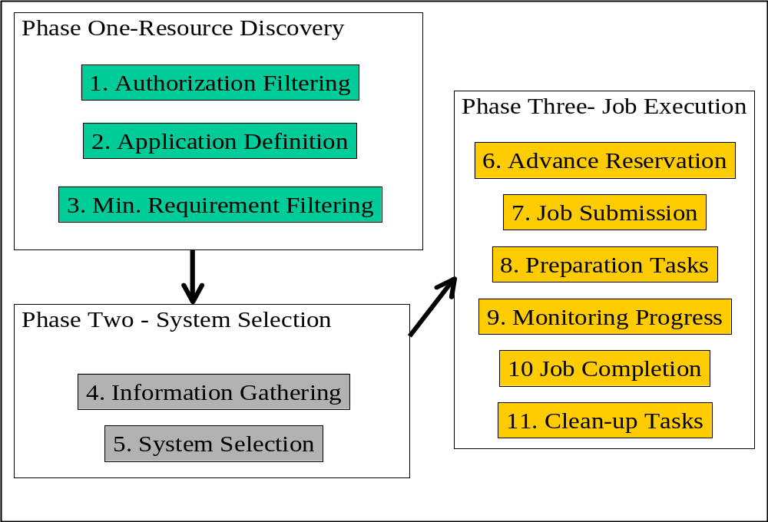
Activities of a Grid Scheduler
Detailing “10 Actions of Super Scheduling (GFD-I.4)”
Identifying required services/components
Source: Jennifer Schopf

Slide 8
Required Services/Components
Relevant to scheduling architecture
  Information Service
  Job/Workflow Description
  Requirement Description
  Resource Discovery
  Reservation
  Monitoring/Notification
  Job Execution
  Security
  Accounting/Billing
  Data Management
  Local RMS
  (…?)
Other services/components required?

Slide 9
OGSA Philosophy
“
Demand
”
“
Supply
”
Workload Mgmt.
Environment
Resource Mgmt. Framework
Framework
Mgmt.
CMM
Reservation
Resource
Primary Interaction
Factory
User/Job
Policies
Job
Information Provider
Resource
Proxies
Factory
Allocation
Dependency management
Meta
-
Interaction
Resource Provisioning
(or Binding)
Optimizing Framework
Workload Optimizing Framework
Scheduling
Resource Optimizing Framework
Queuing Services
Capacity Management
Workload Optimization
Workload Optimization
Resource Placement
Workload Post Balancing
Resource
–
Workload
Admission Control (Resources)
Optimal Mapping
Workload Models (History/Prediction)
Quality of Service (Resources)
Workload Orchestration
Resource Selection
Admission Control (Workload)
Selection Context (e.g. VO)
SLA Management (Workload)
Represents one or more OGSA services

Slide 10
Information Service
Resource Discovery
Relevant for Grid Scheduling:
Access to static and dynamic information
Dynamic information include data about planned or forecasted future events
  e.g.: existing reservations, scheduled tasks, future availabilities
  need for anonymized information (privacy concerns)
information about all resource types
  including e.g. data and network

Slide 11
Job/Workflow Description
Requirement Description
Information about the job specifics (what is the job)
and job requirements (what is required for the job)
need for workflow description
  e.g. a DAG formulation
  need for extracting workflow information to schedule whole workflow

Slide 12
Reservation Management
Agreement and Negotiation
Interaction between scheduling instances, between resource/agreement providers and agreement initiators (higher-level scheduler)
  access to tentative information necessary
  negotiations might take very long
  individual scheduling objectives to be considered
  probably market-oriented and economic scheduling needed
Need for combining agreements from different providers
  coordinate complex resource requests or workflows
Maintain different negotiations at the same time
  probable several levels of negotiations, agreement commitment and reservation

Slide 13
Accounting and Billing
interaction to budget information
charging for allocations, reservations; preliminary allocation of budgets
re-funding in terms of resource/SLA failure, re-scheduling etc.

Slide 14
Job Management Services
Link to execution services to fulfill scheduled allocations
feedback on resource or job failures
interface to cancel or modify scheduled job executions
monitoring of agreement and execution status

Slide 15
Monitoring Services
Monitoring of
  resource conditions
  agreements
  schedules
  program execution
  SLA conformance
  workflow
  …

Slide 16
Data Management
Access to information about the location of data sets
information about transfer costs
schedules about data transfers and data availability
coordination with network or other resources
similarities with general grid scheduling:
  access to similar services
  similar tasks to execute
  interaction necessary

Slide 17
Reviewing Existing Services/Components
Relevant to scheduling architecture
  Information Service (GIR)
  Job/Workflow Description (JSDL,WFM)
  Requirement Description (JSDL, GRAAP)
  Resource Discovery (OGSA, WSRF)
  Reservation (GRAAP)
  Monitoring (OGSI/WSRF, DAMED)
  Job Execution (DRMAA)
  Security (GSI)
  Accounting/Billing (GESA)
  Data Management (DAIS)
  Local RMS (SA)
Other groups to be considered?

