Slide 1
OGSA-WG Basic Profile Session #1
Security
Mar. 14, 2005 (GGF13@Seoul)
Frank Siebenlist, ANL
Takuya Mori, NEC/ANL

Slide 2
Backgrounds
Profile is a document which promotes interoperability of multiple implementations.
Profile refers to a set of currently available specifications and states how to use them.
Draft submissions of the Basic Profile 1.0 documents are targeted from Jun. to Dec.'05.
The security profile is also required to be defined within the same time frame.

Slide 3
Items, Specs and Status (1)
Communication Channel Security
  WS-I BSP 1.0 (latest draft: Jan.20,'05)
    Transport Layer Security (SOAP/HTTPS, TLS, SSL)
    SOAP Message Security (WS-Security, XML-Signature, XML-Encryption)
Authentication
  X509 Identity Certificate (RFC-3280)
  Kerberos
  WS-Trust, WS-SecureConversation (Proprietary specs)

Slide 4
Items, Specs and Status (2)
Delegation
  X509 Proxy Certificate (RFC-3820)
    wide industry support is still unclear...
  WS-Delegation - BoF at GGF13
    possible standardization of Delegation Service?

Slide 5
Items, Specs and Status (3)
Authorization
  Use of SAML for OGSA-Authz (draft, OGSA-Authz-WG)
    SAML 1.1 (Authz Decision)
  OGSA Authz Attributes (draft, OGSA-Authz-WG)
    SAML 1.1, X509 Attribute Certificate (RFC-3281)
  SAML 2.0, XACML 2.0
  (Just approved as OASIS standards)
    Potential GGF OGSA-Authz adoption

Slide 6
Items, Specs and Status (4)
Others
  Firewall – BoF at GGF13
  VPN RG – BoF at GGF13
  Trusted Computing - BOF at GGF13
    Virtual Machines / Isolation / Jailed Environment

Slide 7
Scope
Candidate Items for the BP 1.0
  Communication Channel Security
    WS-I BSP1.0 (SOAP/HTTPS, SSL, TLS, WS-Security, XML-Signature, XML-Encryption...)
  Authentication
    PKI / X509 Identity Certificate
The remaining items will be discussed for the BP 2.0 or later version of profiles

Slide 8
Schedule
Draft will be submitted by Jun.'05
(if assertion communication is not a part of the BP1.0)

Slide 9
Profile Contents – Example (1)
Communication Channel Security
  The profile mandates the use of transport layer security or message level security for secure transmission of messages.
    R0801 When establishing an HTTP connection a SENDER MUST use HTTP over TLS as profiled by WS-I BSP 1.0 Section 3 and Section 9.

Slide 10
Profile Contents – Example (2)
Authentication
  Consumers and instances SHOULD provide authentication information
  To provide interoperability, only X509 Identity Certificate based authentication is permitted by the profile.

Slide 11
Relationship with WS-I BSP1.0
Schedule
  the latest version: draft dated Jan.20, '05
  Originally, the draft was scheduled to be released in May.'04
  No update with their charter
WS-I BSP1.0 Extension Points
  Some statements should be needed for the each extension points
WS-I BSP1.0 Requirements
  Need to find out conflicts against our requirements and to relaxen them if there exist some
  We are now closely looking at the requirements

Slide 12
Outstanding Security Issues for BP1.0
Transport and/or Message Level Security
  ??MUST/SHOULD??
Discovery of key-info for encryption in message level security
  Service Group Profile / EPR embedding?
Use of Proxy-Certificates (PC)
  Standard but not widely adopted outside Grid communicate
Communication of Assertions
  Profiles for common assertions in header or PC

Slide 13
Communication of Assertions
Communicated Assertions:
  Proxy-certificates, SAML Identity/Attribute Assertions, VOMS/PERMIS ACs, SAML Authz Decision Assertions, XACML Policy Assertion, ???
  plus we communicate EPRs to Attribute Svcs (Shib) or Authz Svcs (PDPs)
Inventive ways to communicate:
  SOAP Headers
  Proxy-Certificate embedding

Slide 14
Assertion Communication not all “standardized”
WS-Security OASIS profile for SAML
Proxy-Certificate IETF-RFC
But…
  No WS-Security profile for AC/PC/EPR
  No profile for proxy-certificate embedding of SAML/AC/EPR
To ensure interoperability,
we have to standardize those profiles!!!
  Parties have to know where to put the assertions and where they can find them…

Slide 15
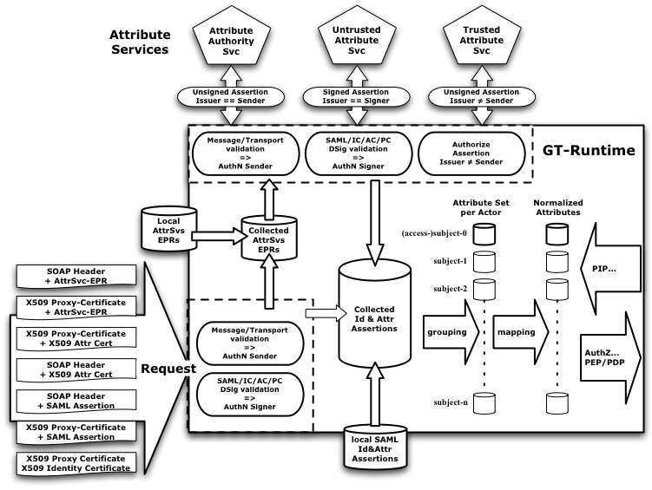
Attribute Collection Framework

Slide 16
GT Authorization Framework (1)

Slide 17
Standardize Assertion Communication
WS-Security profile for AC/PC/EPR ?
  Not sure if OASIS would be interested?
GGF profile for proxy-certificate embedding of SAML/AC/EPR ?
  Grid community is only user of PCs
  (it’s our only way to communicate authz assertions…)
Need Profiles for BP1.0!

Slide 18
Security for BP1.0
Leverage WS-I
  Gives us 90% of what we need…
Issues left:
  Transport and/or Message Level Security
    ??MUST/SHOULD??
  Discovery of key-info for encryption in message level security
    Service Group Profile / EPR embedding?
  Use of Proxy-Certificates (PC)
    Standard but not widely adopted outside Grid community
  Communication of Assertions
    Profiles for common assertions in header or PC
  Separate Security Basic Profile document?

