Slide 1
Defining the Grid:
A Roadmap for the Open Grid Services Architecture
Jem Treadwell, Hewlett-Packard
OGSA Submitted Document Discussion, OGSA-WG #3
28-30 June, 2005 (GGF14 in Chicago)

Slide 2
GGF Intellectual Property Policy
All statements related to the activities of the GGF and addressed to the GGF are subject to all provisions of Appendix B of GFD-C.1, which grants to the GGF and its participants certain licenses and rights in such statements. Such statements include verbal statements in GGF meetings, as well as written and electronic communications made at any time or place, which are addressed to any GGF working group or portion thereof,
Where the GFSG knows of rights, or claimed rights, the GGF secretariat shall attempt to obtain from the claimant of such rights, a written assurance that upon approval by the GFSG of the relevant GGF document(s), any party will be able to obtain the right to implement, use and distribute the technology or works when implementing, using or distributing technology based upon the specific specification(s) under openly specified, reasonable, non-discriminatory terms. The working group or research group proposing the use of the technology with respect to which the proprietary rights are claimed may assist the GGF secretariat in this effort. The results of this procedure shall not affect advancement of document, except that the GFSG may defer approval where a delay may facilitate the obtaining of such assurances. The results will, however, be recorded by the GGF Secretariat, and made available. The GFSG may also direct that a summary of the results be included in any GFD published containing the specification.

Slide 3
Session Agenda
OGSA: Overview and status
Document categories and development schedules
Collaboration opportunities
Contributing projects

Slide 4
Session Agenda
OGSA: Overview and status
Document categories and development schedules
Collaboration opportunities
Contributing projects

Slide 5
Where Are We Now?
OGSA-WG has published:
  OGSA Use Cases
  OGSA Architecture v1.0
  OGSA Glossary
What’s next?
  GGF participants want to understand what OGSA means to them
  Grid developers and users want to know what to expect, and when
  Answer is critical for OGSA, GGF, and Grid!
GGF & OGSA-WG must:
  Fill out the OGSA definition
  Define “OGSA-compliant”

Slide 6
OGSA Roadmap Document
Purpose:
  Clarify the meaning and role of OGSA
  Provide a framework for managing future work
  Identify documents , dependencies and schedules
  Document external activity:
    Opportunities for collaboration
    Contributory work
Plan:
  Publish v1.0 after public comment period
  Continue to evolve (improve!) document
  Publish new versions regularly
Many contributors!

Slide 7
OGSA is…
OGSA Architectural Process:
  Collect requirements
  Evaluate specifications
  Produce and maintain documents:
    Use Case documents
    OGSA Architecture document
    Service Description & Scenario documents
    OGSA Roadmap
OGSA Normative Documents:
  Defined in terms of OGSA Profiles
  Build on underlying specifications and profiles
OGSA Software:
  Enables deployment of interoperable grids
  Adheres to OGSA specifications and Profiles

Slide 8
OGSA Profiles
OGSA Profiles:
  Identify and combine sets of broadly adopted normative specifications and other profiles
  Prescribe their implementation and use for specific purposes in an interoperable grid
OGSA will be defined normatively in terms of OGSA Profiles
OGSA Software developers may:
  Implement grid components that conform to relevant OGSA Profiles
  Claim conformance to only those Profiles
  Example:
    Scheduler vendor claims conformance to OGSA Basic Execution Management Profile 1.0, but not to Basic Data Profile 1.0.

Slide 9
OGSA Branding & Software
Consistency is critical:
  GGF Roadmap will provide guidelines for use of the OGSA prefix by working groups, documents etc.
OGSA Software implementers can make:
  a claim to implement a specification or profile:
    A statement of “best effort” to satisfy requirements
  a claim of conformance:
    A statement of intent to interoperate with other conformant implementations
    Interoperability should be tested with others
  a claim of compliance:
    Implies verification using OGSA Compliance Tests
    No such tests exist today!
    Claims of compliance should not be made!

Slide 10
Session Agenda
OGSA: Overview and status
Document categories and development schedules
Collaboration opportunities
Contributing projects

Slide 11
OGSA Document Categories
Informational Documents
Normative Documents
Recommended Profiles
Informational Profiles

Slide 12
OGSA Informational Documents
Category includes:
  Use cases
  Architecture documents
  Service Description documents
  Scenario documents
No normative components
OGSA Roadmap identifies:
  Responsible working group
  Development schedule

Slide 13
OGSA Informational Document Schedule
Document Who First Draft GFD-I
OGSA Architecture v1.5 OGSA Aug ‘05 Jan ‘06
OGSA Glossary v1.5 OGSA Aug ’05 Jan ‘06
OGSA ByteIO Use Cases v1.0 ByteIO Jun ’05 Mar ’06
OGSA Data Architecture v1.0 Data Jun ’05 Jun ’06
Naming Issues in Distributed
Systems v1.0 Naming Jun ’05 Jun ’06
OGSA Info & Monitoring Arch. v1.0 InfoD TBD TBD

Slide 14
OGSA Normative Documents
Produced by domain-expert working groups (not OGSA-WG)
Referenced by OGSA Profiles
OGSA Roadmap identifies:
  Responsible working group
  Development schedule
  Dependencies

Slide 15
OGSA Normative Document Schedule
Document Who First Draft GFD-R.P
JSDL Specification JSDL Feb ’04 Oct ’05
Resource Namespace Service Spec GFS/Nam Nov ’04 Oct ’05
WS-Agreement GRAAP Aug ’04 Oct ‘05
Application Content Service Specification ACS Jun ’05 Dec ’05
OGSA ByteIO Interfaces ByteIO Jun ’05 Mar ’06
WS-Naming Specification Naming Jun ’05 Mar ‘06
OGSA Basic Execution Svcs Interfaces BES Jun ’05 Jun ’06

Slide 16
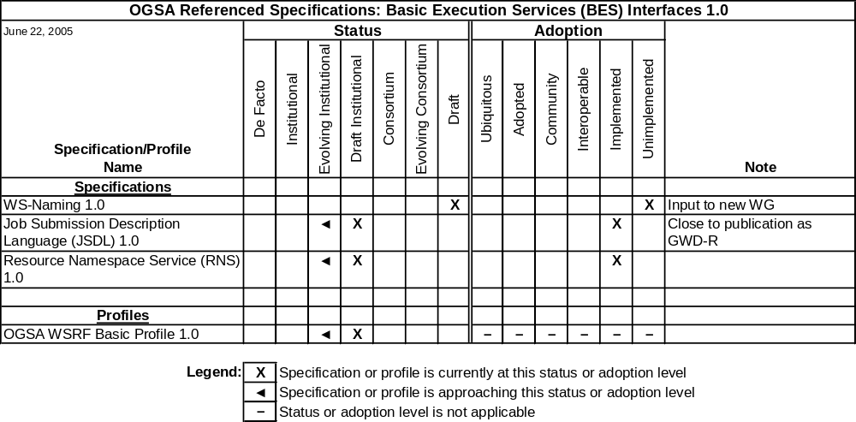
Normative Documents – Example Dependency Chart

Slide 17
OGSA Recommended Profiles
Included specifications or profiles must:
  Address important requirements
  Provide sufficient detail for interoperable implementation
  Complement other specifications in this and other OGSA Profiles
  Have implementation experience
  Have been (or likely will be) adopted by numerous technology providers and consumers
Produced by OGSA-WG or domain-expert working groups
OGSA Roadmap identifies:
  Responsible working group
  Development schedule
  Dependencies

Slide 18
OGSA Recommended Profile Schedule
Document Who First Draft GFD-R.P
OGSA WSRF Basic Profile v1.0 OGSA May ’05 Oct ’05
Future OGSA Recommended Profiles:
OGSA Basic Data Profile v1.0
OGSA Basic Execution Mgmt Profile v1.0
OGSA Basic Security Profile v.10

Slide 19
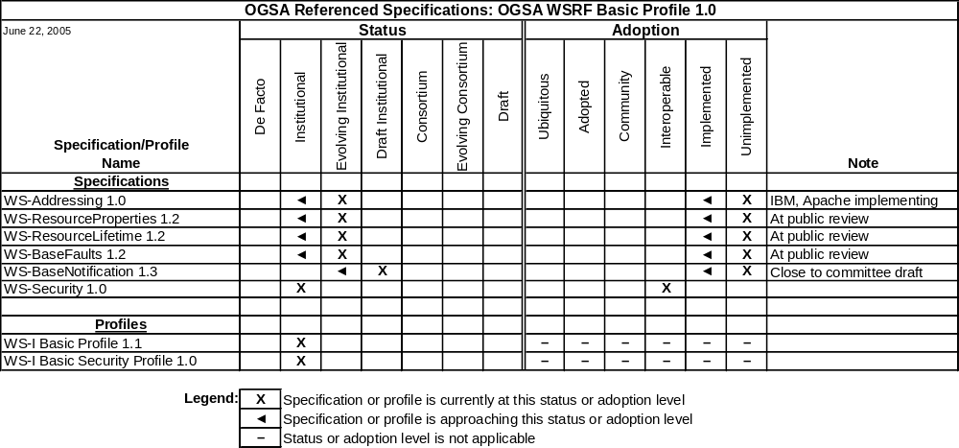
OGSA WSRF Basic Profile v1.0 – Dependency Chart

Slide 20
OGSA Informational Profiles
Reference specifications that do not currently meet the criteria for OGSA Recommended Profiles
Might become Recommended Profiles in the future
OGSA-WG must periodically review and revise status as appropriate
No Informational Profiles planned at present

Slide 21
Session Agenda
OGSA: Overview and status
Document categories and development schedules
Collaboration opportunities
Contributing projects

Slide 22
Collaboration: SDO Liaisons
GGF and WGs liaise with other standards development organizations (SDOs) and industry organizations
Organization | OGSA-WG Liaison | Goals
DMTF Common Information Model (CIM) | Fred Maciel | Research how to apply the CIM model in OGSA resource management.
DMTF Utility Computing | Tom Maguire | Research how to apply Utility Computing specifications within OGSA.
OASIS WSRF & OASIS WSN | David Snelling | Input OGSA requirements into the WSRF and WSN specifications.
OASIS WSDM | Fred Maciel | Research how to apply MUWS and MOWS in OGSA resource management.
Enterprise Grid Alliance (EGA) | Andrew Grimshaw | Understand the EGA use cases and requirements, and evangelize OGSA to their enterprise grid.

Slide 23
Collaboration: SCRM
SDO Collaboration on Networked Resources Management
  Collaboration of major SDOs on next-generation standards
  Focus on standards related to management of networked resources
  Announced June 27th
GGF SCRM-WG:
  New cross-institutional technical working group
  SDO domain experts contribute to and promote SCRM work
  Regular GGF working group – anyone can join
First deliverable – standards landscape document:
  First draft: October 2005 GFD-I publication: April 2006
Contacts:
  Chairs: Jay Unger (GGF), Mark Carlson (SNIA)
  Area Director: Hiro Kishimoto

Slide 24
Session Agenda
OGSA: Overview and status
Document categories and development schedules
Collaboration opportunities
Contributing projects

Slide 25
Contributing Open-Source Software (OSS) Projects
OGSA will be implemented by OSS projects & commercial vendors
Activities contribute to the OGSA process
Example OSS projects:
  Globus Alliance:
    The Globus Toolkit: WSRF, WSN, Security…
  University of Virginia (UVA):
    ByteIO, BES, RNS, WS-Naming
  Business Grid Computing Project:
    ACS, JSDL, WS-Agreement, OGSA WSRF Basic Profile
  National Research Grid Initiative (NAREGI):
    Japanese e-Science project: EMS, BES, RSS, ACS
  Gridbus Project, University of Melbourne:
    WSRF, JSDL
  Others?
Commercial projects & products???

Slide 26
OGSA Roadmap Document Status
Roadmap v1.0 submitted to GGF Editor June 24th
Enters 30-day public comment period
Please read and comment through formal process

Slide 27
Credits
Editors:
  Hiro Kishimoto, Jem Treadwell
Contributors:
  Michael Behrens, Rajkumar Buyya, Dave Berry, Abdeslem Djaoui, Ian Foster, Andrew Grimshaw, Mark Linesch, Allen Luniewski, Tom Maguire, Mark Morgan, Takuya Mori, Manuel Pereira, Kazushige Saga, Andreas Savva, David Snelling, Steve Tuecke, Peter Ziu
Thanks to:
  Mathias Dalheimer, Donal Fellows, Olegario Hernandez, Fred Maciel, Steve McGough, Steven Newhouse, Jim Pruyne, Ravi Subramaniam, Jay Unger, …

Slide 28
Q&A

