Slide 1
Summary: Defining the Grid:
A Roadmap for the Open Grid Services Architecture
Jem Treadwell, Hewlett-Packard
OGSA Submitted Document Discussion, OGSA-WG #1
28-30 June, 2005 (GGF14 in Chicago)

Slide 2
GGF Intellectual Property Policy
All statements related to the activities of the GGF and addressed to the GGF are subject to all provisions of Appendix B of GFD-C.1, which grants to the GGF and its participants certain licenses and rights in such statements. Such statements include verbal statements in GGF meetings, as well as written and electronic communications made at any time or place, which are addressed to any GGF working group or portion thereof,
Where the GFSG knows of rights, or claimed rights, the GGF secretariat shall attempt to obtain from the claimant of such rights, a written assurance that upon approval by the GFSG of the relevant GGF document(s), any party will be able to obtain the right to implement, use and distribute the technology or works when implementing, using or distributing technology based upon the specific specification(s) under openly specified, reasonable, non-discriminatory terms. The working group or research group proposing the use of the technology with respect to which the proprietary rights are claimed may assist the GGF secretariat in this effort. The results of this procedure shall not affect advancement of document, except that the GFSG may defer approval where a delay may facilitate the obtaining of such assurances. The results will, however, be recorded by the GGF Secretariat, and made available. The GFSG may also direct that a summary of the results be included in any GFD published containing the specification.

Slide 3
Where Are We Now?
OGSA-WG has published:
  OGSA Use Cases
  OGSA Architecture v1.0
  OGSA Glossary
What’s next?
  GGF participants want to understand what OGSA means to them
  Grid developers and users want to know what to expect, and when
  Answer is critical for OGSA, GGF, and Grid!
GGF & OGSA-WG must:
  Fill out the OGSA definition
  Define “OGSA-compliant”

Slide 4
OGSA Roadmap Document
Purpose:
  Clarify the meaning and role of OGSA
  Provide a framework for managing future work
  Identify documents, schedules and dependencies
  Document external activity:
    Opportunities for collaboration
    Contributory work
Plan:
  Publish v1.0 after public comment period
  Continue to evolve (improve!) document
  Publish new versions regularly
Many contributors!

Slide 5
What is OGSA?
Architectural process
Normative documents
  Defined in terms of OGSA Profiles
  Build on underlying specifications and profiles
OGSA Software
  Enables deployment of interoperable grids
  Adheres to OGSA specifications and Profiles
Software developers may:
  Implement grid components that conform to selected OGSA Profiles
  Claim conformance to only those Profiles
    e.g. Conform to OGSA Basic Execution Profile 1.0, but not to OGSA Basic Data Profile 1.0.

Slide 6
OGSA Documents
Categories:
  Informational Documents
  Normative Documents
  Recommended Profiles
  Informational Profiles
Roadmap identifies:
  Documents
  Responsible groups
  Schedules
  Dependencies

Slide 7
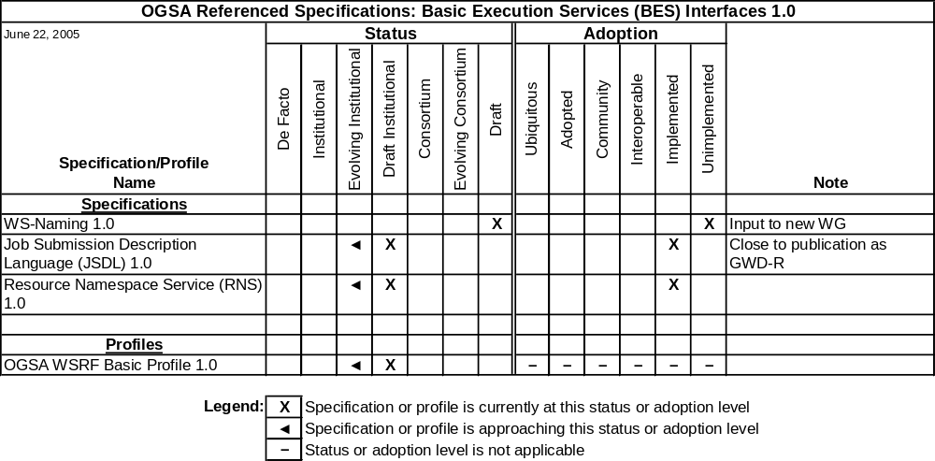
Normative Documents – Example Dependency Chart

Slide 8
Collaboration and Contributions
GGF and working groups liaise with other standards development organizations (SDOs) and industry groups
  Liaisons identified to DMTF, OASIS and EGA
SDO Collaboration on Networked Resource Management (SCRM):
  New cross-institutional working group hosted by GGF
  Developing standards landscape document
Many open-source software projects are actively implementing or using OGSA components:
  Activities contribute to OGSA process
  Summarized in OGSA Roadmap
  Room for more!

Slide 9
OGSA Roadmap Document Status
Roadmap v1.0 submitted to GGF Editor June 24th
Enters 30-day public comment period
Please read and comment through formal process!

