Slide 1
WS-DAIO – the object realization
Thomas Soddemann, RZG
DAIS-WG Session #2
28-30 June, 2005 (GGF14 in Chicago)

Slide 2
GGF Intellectual Property Policy
All statements related to the activities of the GGF and addressed to the GGF are subject to all provisions of Appendix B of GFD-C.1, which grants to the GGF and its participants certain licenses and rights in such statements. Such statements include verbal statements in GGF meetings, as well as written and electronic communications made at any time or place, which are addressed to any GGF working group or portion thereof,
Where the GFSG knows of rights, or claimed rights, the GGF secretariat shall attempt to obtain from the claimant of such rights, a written assurance that upon approval by the GFSG of the relevant GGF document(s), any party will be able to obtain the right to implement, use and distribute the technology or works when implementing, using or distributing technology based upon the specific specification(s) under openly specified, reasonable, non-discriminatory terms. The working group or research group proposing the use of the technology with respect to which the proprietary rights are claimed may assist the GGF secretariat in this effort. The results of this procedure shall not affect advancement of document, except that the GFSG may defer approval where a delay may facilitate the obtaining of such assurances. The results will, however, be recorded by the GGF Secretariat, and made available. The GFSG may also direct that a summary of the results be included in any GFD published containing the specification.

Slide 3
Agenda
What are we dealing with?
What are (the) issues?

Slide 4
Definition of an Object
An object entity is something which …
  … has a state represented by its attributes
  … has methods to modify the state
  … is an instance of a class definition
Object attributes may be
  transient,
  volatile, or
  persistent
Persistent Objects need to have a default constructor

Slide 5
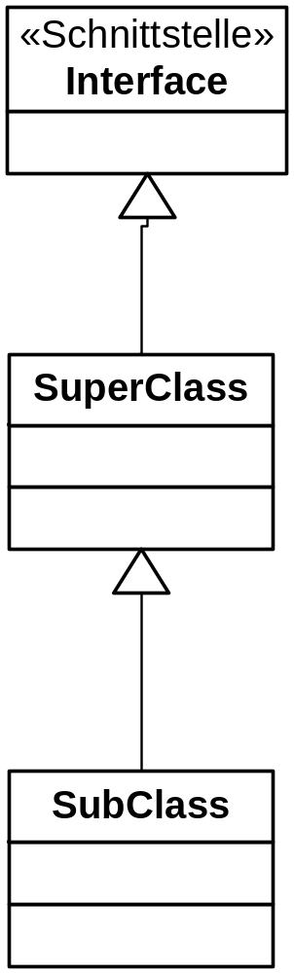
Definition of an Object
There may be different views to an Object
Levels of abstraction
Interfaces
Subclasses

Slide 6
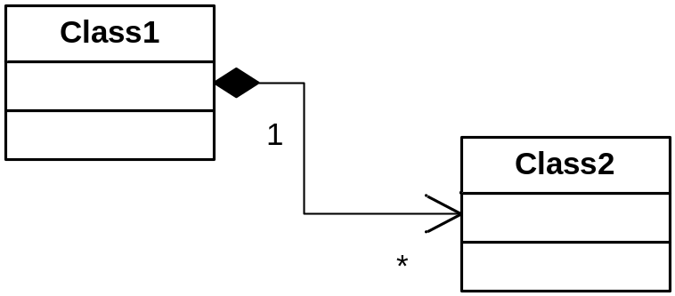
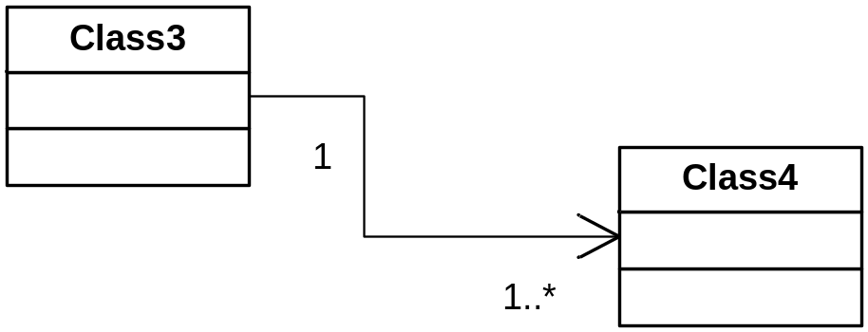
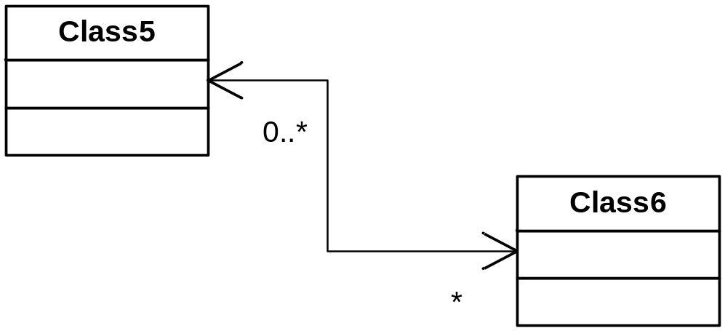
Relations between Objects
Associations (uni- and bidirectional)
Compositions
1-to-1
1-to-n
m-to-n

Slide 7
Object Databases and O/R Mapping
Object Databases:
Objectivity
Caché
VDS (Versant)
FastObjects (Versant)
GemStone
Jasmine(?)
…
O/R Mapping
CMP EJB (+ BMP EJB)
EJB 3
Hibernate
JDO (KODO, Versant, SignSoft, …)
TopLink
…

Slide 8
Querying Object Resources
RDBMS
SQL
OO solutions
SQL++
OQL
HQL
JDO-QL
EJB-QL
TopLink Expressions
SQL (some)
XQuery (some)
…

Slide 9
Object Representation Issues
How do we represent object via WS-DAIO?
WS-DAIO objects are copies of the underlying object (stateless since the underlying object and the copy are not same instances)
WS-DAIO objects are references of the underlying object (stateful, since the underlying object is referenced)

Slide 10
Object Representation Issues
How do we handle …
  … associations?
  … lazy loading?
  … subclassing?
What can we do about the zoo of query languages?
Do we create object?
How do we create objects?
  Constructors – create methods

Slide 11
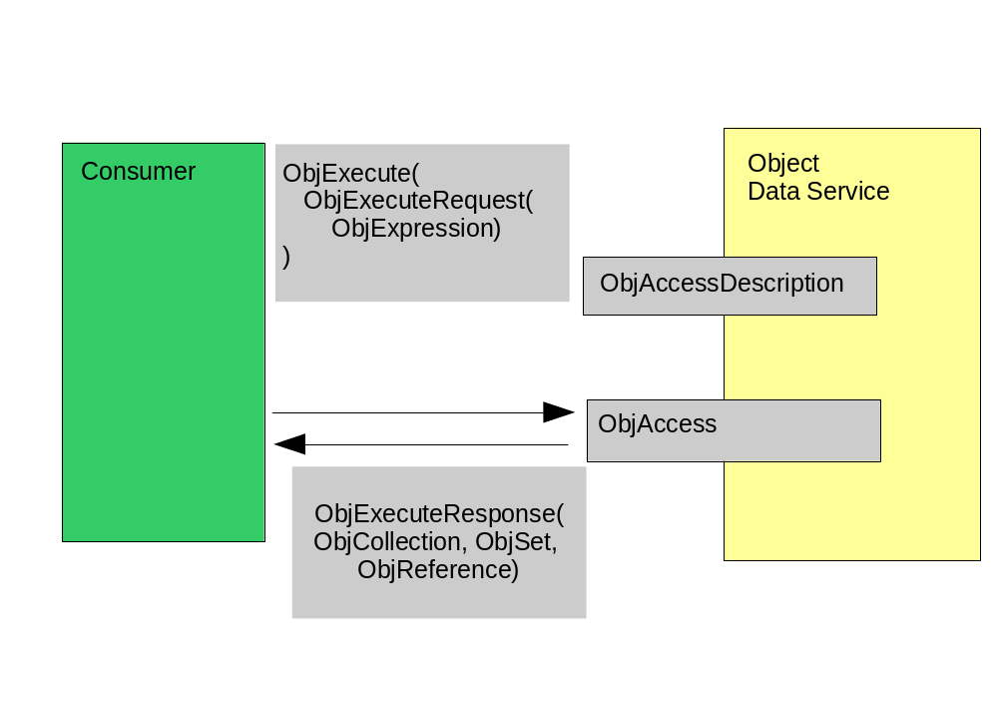
Direct Access

Slide 12
Operations
Object creation
Object deletion
Object method access
DataAccess
  ObjAccess
DataDescription
  ObjAccessDescription

Slide 13
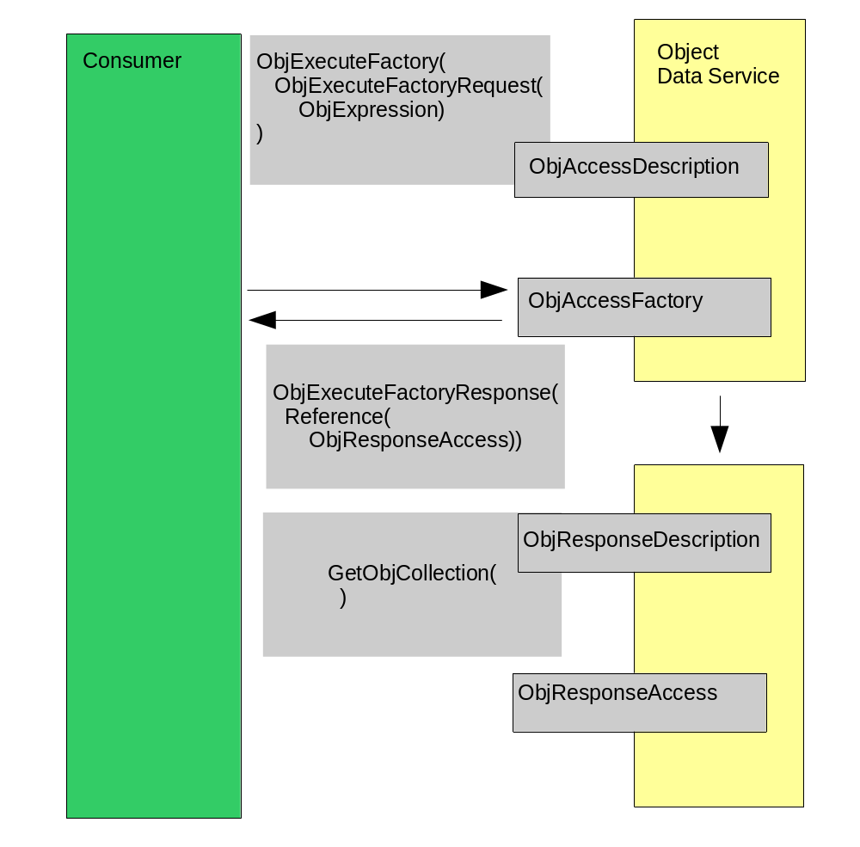
Indirect Access

Slide 14
Distributed Objects
Do we want to access distributed objects?

Slide 15
Action Items and Next Step
Discuss the issues in detail
Extend the currently preliminary draft
Leave the stateless/stateful choice as long as possible untouched

Slide 16
Action Items and Next Step
You are invited to join our efforts!

