Slide 1
GGF14 - GFAC Meeting
June 2005

Slide 2
Agenda
12:00 Lunch
1:00 Welcome and Agenda Overview T. Hey
1:10 GFAC Improvements Discussion M. Linesch, T. Hey
(based on GGF13, Seoul discussion)
1:30 GGF Update and Directions Discussion M. Linesch, S. Crumb
(progress, issues, direction, OGSA policy)
2:15 Break
2:30 GGF Regional Affiliation Discussion T. Hey, S. Sekiguchi, J. Lee
3:45 Wrap-up (Issues/Actions/Owners)

Slide 3
Discussions
GFAC Improvements Discussion
GGF Update and Directions Discussion
GGF Regional Affiliation Discussion
Wrap-up (Issues/Actions/Owners)

Slide 4
GFAC Discussion Agenda
Further recommendations to Mark about the reorganization of GGF
The continued role of the GFAC as proposed in the reorganization or changes to our function and how we operate
The continuing issue that we have discussed before: how to connect GFAC to the steering group and make it of greater use to the organization. This is, of course, related to item #2
A search for a GFAC vice-chair.

Slide 5
GFAC Directions Discussion
GFAC forum to bounce off ideas, develop strategy
  Personally – opportunity for input on strategy and greater visibility on directions
Advise on strategy, questions chair wants us to address
  Insure money spent was being put to good use in research
Longer range role, coordinate, provide advice
  Provide international voice into GGF
Longer term for vision, strategy, big picture that may not be seen by day-to-day technical vision and management
Opportunity for stakeholders to influence
Don’t loose sight of bigger visions (woods not trees)
Position papers
GFSG/GFAC joint meeting

Slide 6
GFAC Directions Discussion
Strategic Issues (brainstorm)
Defining where GGF fits in the Grid Ecosystem
Accelerating Adoption (how)
Much more intimate contact with end user
Who is going to fund Grid Computing in the US (many US agencies seem to be backing away)
How to fill the gap between worldwide and regional community
  Funding, branding, cohesiveness, cooperation, regional development, consolidation
Making sure we have all the right players (Industry expertise, political influence)
Clarifying the scope and definition of the grid
Involve the NIH, involve the application industry
VO security
GFAC are ambassadors of GGF, regional affiliation

Slide 7
Actions/Owners
GFAC Membership
  Recommended new members (Ken King to replace Irving Wladawsky-Berger, Wolfgang Boch to be added, Jysoo Lee to be added)
  If a GFAC member cannot attend, it is recommended that they send an alternate
  If a GFAC member’s boss is at a GGF meeting, it is recommended that they be invited to participate (.e.g. if Kyriakos or Wolfgang come with Ulf Daulston, Ulf could be invited to participate)
  Action: Mark & Bill to discuss and determine resolution
GFAC Meeting Structure & Operation: We will work to improve over meeting structure, agenda, and include meeting minutes. It was also proposed that we have a monthly GFAC call. Action to develop proposal for review at GGF14 ( Mark & Bill )
Sponsorship : Bring NIH in as a GGF sponsor. Action: Frederica to investigate and report back at GGF14 meeting (Frederica Darema)
Regional Affiliation: Satoshi showed several slides on what they are thinking in Japan. Action: Discussion on regional affiliation at GGF14 Tony Hey, Satoshi Sekiguchi)
Web site: Action to change web site label to “Understanding Grids” or something but not “Understanding Grid Computing” due to over focus on the “compute” aspect of grids (Mark, Steve)

Slide 8
Discussions
GFAC Improvements Discussion
GGF Update and Directions Discussion
GGF Regional Affiliation Discussion
Wrap-up (Issues/Actions/Owners)

Slide 9
GGF is pursuing aggressive objectives
Community
Enable active participation & growth for existing Research communities
Pro-actively explore, develop, and establish new Industry communities
Increase community-oriented focus at GGF events
Publish community-driven requirements & best practices
Community Satisfaction
Standards
Publish GGF Standards Roadmap
Publish OGSA v 1.5 Architecture and Profiles
Standards Adoption
Publish, or support the publication of, important Grid specifications
Manage liaisons with standards organizations critical to grid adoption
Operations Efficiency
Operations
Marketing plan that communicates the value of GGF and ongoing contributions
Events plan resulting in increased GGF event satisfaction & financial return
Sponsorship plan resulting in increased sponsor satisfaction and revenue
Revise GGF website while improving GGF document publishing infrastructure
Notes:
Role with BCS Value Creation
Understand current BCS deals
? With BCS
BCS focus?
Same ?
Who gets revenue for x-IGS deals?
Delivery
How to do ?

Slide 10



We have transitioned to new GFSG functions and aligned areas and groups
Community
Standards
Research Applications
Industry Applications
Grid Architectures & Specifications
  (OGSA, DAIS, GridFTP, JSDL)
GGF Liaisons
(e.g. OASIS, W3C, IETF, DMTF, SNIA)
Grid Mega-Projects
Technology Innovations
Grid Operations
Operations
Events
Marketing
Sponsorship
Finance & IT

Slide 11
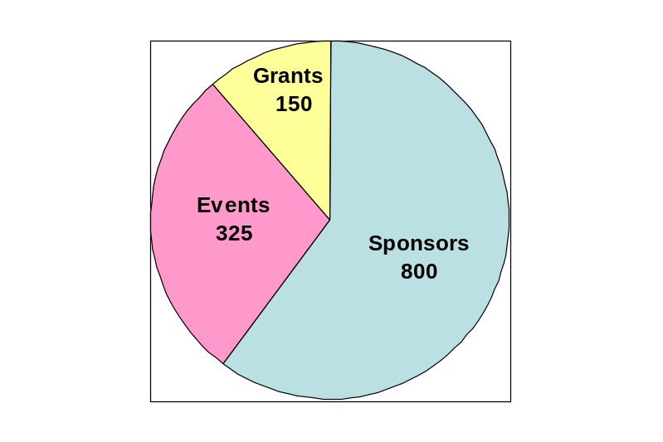
GGF Financials – 2005 Pro-Forma P&L
Revenue ($K) 1,325
Sponsorship 800
Events 375
Grants 150
Expenses ($K) 1,290
Events 406
Sponsorship 161
Salary, Bonus 385
Marketing 113
IT, Facilities & Other 225
Profit (Loss) 35
Limited staff resource for domestic grants and no EU-based PI identified
GGFxx Waivers & expenses from Sponsorship program
GGF12 ($81K) plus GGF13/14
Includes $40K for new PR Firm
3 full time, 3 part time employees, little benefits
Computers & improvements in Document Mgt. needed

Slide 12
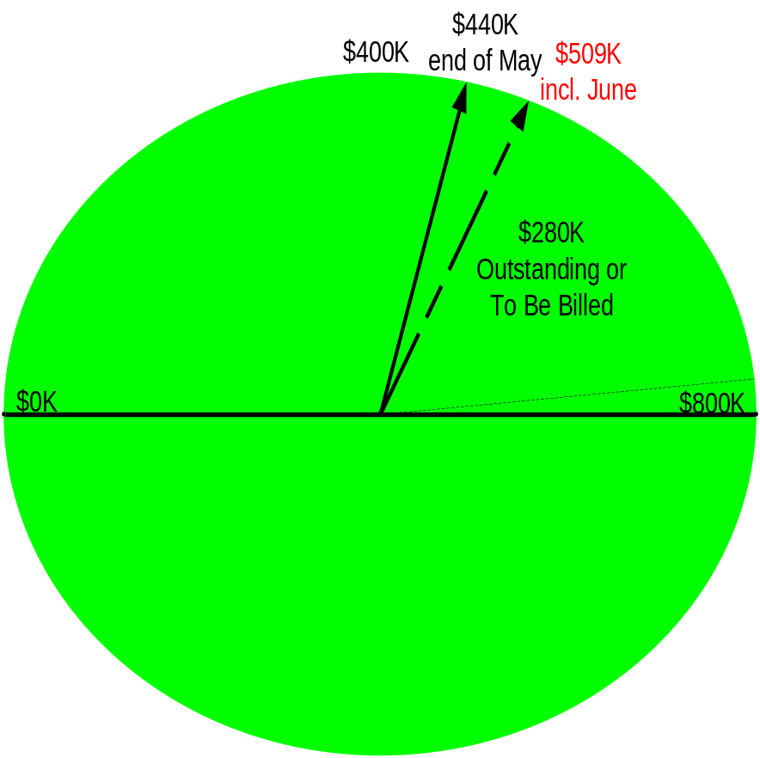
Sponsorship
Challenges & Opportunities
2005 price increases have helped offset departures/ downgrades
Difficult to engage new sponsors given headcount/budget limitations
Improvements to 2006 sponsorship plan being investigated to deliver better value (GGF14 Sponsor workshop)
AR running slightly behind ’04
4 Known Declines (2 Gold, 2 Silver)
7 Downgrades (4 Gold, 3 Silver)
2 New (both Silver)

Slide 13
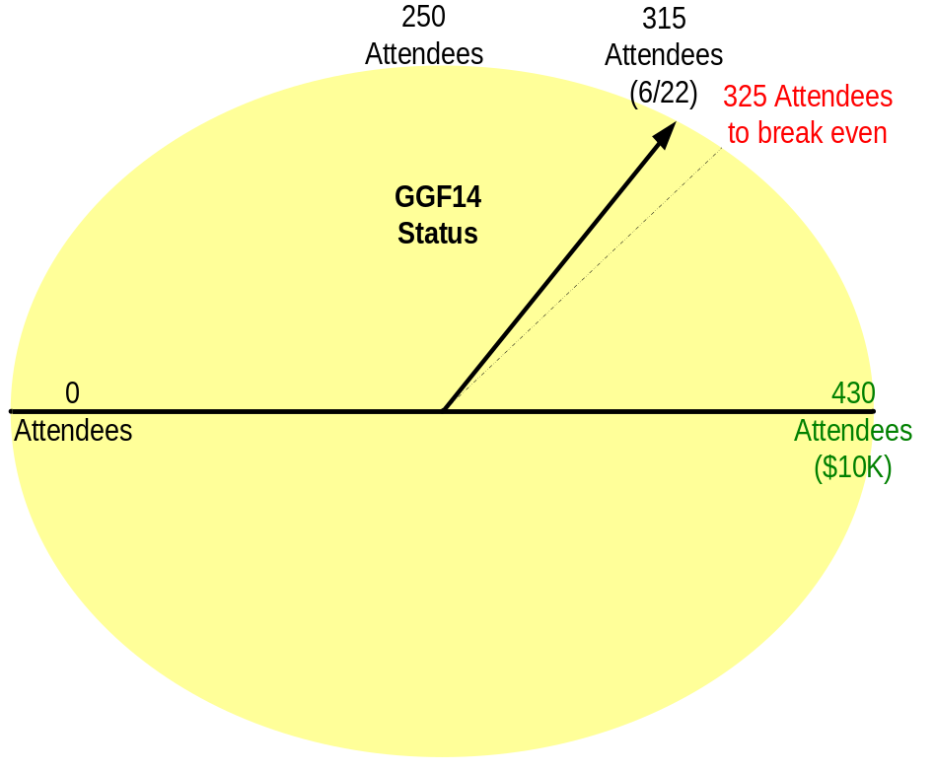
Events
250
Attendees
405 Attendees
to break even
GGF13
451 actual
Attendees
($6.2K)
Status
Break-even includes Ann’s Salary
$200K of Event Sponsorship ($177K expense)
$34K of Sponsor Waivers Used
$6.2K Profit (Loss)
0
Attendees
500
Attendees
($15K)
Break-even includes Ann’s Salary
$0K of Event Sponsorships
$18K of Sponsor Waivers Used
$0K Profit (Loss) - est.
Challenges & Opportunities
Not currently financially profitable - breaking even with coverage of Ann’s overhead
Sponsor and other event waivers are a heavy financial burden
Regional events (Berlin, Seoul, Athens – Spring ’06) work financially
“Core” audience seems to be shrinking

Slide 14
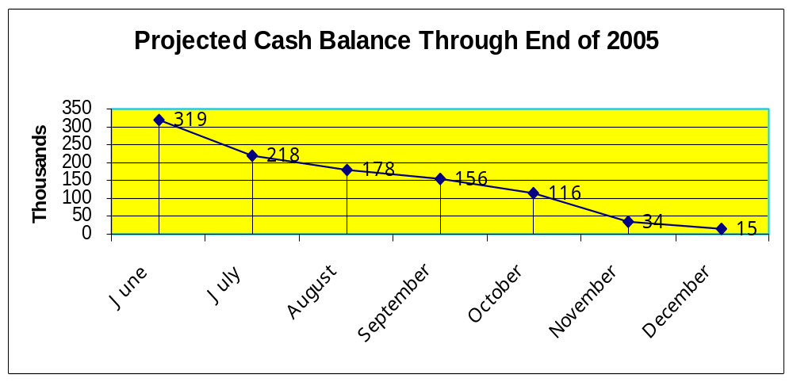
2005 Cash Flow Projections
Challenges & Opportunities
YTD Expenses on target
Cash Flow Forecast indicates no room for “error”
  $45-50K monthly burn-rate (excl. event & big one-time expenses)
Must continue to hold existing sponsors, while attracting new sponsors
  Very difficult without focused headcount for Sponsor Relationship Mgt.
Events MUST be breakeven

Slide 15



… and announced a new Enterprise Event
Premier commercial, educational and technical event for grid computing worldwide
Combines GGF expertise in grid architectures, specifications, best practices and solutions … with IDG’s event marketing and management
Extensive Enterprise Program along with the traditional GGF(15) Community Program and Group sessions

Slide 16

Even as the pressure for broadly adopted specifications continues to grow
Where is the balance?
What is the standards landscape and roadmap look like?
What is the future directions for OGSA and how do we balance the “O” and the “A” in OGSA
When will the web services infrastructure standards that OGSA relies on stabilize?
“O”
“A”
Interoperability

Slide 17
GridWorld/GGF15
Mon
Tue
Wed
Thurs
9:00 – 10:30
Lunch
12:00 – 1:30
Enterprise Program
Community Program
Community Program
Enterprise Program
Community Program
Community Program
Group Session
Groups Sessions
Group Sessions
Group Sessions
4:00 – 5:00

Slide 18
Enterprise at a Glance (16)
Mon
Tue
Wed
Thurs
9:00 – 10:30
Keynote
Keynote
Sessions
Sessions
Lunch
12:00 – 1:30
Enterprise Program
Community Program
Community Program
Enterprise Program
Community Program
Community Program
Group Sessions
Group Sessions
Standards Session
Group Sessions
Sessions
Sessions
4:00 – 5:00
Keynote
Keynote

Slide 19
Community at a Glance (25)
Mon
Tue
Wed
Thurs
9:00 – 10:30
GGF Opening
Keynote
Sessions
Sessions
Sessions
Sessions
Lunch
12:00 – 1:30
Enterprise Program
Community Program
Community Program
Enterprise Program
Community Program
Community Program
Standards Program
Standards Program
Standards Program
Standards Program
Sessions
Sessions
Sessions
Sessions
4:00 – 5:00
GGF Closing
Sessions

Slide 20
Discussions
GFAC Improvements Discussion
GGF Update and Directions Discussion
GGF Regional Affiliation Discussion
Wrap-up (Issues/Actions/Owners)

Slide 21
Regional GGF Chapters?
Tony Hey
VP Technical Computing
Microsoft

Slide 22
Gridforum.nl
In the Netherlands they have set up an ‘Internet Society’-like chapter of GGF
Set up Gridforum with charter modelled on charter for ‘isoc’ chapters
Mission is:
  “To stimulate the use and applications of grid technology in the Netherlands and the participation in the evolution and development of the grid in an international context”

Slide 23
Gridforum.nl will work towards its mission by:
1. Representing the grid community in the Netherlands in the broadest sense
2. Developing and maintaining formal and informal relations with both the national and international grid- and internet communities
3. Offering information, expertise, tutorials and other facilities with regards to grid technology and grid applications
4. Lowering the threshold of grid infrastructure to individuals, groups and organisations in the Netherlands
5. Offering a platform for discussion and dissemination of insights of grid users in the Netherlands

Slide 24
Gridforum.nl will work towards its mission by: (cont.)
6.To cooperate with other organisations active in the field of grids in and outside of the Netherlands for coordination, joint activities and knowledge dissemination.
7.Initiating services in order to reach an optimal use of grids by individuals, groups and organisations for innovation, communication and cooperation
8.Guarding the public and interoperable character of grids in the Netherlands
9.Supporting the development of effective grid standards by the GGF and related organisations
10.Stimulating the use and development of grid technology and grid applications in general

Slide 25
Gridform.nl Members
Organisations
  SGI, SURF, SURFnet, Sun, Amsterdam Internet Exchange, Linvision, Lucent Technologies, 4TEC, LogicaCMG, NCF, IBMUniversity of Amsterdam, NIKHEF, Oracle, Engage Technology
Steering Committee
  Kor Bos (NIKHEF), Arjen van Rijn (NIKHEF), Ad Emmen (Primeur), Cees de Laat (UoA), Michiel Leenars (NCF), Paul Kollner (HP)

Slide 26
UK Views on a GGF-UK (1)
Concerns:
Additional load on busy people who already go to GGF meetings
GGF-UK should not duplicate global GGF activities i.e. no regional WGs, RGs, global mailing lists
Need to define scope of any UK GGF Chapter carefully

Slide 27
UK Views on a GGF-UK (2)
Positives
Communicate GGF activities to wider UK community who cannot attend GGF meetings
Provide forum for coordination of UK views
Education and training on WS and GGF standards
Engage UK wider academic community
Engage UK industry and Government
Support with combination of e-Science and JISC funds in UK

Slide 28
A Policy for GGF Chapters?
GGF Chapters like Gridforum.nl can broaden the appeal of GGF and promote GGF as ‘the’ body for Grid standards
The Charters for such regional chapters need to be designed to complement the global GGF activities
Perhaps could have enhanced emphasis on application activities
Could be key route to build a truly global community

Slide 29
Grid Activities in Korea
Jysoo Lee (jysoo@kisti.re.kr)
Supercomputing Center
KISTI (Korea Institute of Science and Technology Information)

Slide 30
Overview of K*Grid
Goal : Implementation of the National Grid Infrastructure in Korea
Funding Agency : MIC (Ministry of Information and Communication)
Period & Budget : 2002 - 2006 (5 Years) & U$32M
Leading Organization : KISTI (PI of K*Grid Project: Dr. Jysoo Lee)
Scopes
  Construction of K*Grid Infrastructure
    GT based heterogeneous platform systems (Linux, AIX, HP-UX, IRIX) from 13 research institutes/univ (7 supercom + 9 clusters)
    Collaboration with international Grid testbed (PRAGMA, iHPC, GridLab, iVDGL)
  Development of Grid Middleware Technology
    KMI-R1 (K*Grid Middleware Initiative – Release 1) : Integrated Grid middleware service package
    MoreDream : Grid middleware toolkit based on OGSI
  Research on Grid Applications
    1st phase (2002 ~ 2004) : Molecular simulation Grid, Toxicity prediction system, Grid-based remote services for high tech scientific instruments (UHV-TEM)
    2nd phase (2005 ~ 2006) : Rendering Farm, Online Game, Telematics
  Grid Forum Korea (GFK) :
    Outreach program for Korean Grid community and international collaboration for standardization
    903 members from 254 organizations & 25 WGs (as of May 2005)

Slide 31
New Grid Programs in Korea
KCED (Korea Construction Engineering Development) Grid
  Goal : Implementation of the distributed and shared research
  infrastructure for construction and transportation
  Funding Agency : MOCT (Min of Construction and Transportation)
  Period & Budget : 2004-2008 (5 Years) & U$100M
  Leading organization : KCED consortium (SNU)
e-Science Project
  Goal : Production of e-R&D environment for the science and
  technology (domain specific environment)
  Funding Agency : MOST (Min of Science and Technology)
  Period & Budget : 2005-2010 (6 Years) & U$100M
  Leading organization : KISTI

Slide 32
Brief Summary of GGF13
475 participants from 26 different countries attended GGF13 in Seoul, March 13-16, 2005 hosted by KISTI and GFK
One and a half days of regional plenary program by GFK consisted of keynote talks, panel discussions and presentations
Leaders of 10 national scale Grid projects from seven economies in Asia meet in workshop
GGF13 provided a chance to show Grid activities in Asia to the world, and helped to initiate numerous collaborations among Asia, North America, and Europe
Over 58 WG/RG Sessions, 6 BoFs, 5 Workshops and 2 tutorials were held

Slide 33
GGF13 Highlights
Business Grid, or commercial application of Grid technology :
  Several examples of Business Grid were introduced during the Grid Economy Workshop and the Business Grid plenary. As a result, several Korean companies such as KT (Korea Telecom) and Samsung Networks are seriously considering investing in Grid technology.
Chance of conveyance to Policy Makers :
  Korea is well-known for its advanced IT infrastructure. Although Grid can be combined with it to build a unique and efficient testbed, the importance of Grid has not gotten through policy makers. Several efforts by senior GGF people, including discussion with the minister of MIC, helped to convey the importance of Grid to policy makers.
Expansion of Grid Community to Asia :
  GGF, and Grid community in general, has been dominated by North America and Europe. Asia, with the possible exception of Japan, has joined the effort later. Grid community of Asia wishes to contribute to the world-wide effort of Grid, and hopes GGF to pay particular attention to help incorporating to the Grid community of the world.

Slide 34
If you want more information about K*Grid,
please visit the website:
K*Grid (http://www.gridcenter.or.kr/)

Slide 35


Interaction between
GGF and Regional Partners
Jysoo Lee
Director
KISTI Supercomputing Center
(jysoo@kisti.re.kr)

Slide 36
Formal Affiliation
What do you think of a more formal affiliation approach including some type of GGF branding (e.g., GGF-KR, GGF-CN)?
Need for such consideration is very strong
Mixed reactions on name
  Not name, but content (interaction rules) matters
Interaction rules (charter): tight or loose relationship?
  Want to have independence
  Want to decide based on benefits to regional people
Other ideas: GGF-Asia

Slide 37
“Wish List to GGF”
Coordinated community building (promotion/outreach)
  Better understanding of Grid: academia, industry, and government
  Co-developing program/material
  Helping to find appropriate speakers
  Operating education/tutorial program (physical/virtual)
Coordinated standardization
  Coordination between local and GGF’s standardization activity
Others
  Understanding of GGF and its activities
  More regional conferences outside US (cost of travel, visa)
  Possible problem with “dual sponsorships”

Slide 38


jysoo@kisti.re.kr

Slide 39
GGF Affiliate Program
Satoshi Sekiguchi (AIST)
Identify the benefit for both local “GF” (LGF) and global “GF” (GGF)
List of LGF activity type with GGF
Check list of GGF affiliation program for LGF
 | GGF | LGF
Community | International | Local
Standard | Global Standard | No!, except localization
Operation | Individually, but cooperatively

Slide 40
GGF Affiliate Program
Benefit for local “GF” (LGF)
  GGF brand brings more participants with its formality sound
    Nice for marketing
  Tighter cooperation with GGF and its events
    Summery meeting after every GGF-x
    May have a liaison between GGF and LGF within GGF operation (?)
  Being a legal entity for copyright granting of GGF documents
    for translation into the local language

Slide 41
GGF Affiliate Program
Benefit for global “GF” (GGF)
  Increasing members, sponsors from the area
    more people, more money, more opportunity
    Makes GGF a real GGF
    Receive sponsorship from LGFs (?)
  Event host by the LGF
    Local IDG contract, local arrangement support
  Operation efficiency
    Communicate GGF and ongoing contributors

Slide 42
List of Activity type
GGF document localization
  JP, KR?
GGF event reviews with quick summery of highlights
  JP
hosting local WS/seminar/tutorial for dissemination
  JP, KR, etc
“Shadow” ADs at LGF for watching standardization
  (JP??)
Hosting GGF event
  JP, KR
else ?

Slide 43
Checklist for being a GGF affiliate
Sponsorship in GGF
  May have another category for LGF
  What kind of category type?
    Sponsorship fee
    Free coupons
    Other benefit (web ad. Etc.)
Size of the LGF
  Small LGFs will not be qualified
  What is the reasonable size ?
Varieties in the LGF
  LGFs with single project will not be qualified
  Is this too strong ?
Identify LGFs mission to avoid conflict with other LGFs
  Allow only one LGF from each economy ? – maybe NO
  Check with LGF’s charter – no conflicts with GGF

Slide 44
Grid Forums in AP
JpGrid: Grid Consortium Japan
  Since Jun ‘02
  Membership: Corporate 57 (163), Individual 90
  Annual Budget:
    100,000 JPY * 163 = approx. 150K USD
  Chair: Satoshi Sekiguchi,
    Vice Chairs: Takanori Seki (IBM), Kento Aida (Titech)
  Office at AIST
  http://www.jpgrid.org/
GFK: Grid Forum Korea
  Since Oct ’01 - 300 attendees at the 1st meeting
  As a part of the K*Grid project
  Office at KISTI
  http://www.gridforumkorea.org/
China Grid Forum (Planned)
Australia Grid Forum (???)

Slide 45
JpGrid Objectives in two ways
Vertically establishing a link between GGF and the local community
  Translation of the documents into Japanese
  GGF Quick summary meeting (1/2 day)
    3 times/year + Globus World
  Gold level sponsorship at GGF
  GGF event hosting (GGF7, GGF17, …)
Horizontally providing a venue to the local grid community for:
  Grid World event series hosting
    (2000 attendees, GW04)
  Technical Workshop 2-3 times/year (1/2 day)
  Joint symposium with other related activities (W3C, EGA Japan office, Bio Grid, etc.)
Note: No standardizing activities

Slide 46
Potential Strategic Projects
Regional
Certification
Open Source Repository
Sponsorship
Education
Knowledge Management

Slide 47
GFAC Meeting
Chicago, 28 June 2005
Update on EU new activities on Grids
- some might be highly interesting to the GGF -
Kyriakos Baxevanidis
European Commission, DG INFSO
Deputy Head of Research Infrastructures Unit
Directorate Emerging Technologies and
Infrastructures - Applications

Slide 48
CND
Call FP6-2004-
Infrastructues-6
▪
Consolidating
Initiatives
New proposals in negotiations
scheme
GÉANT
GRID
Following a call on “eInfrastructures – consolidating initiatives” (Grids and networking)
Call Budget: 25 M€
New projects expected to start before the end of 2005
Areas covered by the “Consolidating Initiatives” Call:
Reinforce the user communities’ engagement
Reinforce and stimulate eInfrastructure policies
Support international aspects of eInfrastructures

Slide 49
CND
Call FP6-2004-
Infrastructues-6
▪
Consolidating
Initiatives
New proposals in negotiations
scheme
GÉANT
GRID
To connect remote and rare physical infrastructures:
EXPRES (e-VLBI)
AUGERACCESS (Auger Obs.)
ORIENT
(China)
Digital
Libraries
SEEREN2
(Balkans)
PORTA OPTICA STUDY
OCCASION
(Eastern Europe,
NIS, Caucasus)
And to maintain and increase the global reach of Géant

Slide 50
New proposals in negotiations
To expand the GRID layer to new regions or users:
EELA
(Latin America)
BALTICGRID
(Baltic region)
BIOINFOGRID,
ICEAGE
(Europe)
EUCHINAGRID
(China)
EUMEDGRID
ITHANET
(Mediterranean region)
To improve the GRID component of the eInfrastructure:
ETICS (software testing), ISSEG (security)

Slide 51
New proposals in negotiations
GO4IT
(Knowledge and cooperation)
BELIEF
(Communication Platform)
To improve the eInfrastructure:
eIRGSP
(to support the work of the eIRG)

Slide 52
The ICEAGE proposal on Grid education
Main objectives:
Form an international forum on Grid education matters
Establish public shared services on Grid education
Develop and run a t-infrastructure (to support hands-on exercises and demonstrations)
Potential roles with respect to the GGF
Promote Grid standards
Educate and train people to use them (particularly new communities)
Address both Academia and Industry
Strong support by European Commission

Slide 53
Other efforts: Europe discusses on a new eInfrastructure service provisioning model
Main lines of proposal:
Establish national/regional Grid-centres to provide administrative, operational, training, and support (one-stop-shop) service to all eInfrastructure users
Establish a central co-ordination mechanism for the above scheme
The current GÉANT/NRENs/DANTE model provides a good paradigm

Slide 54
eInfrastructures service provisioning model and the GGF
Potential roles with respect to the GGF:
Promote Grid standards through these centres
Provide training, hands-on experience, and support in using GGF-standards
Collect user-feedback to GGF

Slide 55
Discussions
GFAC Improvements Discussion
GGF Update and Directions Discussion
GGF Regional Affiliation Discussion
Wrap-up (Issues/Actions/Owners)

Slide 56
Actions/Owners
Decision taken to not send alternates to GFAC meetings at this time – rely on good notes and better processes.
Follow-up on NIH as a GGF sponsor (Tony, Frederica)
Strawman proposal for merger GGF/EGA (Robert)
Develop a “Regional GGF Proposal” draft white paper for discussion at GGF15. (Steve, Mark)
Discuss co-location of GlobusWorld with GridWorld (Mark)
Don’t fracture but don’t mandate (Tony, Ken)
EU funding opportunities (Education) (Steve, Mark, Kyriakos, Malcom)

