Slide 1
Direct Repository Use
ACS
Application
Archive
Application Repository
Candidate Set Generator (Work -Resource mapping)
Provisioning Deployment Configuration
Information Services
Execution Planning Services
Reservation
Service
Container
Job Manager
Accounting Services

Slide 2
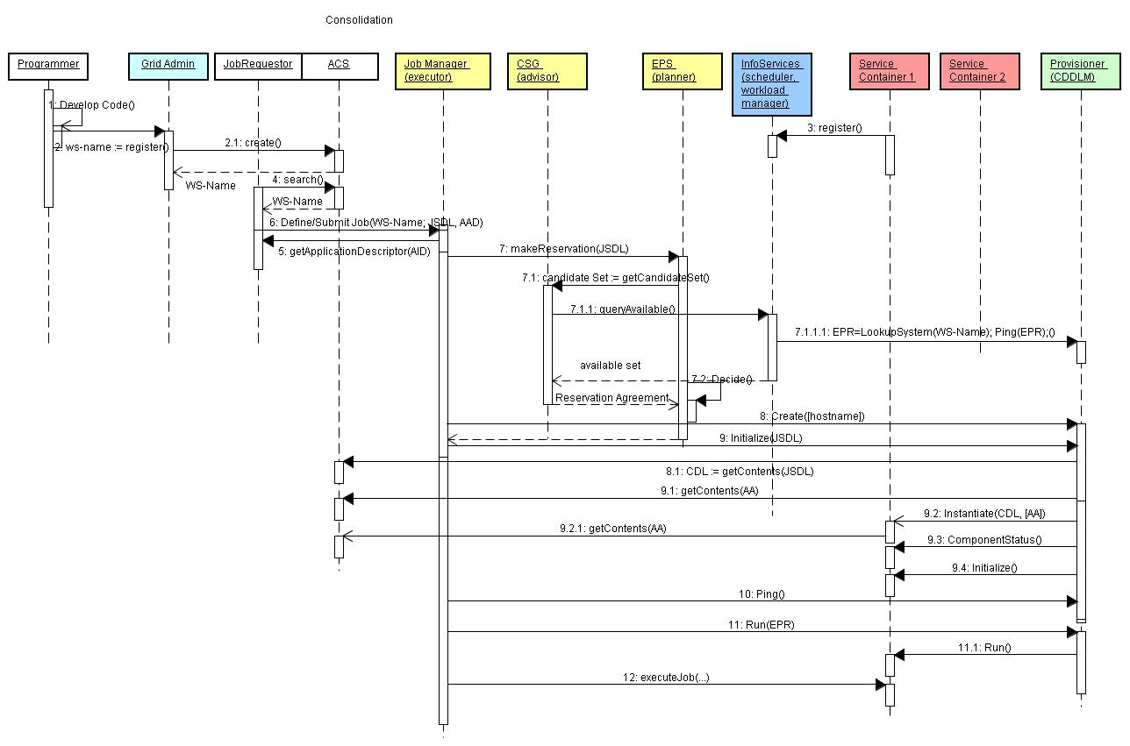

Slide 3
Using Data Services to Access Repository
ACS
Application
Archive
ARI
Application Repository
Candidate Set Generator (Work -Resource mapping)
Provisioning Deployment Configuration
Data Services
(GridFTP, …)
Information Services
Execution Planning Services
Reservation
Service
Container
Job Manager
Accounting Services

Slide 4
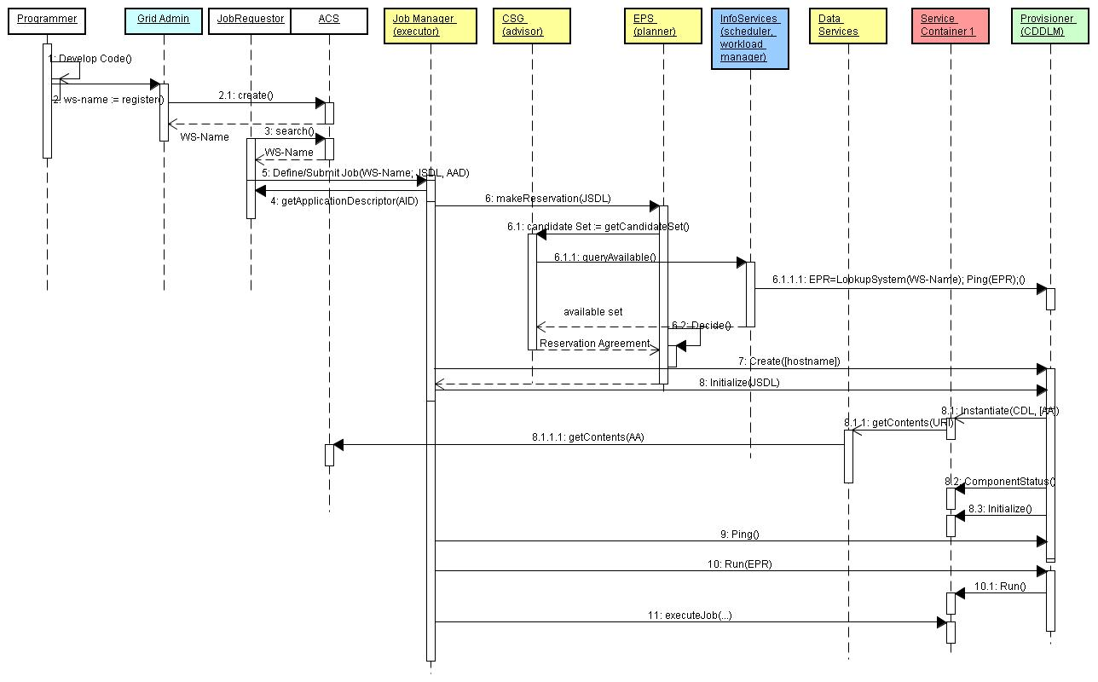

Slide 5
Splitting Content from Execution
ACS
Application
Archive
ARI
Application Repository
Candidate Set Generator (Work -Resource mapping)
Provisioning Deployment Configuration
Information Services
Execution Planning Services
Reservation
Service
Container
Job Manager
Accounting Services

Slide 6
