Slide 1
Overview on WS-Agreement
2005/10/06 GRAAP-WG

Slide 2
GGF Full Copyright Notice
Copyright (C) Global Grid Forum (2005). All Rights Reserved.
This document and translations of it may be copied and furnished to others, and derivative works that comment on or otherwise explain it or assist in its implementation may be prepared, copied, published and distributed, in whole or in part, without restriction of any kind, provided that the above copyright notice and this paragraph are included on all such copies and derivative works. However, this document itself may not be modified in any way, such as by removing the copyright notice or references to the GGF or other organizations, except as needed for the purpose of developing Grid Recommendations in which case the procedures for copyrights defined in the GGF Document process must be followed, or as required to translate it into languages other than English.
The limited permissions granted above are perpetual and will not be revoked by the GGF or its successors or assigns.
This document and the information contained herein is provided on an "AS IS" basis and THE GLOBAL GRID FORUM DISCLAIMS ALL WARRANTIES, EXPRESS OR IMPLIED, INCLUDING BUT NOT LIMITED TO ANY WARRANTY THAT THE USE OF THE INFORMATION HEREIN WILL NOT INFRINGE ANY RIGHTS OR ANY IMPLIED WARRANTIES OF MERCHANTABILITY OR FITNESS FOR A PARTICULAR PURPOSE."

Slide 3
Overview of WS-Agreement
WS-Agreement itself is sort of a frame-work for getting agreements on several different domains. The details of things to be agreed are of course domain-specific and is out of the scope of the WS-Agreement Spec.
  Eg. Job-submission using JSDL is a candidate to be used within the frame-work.
Relation to other specification
  Relies on WS-Addressing, WS-ResourceProperties, WS-ResourceLifetime and WS-Base Faults

Slide 4
A Two Layered Model
Agreement Layer: Provides a Web service-based interface that can be used to create, represent and monitor agreements with respect to provisioning of services implemented in the service
Factory
Factory
Agreement
create()
Agreement
create()
Ops:
Ops:
terminate(limits
terminate(limits
)
)
Agreement
inspect(query
Agreement
inspect(query
)
...
)
...
Layer
Layer
SDEs
SDEs
:
inspect()
:
The service layer represents the application-specific layer of the service being provided.
The class of provided service MAY or MAY NOT be a Web service interface.
inspect()
Terms
Terms
Status
Status
Related
Initiator
Manager
Agrmts
Responder
Factory
Factory
create()
create()
Service
Service
Layer
Layer
Application Instance
Application Instance
foo
foo
()
()
Consumer
Consumer
Provider
Provider
Whether Agreement Initiator becomes a Service Consumer or Service Provider (ie Agreement Responder becomes a Service Provider or service Consumer) is completely domain dependent

Slide 5
Agreement Structure
Information about the Agreement itself
・AgreementInitiator
・AgreementResponder
・ExpirationTime
・・・・
Agreement
Information about the Service Itself
・Contents are Domain Dependent
・Eg.: Job Description(Program name, Number of nodes etc)
Name
Context
Information about Service Levels which should be Guaranteed
・QualifyingCondition(An optional condition that must be met (when specified) for a guarantee to be enforced. Eg: Timespan when the requests can be submitted:Weekdays, etc)
・ServiceLevelQbjective(Conditionthe condition that must be met to satisfy the guarantee. Eg:Needs 128 MB of memory..)
・・・・
Terms Compositor
Service Terms
Guarantee Terms
The structure of an Agreement Template is the same as that of an agreement, but an Agreement template MAY also contain a creation constraint section, i.e. a section with constraints on possible values of terms for creating an agreement. The constraints make it possible to specify the valid ranges or distinct values that the terms may take.

Slide 6
Typical Agreement Lifecycle
Initiator
Responder
Get Template
Four phases in the lifecycle:
  Exploration: a service provides templates describing possible agreement parameters
  Creation: Consumer fills in parameters, and makes an offer
  Operation: Agreement state available as a ResourceProperty
  Termination: Agreement destroyed explicitly or via soft state (termination time)
Provider
Agreement
Context
Compositor
Service Description Terms
Guarantee Terms
Creation constraints
Provider
Agreement
Context
Create Agreement
Compositor
Service Description Terms
Guarantee Terms
Accept (EPR)
GetResourceProperties
Provider
Agreement
Context
Compositor
Service Description Terms
Guarantee Terms
Notes:
This is the general scheme of how things work. Upcoming slides will detail what actually goes into the document at each step. But, I hope this gives people a sense for the overall life-cycle to see what all the sub-steps in between look like.

Slide 7
EMS: Collaborative Work Example
Things to ponder on?
ACS
Area to ponder on
Scope of WS-AG
GRAAP+JSDL?
App. Contents Service
Candidate Set Generator (Work -Resource mapping)
RSS
Provisioning
Deployment
Configuration
CDDLM
Information Services
Execution Planning Services
Reservation
JSDL
BES
GRAAP
Service
Container
Data
Container
Job Manager
Accounting Services
EMS

Slide 8
Why WS-Agreement + JSDL rather than JSDL alone?
Templates make it possible to show Service Provider's capabilities.
Treatment of several jobs using ServiceNames to group them.
  Eg. Preprocess (eg Mesh Generation), Compute, Post Process (Visualization)
Guarantee Terms
  JSDL alone: 2-5 CPUs 1-5 Flops / CPU
  WS-AG + JSDL:2-5 CPUs 1-5 Flops / CPU & Total Gflop > 12 Gflops
Combine 2) and 3) to describe relationship among jobs ( such as Total Walltimelimit of Preprocess+Compute+Postprocess)

Slide 9
Why WS-Agreement + JSDL rather than JSDL alone(2)?
Advance reservation of resources and/or setting up of resource preference profile via agreement -- for subsequent one or more job submissions,
  Use of agreement (for resource reservation) for coordination across multiple resource providers -- when job involves multiple resource providers,
  Complex multi-step execution that requires pre-assurance on the availability of resources for each step
Use of Business Value expression for expressing preferences across resource configuration alternatives (simple constraint on single attribute, i.e., as in JSDL -- does not come close to this extremely important feature)
Monitoring of agreement state -- to signal dynamically allocation is not feasible either due to failure of some allocated nodes or presence of other high priority jobs

Slide 10
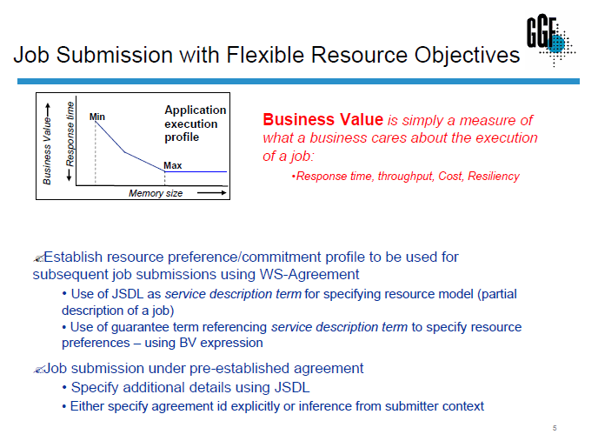
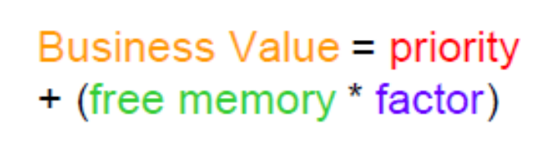
GGF14: A. Dan et al WS-Agreement Implementation:
Infrastructure for protocol support, and its use in Job Scheduling

Slide 11
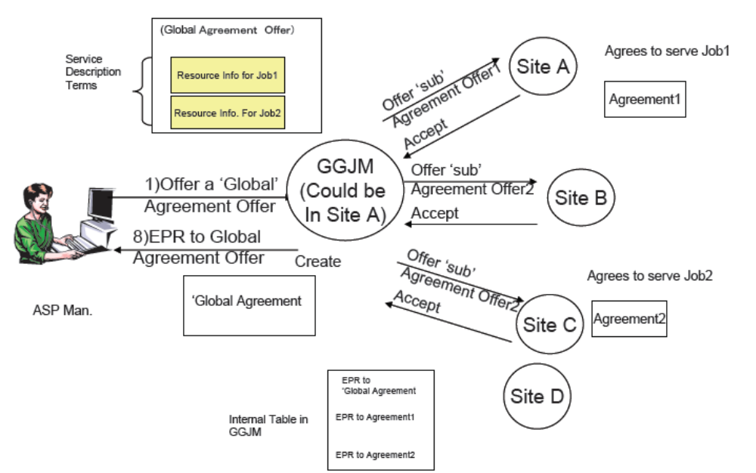
GGF14: T. Nakata et al.
Use of WS-Agreement in the Business Grid Project

Slide 12
EMS: Collaborative Work Example
Things to ponder on-- Reservation?
ACS
Area to ponder on
Scope of WS-AG
GRAAP+JSDL?
App. Contents Service
Candidate Set Generator (Work -Resource mapping)
RSS
Provisioning
Deployment
Configuration
CDDLM
Information Services
Execution Planning Services
Reservation
JSDL
BES
GRAAP
Service
Container
Data
Container
Job Manager
Accounting Services
EMS

Slide 13
Reserve

Slide 14
Clear Separation of Agreement Initiator/ Agreement Responder vs. Service Consumer/Service Provider
Whether Agreement Initiator (AI) becomes a Service Consumer or Service Provider is completely domain dependent.
However there always seemed to be a confusion (or assumption) that Agreement Provider(prev. term) = Service Provider
Domain A:
  Initiator: Individual with Job to be run(=Service Consumer)
  Responder: Provider of job execution service(=Service Provider)
Domain B:
  Initiator: Provider of job execution service(=Service Provider)
  Responder: Individual with Job to be run(=Service Consumer)
AI(=SC)
AP=(SP)
AI=(SP)
AP(SC)
Tell me what kind of Service You provide
Tell me what kind of Service You need
Get Template
A Computational Job with 4-32 2GFlops CPUs …
An engine to do a CFD job with 100 Gflops at less than 1K dollars
Get Template
Please process my CFD job with
At least 100GFlops System Power
Templates
I can do the job for you @ 800$
Templates
Create Agreement
Create Agreement
OK I’ll do it
OK I’ll take it
Agreement EPR
Agreement EPR

Slide 15
Simple Sequence-1
Agreement Initiator
Agreement Responder
GetTemplate()
(templates)
Based on the
Template create an offer
CreateAgreement(offer)
Decide to agree
To the offer Create an agreement
(EPR to Agreement1)
At this moment the agreement is
Observed. A-I cannot refuse to the
Created Agreement
Agreement1
Asynchronous versions also available

Slide 16
Business Value List
<wsag:BusinessValueList>
<wsag:Importance> xsd:integer </wsag:Importance>?
<wsag:Penalty> </wsag:Penalty>?
<wsag:Reward> </wsag:Reward>?
<wsag:Preference> </wsag:Preference>?
<wsag:CustomBusinessValue> … </wsag:CustomBusinessValue>*
</wsag:BusinessValueList>
wsag:importance
  Relative terms, such as high, low, medium, etc. can be used to prioritize across many guarantees. However, to provide stronger semantics and easier comparison of this value, this is expressed using an integer.
wsag:Penalty
  Expresses the penalty to be assessed for not meeting an objective.
wsag:Reward
  expresses reward to be assessed for meeting an objective..
wsag:Preference
  This element specifies a list of fine-granularity business values for different alternatives, where each alternative refers to a ServiceDescriptionTerm and its associated utility.
wsag:CustomBusinessValue:
  Can be added and is completely domain specific

Slide 17
Simple Sequnce-2
Agreement Initiator
Agreement Responder
GetTemplate()
(templates)
Based on the
Template create an offer
CreateAgreement(offer)
Decide to refuse
(Return a Fault)

Slide 18
Job Submission Example Using prototype JSDL document as Service terms: Template Example
<wsag:ServiceDescriptionTerm
wsag:Name="Job JSDL" wsag:ServiceName="Job">
<jsdl:JobDefinition>
<JobDescription>
<Application>
<jsdl-posix:POSIXApplication>
<FileSizeLimit>1048576</FileSizeLimit>
<CoreDumpLimit>0</CoreDumpLimit>
<OpenDescriptorsLimit>64</OpenDescriptorsLimit>
</jsdl-posix:POSIXApplication>
</Application>
<Resources ...>
<OperatingSystem>
<OperatingSystemType>
<OperatingSystemName>LINUX</OperatingSystemName>
</OperatingSystemType>
</OperatingSystem>
<CPUArchitecture>
<CPUArchitectureName>x86</CPUArchitectureName>
</CPUArchitecture>
<IndividualCPUSpeed>
<Exact>1600000</Exact>
</IndividualCPUSpeed>
<IndividualCPUCount>
<Exact>2.0</Exact>
</IndividualCPUCount>
<IndividualNetworkBandwidth>
<Exact>100000000</Exact>
</IndividualNetworkBandwidth>
<TotalResourceCount>
<Exact>1</Exact>
</TotalResourceCount>
</Resources>
</JobDescription>
<jsdl:JobDefinition>
</wsag:ServiceDescriptionTerm>
Default 1 MB file size limit
Default 0 byte core dump size limit
Default 64 open file descriptors limit
Default "LINUX" operating system
Default "x86" CPU type
Default 1.6 GHz CPU speed
Default 2 CPUs per node
Default 100 Mb/s network connectivity for nodes
Default 1 node per job

Slide 19
Job Submission Example Using prototype JSDL document as Service terms contd.
Maximum 500 MB file size limit (Default 1MB)
Maximum 500 MB core dump size limit (Default 0MB)
Maximum 1024 open file descriptors limit(Default 64)
<wsag:Item>
<Location>//jsdl-posix:FileSizeLimit</Location>
<xsd:restriction base="xsd:positiveInteger">
<xsd:maxInclusive value="524288000"/>
</xsd:restriction>
</wsag:Item>
<wsag:Item>
<Location>//jsdl-posix:CoreDumpLimit</Location>
<xsd:restriction base="xsd:positiveInteger">
<xsd:maxInclusive value="524288000"/>
</xsd:restriction>
</wsag:Item>
<wsag:Item>
<Location>//jsdl-posix:OpenDescriptorsLimit</Location>
<xsd:restriction base="xsd:positiveInteger">
<xsd:maxInclusive value="1024"/>
</xsd:restriction>
</wsag:Item>
<jsdl:JobDefinition>
<JobDescription>
<Application>
<jsdl-posix:POSIXApplication>
<FileSizeLimit>1048576</FileSizeLimit>
<CoreDumpLimit>0</CoreDumpLimit>
<OpenDescriptorsLimit>64</OpenDescriptorsLimit>
</jsdl-posix:POSIXApplication>
</Application>
Template:Service Description Term
Template: Creation Constraint
<FileSizeLimit>16777216</FileSizeLimit>
<CoreDumpLimit>0</CoreDumpLimit>
<OpenDescriptorsLimit>1024</OpenDescriptorsLimit>
16MB file size limit
0 MB core dump size limit
1024 open file descriptors limit
Offer: Service Description Term

Slide 20
Job Submission Example Using prototype JSDL document as Service terms contd.
Choice of "LINUX" or "FreeBSD" (exclusive)
Choice of "x86", "x86_32", or "x86_64" CPU types (exclusive)
<wsag:Item>
<Location>//jsdl:CPUArchitecture/CPUArhitecturename</Location>
<xsd:restriction base="jsdl:ProcessorArchitectureEnumeration">
<enumeration value="x86_32"/>
<enumeration value="x86_64"/>
<enumeration value="x86"/>
</xsd:restriction>
</wsag:Item>
<wsag:Item>
<Location>
//jsdl:OperatingSystem/jsdl:OperatingSystemType/jsdl:OperatingSystemName
</Location>
<restriction base="jsdl:OperatingSystemTypeEnumeration">
<enumeration value="LINUX"/>
<enumeration value="FreeBSD"/>
</restriction>
</wsag:Item>
<OperatingSystem>
<OperatingSystemType>
<OperatingSystemName>LINUX</OperatingSystemName>
</OperatingSystemType>
</OperatingSystem>
<CPUArchitecture>
<CPUArchitectureName>x86</CPUArchitectureName>
</CPUArchitecture>
Template:Service Description Term
Template: Creation Constraint
<OperatingSystem>
<OperatingSystemType>
<OperatingSystemName>LINUX</OperatingSystemName>
</OperatingSystemType>
</OperatingSystem>
<CPUArchitecture>
<CPUArchitectureName>x86_32</CPUArchitectureName>
</CPUArchitecture>
"LINUX"
"x86_32"
Offer: Service Description Term

Slide 21
Job Submission Example Using prototype JSDL document as Service terms contd.
Choice of 10, 100, or 1000 Mb/s network connectivity for nodes
(inclusive)
Template: Creation Constraint
<wsag:Item>
<wsag:Location>//jsdl:IndividualNetworkBandwidth</wsag:Location>
<xsd:sequence>
<xsd:element name="Exact" minOccurs="1" maxOccurs="unbounded">
<xsd:simpleType>
<xsd:restriction base="xsd:double">
<xsd:enumeration value="1000000000"/>
<xsd:enumeration value="100000000"/>
<xsd:enumeration value="10000000"/>
</xsd:restriction>
</xsd:simpleType>
</xsd:element>
</xsd:sequence>
</wsag:Item>
<IndividualNetworkBandwidth>
<Exact>100000000</Exact>
</IndividualNetworkBandwidth>
Template:
Service Description Term
<IndividualNetworkBandwidth>
<jsdl:Exact>1000000000</jsdl:Exact>
<jsdl:Exact>100000000</jsdl:Exact>
</IndividualNetworkBandwidth>
Selects 100/1000 Mb/s network speeds
(the scheduler can choose which)

