Slide 1
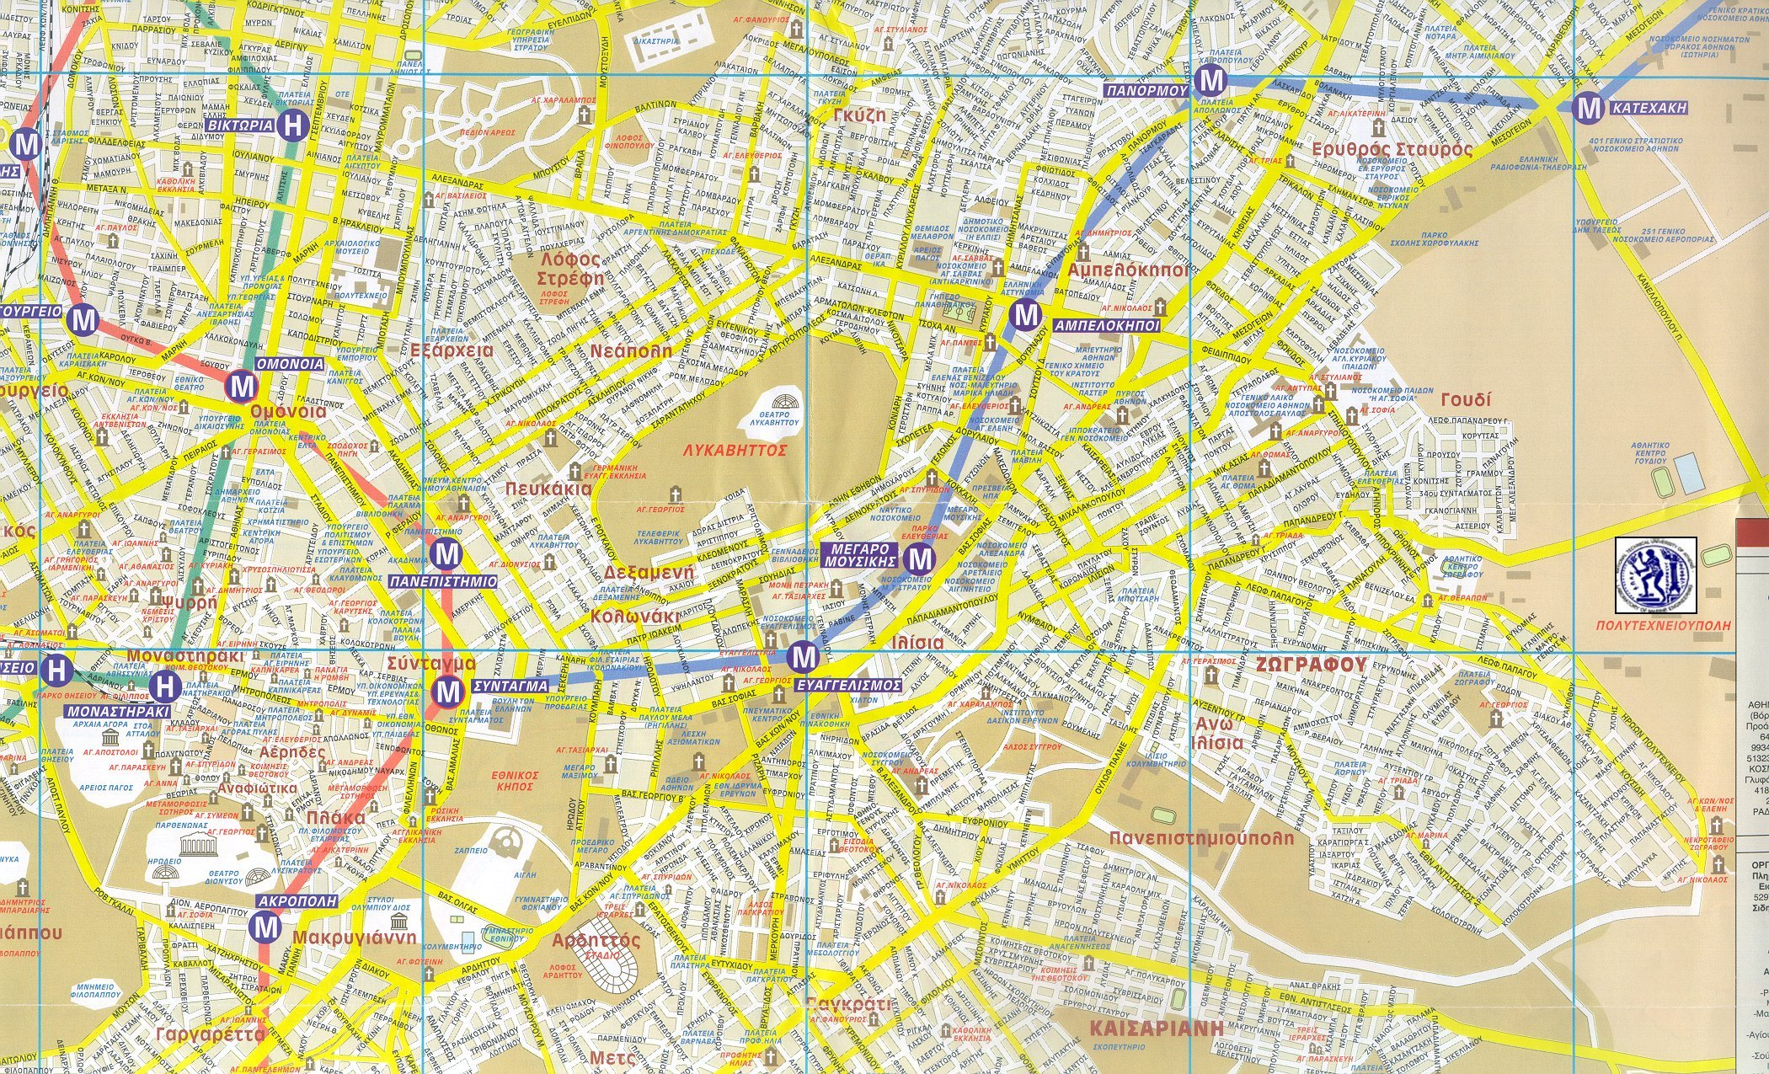
OGSA-WG F2F on Feb. 17
At National Technical University of Athens
Campus
Entrance
Meeting room
At Library
Divanis
Caravel
Hotel

Slide 2
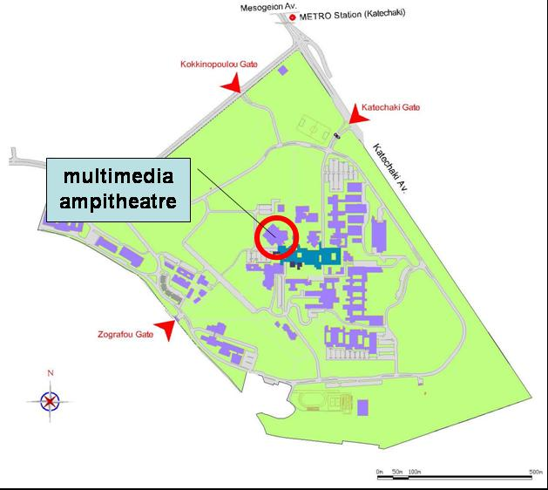
Location
  National Technical University of Athens
  Zografou Campus, Iroon Polytexneiou 9, 15780 Zografou
  Multimedia Ampitheatre, the library building ground floor
  February 17, Friday 9am-5pm
Direction from Divani Caravel Hotel
  We will meet at hotel lobby 8:30am and take taxi to NTUA. It will take 20-25 minutes depending on traffic.
  In case you prefer to use public transportation (it will take 30-45 minutes):
  From “Evangelismos” station near by hotel, take line 3 metro to “Katehaki” station (4th stop). From “Katehaki” station, take bus number 242 to NTUA Administration Building. Bus departs 15 and 45 every hour from Metro station.
Library building is the next to the Administration Building.
Local contact:
  Konstantinos Dolkas
  work phone +30-2107722546
  mobile +30-6974899851

