Slide 1
Looking ahead for GFS …
Arun Jagatheesan
San Diego Supercomputer Center
Remote Talk at GGF-16
Athens, Greece

Slide 2
IP & ©
Intellectual Property Statement
The GGF takes no position regarding the validity or scope of any intellectual property or other rights that might be claimed to pertain to the implementation or use of the technology described in this document or the extent to which any license under such rights might or might not be available; neither does it represent that it has made any effort to identify any such rights. Copies of claims of rights made available for publication and any assurances of licenses to be made available, or the result of an attempt made to obtain a general license or permission for the use of such proprietary rights by implementers or users of this specification can be obtained from the GGF Secretariat.
The GGF invites any interested party to bring to its attention any copyrights, patents or patent applications, or other proprietary rights which may cover technology that may be required to practice this recommendation. Please address the information to the GGF Executive Director.
Copyright (C) Global Grid Forum (2004). All Rights Reserved.
This document and translations of it may be copied and furnished to others, and derivative works that comment on or otherwise explain it or assist in its implementation may be prepared, copied, published and distributed, in whole or in part, without restriction of any kind, provided that the above copyright notice and this paragraph are included on all such copies and derivative works However, this document itself may not be modified in any way, such as by removing the copyright notice or references to the GGF or other organizations, except as needed for the purpose of developing Grid Recommendations in which case the procedures for copyrights defined in the GGF Document process must be followed, or as required to translate it into languages other than English.
The limited permissions granted above are perpetual and will not be revoked by the GGF or its successors or assigns.
This document and the information contained herein is provided on an "AS IS" basis and THE GLOBAL GRID FORUM DISCLAIMS ALL WARRANTIES, EXPRESS OR IMPLIED, INCLUDING BUT NOT LIMITED TO ANY WARRANTY THAT THE USE OF THE INFORMATION HEREIN WILL NOT INFRINGE ANY RIGHTS OR ANY IMPLIED WARRANTIES OF MERCHANTABILITY OR FITNESS FOR A PARTICULAR PURPOSE."
Notes:
This has to be displayed on all GGF presenatations

Slide 3
Talk Outline
Grid File System Status
Looking ahead
  What should be done?
  What could be done?
  How could we do it? (Possibilities and Opportunities)
Summary
Notes:
Outline

Slide 4

Talk Outline
Grid File System Status
Looking ahead
  What should be done?
  What could be done?
  How could we do it? (Possibilities and Opportunities)
Summary
Notes:
Outline

Slide 5
GFS-WG Status
Informational Document : GFS-Architecture
  Approved now as a GFD-61
  http://www.ggf.org/documents/GFD.61.pdf
  That was only version – 1 of the Architecture workbook
RNS Specification
  Under discussion, public review (?)
  More discussion on this session too
New Secretary
  Christopher Jordon
External Alliances
  SNIA, IETF NFSv4 (??)
Notes:
GFS-Architecture version-1.0 was made a GFD Informational document after public review.
RNS still in dicussion.
Christopher Jordon of SDSC / Teragrid will be GFS-WG secretary
GFS-WG has worked closely with grid related activities in SNIA. Could consider some thing similar (if required) for NFSv4 logical namespace.

Slide 6
Talk Outline
Grid File System Status
Looking ahead
  What should be done?
  What could be done?
  How could we do it? (Possibilities and Opportunities)
Summary
Notes:
Outline

Slide 7
What should be done?
Standards to support grids in production
  Proliferation of grid standards for file system use cases
  Many global projects use these technologies. Learn from them and use them to evolve GFS data grid standards
Standards based on what works
  Similar patterns in production use cases for files observed
  Products emerge based on what works and user needs
  Standards design based on what works in multiple projects

Slide 8
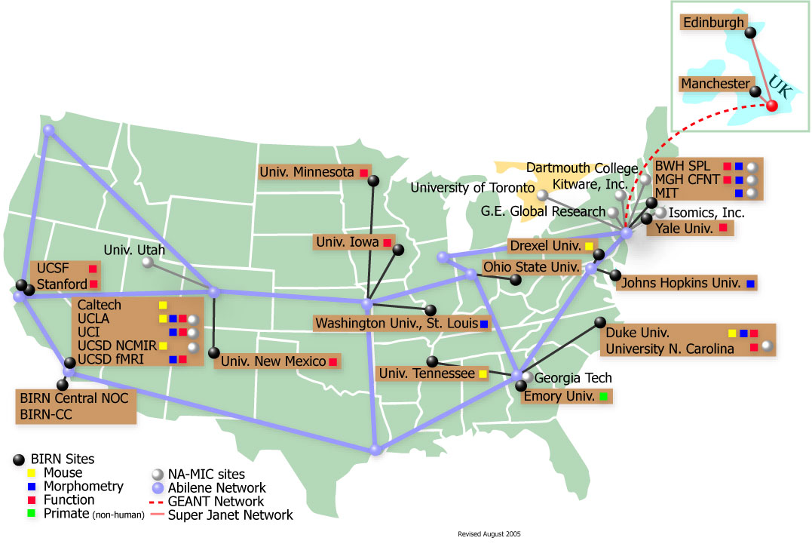
What should be done? (users)
NIH BIRN Data Grid
Notes:
BIRN project is a good example for data grid or GFS requirements. It already supports more than 20 organizations for a collaborative logical namespace

Slide 9
Growing User Community (I)
BaBar, Stanford Linear Accelerator Center (SLAC)
California Digital Library (CDL)
Center for Integrated Space Weather Modeling (CISM)
CVC, Visualization Portal
LDC Data Storage
NIH Bio Informatics Research Network (BIRN)
NSF Southern California Earthquake Center (SCEC)
National Archives and Records Administration (NARA)
National Aeronautics and Space Administration Centers (NASA)
National Virtual Observatory (NVO)
Npackage, NSF Middleware Initiative (NMI)
National Science Digital Library (NSDL)
National Optical Astronomy Observatory (NOAO)
ROADNet
Purdue University
SCCOOS, USA
Scientific Rich Media Archive
Salk Institute
Strand Map Service, USA
UC Berkeley Library
UCSD Library
University of Houston
Persistent Archives Test bed
University of Wisconsin, Madison
WebBase, Stanford University
Yale University Library
Notes:
Data grid software is now used in production in multiple academic projects around the world

Slide 10
Growing User Community (II)
Academia Sinica, Taiwan
Australian National University
Bio-Lab, University of Genoa, Italy
Council for the Central Laboratory of the Research Councils (CCLRC), UK
CC-IN2P3, France
Distributed Framework, Singapore
Distributed Aircraft Maintenance Environment (DAME), UK
eMinerals Project, UK
eScience, Belfast Center
Fraunhofer ITWM, Germany
High Energy Accelerator Organization, KEK, Japan
K* Grid Computing, Korea
KEK Computing Center, Japan
Lyon, France
NorGrid, Norway
NCHC, Taiwan
Nanyang Data Grid, Singapore
Queensland University of Technology (QUT), Australia
Rutherford Appleton Laboratory (RAL), UK
T-Systems, Germany
UK eScience Project, UK
UniGrid, Poland
UMK, Poland
Virtual Laboratory for eScience, Netherlands
Notes:
Data grid software is now used in production in multiple academic projects around the world

Slide 11
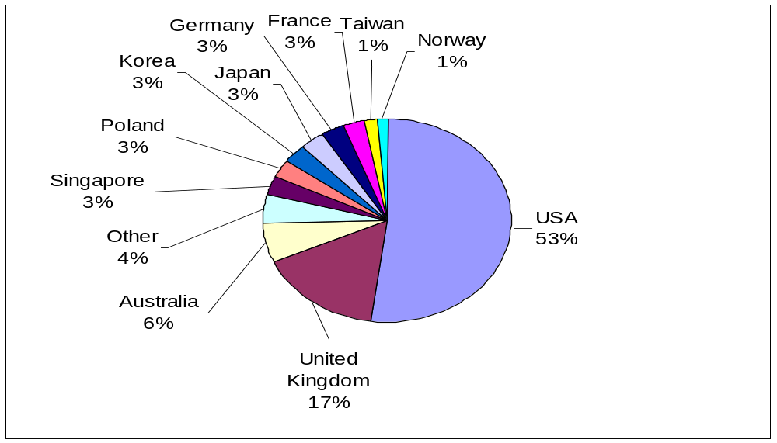
Countries actively using GFS-like S/W
Notes:
Data grid software is now used in production in multiple academic projects around the world

Slide 12
Talk Outline
Grid File System Status
Looking ahead
  What should be done?
  What could be done?
  How could we do it? (Possibilities and Opportunities)
Summary
Notes:
Outline

Slide 13
What could be done?
Standards with functionalities or operations used by users in production
  Collaborative logical namespace management
  Inter/Intra/Multi Organizational namespace
  Logical storage resources (no mount points)
  Metadata, annotation support for discovery
  Bulk operations
  User groups and User access control
  Automated data integrity checks

Slide 14
Talk Outline
Grid File System Status
Looking ahead
  What should be done?
  What could be done?
  How could we do it? (Possibilities and Opportunities)
Summary
Notes:
Outline

Slide 15
How could we move forward?
A single interface for “Data Grid Management”
  Users won’t prefer managing multiple interfaces
  A single “Data Grid” interface is required
  Either GFS-WG or a new WG that evolves from this WG has to focus on this interface
Collaboration with vendors and data grid users
  SNIA “Storage for grids” effort – logical storage resources for grids
  Data Grid interface – user community formation for evolution of standards
  Academic users – SDSC SRB Data Grid Management System

Slide 16
Summary
GFS-WG results delivered, has to evolve
Data Grids : Multiple projects and production users world-wide
  Multiple common features and patterns observed in academic usage
  Vendor or Industry Interest for similar commercial use cases
GFS-WG or a new group in Data Area has to focus on a single “Data Grid Interface”

