Slide 1
Grid File System WG
GGF16, Athens
Feb 14, 2006

Slide 2
GFS-WG Session Agenda
Introduction (10min)
  New secretary: Christopher Jordan (SDSC)
Looking ahead for GFS-WG (10min)
Hierarchical (Human Interface) Namespace discussion (60min)
  Current status of RNS
  WS-Directory
  VFDS (Virtual Filesystem Directory Service) profile
Grid File System Architecture discussion (10min)
  Architecture workbook now out
  Early Draft of Architecture of Grid File System

Slide 3
Looking Ahead for GFS-WG

Slide 4
Hierarchical (Human Interface) Namespace discussion

Slide 5
RNS Status
Before RNS, we proposed object-oriented VFDS (Virtual Filesystem Directory Service)
Necessity of general-purpose Hierarchical Naming Service was discussed in OGSA and OGSA-D WG
Responding to the discussion, we proposed RNS spec in cooperation with OGSA-D WG;
  All file system specific features have been factored out
  No bias for Grid file system anymore
  Satisfy requirements by Grid file system
    Extensible interface enables GFS Naming Profile
    Scalability, practicality, …
Submitted to GFD Editor on November 1, 2005
Ownership of RNS transitions to OGSA-Naming WG after public comment period
GFS-WG to begin GFS Naming Profile now

Slide 6
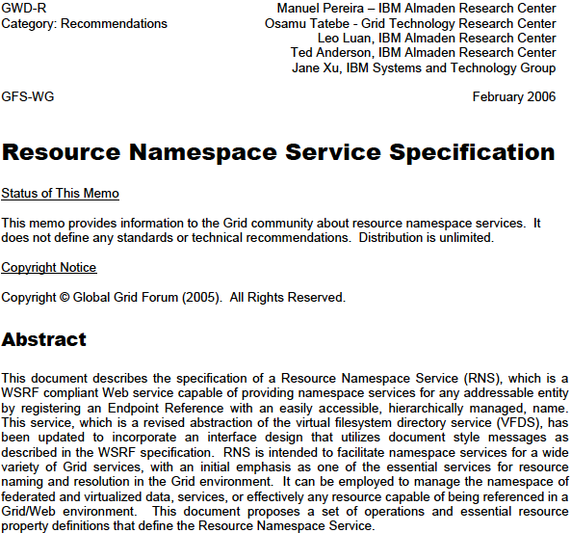
RNS Specification
https://forge.gridforum.org/projects/gfs-wg/document/Resource_Namespace_Service_Final_Draft/en/2

Slide 7
Resource Namespace Service (RNS)
A multi-faceted approach for addressing the needs of access to resources within a distributed network or grid
Facilitates a uniform and universal namespace where:
  Names resolve to ultimate target addresses
  Names are hierarchically managed
  Names may be used in human interface applications and browsable
Utilizes document style messaging
Intended to facilitate namespace services for a wide variety of Grid services
  OGSA Basic Profile compliant Web service capable of providing namespace services for any addressable entity by registering an Endpoint Reference

Slide 8
RNS Service Description
RNS
GFS Naming Profile
Other Naming Profile

Slide 9
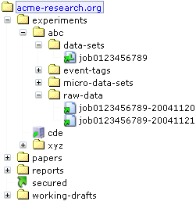


RNS Three-Tier Naming Architecture
Human Interface Names
Logical References
Endpoint References
Junction
Virtual directory

Slide 10
RNS Basic Naming Components
Virtual Directories
Junctions
  Referral Junction
  Logical Reference Junction
  Endpoint Reference Junction

Slide 11
RNS Entry Property
All of the following properties MUST be implemented to represent properties of a namespace entry by an RNS service implementation.
QName | Description
ChildCount | Integer: Number of subentries corresponding to Entry, if and only if Entry is a Virtual Directory; zero or NULL otherwise.
Description | String: Description of Entry
ModificationTime | DateTime (xsd:dateTime) representation of the last modified timestamp of Entry
Name | String: Representation of the human interface name of Entry
Optional entry property for (Endpoint Reference) Junction
EndpointReferenceList | wsa:EndpointReference[]: List of all Endpoint References associated with Entry
Optional entry property for Logical Reference Junction
LogicalName | String: Used to set , add, or retrieve the logical name of a LogicalReference
LogicalResolver | String: Used to set or add a single resolver of a LogicalReference
LogicalResolvers | LogicalResolver[]: List of all resolvers of a LogicalReference

Slide 12
Referral Junction (EPR)
Referral junctions MUST include an rns:Path element within the EPR’s wsa:ReferenceProperties element to denote the RNS namespace resource being targeted
<wsa:EndpointReference>
<wsa:Address> … </was:Address>
<wsa:ReferenceProperties>
<rns:Path> path/to/target/directory </rns:Path>
</wsa:ReferenceProperties>
</wsa:EndpointReference>

Slide 13
RNS Operations
Naming Operations
  create
  delete
  list
  lookup
  update
Iterator Context Operations
  createIteratorContext
  getIteratorContext
Extensibility Operations
  deleteProperty
  insertProperty
  listProperties
  updateProperty

Slide 14
Document style Messaging
greater flexibility is realized in the exchange of parameters and complex types or objects
greater extensibility is facilitated without breaking applications that utilize the service

Slide 15
Lookup operation
lookup
  Parameter: QueryInput
  Returns: QueryResponse
  Faults: RNSInvalidPropertyFault, RNSEntryNotFoundFault, RNSTypeFault

Slide 16
Operation parameters (1) – document literal service compliant message
QueryInput
  parameterList – unbound array of name-value pairs (that specifies the entry)
    Path, IteratorMaxAtOnce, …
  propertyTypes - unbound array of (xsd:QName) string (for output property)
    All, Name, EndpointReferenceList, …
<xsd:complexType name="QueryInput">
<xsd:sequence>
<!-- Dynamic list of parameters -->
<xsd:element ref="rns:parameterList" minOccurs="1" maxOccurs="1"/>
<!-- Array of QNames used to indicate what properties to retrieve -->
<xsd:element ref="rns:propertyTypes" minOccurs="1" maxOccurs="unbound"/>
</xsd:sequence>
</xsd:complexType>

Slide 17
Operation parameters (2)
QueryResponse
  BaseDirectory – current working directory
  EndOfList – for IteratorContext
  Referral – Referral references (EPRs)
  Any – output array of unrestrained message elmts
<xsd:complexType name="QueryResponse">
<xsd:sequence>
<xsd:element ref="rns:baseDirectory" minOccurs="1" maxOccurs="1"/>
<xsd:element ref="rns:endOfList" minOccurs="0" maxOccurs="1"/>
<xsd:element ref="rns:referral" minOccurs="0" maxOccurs="unbound"/>
<xsd:any minOccurs="0" maxOccurs="unbound"/>
</xsd:sequence>
</xsd:complexType>

Slide 18
Operation Faults
RNSFault
  RNSDirectoryNotEmptyFault
  RNSEntryExistsFault
  RNSEntryNotFoundFault
  RNSInvalidPropertyFault
  RNSTypeFault

Slide 19
Comments from the editor on Jan 24, 2006
a good proposal for a naming in a Grid File System
could sensibly proceed to public comment if it is identified as being a proposal for naming in this specific context

Slide 20
Comments in detail
It contains at least three specifications; RNS, Iterator, and logical name resolver. Need to factored out them
  → There are no specific reasons apart from the dependency on such functionality for practical use
  → Performance and scalability are primary concerns without an iterator
  → As for removing the resolver, that has already been agreed to and is currently included only to offer a default and simple companion solution to avoid having a dependency on an unspecified service
Reference Property of EPR should be opaque to a client
  → we need some other mechanism to identify what type of EPR it is. If there is a standard way to resolve services that correspond to given EPRs then there is no issue

Slide 21
GFSG recommendation
(Option 1) Modify the document so it is re-cast and re-scoped to more clearly reflect just filesystems, and not try to be too general. I.e., not "any accessible entity" but filesystem
  Two fundamental concerns:
    Such an approach is likely to soon become divergent and incompatible with other Grid-oriented namespace services. If other namespace specifications are standardized then GFS-WG should strive to ensure compatibility and interoperability with the standard approach and OGSA endorsed mechanism.
    This issue was discussed in detail in March of 2005 (GGF13) with the general consensus to proceed with RNS as a more general namespace specification that will be refined to reflect the concerns of all interested parties. Nearly a year has passed and now this issue is resurfacing.
(Option 2) Work with the OGSA Naming WG, so that your document can become part of that group's broader work

Slide 22
RNS and WS-Directory
 | RNS | WS-Directory
What is provided | A directory tree | A directory
# operations | 5 (lookup, list, create, delete, update) + extensibility operations + iterator ops | 3 (lookup, add, remove)
EPR Type | Virtual directory, and Junctions (Logical reference and Endpoint reference) | No specific type (a client cannot determine the type)
Extensibility to add metadata | Yes, extensibility operations ({delete,insert,list,update}Property) can associate any property without any change of service by document style messaging | Νο
Scalability | Good (Referral and iterator) | Referral mechanism not specified explicitly, iterator may come from another standard
ACL | Can be associated at each entry in RNS | Not sure to set up and modify required fine-grained ACL

Slide 23
WS-Directory talk
Mark Morgan (University of Virginia)

Slide 24
Grid File System Architecture discussion

Slide 25
Additional functionalities (listed by Reagan Moore)
versions
backups
locks (partial file locks)
containers
checksums
verification time on checksum
quota limits
space used by an individual
replicas
synchronization flags for replicas
descriptive metadata
schema extension / snowflake schema
annotations added by other persons
comments (set by owner)
audit trails on all data accesses
audit trails on all metadata update
access controls on data
access controls on metadata
access controls on resources
roles for assigning access controls for read/write/turn on audit trail/add annotation/create metdata
sticky bits
soft links within the logical name space
end-to-end encryption
logical names for resources to support collective operations
logical names for users
logical names for files
transport using serial I/O
client-initiated parallel I/O transport
server-initiated parallel I/O transport (needed to deal with firewalls)
third party parallel I/O transport
bulk registration (use of multiple threads to interact with metadata catalog)
Bulk transport (packing of files before transmission)
remote procedures for parsing/filtering data
bulk transport using both packing and parallel I/O
bulk deletion

Slide 26
Additional functionalities (2)
Deciding which of these features is essential depends upon the user community
It should be possible to characterize a feature as generic, or used principally by the digital library community, or used principally by the preservation community

