Slide 1
Grid Scheduling Architecture –
Research Group
Ramin Yahyapour
Philipp Wieder
GSA-RG
11 May, 2006 (GGF17 in Tokyo)

Slide 2
GGF Intellectual Property Policy
All statements related to the activities of the GGF and addressed to the GGF are subject to all provisions of Appendix B of GFD-C.1, which grants to the GGF and its participants certain licenses and rights in such statements. Such statements include verbal statements in GGF meetings, as well as written and electronic communications made at any time or place, which are addressed to any GGF working group or portion thereof,
Where the GFSG knows of rights, or claimed rights, the GGF secretariat shall attempt to obtain from the claimant of such rights, a written assurance that upon approval by the GFSG of the relevant GGF document(s), any party will be able to obtain the right to implement, use and distribute the technology or works when implementing, using or distributing technology based upon the specific specification(s) under openly specified, reasonable, non-discriminatory terms. The working group or research group proposing the use of the technology with respect to which the proprietary rights are claimed may assist the GGF secretariat in this effort. The results of this procedure shall not affect advancement of document, except that the GFSG may defer approval where a delay may facilitate the obtaining of such assurances. The results will, however, be recorded by the GGF Secretariat, and made available. The GFSG may also direct that a summary of the results be included in any GFD published containing the specification.
Sign into
participants list !

Slide 3
Session Agenda
Update on group status
  Roadmap
  Documents: Status and plans
Interaction between scheduling instances
  Use case
  Discussion of requirements etc.
General discussion
Next steps

Slide 4
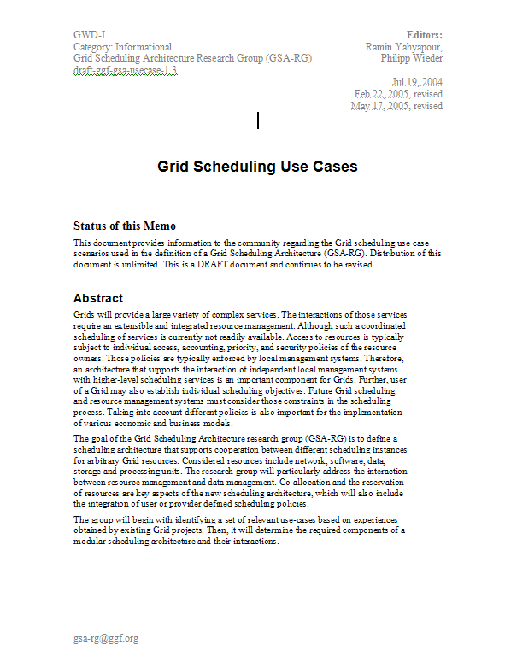
Roadmap
Compile use cases
Ongoing process
for further revisions
Derive use case profiles
√
Doc 1: Use Cases
Identify requirements
for scheduling architecture
Ongoing process
for further revisions
Determine architecture
framework and necessary
component services
Doc 2: Requirements/
architecture
Ongoing process
for further revisions
Review existing
services and protocols
Doc 3: Existing services
review

Slide 5
Grid Scheduling Use Case Document
February 2006: Final version (post public comment) sent back to editor
Now GFD.64 (since March 2006), please see http://www.ggf.org/documents/GFD.64.pdf
Many thanks to all the authors!
Additional use cases are always welcome
  This document will be updated with future revisions

Slide 6
Grid Scheduling Architecture – Requirements Document
Identifies components & interactions for a modular scheduling architecture
Introduces terminology
  Scheduling instance and relation between instances
  What else? – Basic terminology, but no dictionary
Derives service requirements from
use cases
  Descriptive, no WSDL, protocols, etc.
Compares requirements with existing solutions
Done
Current
activity
Description of services & their interaction

Slide 7
Grid Scheduling Requirements: Template
Free-form specification of
requirements did not
work properly -> template
  helps authors of
  requirements
  guarantees comparable
  level of abstraction
  delivers also description
  of terms
https://forge.gridforum.org/projects/gsa-rg/
document/GSA_Requirements_Template_V0.5/en/1
ID |  | Category
Short name
Requirement
Use case(s)
Acting entities
Profile(s)
Reason
References
Priority
Constraints
Frequency
Performance
Comments
Author |  | Version

Slide 8
Performance Prediction Requirements Example
ID | R-PP-F1 |  | Category | Functional
Short name | Job Execution Times Prediction
Requirement | A performance prediction system must provide a prediction of job execution times
Use case(s) | K-Grid
Acting entities | Grid Scheduling Instance, Scheduling Access Client
Profile(s) | Single-site execution with service guarantees, job execution with advance reservation, complex workflow
Reason | This knowledge is essential for accurate scheduling and service guarantees
References
Priority | Critical
Constraints
Frequency | For each submitted job; may be very frequent
Performance | Response must be very quick to avoid slowing down a whole scheduling process
Comments
Author | AO | Version |  | 1.2

Slide 9
Grid Scheduling Requirements: Current List
Information Service (IS)
Job/Workflow/Requirement Description (JD)
Resource Discovery (RD)
Reservation Management/Agreement and Negotiation (RM)
Accounting (AC)
Billing (BI)
Job Management (JM)
Job and Resource Monitoring (MO)
Data Management (DM)
Network Management (NM)
Performance Prediction (PP)

Slide 10
Interaction between Scheduling Instances
High-level definition of requirements for a Grid Scheduling architecture is needed, but …
… interaction between scheduling instances is of particular interest
Not properly addressed yet
Requirement for a significant number of GSA-RG participants
Essential for interoperable GSA implementations

Slide 11

Next steps: Interaction between Scheduling Instances
Grid-
User/Application
Grid-
Scheduler
Grid-
Scheduler
Grid-
Scheduler
Information
Services
Monitoring
Services
Security
Services
Grid
Middleware
Grid
Middleware
Grid
Middleware
Grid
Middleware
Accounting/Billing
Other
Grid Services
Local RMS
Local RMS
Local RMS
Local RMS
Interoperability of different Grid schedulers;
Not about simple job submissions, but applying scheduling policies.
time
time
time
time
Schedule
Schedule
Schedule
Schedule
Compute
Resources
Data
Resources
Network
Resources
Other
Resources/Services

Slide 12


Use Case Example:
Interaction between Scheduling Instances
VO_{A}
VO_{B}
Data Management System
Data Management System
Grid Scheduler A
Protocol + Interface
Grid Scheduler B
Information System
Information System
Local Resource Manager
Local Resource Manager
Local Resource Manager
Local Resource Manager
Local Resource Manager
Local Resource Manager
Notes:
Another goal of the GSA-RG is to propose the way how Grid schedulers can interact with each other.
To this end a protocol and interface will be proposed. Of course, existing GGF recommendations and specifications will be taken into consideration where possible.
Other components of the architecture are not the comprehensive set and of course the remaining elements can be included to a VO.

Slide 13
Interaction between Scheduling Instances – Issues
Grid Scheduler B (GS_{B}) may return
  all resources that meet requirements
  a subset of the best resources
  the best resource
Grid Scheduler A (GS_{A}) may query GS_{B}
  only if no resources have been found in VO_{A}
  each time it schedules a job
GS_{A} can
  pass all interactions of end-users to GS_{B}
  return only a job id and an address of GS_{B} to end-users
The interface between GSs can use
  high level parameters such as, e.g. guaranteed start time, cost etc.
  low level parameters such as, e.g. CPU load, free memory etc.
Notes:
Examples of questions that must be answered during work on the interaction between schedulers.

Slide 14
Next Steps
Requirements document
  Complete document sections for required services and elaborate on interaction of services
  1st complete version for GGF18
  Actually planned for GGF17, but … (the well-known one)
Review of existing services
  Existing Grids, OGSA, …
  Use mailing list for discussion
  Depending on decisions made wrt interaction between scheduling instances: Compile first contributions for GGF18
If you want to participate in the work you are invited to subscribe to the mailing list: gsa-rg@gridforum.org

Slide 15
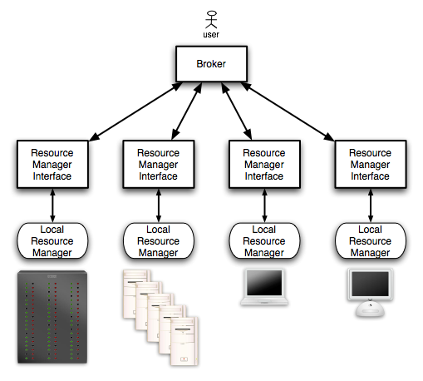
Example for Scheduling-Structures:
Enterprise/Campus Grids

Slide 16
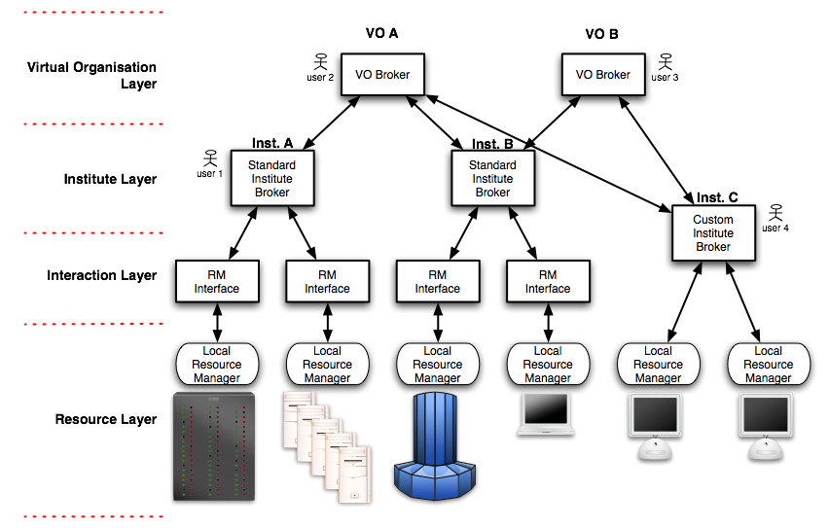
Example for Scheduling-Structures:
Structured HPC Grids

Slide 17
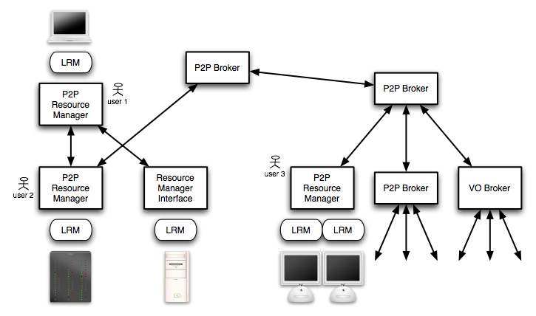
Example for Scheduling-Structures:
Global Grids

