Slide 1

DAIS-WG
RDF(S) Specification Discussion

Slide 2

OGF IPR Policies Apply
“I acknowledge that participation in this meeting is subject to the OGF Intellectual Property Policy.”
Intellectual Property Notices Note Well: All statements related to the activities of the OGF and addressed to the OGF are subject to all provisions of Appendix B of GFD-C.1, which grants to the OGF and its participants certain licenses and rights in such statements. Such statements include verbal statements in OGF meetings, as well as written and electronic communications made at any time or place, which are addressed to:
    the OGF plenary session,
    any OGF working group or portion thereof,
    the OGF Board of Directors, the GFSG, or any member thereof on behalf of the OGF,
    the ADCOM, or any member thereof on behalf of the ADCOM,
    any OGF mailing list, including any group list, or any other list functioning under OGF auspices,
    the OGF Editor or the document authoring and review process
Statements made outside of a OGF meeting, mailing list or other function, that are clearly not intended to be input to an OGF activity, group or function, are not subject to these provisions.
Excerpt from Appendix B of GFD-C.1: ”Where the OGF knows of rights, or claimed rights, the OGF secretariat shall attempt to obtain from the claimant of such rights, a written assurance that upon approval by the GFSG of the relevant OGF document(s), any party will be able to obtain the right to implement, use and distribute the technology or works when implementing, using or distributing technology based upon the specific specification(s) under openly specified, reasonable, non-discriminatory terms. The working group or research group proposing the use of the technology with respect to which the proprietary rights are claimed may assist the OGF secretariat in this effort. The results of this procedure shall not affect advancement of document, except that the GFSG may defer approval where a delay may facilitate the obtaining of such assurances. The results will, however, be recorded by the OGF Secretariat, and made available. The GFSG may also direct that a summary of the results be included in any GFD published containing the specification.”
OGF Intellectual Property Policies are adapted from the IETF Intellectual Property Policies that support the Internet Standards Process.

Slide 3
Agenda
Introduction (I.Kojima)
  DAIS-RDF(S) : Brief overview & History
  Progress after GGF17
  Motivational Document Introduction
    Scenarios (Use Cases)
Specification Discussion
  RDF(S) Model and WS-DAI(M. Esteban Gutiérrez)
  RDF(S) Ontology Access Specification (M. Esteban Gutiérrez)
  RDF(S) Querying Specification (I.Kojima)
Discussions

Slide 4
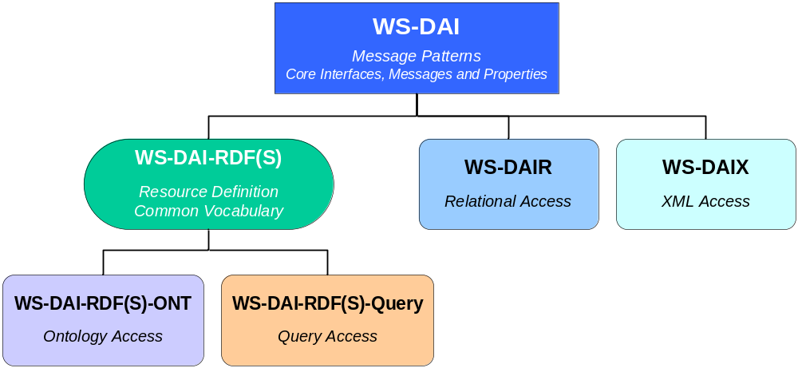
WS-DAI-RDF(S)
Details are
Presented Later
New WS-DAI realization for RDF(S) databases
  Will be composed with 2 complementary specifications
Currently leaded by AIST and UPM which has separate implementation projects
(We have already 2 candidates for the reference implementations)

Slide 5
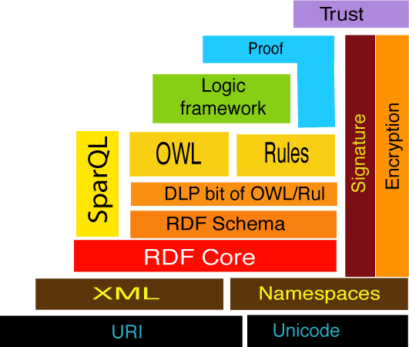
RDF (Resource Description Framework)
Common metadata/knowledge description in Semantic Web Applications
Number of RDF data is increasing
=> Support by the database technology/specs will be important
Statement:
“creator of “http://gtrc.aist.go.jp/~a.matono/ is matono”
http://gtrc.aist.go.jp/~a.matono
creator
matono
subject
predicate
object
DAIS
Next
<?xml version="1.0"?>
<rdf:RDF xmlns:rdf="http://www.w3.org/1999/02/22-rdf-syntax-ns#"
xmlns:dc="http://dublincore.org/2001/08/14/dces#">
<rdf:Description about="http://gtrc.aist.go.jp/~a.matono">
<dc:creator>matono</dc:creator>
</rdf:Description>
</rdf:RDF>
DAIS
NOW
XML-based Format
Layer Cake of the Semantic Web

Slide 6
Motivation : DAIS for RDF
(as shown in the motivational document)
Semantic Web and Grid Computing
  Grid technology should support Semantic Web applications and Tools
  Semantic Web technology will be widely used within Grid applications
  RDF and its Ontology should be
  supported by the grid standard framework
Next Generation SOA
  Grid -> Service Oriented Science?
  Next SOA -> Semantic SOA
  RDF/ontology storage will be the key component for the next generation SOA/Grid environment
Many Grid applications
use Ontology
Data in Semantic
SOA is described with RDF
Notes:
This is the motivation for Grid Standards which is shown in the Motivational Document,
1st is the Semantic web and the Grid Computing.
As the scale of the semantic web application grows, grid technology should support semantic web applications and tools
Also, Semantic web technology is widely used within the grid applications.
Ontology is a typical example which is widely used within the grid applications
So, it is very important to support this by the grid standard framework.
2nd is the Next Generation SOA,
As Ian Foster talked before, grid directs to service oriented science.
On the other hand, SOA directs to the Semantic SOA

Slide 7
History
2006.02: GGF16 at Athens
  DAIS for RDF BOF: Share the Motivation
2006.05: GGF17 DAIS-WG at Tokyo
  Charter Discussion
  Focus on RDF and RDF Schema (RDF(S))
  Scope/Roadmap/Deliverables
2006.06: RDF F2F at Edinburgh
  Decide to make an informational document
    Motivational Document : Structure Discussion
2006.09: GGF18 at Washington

Slide 8
DAIS RDF(S)
Chartering RDF/Ontology Access Initiative
1) Format: DAIS-WG
2) Scope： Setting RDF(S) access specifications (WS-DAI-RDF(S))
based on the existing WS-DAI specifications, which is defined by the DAIS-WG.
3) Goals:
The following documents will be added to the current DAIS goals/milestones.
Data Service Specification: RDF(S) Querying
Data Service Specification: RDF(S) Ontology Access
4) Proposed schedules:
March 2007 : Initial draft of the WS-DAI-RDF(S) specifications, which is
consistent with WS-DAI and the OGSA data architecture.
August 2007: Revised draft of the WS-DAI-RDF(S) specifications.
March 2008 : Final specifications, submitted as a recommendation
GGF Document GGF Recommendation (Due March 2008)

Slide 9
Progress after GGF17 & F2F
Motivational Document created
  Informational Document
  1st version is completed
  already on the gridforge
  (presented later)
Charter details refined
  Scope/Roadmap/Deliverables
  Make 2 specification documents for Ontology/Querying

Slide 10
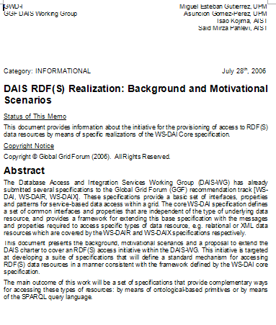
1st Output = Motivational Document
DAIS RDF(S) Realization:
Background and Motivational Scenarios
Aim of this document
  To define the scope of this activity
  To appeal to wider audience

Slide 11
Status and Issues
Already on the GridForge
  http://forge.gridforum.org
  Please download and have a look.
  Several comments are reflected. ☺
  No direct comments from the DAIS-WG/Sem-RG ML ;-<
Current Document Status:
  Document Structure : No need to improve.
  Charter & Roadmaps : Minor adjustment might happen
  Scenarios/Use cases : the More, the Better
  Contributors/Authors : the More, the Better
Future
0) Send the current version to GGF reviewing process to publish, OR,
  Announce again to get more attention/use cases
  Get more scenarios/use cases from other contributors.
  improve the doc and send it to GGF reviewing process.

Slide 12
Document Introduction
Introduction
2. Background
  2.1. Ongoing Research and Development Projects
    2.1.1. Ontology Access in Grids
    2.1.2. Semantic Service Oriented Architecture: AIST-SOA
  2.2. GGF Database Access and Integration Services Working Group
  2.3. W3C RDF Data Access Working Group
  2.4. RDF Storage (Database) Systems
3. Motivational Scenarios
  3.1. Ontology-based Access to RDF(S) Data Resources
  3.2. Query-based Access to RDF(S) Data Resources
    3.2.1. Semantic Matchmaking of Grid Resources using SPARQL
    3.2.2. RDF Data Snapshot and View
4. Roadmap
  4.1. Specification Organization
  4.2. Scope and Goals
  4.3. Schedule
5. Conclusions
Our R&D Background
Related Standard
Activity
System Development
Status
Ontology
Scenario
Querying
Scenario
Charter
Details

Slide 13
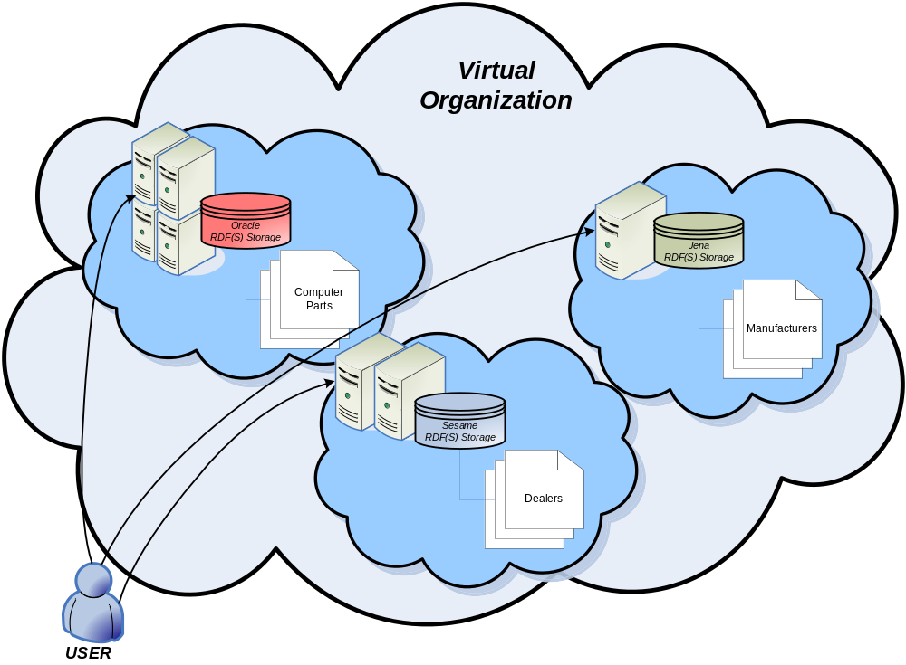
Ontology Scenario
Provides uniform ontology access
over different organizations, products and locations
Requirements
Service-based Ontology Access
Platform Independent Specification

Slide 14
Querying Scenarios
W3C working draft includes many use cases for RDF query
  K. Clark, RDF Data Access Use Cases and Requirements , W3C Working Draft, last release 25 March 2005,
  http://www.w3.org/TR/2005/WD-rdf-dawg-uc-20050325/
  Use cases for finding RDF Querying Functions
  No Distributed / Coordinated Processing
  No Indirect Access
This document aims to include WS-DAI specific use cases, such as using Indirect Access.
Snapshot Result
Grid matchmaking

Slide 15
W3C Query Use Cases
Many Use Cases in W3C working draft
* 2.1 Finding an Email Address
* 2.2 Finding Information about Motorcycle Parts
* 2.3 Finding Unknown Media Objects
* 2.4 Monitoring News Events
* 2.5 Avoiding Traffic Jams
* 2.6 Discovering What People Say about News Stories
* 2.7 Exploring the Neighborhood
* 2.8 Sharing Vacation Photos with a Friend
* 2.9 Finding Input and Output Documents for Test Cases
* 2.10 Discovering Learning Resources
* 2.11 Finding Out New Things About People
* 2.12 Browsing Patient Records
* 2.13 Finding Disjunct Conditions
* 2.14 Finding Film Soundtracks
* 2.15 Managing Personal Identities
* 2.16 Customizing Content Delivery
* 2.17 Building Ontology Tools
* 2.18 Working with Enterprise Web Services
* 2.19 Building Tables of Contents
Use cases
For
Querying
Function
No Grid Example
No Distributed/Coodinated Processing
No Indirect Access

Slide 16
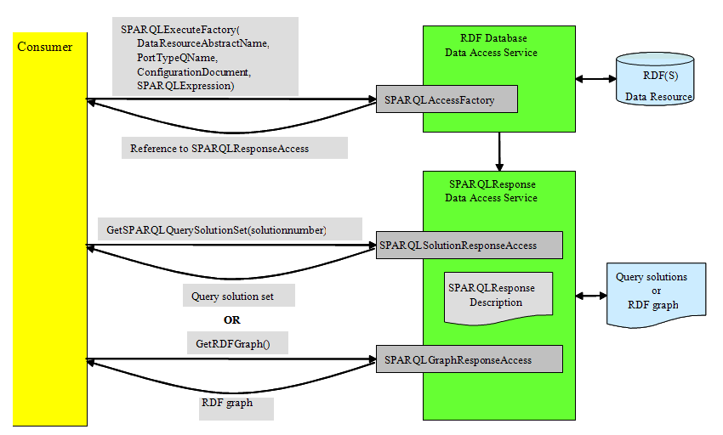
Query Scenario 1
RDF Data Snapshot and View
Result set is used/stored as a snapshot for further analyzing (computation process)
Requirements
Result Set & Indirect Access

Slide 17
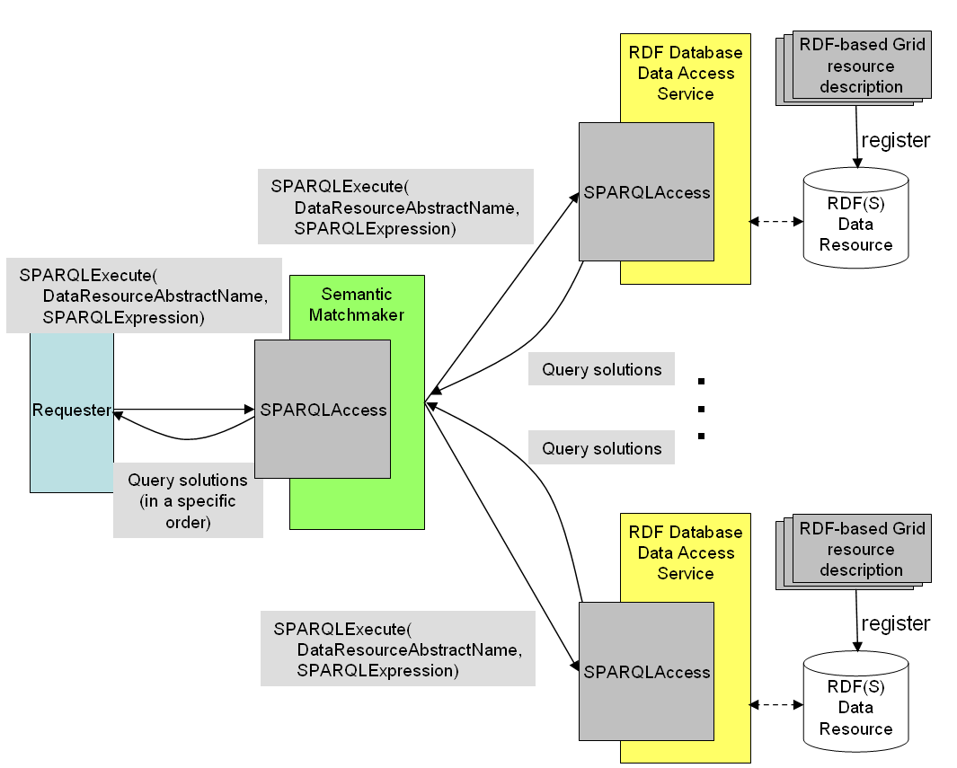
Query Scenario 2
Grid Resource Matchmaking using SPARQL
Integrates distributed resource databases with RDF grid resource descriptions
Matchmaking is done with a query
Results are merged, ordered and queried
Requirements
Result Set &
Indirect Access?
Service-based
Distributed Processing?

Slide 18
Issues
Motivational Document
  Complete this doc.
  OR,
  Do we need to collect more scenarios/use cases?
Need to enlarge the community
Notes:
Issues is here

Slide 19
RDF(S) Model & WS-DAI
RDF(S) Ontology Specification

Slide 20
RDF(S) Querying Specification
Design Issues / Discussion Items

Slide 21
Summary
Querying Specification
Overview
  Related W3C Standards
  Current Specification Structure
Issues
  Technical Issues
  Other Issues

Slide 22
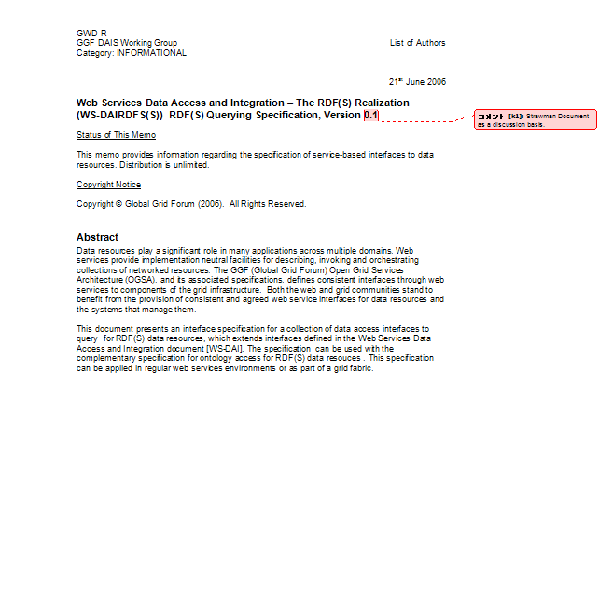
Querying Specification
Name: WS-DAI RDF(S) Querying
Feature:
  Focus on Instances, Not Schema.
    RDF Graph (Triples)
  Focus on Query Language, Not API.
    W3C SPARQL
Approach: Start Small
    Minimum extensions to the existing standards
Status: We are still writing the 1st Version
  Could not complete for this GGF

Slide 23
Querying Specification
Will Support
  WS-DAI Core Specification
  WS-DAI Access model & Resource Properties
    Direct and Indirect Access
  W3C SPARQL and related W3C standards
    SPARQL Query Language
    SPARQL Query Result XML Format
    SPARQL Protocol (should have some interoperability)
Will NOT Support
  Triples/Graph Updates
    No Standard language at now. Wait for the future update language
  Schema Handling
    Will be covered with our companion specification for Ontology
  Reasoning
    Out of focus of SPARQL spec.

Slide 24
W3C Standards Introduction
3 Candidate Recommendations
SPARQL Query Language
SPARQL Query Result XML Format
SPARQL Protocol for RDF
Affects on the WS-DAI-RDF(S) Querying Spec.
1. has almost No impact on our spec.
Will use this format as WS-DAI result set
We must achieve maximum compatibility
between 3. and WS-DAI Querying

Slide 25
W3C SPARQL
SQL-like Query Language for RDF graphs
Example:
  PREFIX dc: <http://purl.org/dc/elements/1.1/>
  PREFIX ns: <http://example.org/ns#>
  SELECT ?title ?price
  WHERE { ?x ns:price ?price . FILTER (?price < 30) . ?x dc:title ?title . }
Issue:
Data Resource (in the WS-DAI/OGSA context) definition?
  Already presented in our Ontology Part
  Query Spec Issue:
  Provide the interoperability with SPARQL database definition

Slide 26
Resource Issue for Querying
RDF(S) Data Resource = RDF DataSet
  One (or many?) default graph
  Zero or more NAMED graphs
  Graph has URI like WS-DAIX XML Collection
  No need to have hierarchical structure (simple!)
  (Currently we don’t have a plan to support CollectionManagement)
  PREFIX foaf: <http://xmlns.com/foaf/0.1/>
  SELECT ?name
  FROM <http://example.org/foaf/aliceFoaf>
  WHERE { ?x foaf:name ?name }
Graph URI

Slide 27
W3C SPARQL Query Result XML Format
XML-based data format for SPARQL Query Result
SPARQL Query Result Patterns
SELECT: returns a set of data (variables)
CONSTRUCT: returns a RDF graph <rdf>……</rdf>
DESCRIBE: returns a RDF graph
ASK : returns boolean (Match or Not)
Issue:
No Access Method
  WS-DAI compliant access function must be defined
  Iteration access of GetItemRequest will apply only to the case 1.

Slide 28
IndirectAccess of WS-DAI
Indirect Access
  Result Set= SPARQL Query Result XML Format
Access Function is defined
  Each <result> of the results is accessible with StartPosition, ItemCount,,etc
<?xml version="1.0"?>
<sparql xmlns="http://www.w3.org/2005/sparql-results#">
<head>
  <variable name="x"/>
  <variable name="hpage"/>
</head>
<results ordered="false" distinct="false">
  <result>
    <binding name="x"> ... </binding>
    <binding name="hpage"> ... </binding>
  </result>
  <result>
    <binding name="x"> ... </binding>
    <binding name="hpage"> ... </binding>
  </result> ...
</results>
</sparql>
Example of the Query Result
SPARQLQueryResultAccess
(or SPARQLSolutionSetAccess)
Of WS-DAI-RDF(S) Querying

Slide 29
SPARQL Protocol for RDF
Simple Access Protocol for SPARQL
Input: Query String
Output: Query Result
WSDL2.0, WSDL1.1 and HTTP bindings exists.
Issue:
No Indirect Access : Support WS-DAI Indirect Access (Upward Compatibility)
  Different Error Message & Patterns: Provide some interoperability
Query String
Server
Client
Query Results

Slide 30
Querying Specification Structure
Minimum WS-DAI Wrapping of W3C standards
Comparison with WS-DAIX specification document.
RDF(S) Data Resource (only for Querying)?
  Share the definition with Ontology Interface?
No CollectionManagement (Create/Update/Delete,,,)
  Issue:Do we need to have this function?
  Supports some GetProperty interface for RDF(S) Dataset(?)
SPARQLAccess interface
  With SPARQLFactory
No Update language intefaces
SPARQLQueryResultAccess interface
  With SPARQLQueryResultPropertyDocument

Slide 31
Functions Overview Update
 | WS-DAIR | WS-DAIX | WS-DAI-RDF(S) Querying | Note
Representation (Schema and Instance) | Tables & Data Types | XML & XML Schema | RDF and RDFS | No Direct Impact on Querying Spec.
Data/Database | Table & Tuples | XML Collections & Docs. | Graphs & RDF DataSet | DataSet is a set of Graphs
(Schema Handling?) | SQL | XML Collection Management |  | Done with Ontology Spec.
Query Language | SQL | XPath, XQuery | W3C SPARQL | Should/Must harmonize with W3C SPARQL protocol
Result Set | RowSet | XML Sequence | W3C SPARQL Query Result XML Format | SPARQLQueryResultAccess to support basic I/O to get the result items
Update | SQL | XUpdate | Keep Open | No Standard Language Spec

Slide 32
Status & Future
September: Strawman is scheduled to be out
  We are still writing it Now.
    Could not complete until this GGF
    Document structure is fixed if there is no problem today
    Need to adjust our Ontology spec.
  Terminology
    Not unified at now
  Tags/Namespaces/WSDLs ,,,,,,
    Many tasks remains,,,

Slide 33
Other Issue : Enlarge the Community
Need to have more authors/contributors.
  Announced DAIS-WG and Semantic Grid RG
  Current response is not so good.
  Still need to advertise this activity.
  To? How?
Especially from commercial company
  How?

Slide 34
Other Issue : Relationship with W3C
W3C RDF Data Access Working Group (DAWG)
  Currently No interactions
  Will make some interaction after our initial spec completed
  Japanese DAWG member will help us.
  Other?
  AIST (also a member of W3C)?

Slide 35
Discussions
Motivational Document
Ontology Specification
Querying Specification
Other Topics

