Slide 1

Firewall Issue Research Group
Next document(s)
Thijs Metsch
German Aerospace Center – DLR e.V.

Slide 2

Outline
Overview
Interaction
Documents
Abstract from
the charter
OGF/IETF
interaction
Action items
for the next
documents

Slide 3
The next documents
Submit informational documents that describe (Abstract from Goals & Milestones):
  An inventory of the type of issues when Grid jobs have to deal with middle-box functions, application level gateways, VPN style gateways, etc. Describe and classify the issues in document #1
  An evaluation of existing IETF middle-box (signaling-) protocols and functions. Recognize possible limitations and produce a list of requirements towards the IETF in document #2
  An evaluation of approaches and solutions such as application level gateways, host based firewalls, VPN style gateways etc. Capture results in document #3

Slide 4


IETF / OGF interaction
Firewall/NAT
Solution developers
Grid Specific
Requirements
Definition
Requirements
Document

Slide 5
IETF / OGF interaction (2)
Firewall/NAT
Solution developers
Solution
(Protocol)
Development
Liaison
functions

Slide 6
IETF / OGF interaction (3)
Firewall/NAT
Solution developers
Offer
Interoperable
Grid Specific
Solutions
Uses
Solutions
Yield
Stakeholder Value

Slide 7
Actions for next documents
Firewall vendor contributions
Existing
Solution
Description &
Analyses
Grid Firewall
Issues &
Analyses
Grid community
Documents
2 & 3
Emerging/
New
Solution
Description &
Analyses
Document #1
Vendor
community

Slide 8
Document structures
Document 2
Traditional standards and solutions (IETF, Specific Vendors)
Analyses of missing functions and protocols.
➔ Gap-Analyses
Conclusion
Document 3
Introduction to emerging networks (optical & hybrid networks)
New Approaches/Solutions on Firewall Issues
Analyses of pro's and con's
Conclusion

Slide 9
Actions for next documents
Requirements
  Help us setting up the requirements
  Analyze the requirements
Existing Solutions
  Document and comment currently available solutions
  Analyze the (maybe available gaps)
New Approaches
  Commit your solution to the wiki!
  Do the research ☺
Join in at https://forge.gridforum.org/sf/projects/fi-rg!

Slide 10
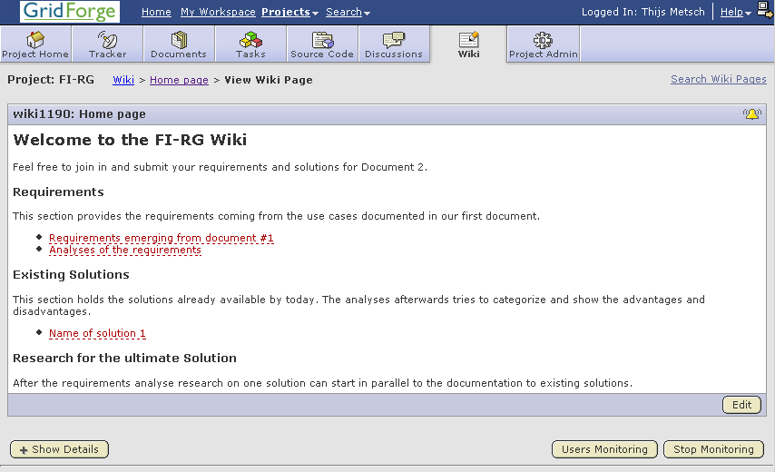
FI-RG Wiki

