Slide 1
GLOBALGRIDFORUM.ORG
GRAAP-WG
Grid Resource Allocation Agreement Protocol Working Group
GGF6
Chicago, IL
October, 2002

Slide 2
Agenda
Discuss the revised GRAAP-WG milestones.
Discuss web-page clarifications about the group and its purpose (2.1), including links to other GGF groups (2.2).
Discuss working definition of Advance Reservation.
Discuss revised document/additions to Advance Reservation State-of-the-Art Document (4.1). Get named contacts for each scheduler, so we can contact them directly to get this document into a useful state (4.2)...
Discussion of Use Cases. Construct initial requirements for the protocol, including a
discussion on whether we need to do an
exemplar Resource Description Language
or not.
Anything else?

Slide 3
1. Revised Milestones
Milestones (including past):
  End of May: First draft of the charter ready (done, charter approved)
  GGF-5: Discussion of the charter, SchedWD 12.2, SNAP; next Steps (done)
  GGF-6: Grid RAA Protocol: Discussion of Use Cases to procure requirements
  GGF-7: Grid RAA Protocol: Description of Requirements ready
  GGF-8: Grid RAA Protocol: Description of Operations ready
  GGF-9: Description of Leverage/Interaction with other Grid Service Standards
  GGF-10: Grid RAA Protocol: First Description of
  Bindings ready
  GGF-11: Final Grid RAA Protocol specification
  ready

Slide 4
2.1. Clarifications of Purpose and Scope
Charter already approved
Wanted to clarify purpose of the group
So we have added the following clarification to our Web Page:
  “We noticed at GGF5 that there was some confusion over the scope of the WG. It seemed that it would be helpful for us to make some clarifications to our scope. In particular, we would like to make it clear that we will NOT be working on a co-scheduler, although our protocol is intended to be used by a co-scheduler... As part of this scoping, we will also work out which groups we are going to have a relationship with, and state these explicitly. These links
  will be discussed on the list, and then posted here”

Slide 5
2.2. Other GGF Groups to Link To
Existing Groups:
  Scheduling Dictionary (SD-WG)
  Distributed Resource Management Application API (DRMAA-WG)
  CIM-based Grid Schema (CGS-WG): for Resource Description purposes, also Job Submission Interface Model (JSIM)
  Open Grid Service Infrastructure (OGSI-WG)
  New Productivity Initiative (NPI-WG)
  Grid Protocol Architecture (GPA-WG)
  Something in the security area? Choices are:
    Grid Security Infrastructure (GSI-WG)
    Grid Security Policy (GCP-WG)
    Open Grid Services Architecture (OGSA) Security (OGSA-SEC-WG)
Proposed Groups:
  Scheduling Architecture Research Group

Slide 6
3. Definition of Advance Reservation
Current Definition stands as:
  Advance Reservation is the process of negotiating the (possibly limited or restricted) delegation of particular resource capabilities over a defined time interval from the resource owner to the requester.
This definition has been discussed on the list, in particular regarding the use of the word “Delegation”.
This has led to a clarification:
  The delegation process is rooted with the Resource Owner who delegates the resource capabilities to a different delegation domain, i.e. to some management system which is accessible
  through GRAAP (e.g. a scheduler) which has received
  its control by some other delegation mechanism (i.e.
  the administrator has installed and activated it).

Slide 7
3. Definition of Advance Reservation
The IETF RAP group’s RFC 2753 defines:
  Administrative Domain: A collection of networks under the same administrative control and grouped together for administrative purposes.
For the same token we could define “resource owner" as something like:
  A Resource Owner controls a collection of resources from a particular administrative domain.
Example Resource Owners:
  A broker that owns resources delegated from a number of different resource owners
  A department owning a sub-set of a set of corporate resources.
Do we have any requirements in this area, i.e.
regarding ownership or delegation?

Slide 8
4.1. State-of-the-Art: Current state
Document now in HTML format at:
  http://people.man.ac.uk/~zzcgujm/GGF/sched-graap-2.0.html
Document to be rapidly updated, periodically “baselined” as a fixed version, and kept as both HTML and Acrobat PDF, e.g.
  http://people.man.ac.uk/~zzcgujm/GGF/sota-04.10.02/sched-graap-2.0.html
  http://people.man.ac.uk/~zzcgujm/GGF/sota-04.10.02/sched-graap-2.0.pdf
Other key changes this time:
  Basic clarifications, incl. replacing "Advanced Reservation" with "Advance Reservation“, consistent with Scheduling Dictionary.
  Added contributions on Maui and Catalina.
  Added list of contributors/editors.
  Clarified what negotiation means in the table.
  Added document change control section.
  Updated document into correct GGF format.

Slide 9
4.2. State-of-the-Art: Contacts and Future
Contacts we have:
  LSF – Bingfeng Lu (Platform)
  Maui – Dave Jackson (Supercluster)
  EASY/COSY – Wolfgang Ziegler (SCAI)
  Catalina – Kenneth Yoshimoto (SDSC)
Contacts we need:
  OpenPBS/PBS –
  Paderborn CCS –
  LoadLeveler – Gareth Bestor (IBM)?
  Sun GridEngine –
More schedulers?
  Libra (budget-based Economic Scheduler which plugs into
  PBS) – Rajkumar Buyya (University of Melbourne)?

Slide 10
5. Use Cases and Requirements
Thanks to all who sent in Use Cases for GRAAP:
  Jim Pruyne (HP Labs)
  Volker Sander (FZ-Jülich) and Keith Jackson (Lawrence Berkeley National Laboratory)
  Stephen Pickles (University of Manchester)
  J P Giddy (Welsh e-Science Centre - WeSC) – no co-scheduling required.

Slide 11
Classes of Grid Applications
Distributed Supercomputing
  Coupling of multiple potentially distributed supercomputers
  to solve a single, tightly coupled problem
High-Throughput Computing
  Massive acquisition of available and accessible computing resource to solve an autonomous fraction of a large scale problem problem
On-Demand Computing
  Ad-Hoc access to advanced capabilities to fulfill a short term demand
Data-Intensive Computing
  Synthesis of new information from geographically-distributed data repositories, digital libraries, and databases
Collaborative Computing
  Enabling and enhancing human interactions

Slide 12
The Advance Reservation Case
Distributed Supercomputing
  “Co-scheduling” and co-allocation of scarce, expensive resources
  Some local schedulers have to exclusively assign subtasks to nodes
  Advance Reservation can improve usage economy
High-Throughput Computing
  Trade-off between allocation overhead and benefit
  Remote checkpointing
  Win might be improved by relying on particular network capabilities
On-Demand Computing
  Increased Trade-off demand
  Co-allocation and network capabilities often required
Data-Intensive Computing
  Workflow dependencies
  Deadline file staging
Collaborative Computing
  Co-allocation and network capabilities often required

Slide 13
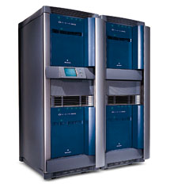
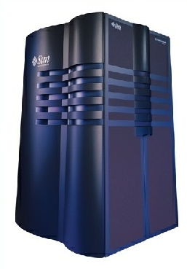
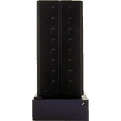

The Root: Job-Scheduling on the Grid
Program main
Call setup(a,b,f,g)
Nt=1000
Do j=1,Nt
call stepdt(1)
call stepdt(2)
call stepdt(3)
Enddo
If(host=jim) then
do stuff for jim
Elseif(host=seymour) then
do stuff for seymour
Endif
Stop
end
Job
Program main
Call setup(a,b,f,g)
Nt=1000
Do j=1,Nt
call stepdt(1)
call stepdt(2)
call stepdt(3)
Enddo
If(host=jim) then
do stuff for jim
Elseif(host=seymour) then
do stuff for seymour
Endif
Stop
end
Program main
Call setup(a,b,f,g)
Nt=1000
Do j=1,Nt
call stepdt(1)
call stepdt(2)
call stepdt(3)
Enddo
If(host=jim) then
do stuff for jim
Elseif(host=seymour) then
do stuff for seymour
Endif
Stop
end
PBS
LSF
NQS
LoadLeveler

Slide 14
Distributed Supercomputer Application
Program main
Call setup(a,b,f,g)
Nt=1000
Do j=1,Nt
call stepdt(1)
call stepdt(2)
call stepdt(3)
Enddo
If(host=jim) then
do stuff for jim
Elseif(host=seymour) then
do stuff for seymour
Endif
Stop
end
Job
Program main
Call setup(a,b,f,g)
Nt=1000
Do j=1,Nt
call stepdt(1)
call stepdt(2)
call stepdt(3)
Enddo
If(host=jim) then
do stuff for jim
Elseif(host=seymour) then
do stuff for seymour
Endif
Stop
end
Program main
Call setup(a,b,f,g)
Nt=1000
Do j=1,Nt
call stepdt(1)
call stepdt(2)
call stepdt(3)
Enddo
If(host=jim) then
do stuff for jim
Elseif(host=seymour) then
do stuff for seymour
Endif
Stop
end
Some standardized
Protocol
Some standardized Protocol
Super-Scheduler
Some standardized
Protocol
PBS
LSF
NQS
LoadLeveler
Grid Service
Factory
Grid Service
Factory
Grid Service
Factory
Grid Service
Factory

Slide 15
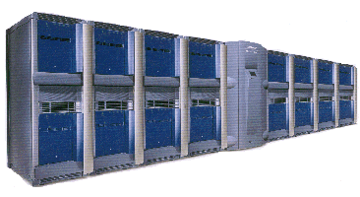

Application Example:
Distributed Supercomputing
Program main
Call setup(a,b,f,g)
Nt=1000
Do j=1,Nt
call stepdt(1)
call stepdt(2)
call stepdt(3)
Enddo
If(host=jim) then
do stuff for jim
Elseif(host=seymour) then
do stuff for seymour
Endif
Stop
end
Job
Program main
Call setup(a,b,f,g)
Nt=1000
Do j=1,Nt
call stepdt(1)
call stepdt(2)
call stepdt(3)
Enddo
If(host=jim) then
do stuff for jim
Elseif(host=seymour) then
do stuff for seymour
Endif
Stop
end
Program main
Call setup(a,b,f,g)
Nt=1000
Do j=1,Nt
call stepdt(1)
call stepdt(2)
call stepdt(3)
Enddo
If(host=jim) then
do stuff for jim
Elseif(host=seymour) then
do stuff for seymour
Endif
Stop
end
Some standardized Protocol
Super-Scheduler
Notes:
This slide looks much better as a slide show!
It introduces the concept that the concept of “co-allocation” as found in GRAM now needs to apply both to “co-reservation” and “co-creation”.
The example shows how a user needing to connect a scientific instrument to a visualization device contacts a broker, which selects from among the two possible sets of resources, returning a set of reservations that will allow one of these to be used.
A reservation co-allocator is used to reserve the resources, returning a set of ResHandles.
An object creation co-allocator is used to create the network and process objects.
Finally, an online monitor watches performance, and may decide (as shown here) to increase a network reservation at a later time.

Slide 16
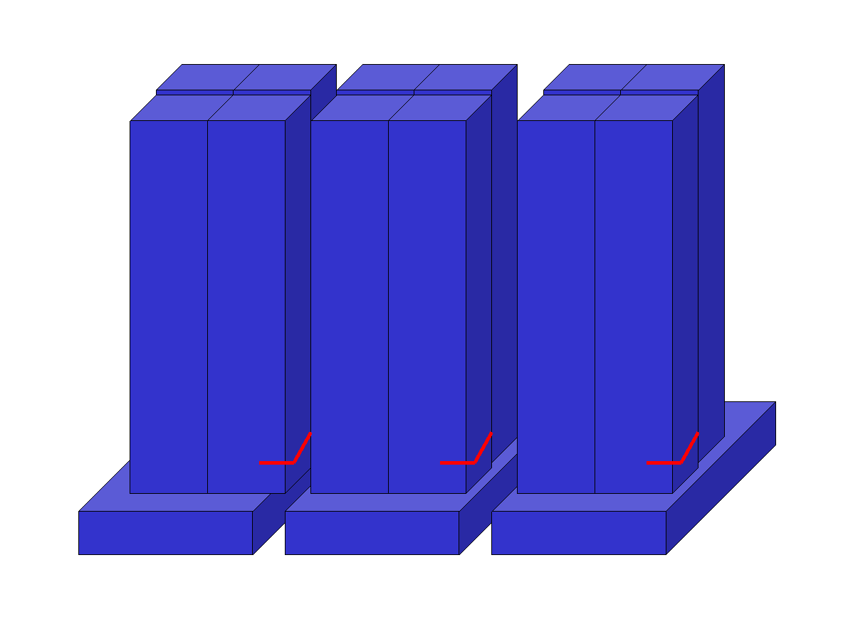
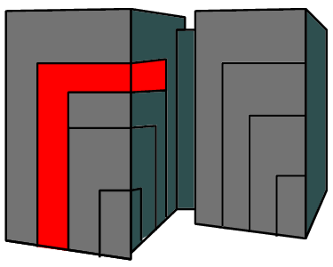
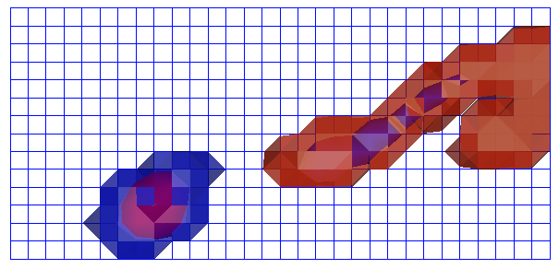
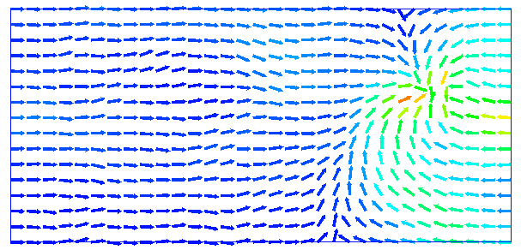

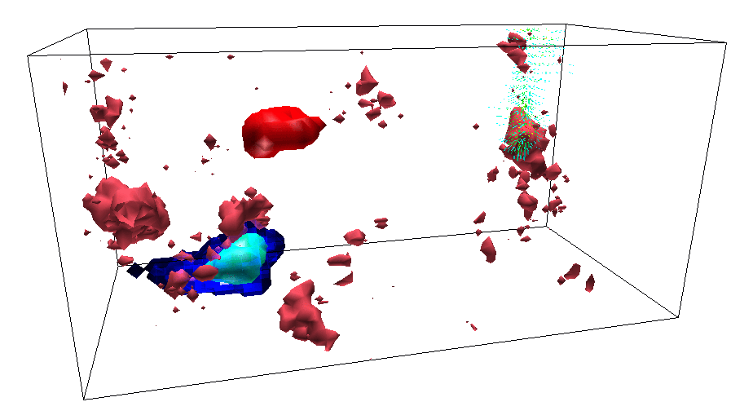
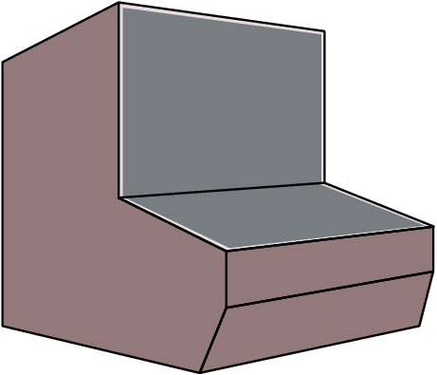
Example
Pollution Penetration in the Ground
Streaming
Concentration
Trace
Partrace
Visualization
Notes:
This slide looks much better as a slide show!
It introduces the concept that the concept of “co-allocation” as found in GRAM now needs to apply both to “co-reservation” and “co-creation”.
The example shows how a user needing to connect a scientific instrument to a visualization device contacts a broker, which selects from among the two possible sets of resources, returning a set of reservations that will allow one of these to be used.
A reservation co-allocator is used to reserve the resources, returning a set of ResHandles.
An object creation co-allocator is used to create the network and process objects.
Finally, an online monitor watches performance, and may decide (as shown here) to increase a network reservation at a later time.

Slide 17
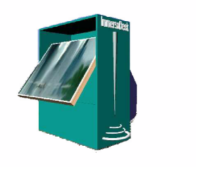
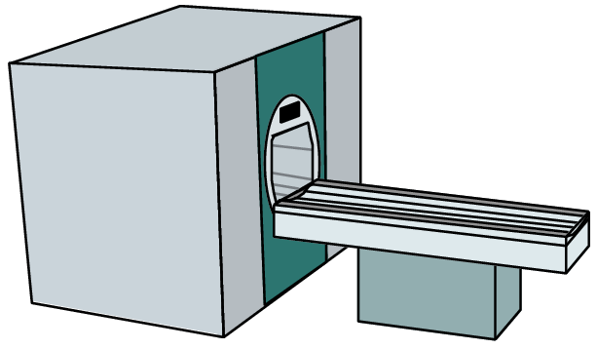
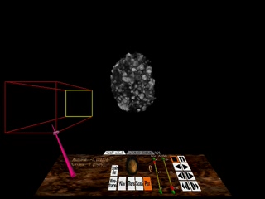
Application Example:
Smart Instruments
Program main
Call setup(a,b,f,g)
Nt=1000
Do j=1,Nt
call stepdt(1)
call stepdt(2)
call stepdt(3)
Enddo
If(host=jim) then
do stuff for jim
Elseif(host=seymour) then
do stuff for seymour
Endif
Stop
end
Job
Program main
Call setup(a,b,f,g)
Nt=1000
Do j=1,Nt
call stepdt(1)
call stepdt(2)
call stepdt(3)
Enddo
If(host=jim) then
do stuff for jim
Elseif(host=seymour) then
do stuff for seymour
Endif
Stop
end
Program main
Call setup(a,b,f,g)
Nt=1000
Do j=1,Nt
call stepdt(1)
call stepdt(2)
call stepdt(3)
Enddo
If(host=jim) then
do stuff for jim
Elseif(host=seymour) then
do stuff for seymour
Endif
Stop
end
Some standardized Protocol
Super-Scheduler
CPU
Notes:
This slide looks much better as a slide show!
It introduces the concept that the concept of “co-allocation” as found in GRAM now needs to apply both to “co-reservation” and “co-creation”.
The example shows how a user needing to connect a scientific instrument to a visualization device contacts a broker, which selects from among the two possible sets of resources, returning a set of reservations that will allow one of these to be used.
A reservation co-allocator is used to reserve the resources, returning a set of ResHandles.
An object creation co-allocator is used to create the network and process objects.
Finally, an online monitor watches performance, and may decide (as shown here) to increase a network reservation at a later time.

Slide 18
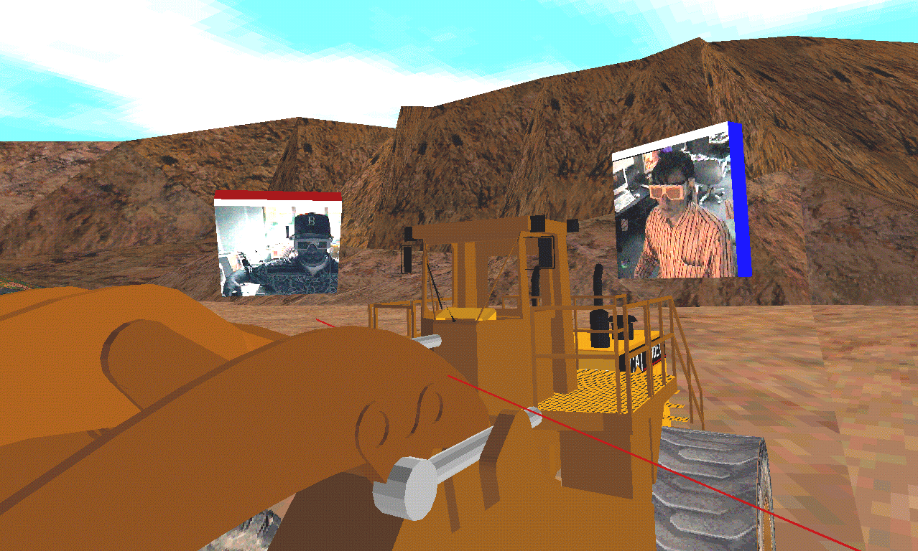
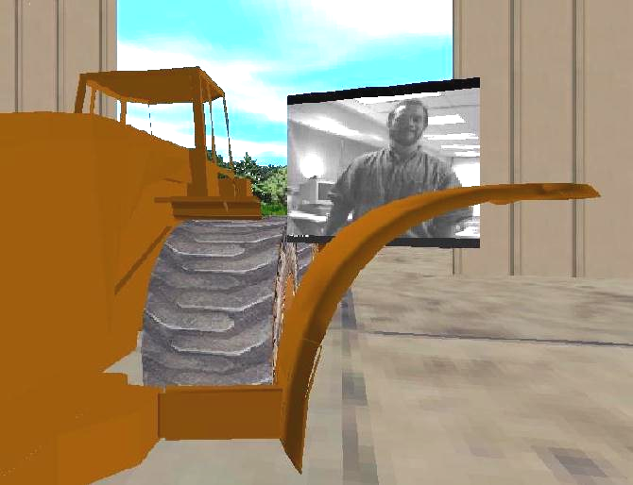
Collaborative Development Environments
Graphics: Valerie Lehner, NCSA, Tom DeFanti, UIC/EVL

Slide 19
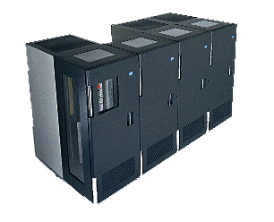
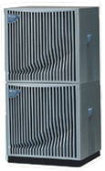
Application Example:
Simulation using Data from some Archive
Program main
Call setup(a,b,f,g)
Nt=1000
Do j=1,Nt
call stepdt(1)
call stepdt(2)
call stepdt(3)
Enddo
If(host=jim) then
do stuff for jim
Elseif(host=seymour) then
do stuff for seymour
Endif
Stop
end
Job
Program main
Call setup(a,b,f,g)
Nt=1000
Do j=1,Nt
call stepdt(1)
call stepdt(2)
call stepdt(3)
Enddo
If(host=jim) then
do stuff for jim
Elseif(host=seymour) then
do stuff for seymour
Endif
Stop
end
Program main
Call setup(a,b,f,g)
Nt=1000
Do j=1,Nt
call stepdt(1)
call stepdt(2)
call stepdt(3)
Enddo
If(host=jim) then
do stuff for jim
Elseif(host=seymour) then
do stuff for seymour
Endif
Stop
end
Some standardized Protocol
Super-Scheduler
Pre-
Staging
Post-
Staging
archival
storage
Notes:
This slide looks much better as a slide show!
It introduces the concept that the concept of “co-allocation” as found in GRAM now needs to apply both to “co-reservation” and “co-creation”.
The example shows how a user needing to connect a scientific instrument to a visualization device contacts a broker, which selects from among the two possible sets of resources, returning a set of reservations that will allow one of these to be used.
A reservation co-allocator is used to reserve the resources, returning a set of ResHandles.
An object creation co-allocator is used to create the network and process objects.
Finally, an online monitor watches performance, and may decide (as shown here) to increase a network reservation at a later time.

Slide 20
A use case from the RealityGrid project (1/9)
Sent in by Stephen Pickles, Software Infrastructure Manager, RealityGrid, 13 October 2002
Introduction (1/3)
  The RealityGrid project (http://www.realitygrid.org) aims to predict
  the realistic behaviour of matter based on the properties of the microscopic components using diverse simulation methods (Lattice Boltzmann, Molecular Dynamics and Monte Carlo) spanning many time and length scales and the discovery of new materials through integrated experiments. A central theme of RealityGrid is the facilitation of distributed and collaborative exploration of
  parameter space through computational steering and
  on-line, high-end visualization.

Slide 21
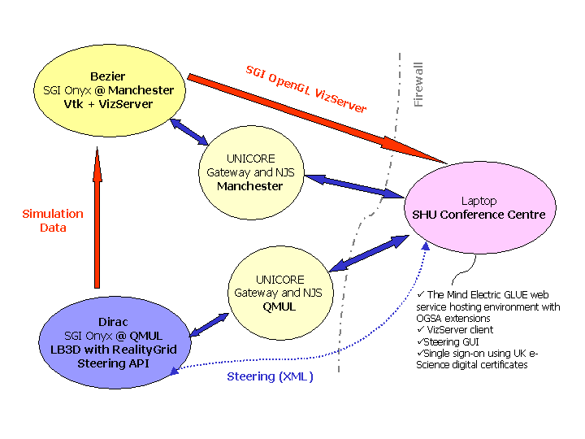
A use case from the RealityGrid project (2/9)
Introduction (2/3)
Figure 1. One
experimental
configuration
employed in the
RealityGrid
“Fast Track”
Computational
steering
demonstration
at the UK
e-Science All
Hands Meeting,
Sheffield,
September 2002

Slide 22
A use case from the RealityGrid project (3/9)
Introduction (3/3)
  A typical RealityGrid scenario involves a large-scale simulation running on a massively parallel system at on site coupled to a high-end visualization system at another site with the steering and display interfaces running at one or more remote sites.
  The simulation component periodically (or as demanded by the steerer component) emits “samples” for consumption by the visualization component, while grid middleware is responsible for the transfer of data between components.
  The RealityGrid “fast track” prototype (see figure 1) relies heavily on UNICORE and web services with OGSA extensions, but RealityGrid is not locked in to any particular middleware; indeed the
  RealityGrid “deep track” is able to demonstrate similar
  functionality using ICENI and Globus.

Slide 23
A use case from the RealityGrid project (4/9)
Immediate Requirements for Advance Reservation (1/3)
  The most pressing requirement for advance reservation in RealityGrid arises out of the need to co-allocate (or co-schedule)
    (a) multiple processors to run a parallel simulation code and
    (b) multiple graphics pipes and processors on the visualization system
  Co-allocation may be required now (either by a RealityGrid developer or by a scientist engaged in routine investigations) or at some more distant time in the future (for a scheduled collaborative session). We expect advance reservation to subsume both co-allocation scenarios.
  The visualization resources (b) will usually be located on a different system to the computational resources (a).
  The two sets of resources ((a) and (b)) will often be located on
  systems owned and administered by different organisations,
  and the administration teams within the two organisations, if
  aware of each other’s existence at all, are unlikely to have
  established comprehensive Service Level Agreements.

Slide 24
A use case from the RealityGrid project (5/9)
Immediate Requirements for Advance Reservation (2/3)
  It is assumed that the end-user(s) will be able to access resources on both systems by presenting a single credential, through a single sign-on mechanism based on digital certificates such as GSI or the UNICORE security model.
  It is anticipated that the system (a) running the simulation will typically be a massively parallel system with a workload characterised by sustained heavy demand and therefore the allocation of resources is likely to be entrusted to a batch scheduling system. The characteristics of the visualization system on the other hand are likely to vary, with demand for graphics and CPU ranging independently from low to high, and there may or may not be a batch scheduling system in place.
  The resources (b) required on the visualization system include
  both graphics pipes and processor (CPU+memory)
  resources. In general, whatever system may exist for
  booking the graphics pipes is unlikely to be integrated
  with whatever system may exist for booking the processors.

Slide 25
A use case from the RealityGrid project (6/9)
Immediate Requirements for Advance Reservation (3/3)
  We may therefore distinguish two cases:
    co-allocation of processors on the simulation system, graphics pipes on the visualization system, and processors on the visualisation system;
    where the visualization system does not run a batch scheduling system, co-allocation of processors on the simulation system and graphics pipes on the visualization system, relying on chance (or external arrangement) to acquire a sufficient share of CPU resource for visualization purposes.
  The ability for a RealityGrid user to reserve processors and graphics pipes manually without involving system administrators would be useful now, and would remove a significant barrier to the
  routine use of computational steering. The ability for an
  agent to do the same will be important for the resource
  broker that will be developed in the later stages of the
  RealityGrid project.

Slide 26
A use case from the RealityGrid project (7/9)
Future Requirements for Advance Reservation (1/3)
  Based on current projections, the largest computationally-steered simulations that RealityGrid is likely to undertake will require bandwidth between the simulation and visualization systems of order 5 Gbps in order to achieve satisfactory interactivity. The bandwidth requirements between visualization systems are less demanding – 100 Mbps will be adequate for most purposes – but reasonably good latency and jitter characteristics are desirable. Thus the ability to make advance reservations of network bandwidth with certain quality of service characteristics and using the same protocols as for the reservation of processors are seen as desirable by RealityGrid.

Slide 27
A use case from the RealityGrid project (8/9)
Future Requirements for Advance Reservation (2/3)
  RealityGrid’s design philosophy is component based. Although the componentisation in the “fast track” example of figure (1) is coarse-grained (the simulation and visualization components are deployed on different systems), the RealityGrid “deep track” is investigating finer-grained componentisation in which the simulation is composed out of a number of smaller communicating components, each of which must be deployed onto (possibly remote) computational resources at run-time. Thus RealityGrid will need robust mechanisms for co-allocating much more complex sets of resources than indicated in figure (1).

Slide 28
A use case from the RealityGrid project (9/9)
Future Requirements for Advance Reservation (3/3)
  RealityGrid has a significant “deep track” work package devoted to performance control. The goal of this work package is to optimise the collective performance of the components comprising the RealityGrid application based on performance information collected at run time. Initially, the set of resources will be assumed to be fixed during execution, and it is by redistributing components across this set of resources that the performance control system hopes to achieve performance improvement. Ultimately, however, the ambition is to adapt the application to utilize new resources that become available during execution; this is likely to require rather specialist
  functionality of the advance reservation system such
  as the ability to renegotiate an existing reservation.

Slide 29
5. Requirements: Do we write an RDL?
The GRAAP protocol will carry a description of the resources that are being negotiated, specified in some Resource Description Language or RDL.
We want GRAAP to be RDL-neutral, i.e. to be able to handle any well-defined where the resource description can be encoded as some sort of byte-stream, e.g. string.
We also want to be able to use and test GRAAP.
So do we need to write a simple exemplar RDL, e.g. for blocks of supercompter time?
Or can we wait for a while to see if the Grid
community will do this for us?
Must stay within the scope of our group…

