Slide 1
Specification of a
Network Adaptation Layer for the Grid
GGF7 presentation
Michael Welzl
michael.welzl@uibk.ac.at
University of Innsbruck

Slide 2
Outline
Problem statement
Proposed solution
  what
  why
  how
Just 10 mins... no time to conclude ;-)

Slide 3
Note: we simplify!
Assumption 1:
all is done @ end nodes
  No dedicated network
  No management / control of network resources
Assumption 2:
realistic usage of existing Internet technology
  No QoS mechanisms like DiffServ or IntServ
  No QoS routing, no Active Networks
Assumption 3:
a single end2end connection!
  No overlay structure
  No distributed schemes ... no P2P, caching, etc.
a tough one, right? ;-)

Slide 4
Current use of the Internet
TCP
  byte stream from source to destination
  reliable, connection oriented service
  all kinds of complex features
    window based flow and congestion control
      RTT estimation, self-clocking, parameters: max. / init. window size,...
      slow start / congestion avoidance
    flavors: Tahoe, Reno, NewReno, SACK, with and w/o ECN, ..
UDP
  connectionless service
  ports and a checksum ... that‘s it :)
    simpler, but useless for reliable transport (DIY)
    What about congestion control?

Slide 5
Some (realistic) things we can do...
Alter packet size
Tune TCP parameters
  decide which TCP flavor to use, fiddle with window size, ..
Implement rate control on top of UDP
Use new technologies, like...
  UDP Lite: transmission of erroneous payload
  SCTP: transport level multihoming, reliable out-of-order transmission
  DCCP: congestion control for datagrams (connectionless)
Measure and do something... maybe adapt payload...

Slide 6
Proposed solution

Slide 7
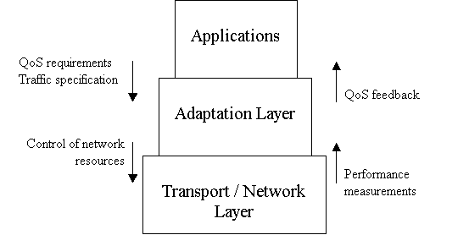
What: an “Adaptation Layer“

Slide 8
Why we need it
Application relieved of burden
  more sophisticated transmission mechanisms possible
  tailored network usage instead of “one size fits all“ (just UDP / TCP)
Network provides service - app specifies QoS requirements
  Adaptation layer makes the most out of available resources
Adaptation layer provides QoS feedback
  Information logically closer to application
Full transparency to application
  gradual deployment of new transport mechanisms

Slide 9
How it could work: application interface
from application
  QoS spec
    apply weights to QoS parameters
    goal: tune trade-offs (packet sizes, ..)
    Examples:
      reduced delay is more important than high throughput
      I don‘t care about a smooth rate (I use large buffers)
  Traffic spec
    Example: long lasting stream, “greedy“
to application
  “video frame complete“ instead of “throughput = ... loss = ... “, ..

Slide 10
How it could work: internals
Control of network resources
  Tune packet size
    maximize throughput + minimize delay according to QoS spec
  Choose congestion control + tune parameters
    based on QoS-centric evaluation of mechanisms:
    RAP, TFRC, TEAR, LDA+, GAIMD, Binomial CC., ..
    Negotiation: DCCP
  Further functions: buffer, bundle streams, ..
    Example: long-term stream, sporadic interruptions + delay not important ⇒ buffer, don‘t restart CC
Performance measurements
  use existing tools (NM-WG) + passively monitor TCP

Slide 11
Bringing it to life
Now
  architectural design: interfaces, QoS spec format, ..
  could be done in IETF for other apps, but:
    Grid apps have special QoS requirements / traffic properties
    => tailored architecture
Future
  a lot of work required (QoS-evaluation of CC., DCCP, ...)
  extension to use “real“ QoS mechanisms, distributed measurements, coordination protocol, ...
  could grow along!
RG? WG? Document(s?) in existing RG / WG?

