Slide 1
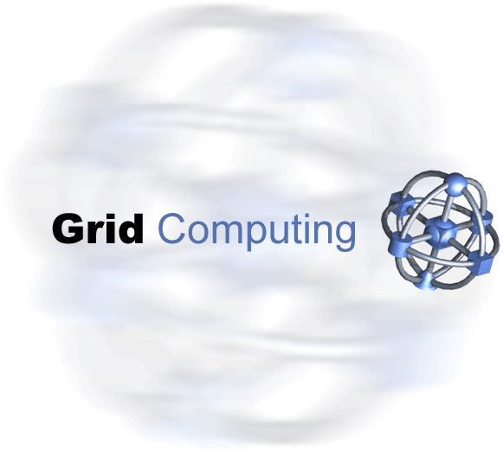
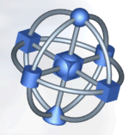
Grid Network
Infrastructure WG
Proposal
David E. Martin
martinde@us.ibm.com
March 6, 2003

Slide 2
Problem Statement
The current Grid network model is very simplistic. The model assumes the network is unknowable and at the same time provides good performance. Applications and middleware that could benefit from network information have no standard way to get it. The applications and middleware also have no ability to inform networks of their needs.

Slide 3
Same Example Network Information
Node
  Interface(s)
  Network Location
Link (Topology)
  Bandwidth, Latency
  Redundancy
  Congestion, Cost
Metering/Monitoring
  Usage, Performance, Cost
  Intrusion Detection, Security

Slide 4
Network Control
Should we address network control?
Quality of Service
  RSVP, Diffserv, Packet Shaping, MPLS
Bandwidth Management
  Link Establishment
  Scheduling
  Dynamic Bandwidth Allocation
  Firewall Control

Slide 5
Charter
The current Grid architecture relies on a very simple model of the network infrastructure. However, underlying network components can have a dramatic impact on Grid performance and reliability. The GNI WG will
  Document use cases where middleware and applications can take advantage of network information
  Develop a network model that will aid the development of middleware and applications
  Use this model to detail useful network information
  Document OGSA/OGSI port types and data structures

Slide 6
WG Milestones
Use Cases
  Applications and Middleware that Can Use Network Information
Network Model/Characteristics
Mapping
  OGSA/OGSI Mapping
  Java/C++ Libraries

Slide 7
What We’re Not Going to Do
Bandwidth Broker
Specify new (non-existing) network information

Slide 8
Other Groups to Leverage
Steal what we can!
GGF NM-WG
IETF
  SNMP, Diffserv, RSVP, etc.
DMTF

