Slide 1
GGF8
Data management
in GridRPC
Eddy Caron, Philippe Combes, Frédéric Desprez
[ReMaP, LIP – Lyon, France]

Slide 2
Introduction
Specifying the way data are handled in a GridRPC call is mandatory
  True portability
  Data persistence issues
Things that need to be specified
  High level data types
  Data handle
  Persistence flags
  Functions to send data and get the results
The standardization should allow the use of high level data management environments (like IBP)

Slide 3
The data handler
grpc_data_handle_t
  Should use an ID
  Persistency flags:
  Accurate data type description
 | IN | OUT |  | INOUT
 |  | return | no return | return | no return
Sticky | C➔S Stored | Ø | C S Stored | Ø | C➔S Stored
Persistent | C➔S Stored | C⬅S Stored | C S Stored | C⬅➔S Stored | C➔S Stored
Volatile | C➔S NOT stored | C⬅S NOT stored | Ø | C⬅➔S NOT stored | Ø

Slide 4
The type description
It is possible to define a set of types, but that would lead user to develop some complex interfaces.
  Use MPI types (hierarchical types) ?
Problem for files: a type or a media ?
  should be both
    a type for files with no structure
    a media (to be mentioned in the grpc_data_handle_t) for structures like matrices…

Slide 5
Data movement functions
Data handle Creation and release
  Data handle creation
    grpc_new_data_handle(grpc_data_handle_t* data_handle)
  Data handle release
    grpc_free_data_handle(grpc_data_handle_t* data_handle)
Data movements (persistent data)
  Remote data gather
    grpc_get_data(grpc_data_handle_t* data_handle,
    grpc_data_type* data)
  Remote data release
    grpc_free_data(grpc_data_handle_t* data_handle)

Slide 6
An other issue : Group RPC
To be able to call the same RPC function from a set clients to a set of servers in an SPMD fashion, i.e. connecting two SPMD environment or environment codes
CLIENT(S)
NES environment
SERVER(S)
But then
  How do we define groups ?
  Fault tolerance ?
  Asynchronous routines ?

Slide 7
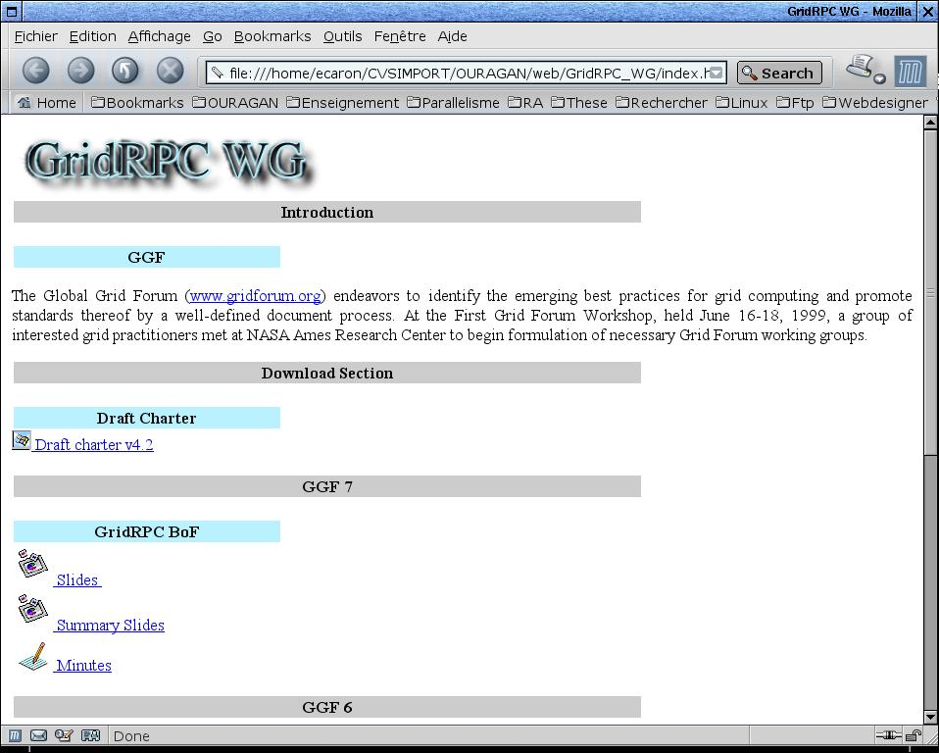
http://graal.ens-lyon.fr/GridRPC
Coming soon
your contribution

Slide 8
GridRPC CVS for GridRPC member
How to have an access to the GridRPC CVS repository ?
  Send a mail to Craig Lee with your
    First Name, Last Name
    Public ssh key
  When you receive a mail to confirm your login on graal computer
    cvs –d :ext:graal.ens-lyon.fr:/home/CVS/gridrpc co GridRPC
Coming soon
your contribution

