Slide 1
Wireless Grids
Presentation to:
High Performance Networking Research Group
Global Grid Forum 8 Seattle, WA June 24-27, 2003
Lee W. McKnight
Syracuse University
Mark Gaynor
Boston University

Slide 2

Agenda
Introduction to Wireless Grids
  draft-ggf-lwmcknight-wgissues-0
  Application Examples
Network Architecture Issues
  Example: Sharing Protocol for Resource Discovery
Virtual Markets & Policy in Wireless Grids
  IPR Tracking Example
Conclusion

Slide 3
Wireless Grids NOT Measured Just by Compute Cycles/Sec
Wireless Grids Can Be Viewed As:
  A Front-End/User Interface to Wired Grid Resources
  A Mesh Network Used for Sharing Resources
  Low-powered Sensors Networked Together
  Not to Mention UltraWideband, XG, and other High-Capability Spectrum Sharing Technologies
  A Grid Reaching to Saturn’s Rings – and Beyond!?

Slide 4
Characteristics of Wireless Grids
Small, low powered devices
  Power efficiency major concern
mobile & nomadic devices
  Phones, PDA’s, laptops, and ???
  Telematics eg Onstar, Car.net
Mesh capabilities of groups of devices
  Resource pooling may enable new applications
Networks of wireless sensors
  such as smartdust, or a phone
  Environmental, health, security monitoring

Slide 5
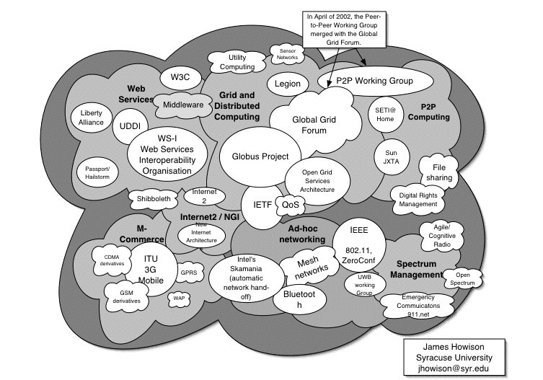
Issues Map - click section for an introductory link
The Wireless Grid Standards Jungle

Slide 6
Wireless Grids
Wire/
(W)LAN Grid
Wireless
Gird
Arriving
users/servers
Dynamic model
Departing
users/servers
Internet
Internet
Stable users
(W)LAN Grid
LAN
Stable servers
Grid
Static model

Slide 7
Wireless Grid Application Classes
• Class 1: Applications aggregating information from the range of input/output interfaces found in nomadic devices.
• Class 2: Applications leveraging the locational and contextual characteristics in which the devices will be found
• Class 3: Applications leveraging the mesh network capabilities of groups of devices.

Slide 8

Sharing Protocol
To Enable Service Discovery for Nomadic Ad Hoc Resource Allocation
  For Pay?
  For Barter?
  For Free?

Slide 9
Sharing Protocol Attributes
Resource Description
Resource Discovery
Clearing Mechanisms
Coordination of systems
Trust establishment

Slide 10
Sharing Protocol Functions
Resource discovery
  Ad-hoc UDDI for dynamic clients and servers
  Service providers advertise with IP multicast
  Draw from zero-conf, SDP, and UP&P
    Servers and clients should require no configuration to discovery and use each other
Resource description
  WSDL and XML

Slide 11
Middleware for Wireless Grids
Globus – Open Grid Service Architecture
  Use of SOAP and XML
  Integrate with Bandwidth Management Platform
  (see Hwang 03)
Power Efficient Routing
  Initial Studies of Power-Efficiency of Ad Hoc Network Protocols for Wireless Grid Applications (see Chang 03, Chen 03)

Slide 12
Security and Trust
End-to-end security and trust
Content Monitoring vs Privacy
  Distribution Volume Tracking Systems

Slide 13
Business Models
Open vs Closed Grid Gardens
  Who Captures Revenue for What? (eg iMode)
Information and resource sharing
  Who pays for what?
  How?
  Transaction management vs privacy
  Grid Collaboration and cooperative markets

Slide 14
Policy Challenges for (Wired and) Wireless Grids
Open vs Closed Grid Gardens
  Who Can Innovate?
Jurisdiction & Geography
  Who/Where is the Grid Regulator?
  Nomadicity divide: If successful, what happens to those left off the grid?
Policies to promote use of wireless grids for university research & educational applications (wireless as client-side front-end)

Slide 15
Conclusion
Ad-hoc service discovery and description key area of research
Business models and application use cases important for contextual analyses
Security paramount for wireless grids
Stakeholders emerging
Policy not yet addressed
(LOTS of) Further Research & Stds Needed!

Slide 16
Real Wireless Grid Applications:
Let’s Boogie!
A group of friends meet for a night out clubbing and head out with their devices. During the evening two friends capture footage of their friends dancing from two different angles.
  They then instruct their devices to render the footage into a montage according to preset templates.
  The devices discover one another, exchange meta-data on the footage available and discover the devices of the friends and others in the club for assistance in the processor (and thus battery) intensive rendering of the footage.
  Once this has been completed the device access the video screen provided by the nightclub and request that their footage be shown – to the great enjoyment of their friends.
  And to the Amusement/Ridicule of Others ‘Sharing’ the Experience?

Slide 17
Resources
Rajiv Chakravorty, Maurizio D'Arienzo, Ian Pratt and Jon Crowcroft, Dynamic SLA-based QoS Control for Third Generation Wireless Networks: The CADENUS Extension, Proceedings of 38th IEEE International Conference on Communications (IEEE ICC 2003), May 2003.
Jon Crowcroft, Richard Gibbens, Frank Kelly and Sven Ostring, Modelling Incentives for collaboration in Mobile Ad Hoc Networks, Proceedings of WiOpt'03: Modeling and Optimization in Mobile, Ad Hoc and Wireless Networks, March 2003
Boris Dragovic, Steven Hand, Tim Harris, Evangelos Kotsovinos and Andrew Twigg Managing Trust and Reputation in the XenoServer Open Platform, to appear in the Proceedings of the First International Conference on Trust Management, May 2003.

Slide 18
More Resources
Lee W. McKnight, Mark Gaynor, et al
  ‘Wireless Grid Issues,’ draft-ggf-lwmcknight-wgissues-0, information statement submitted to GHPN RG, Global Grid Forum 8 (GGF8), Seattle, June 24-27, 2003
  ‘Implications for Inter-System Mobility Management of Wireless GRID Networks and Virtual Markets for Sharing Resources in Dynamic Ad-hoc Environments,’ liaison statement submitted to International Telecommunication Union, Q.2/SSGwirelessgridsmcknight, Geneva, June 2 – 6, 2003
  CCCT ’03, Towards Trusted Wireless Grids, Invited Session, July 31-Aug. 2, 2003
  See www.wirelessgrids.net for above papers and documents
  See Wireless Grids Special Issue Call For Papers (Scott Bradner & Lee McKnight, eds) in next Internet Computing (IEEE)
  See Forthcoming Special Issue on Internet Economics (Stiller, McKnight, etc. eds.), Computer Networks (Elsevier), 2004

