Slide 1
GLOBALGRIDFORUM.ORG
GRAAP-WG
Grid Resource Allocation Agreement Protocol Working Group
http://forge.gridforum.org/projects/graap-wg
GGF9
Chicago, USA
October, 2003

Slide 2
Chairs
Volker Sander
Forschungszentrum Jülich GmbH, Germany
v.sander@fz-juelich.de
Jim Pruyne
Hewlett-Packard Laboratories, USA
pruyne@hpl.hp.com
Wolfgang Ziegler
Fraunhofer–Institute for Algorithms and Scientific Computing, Germany
Wolfgang.Ziegler@scai.fhg.de

Slide 3
GGF IPR Policy
The GGF takes no position regarding the validity or scope of any intellectual property or other rights that might be claimed to pertain to the implementation or use of the technology described in this document or the extent to which any license under such rights might or might not be available; neither does it represent that it has made any effort to identify any such rights. Copies of claims of rights made available for publication and any assurances of licenses to be made available, or the result of an attempt made to obtain a general license or permission for the use of such proprietary rights by implementers or users of this specification can be obtained from the GGF Secretariat.
The GGF invites any interested party to bring to its attention any copyrights, patents or patent applications, or other proprietary rights which may cover technology that may be required to practice this recommendation. Please address the information to the GGF Executive Director.

Slide 4
Agenda
Overview of Activities since GGF8
Introduction to WS-Agreement as presently specified
Examples of domains of use for WS-Agreement
Plans for the rest of this GGF
Goal: Make sure all of you understand what agreement is all about, and understand some domains that have already been identified where it is useful. Get you to think about it in your domain and/or get interested in issues related to our spec.

Slide 5
Review of current state and activities
Adopted WS-Agreement as our principle activity
  Spec. draft updated with WS- naming, more on next slide
Held two-day Face-to-Face in August at ANL
  Approximately a dozen attendees
  Generated large list of issues to be resolved in the specification
Began (irregular) weekly telecons
  Mondays at 11am Central time US, open to re-scheduling
  Categorized/prioritized issue list
Mailing list follow-up on some of the most pressing issues
Increasing involvement with other groups
  JSDL
  GESA
  OGSA (Program Execution sub-group)
  DAIS

Slide 6
A Brief Note on Naming
At GGF8, we were introduced to OGSI-Agreement, but we now refer to WS-Agreement, why?
  Politics!
  Based on lessons learned by the OGSI team
  Wish to emphasize the generality of the specification to all Web Services environments
  Besides, no one “controls” the WS-* namespace
Name change does NOT imply any less intent to build upon OGSI

Slide 7
WS-Agreement purpose and goals
Create a method of doing Service Management
  Define the policies and behaviors associated with service accesses via negotiation between parties involved with those accesses
  Includes creation of agreement as well as monitoring of the relationship that has been established
Goal: Remain domain independent
  Define the patterns needed for creating agreements without becoming

Slide 8
WS-Agreement Concepts and Terminology
What’s an Agreement?
  A representation of an on-going relationship between a provider and initiator
    An Initiator begins the relationship by requesting creation
    A Provider maintains relationship by holding the state of the agreement
      A bi-directional agreement may have each party acting in both roles
  An Agreement is composed of a set of Terms with a structured grouping
An Agreement Term contains:
  Domain specific definition of content
  State concerning the commitment by the parties to the current value
  State concerning the freedom to re-negotiate these values
Negotiation is the process of updating term states to reach a final condition
  This is the core of the WS-Agreement specification

Slide 9
WS-Agreement Methodology
Generic/extensible negotiation model
  Agreement envelopes domain-specific terms
  Negotiation may take place over multiple interactions between initiator and provider
  Agreement supports extensible monitoring
Reuse of OGSI mechanisms
  Specializes ogsi:Factory pattern
  Flexible lifetime negotiation for Agreements building on existing soft-state management
  ServiceData for monitoring/introspection

Slide 10
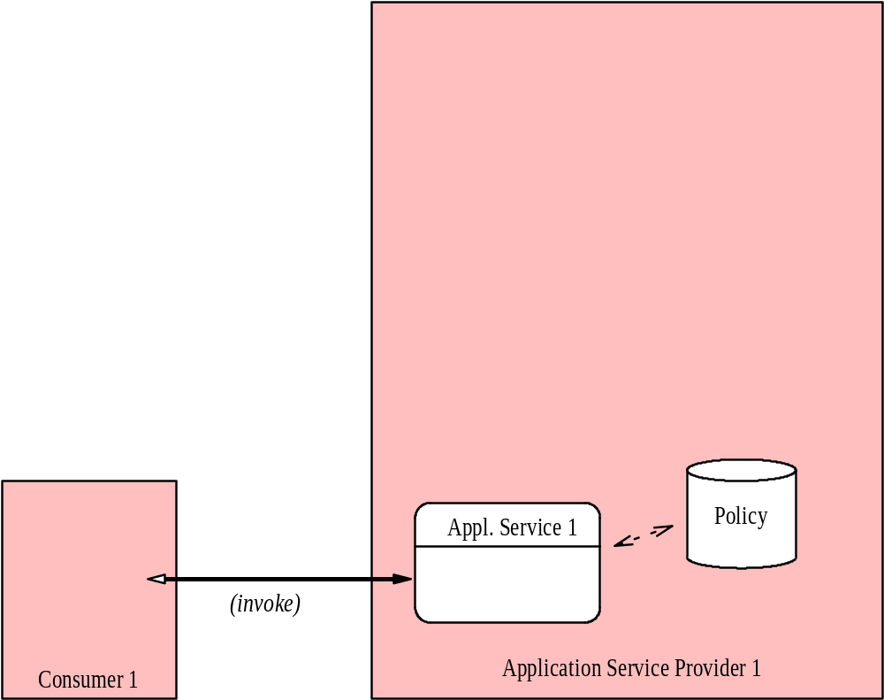
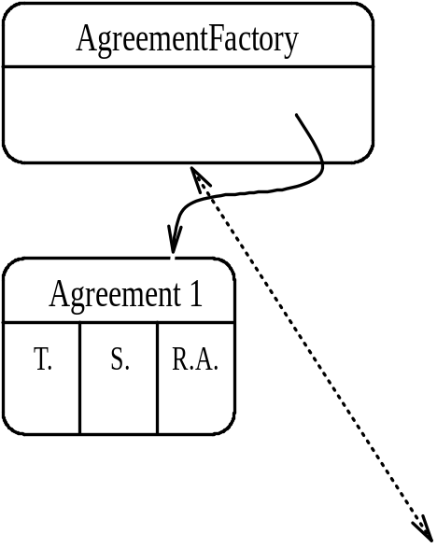
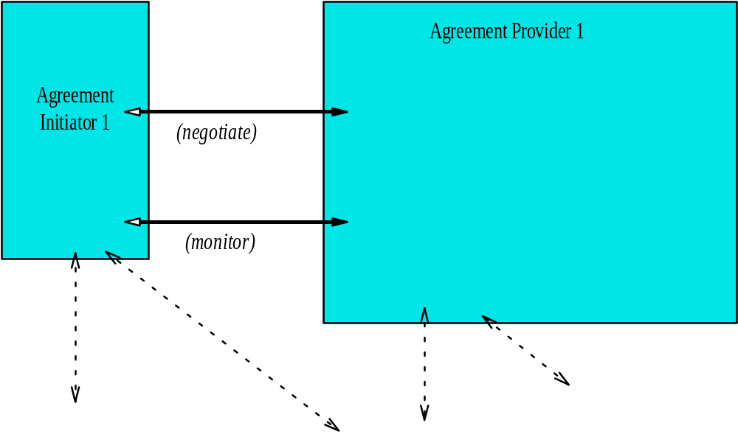
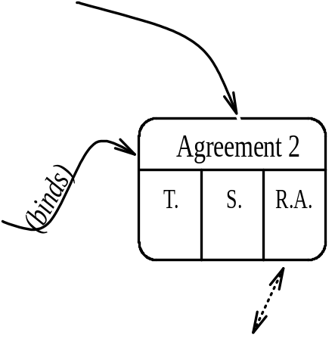
WS-Agreement Components
Notes:
The big picture. Green layer is provisioning/negotiation domain. The pink layer is the actual provided-service domain. Green corresponds to job-submission mechanisms. Pink corresponds to actual executing job and any client/interactions it might have. Agreement 2 represents advance reservation (it affects policy of computational resource). Agreement 1 represents actual job (it exploits policy which promised resource availability).

Slide 11
Relationship between Agreement & Agreement “Target”
 | Creating Agreement Creates Target | Creating Agreement does NOT Create Target
Agreement Target is a Grid Service | AgreementFactory is equivalent to the GridServiceFactory | Agreement describes behavior for interactions with an existing grid service (perhaps another factory)
Agreement Target is not a Grid Service | New activity is created under the agreement, but is not accessible as grid service (e.g. a Unix account) | Parameters for interaction with existing service setup (e.g. Network bandwidth)

Slide 12
Negotiation Interfaces
AgreementFactory
  Persistent service
  Ex: façade to scheduler(s)
  Creates Agreement services
Agreement
  Transient service instance
  Ex: job entry virtualized into a service
  Encapsulates state of negotiation
  Lifetime maps to lifetime of “terms of service”

Slide 13
Two-level Negotiation
AgreementFactory::createService()
  Coarse-grained
  Conventional fault/response model
  Batch negotiation of complex terms
  Idiom: enables one-shot job submission
Agreement::renegotiate()
  Fine-grained
  Allows complex multi-message negotiation
  Permits adaptation of provisioning terms

Slide 14
Stateful (Re-)Negotiation
A generic WS-Agreement semantics
  Operations cause refinement of terms
Contextualization of domain terms
  Provider “advertisement”
  Client or provider “offer/counter-offer”
  Enacted “agreement terms”
Term meta-language
  Attribute markup for terms
  Containers for terms

Slide 15
Experiences and Thoughts on WS-Agreement
Asit Dan: SLAs and Monitoring based on WS-Agreement
Kate Keahey: National Fusion Collaboratory on WS-Agreement for guaranteeing app. run-times
Jon MacLaren: UK e-Science project on scheduling with SLAs
Steven Newhouse: GESA and WS-Agreeement
Frank Siebenlist: Authorization views on WS-Agreement
Chris Smith: Platform CSF

Slide 16
Supporting Guarantee Semantics in WS-Agreement
Asit Dan
Heiko Ludwig
John Rofrano

Slide 17
Outline
Motivation
Guarantee specification in WSLA
Proposals for guarantee support in WS-Agreements

Slide 18
Motivation
Guarantee specification is fundamental to all service agreements
  Provides assurances to clients on resource availability and/or service level
  Avoid fixed allocation of resources in a service provider (key to virtualization)
  Dealing with exceptions (e.g., surge in client requests, failure of nodes) -- penalty assessment or other protocols for handling violations
Scenarios:
Resource specification: Advance resource reservation
  Client confidence in resource availability
  Protocols for handling exceptions
Service level specification: Repeated client invocations of a service
  Service level on performance (e.g., response time, throughput), availability (e.g., downtime, recovery time), etc. may be guaranteed on per invocation or across invocations
  Important agreement scenario for web service invocation

Slide 19
Guarantee Specification in WSLA
Three components of a guarantee specification
  Guarantee expression:
    An expression that must hold - guaranteeing service level or resource availability
    Example: average response time < 1 sec, availability > 99%, etc.
  Qualifying conditions:
    Must be met for a guarantee to be valid - expressed over parameters not controlled by provider
    Example: Time (weekdays, prime time), request rate < 50 trx /sec
  Penalty or violation handling:
    Qualitative impact specification (e.g., $ amount)
    Explicit action statement (e.g., suspend, terminate request)
References: http://www.research.ibm.com/wsla/

Slide 20
Service & Guarantee Definition
Service definition is domain dependent
  Web Services via WSDL
  Defines service elements or attributes
    Definition of operations in WSDL
    Network connectivity definition
    Job definition via RSL
Definition of guarantees on service qualities or attributes are domain independent
  Defines qualifying conditions, guarantees on attributes and violation handling
  Examples
    Service level (e.g., performance & availability) definition of web service operations
    Service level (bandwidth, jitter, availability) definition of network connectivity
    Assurance in resource availability of job submission

Slide 21
Two alternative Proposals on Guarantee support
A special agreement term type for guarantee specification
  Standardization is key to SLA specification for web services
  Guarantee concept (and hence, qualifying conditions and violation handling) applies to all agreement terms not just service level specification
Extension to core term specification
  Optional elements on specification of qualifying condition and violation handling are available to all terms specification
  Example: agreement term on resource specification (RSL) can be combined with qualifying condition and violation handling

Slide 22
Guarantee Term Type
<xsd:complexType name=”Guarantee”>
<xsd:complexcontent>
<xsd:extension base=”gsa:TermType”
<xsd:sequence>
…
</xsd:sequence>
</xsd:extension>
</xsd:complexContent
</xsd:complexType>
Guarantee term extensions

Slide 23
GSA Term Type
<xsd:complexType name=”TermType” abstract=”true” >
<xsd:attributeGroup ref="wsp:CompositorAndAssertionAttributes" />
<xsd:attribute name=”Name” type=”xsd:NCName” />
<xsd:attribute name=”Negotiability” type=”gsa:NegotiabilityType”/>
<xsd:sequence>
minOccurs=”0”
…
</xsd:sequence>
</xsd:complexType>
<xsd:simpleType name="NegotiabilityType">
<xsd:restriction base="xsd:QName">
<xsd:enumeration value="gsa:Fixed"/>
<xsd:enumeration value="gsa:Negotiable"/>
</xsd:restriction>
</xsd:simpleType>
GSA term extensions with optional qualifying condition and violation handling

Slide 24
WS-Agreement for National Fusion Collaboratory
Kate Keahey
keahey@mcs.anl.gov
Argonne National Laboratory

Slide 25
National Fusion Collaboratory
Fusion Experiments
  Experimental pulses every ~20 minutes
  Need to run analysis codes between pulses
Need to use the Grid
  Resource usage
    More codes, more resources
  Portability problems
Requirements
  End-to-end deadline-bound code execution
  Reliability
    If some aspect of E2E execution fails, the execution needs to be renegotiated on the fly
  Control issues
    Making sure that client’s policies are enforced when needed
  Preemption

Slide 26

NFC Scenario
Client’s view:
Service Provider’s view:
Submit a job with end-to-end
QoS constraints
TRANSP
Factory
Execution
Broker
Meta-data describes
resource capabilities
as well as multiple,
differently configured
service installations
Data Source
(MDSplus)
(1)
(2)
(3)
Agreements (time critical)
End-to-end QoS-driven execution
Managing a workflow of multiple activities
Adaptive capabilities to satisfy composite QoS

Slide 27
NFC: Services
Resource Management
  Agreement for reserving a CPU slice
Application Execution
  Choosing a configuration (accuracy vs time)
  How does the execution time map onto resources?
  Agreement depends on prior agreement about resources
Data transfer service
  Transfer over Internet
  Dealing with uncertainty: levels of confidence
E2E Application Service
  Agreement composition
  How do we model its terms based on terms of subsidiary services?

Slide 28

The Client’s Viewpoint
Service Factory
Information
Negotiation
Claiming
Service Manager
query
agreement proposals
feasibility check
Resource
agreement request
Client
reservation
agreement handle
agreement handle
claiming
virtual service handle

Slide 29
www.ggf.org
Service Level Agreement
Based Scheduling Heuristics
GGF9
Chicago, IL
October, 2003

Slide 30
Why?
We (Manchester) are interested in scheduling: building sophisticated brokers and superschedulers for the Grid
We want to be able to schedule workflows of complex jobs onto compute resources
To do this, we need to honour dependences between parts of the workflow
So we need to know when jobs are going to run – sometimes precisely when, but mostly we’re only interested in the bounds (soonest start, latest end time)
How do we achieve this, given the current
state-of-the-art of compute resource
schedulers, i.e. batch queue systems?

Slide 31
State of the Art
Current schedulers offer two basic levels of service:
Run this when it reaches the head of the queue
?
Run this at a precise time (advance reservation)

Slide 32
What’s the problem?
Any Grid job, e.g. a sequence of tasks in a workflow, can only be implemented well with advance reservation
Exceptions are restricted cases, e.g. where all tasks in the job can be sent to the same Condor pool
Often, this is a sledgehammer being used to crack a nut
The other problem is that advance reservation doesn’t fit very well into the batch processing model
It causes expensive gaps in the schedule that can’t be plugged
  Checkpointing takes time. Up to an hour for large machines
  Suspend/Resume quicker, but impacts available resources/performance of the AR job
Experience suggests utilisation will decrease rapidly
(worse than linear) as the percentage of AR jobs in
the job mix increases

Slide 33
What’s the solution?
Clients (users, brokers, superschedulers) often know or could easily define constraints for soonest start, latest end time – which could form part of an SLA
Additional constraints might be based on performance when running (e.g. time per iteration) or cost.
But all of this information is being ignored, i.e. it is available, but not captured!!!
So the solution is to capture and use
this information!!!

Slide 34
A new approach to Scheduling?
So whenever a job is submitted to our scheduler, there is a negotiation, where constraints are agreed and an SLA is formed.
The scheduler bases what to run next on these SLAs
Also, the current set of SLAs will determine what new SLAs the scheduler can commit to
But of course, some jobs will fall over, or be withdrawn, so some overbooking might come in handy
And of course, if someone came along with a huge amount of cash, we might want to break a
couple of smaller agreements...
The problem looks different now –
WHAT’S GOING ON?

Slide 35
Or an old approach to Scheduling?
The problem doesn’t look like a batch scheduling problem any more.
It looks like a “traditional scheduling” optimisation problem, like timetable optimisation, or optimising workflow in a factory.
There is a community with well developed techniques for solving such problems.
It seems that at some point in the past “scheduling” split into these two separate disciplines.
Now it’s time to re-unite them.
The Grid needs this community,
and their techniques.

Slide 36
So what next?
We’ve joined forces with the ASAP group from Nottingham, one of the best “traditional scheduling” groups in the world.
They bring their fuzzy logic and heuristic techniques to the table; we bring our Grid scheduling expertise.
These people have a lot to teach us – let’s get them on board!
So, taking a longer view, there is a workshop at NeSC later this month which aims to bring together
people doing scheduling on the Grid, and
Traditional Scheduling people.

Slide 37
And finally...
We’re looking for a researcher at Manchester with Grid experience, and Nottingham are looking for a researcher in traditional scheduling.
Job ad: http://www.man.ac.uk/news/vacancies/research.html#761
Trad sched job: http://www.asap.cs.nott.ac.uk/
Collectively, NeSC and the Interdisciplinary Scheduling Network (ISN) are looking for people to attend the cross-community scheduling workshop on the 21st and 22nd of October, in Edinburgh, title “Open Issues in Grid Scheduling”
More info: http://www.nesc.ac.uk/esi/events/309/

Slide 38
Conclusions
Urgent need for agreement-based services
  Time critical execution
  Ability to renegotiate automatically
Issues related to WS-Agreement
  Framework
  Terms and levels of confidence
  Agreement composition
Acknowledgements
  Takuya Araki (NEC Corporation/ANL)
  Kal Motawi, Balamurali Anathan, Dong Lu
  Discussions with WS-Agreement team

Slide 39


Early Experiences with WS-Agreement
Chris Smith, Platform Computing

Slide 40



What is CSF?
GT3.0
GT3.0
Queuing
Service
RM
Adapter
for LSF
LSF 1
Internet
Job
Service
Site A
Reservation
Service
GT3.0
VO
RM
Adapter
for PBS
PBS
Interoperability of the RMs
Reliability/Scalability
Platform for more interesting work
  VO security and trust model
  Economy scheduler
  xSPs
Site B
GT3.0
RM
Adapter
for SGE
SGE
Site C

Slide 41
CSF Grid Services
Job Service creates, monitors and controls compute jobs
Reservation Service guarantees resources are available for running a job
Queuing Service provides a service where administrators can customize and define scheduling policies at the VO level and/or at the different resource manager level
RM Adaptor Service provides a Grid service interface that bridges the Grid service protocol and resource managers (LSF, PBS, SGE, Condor and other RMs)

Slide 42
How to get it
CSF is in Beta phase
http://www.platform.com/services/support/csf/beta.asp

Slide 43

Experiences

Slide 44
Reservation Service uses WS-Agreement
GT3.0
GT3.0
Queuing
Service
RM Adapter
LSF
Internet
Job
Service
Site A
Reservation
Service
GT3.0
RM Adapter
PBS
VO
Site B
_{Reservation Agreement Exchange}
GT3.0
RM
Adaptor
SGE
Site C

Slide 45
What we implemented
Exposed an advance reservation as an Agreement Service
Defined the reservation agreement terms, currently to only use
  “all” agreement terms
  Wsp:Usage=“required” and Gsa:Negotiability=“fixed”
Negotiation is being explored in implementing Platform LSF MultiCluster’s resource leasing feature on top of OGSI-Agreement

Slide 46
Reservation Service PortType
<gwsdl:portType name="ReservationPortType" extends="ogsi:GridService">
<operation name="modify">
<input message="tns:ModifyInputMessage"/>
<output message="tns:ModifyOutputMessage"/>
<fault name="ReservationFault" message="tns:ReservationFaultMessage"/>
</operation>
<operation name="cancel">
<input message="tns:CancelInputMessage"/>
<output message="tns:CancelOutputMessage"/>
<fault name="ReservationFault" message="tns:ReservationFaultMessage"/>
</operation>
<operation name="getStatus">
<input message="tns:GetStatusInputMessage"/>
<output message="tns:GetStatusOutputMessage"/>
<fault name="ReservationFault" message="tns:ReservationFaultMessage"/>
</operation>
<operation name="getRsvData">
<input message="tns:GetRsvDataInputMessage"/>
<output message="tns:GetRsvDataOutputMessage"/>
<fault name="ReservationFault" message="tns:ReservationFaultMessage"/> </operation>
</gwsdl:portType>
To be updated to extend AgreementPortyType
_{CONT}

Slide 47
AgreementFactory:supportedAgreement SDE
<ns1:result type="ns1:ExtensibilityType“ xmlns:ns1="http://www.gridforum.org/namespaces/2003/03/OGSI">
<ns2:serviceDataValues xmlns:ns2="http://www.gridforum.org/namespaces/2003/03/serviceData">
<ns3:supportedAgreement
type="ns3:SupportedAgreementType"
qname="ns4:createByAgreement" xmlns:ns3="http://www.platform.com/namespaces/2003/05/metascheduler/gsa"
xmlns:ns4="http://www.platform.com/namespaces/2003/05/metascheduler/reservation">
<ns3:term type="ns3:SupportedTermType"
qname="ns5:hostsTerm"
xmlns:ns5="..."/>
<ns3:term type="ns3:SupportedTermType"
qname="ns6:cpuTerm"
xmlns:ns6="..."/>
<ns3:term type="ns3:SupportedTermType"
qname="ns6:cpuTerm"
xmlns:ns6="..."/>
<ns3:term type="ns3:SupportedTermType"
qname="ns7:userTerm"
xmlns:ns7=".../>
<ns3:term type="ns3:SupportedTermType"
qname="ns8:startTime"
xmlns:ns8="..."/>
<ns3:term type="ns3:SupportedTermType"
qname="ns9:endTime"
xmlns:ns9=".../>
<ns3:term type="ns3:SupportedTermType"
qname="ns10:reqReq"
xmlns:ns10=".../>
</supportedAgreement>
</serviceDataValues>
</result>

Slide 48
Submit a reservation
plato:~/csf> csf-rsv-create agreement agreement.xml csmith_rsv1
Service location:
http://192.168.40.1:8080/ogsa/services/metascheduler/ReservationFactoryService/csmith_rsv1

Slide 49
Agreement:agreement SDE
<ns1:result type="ns1:ExtensibilityType">
<ns2:serviceDataValues>
<ns3:agreement type="ns3:AgreementType">
<ns3:all type="ns4:Compositor"
Preference="0"
Usage="wsp:Required">
<ns4:TextEncoding nil="true" />
<ns4:Language nil="true" />
<ns4:SpecVersion nil="true" />
<ns4:MessagePredicate nil="true" />
<ns6:hostsTerm type="ns6:HostsTermType">
<ns6:host>plato</host>
</hostsTerm>
<ns7:cpuTerm type="ns7:CpuTermType">
<ns7:number>1</number>
</cpuTerm>
<ns8:userTerm type="ns8:UserTermType">
<ns8:user>csmith</user>
</userTerm>
<ns9:startTime type="ns9:TimeTermType">
<ns9:time>2003-10-03T11:30:00.000-08:00</time>
</startTime>
<ns10:endTime type="ns10:TimeTermType">
<ns10:time>2003-10-04T20:00:00.000-08:00</time>
</endTime>
</all>
<ns3:id nil="true" />
<ns3:language nil="true" />
<ns3:messagePredicate nil="true" />
<ns3:name nil="true" />
<ns3:policyReference nil="true" />
<ns3:specVersion nil="true" />
<ns3:targetNamespace nil="true" />
<ns3:textEncoding nil="true" />
</agreement>
</serviceDataValues>
</result>

Slide 50
Agreement:status SDE
<ns1:result
type="ns1:ExtensibilityType"
xmlns:ns1="http://www.gridforum.org/namespaces/2003/03/OGSI">
<ns2:serviceDataValues xmlns:ns2="http://www.gridforum.org/namespaces/2003/03/serviceData">
<ns3:status
type="ns3:StatusType"
Activity="gsa:Inactive"
Negotiation="wsp:Observed"
Satisfaction="gsa:Satisfied"
xmlns:ns3="..." />
</serviceDataValues>
</result>

Slide 51
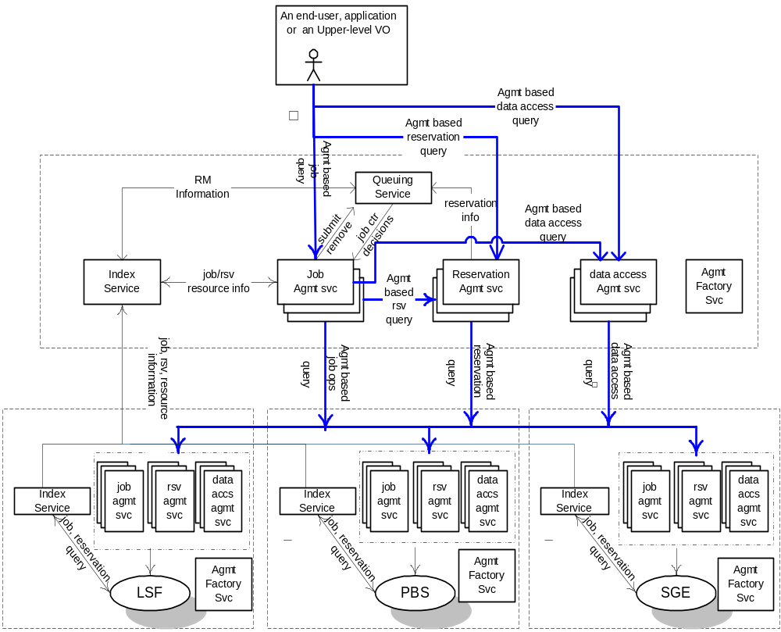
Future CSF Architecture and WS-Agreement

Slide 52
Other (non-GRAAP) Sessions of Interest
JSDL-WG
  Tuesday at 4:00 in Ohio
  Wednesday at noon in Ohio, this session specifically relates to use of WS-Agreement in JSDL. A proposal for this has already been made.
GESA-WG
  Tuesday at 10:00 in Michigan A
  Tuesday at 2:00 in Michigan A
OGSA Program Execution sub-group
  Tuesday at noon in Sheraton 4 (come here me give much of the same overview!)
DAIS-WG
  Discussion going on there about WS-Agreement also, but I’m uncertain which session (if any) will specifically address this.

Slide 53
Remaining GRAAP Sessions
Technical Discussion on the definition of Term States and the negotiation protocol
  Today at 4:00 in the Ohio Room
Technical Discussion on issues related to life-cycle of an agreement and monitoring of agreement state
  Tomorrow at 6:00 in the Huron Room
Goal of these sessions is to make progress on these issues via discussion
  If at all possible, come prepared with questions, concerns, etc., and speak up.
  Think about using WS-Agreement in your domain, or how
  it can be improved

