Slide 1
GLOBALGRIDFORUM.ORG
GRAAP-WG
Grid Resource Allocation Agreement Protocol Working Group
http://forge.gridforum.org/projects/graap-wg
GGF9
Chicago, USA
October, 2003

Slide 2
Chairs
Volker Sander
Forschungszentrum Jülich GmbH, Germany
v.sander@fz-juelich.de
Jim Pruyne
Hewlett-Packard Laboratories, USA
pruyne@hpl.hp.com
Wolfgang Ziegler
Fraunhofer–Institute for Algorithms and Scientific Computing, Germany
Wolfgang.Ziegler@scai.fhg.de

Slide 3
GGF IPR Policy
The GGF takes no position regarding the validity or scope of any intellectual property or other rights that might be claimed to pertain to the implementation or use of the technology described in this document or the extent to which any license under such rights might or might not be available; neither does it represent that it has made any effort to identify any such rights. Copies of claims of rights made available for publication and any assurances of licenses to be made available, or the result of an attempt made to obtain a general license or permission for the use of such proprietary rights by implementers or users of this specification can be obtained from the GGF Secretariat.
The GGF invites any interested party to bring to its attention any copyrights, patents or patent applications, or other proprietary rights which may cover technology that may be required to practice this recommendation. Please address the information to the GGF Executive Director.

Slide 4
Goals for this Session
Explain the approach to negotiation
Have really good discussion on the meaning, correctness, applicability, etc. of the proposed protocol / states
Reach some consensus whether we are getting where we need to be to have a useful, robust specification

Slide 5
WS-Agreement Concepts and Terminology
What’s an Agreement?
  A representation of an on-going relationship between a provider and initiator
    An Initiator begins the relationship by requesting creation
    A Provider maintains relationship by holding the state of the agreement
      A bi-directional agreement may have each party acting in both roles
  An Agreement is composed of a set of Terms with a structured grouping
An Agreement Term contains:
  Domain specific definition of content
  State concerning the commitment by the parties to the current value
  State concerning the freedom to re-negotiate these values
Negotiation is the process of updating term states to reach a final condition
  This is the core of the WS-Agreement specification

Slide 6
Two-level Negotiation
AgreementFactory::createService()
  Coarse-grained
  Conventional fault/response model
  Batch negotiation of complex terms
  Idiom: enables one-shot job submission
Agreement::renegotiate()
  Fine-grained
  Allows complex multi-message negotiation
  Permits adaptation of provisioning terms

Slide 7
Term State Dimensions
Status
  Offered – The initiator has proposed a value for the term
  Observed – The provider agrees to the value, and there is agreement
  Ignored – This term is not being considered any further
Criticality
  Optional – This term could be discarded during negotiation (status could change to ignored in the future)
  Required – Parties MUST reach an agreement on this term to form an agreement
Negotiability
  Negotiable – It is possible to change the value of this term
  Fixed – The term’s value cannot be changed in the future
Not all state combinations are valid
  (Ignored, Required, *), (Observed, Optional, *)

Slide 8
Joint State Definitions
Status | Criticality | Negotiability | Joint State Definition
Offered | Optional | Negotiable | OPTION-NEG
Offered | Optional | Fixed | OPTION-FIX
Offered | Required | Negotiable | REQUIRE-NEG
Offered | Required | Fixed | REQUIRE-FIX
Observed | Required | Negotiable | OBSERVE-NEG
Observed | Required | Fixed | OBSERVE-FIX
Ignored | Optional | Negotiable/ Fixed | IGNORED
These are Initial States set by initiator on call
to createService
These are final states leading to agreement, set in response by provider

Slide 9
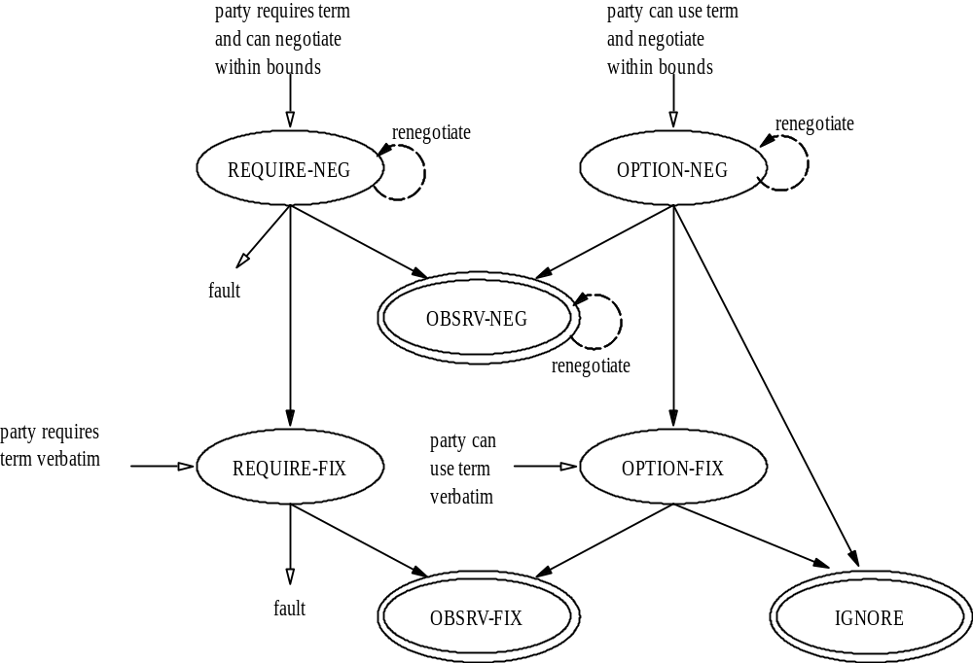
Term States
?
Notes:
This is a proposed state-machine for understanding the stateful negotiation process FOR EACH TERM. Might be abstracted to view stateful process for whole Agreement.

Slide 10
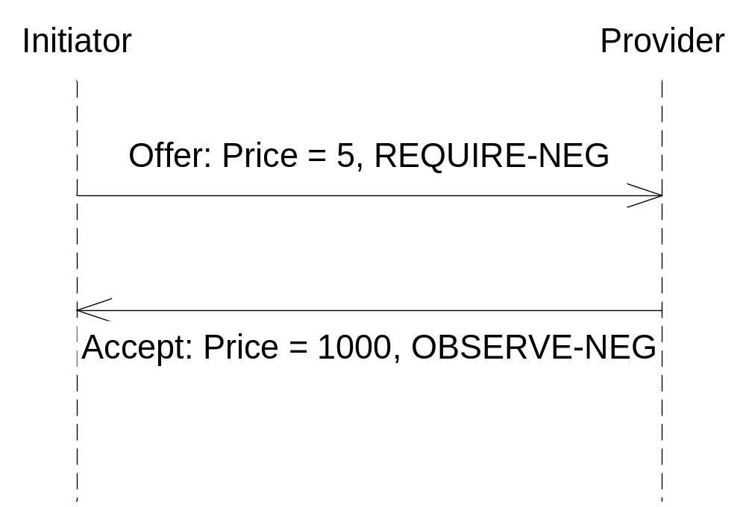
Example: How Not to Negotiate a price
Initiators leaves themselves open to any response by setting NEGOTIABLE in initial offer

Slide 11
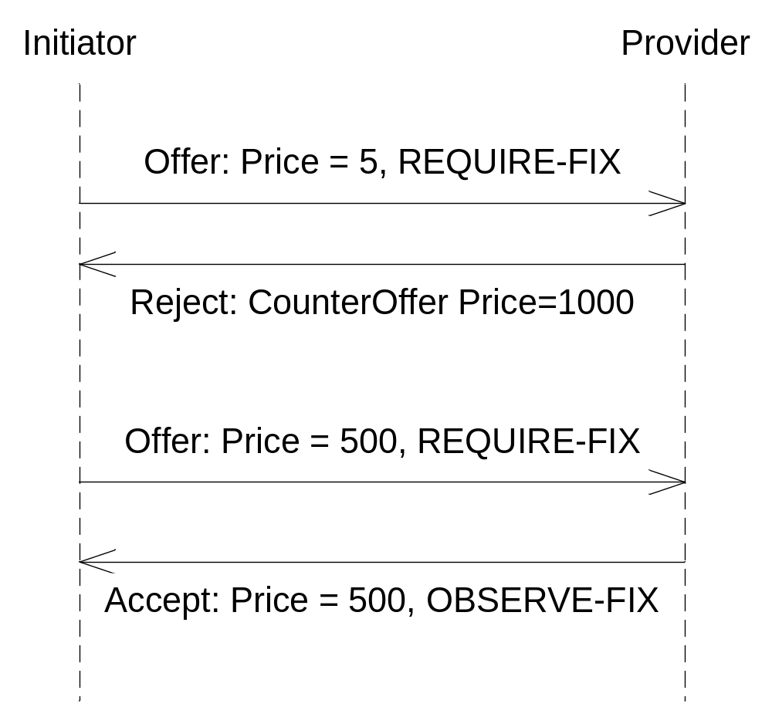
Better example of negotiating price
Initiator prevents provider from choosing arbitrary value by setting initial offer to FIXED

Slide 12
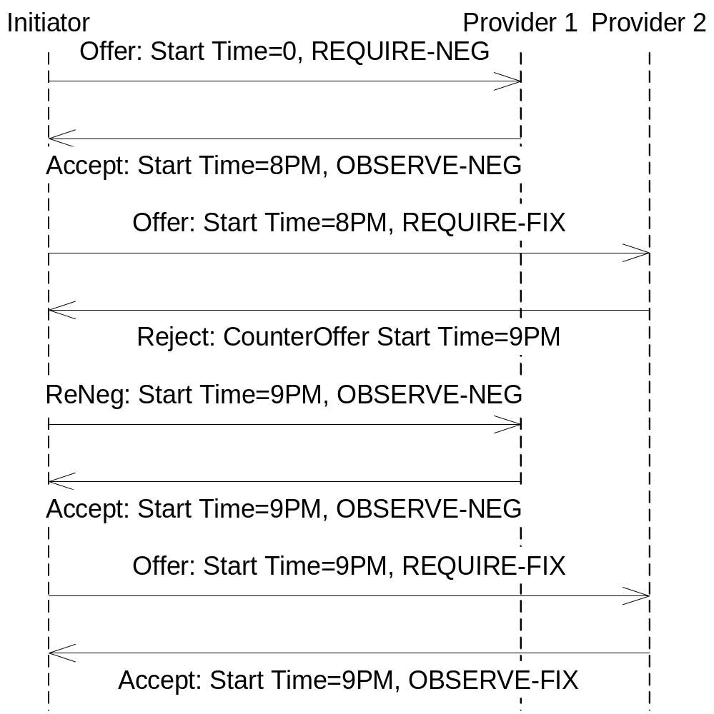
Co-Scheduling via Negotiation

Slide 13
How this looks in the Spec.
Logical State | wsp:usage term attribute | wsa:negotiability term attribute
OPTION-NEG | wsp:Optional | wsa:Negotiable
OPTION-FIX | wsp:Optional | wsa:Fixed
REQUIRE-NEG | wsp:Required | wsa:Negotiable
REQUIRE-FIX | wsp:Required | wsa:Fixed
OBSERVE-NEG | wsp:Observed | wsa:Negotiable
OBSERVE-FIX | wsp:Observed | wsa:Fixed
IGNORED | wsp:Ignored | *

Slide 14
Term Containers
Envelopes
  Message parts of portType
  ServiceData elements
Composition
  Logical compositors, e.g. AND/OR/XOR
  Negotiation constraints
    Limits on (re-)negotiable values/ranges
  Service constraints
    Limits on provisioning values/ranges
    Combine w/ semantics of domain-specific term
Notes:
Emphasize that Service Constraints contribute to the provisioned service semantics. Negotiation constraints and Envelopes only contribute to the negotiation outcome. Logical compositors contribute to both.

Slide 15
Defining the renegotiate port type
Renegotiate is defined in our state tables, but the port type definition has not been done. A modest proposal:
Input
NewTerms: an AgreementType document proposing new terms (complete, or only those to be updated?)
Output
Terms: an AgreementType document containing all of the terms associated with the current agreement
Fault
???: The same as the createService faults? Others? How would faults here impact the life of the agreement?

Slide 16
Some other issues
How does a provider initiate renegotiation?
  Is this desirable at all? If so, it doesn’t seem to fit the present model
Do we need an explicit phase for acceptance of an agreement?
Can we introduce new terms via renegotiation? If so, are there some terms that we explicitly want to introduce only in this phase because of granularity issues?
How would the introduction of term value constraints impact negotiation operations?

Slide 17
Remaining GRAAP Sessions
Technical Discussion on the definition of Term States and the negotiation protocol
  Today at 4:00 in the Ohio Room
Technical Discussion on issues related to life-cycle of an agreement and monitoring of agreement state
  Tomorrow at 6:00 in the Huron Room
Goal of these sessions is to make progress on these issues via discussion
  If at all possible, come prepared with questions, concerns, etc., and speak up.

