Slide 1
GGF Data Access and Integration Services
DAIS

Slide 2
Goals
Provide service-based access to structured data resources as part of OGSA architecture.
Specify a selection of interfaces tailored to various styles of data access starting with relational and XML
Play well with other GGF OGSA specs

Slide 3
Non-Goals
No new common query language
No schema integration or common data model
No common namespace or naming scheme
No data resource management
  E.g starting/stopping database managers
No push based delivery
  Information Dissemination?

Slide 4
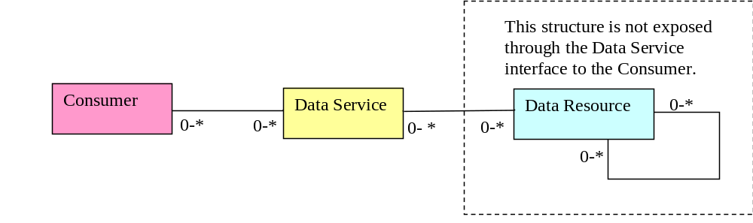
DAIS View Of Data Services Model
A Data Service presents a Consumer with an interface to a Data Resource. A Data Resource can have arbitrary complexity, for example, a file on an NFS mounted file system or a federation of relational databases. A Consumer is not typically exposed to this complexity and operates within the bounds and semantics of the interface provided by the Data Service

Slide 5
Specifying Interfaces
Interface
Data Resource
SQL
Graph
Rowset
RDB
XML
File
Graph
XML
File
OO
OO
Hier
Stream

Slide 6
Specification Names
Web Services Data Access and Integration (WS-DAI):
  The specification formerly known as the Grid Data Service Specification.
  A paradigm-neutral specification of descriptive and operational features of services for accessing data.
The WS-DAI Realisations:
  WS-DAIR: for relational databases.
  WS-DAIX: for XML repositories.

Slide 7
DAIS Specification Landscape
OGSA Data Services
Scenarios for Mapping
DAIS Concepts
GWD-I
Is Informed By
WS-DAI
GWD-R
WS-DAIR
WS-DAIX
Extend

Slide 8
GGF
Arch
Data
ISP
SRM
OGSA
AL
INFOD
SM
OREP
GSM
TM- BoF
CGS
NP,BC,SM
GRAAP
SL
CMM
GridFTP
GIR
DFDL
ADF-BoF
BC
DT
GFS
DAIS
Policy
DAIS and Other Standards/Specs
Other Standards Bodies
OASIS
DMTF
ANSI
W3C
????
WS-DM
(BC)
CIM
via CGS
SQL
XQuery(X)
WS
Policy
WS-RF
SM, SL
WS
Address
IETF
JCP
WS-N
SM, SL
SNMP
JDBC
Notes:
Fix colours

Slide 9
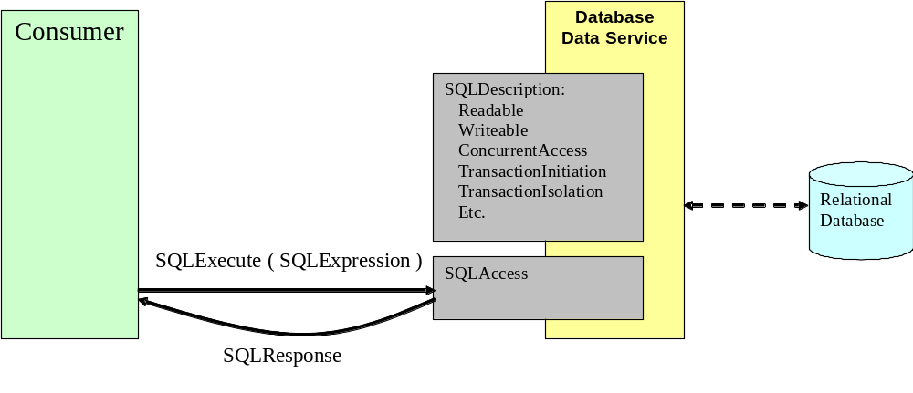
DAIS Data Access

Slide 10
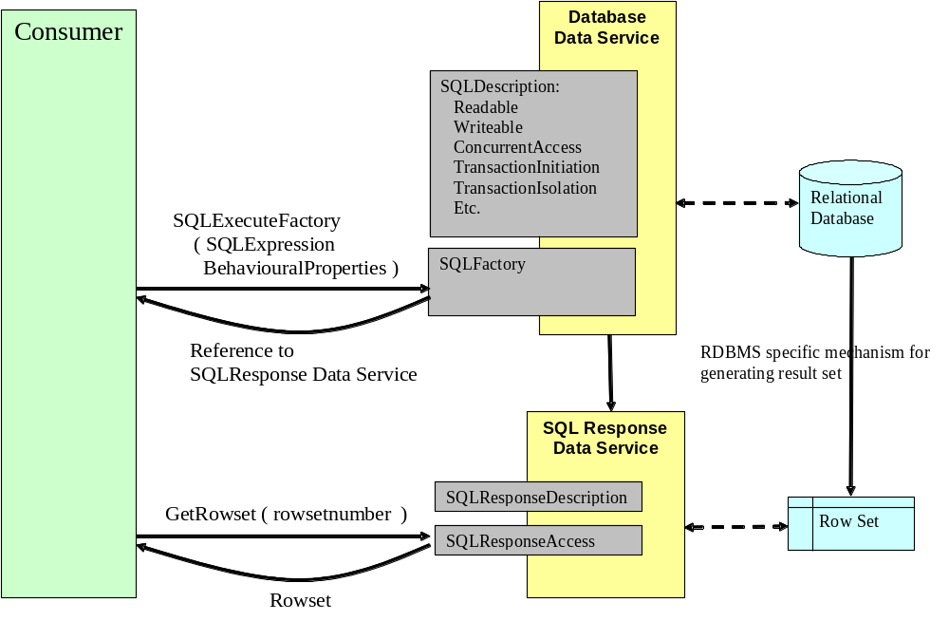
DAIS Derived Data Access
Notes:
Rowsetnumber?

Slide 11
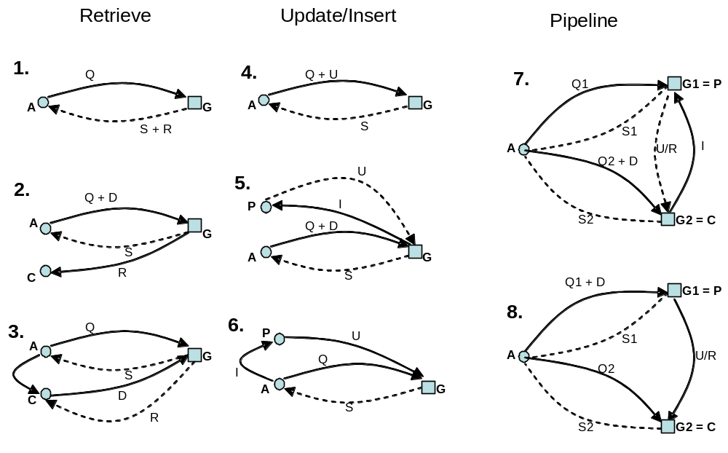
Delivery Scenarios

