Slide 1
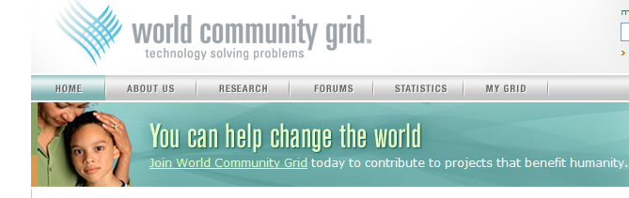
Public Services Announcement
http://www.worldcommunitygrid.org/
Participate by:
Downloading the software
Submitting a proposal

Slide 2
Welcome to GGF14!

Slide 3

Agenda
GGF14 Highlights
Progress & Plans
GGF 14
June 27-30 2005
Chicago, USA

Slide 4
GGF14 at a Glance
Mon
June 27
Tue
June 28
Wed
June 29
Thurs
June 30
Opening Plenary Session
9:00p - 10:00p.
Town Hall
12:30p - 2:00p.
Community Program
Community Program
Community Program
Community Program
Group Sessions
Group Sessions
Group Sessions
Groups Sessions
Closing Plenary Session
1:30p - 3:00p.

Slide 5

Community Program - Building GGF Communities
Telcom Community
Education Communities
Semantic Grids and the Agents Community
Life Sciences Community
Network-Centric Operations Community
Building an international community for the exchange of ideas, experiences, requirements, best practices
WUN Cultural Grid
How to Support New Communities in GGF
Roundtable discussion
Tuesday, 6:30p – 8:00p, Regent 1

Slide 6

Community Program – workshops
“Why, how and when to invest in working with GGF”- Improving Interaction between Grid Standards & Projects
Grid Applications: from Early Adopters to Mainstream Users
Healthcare Security & Privacy: Is GGF Doing Enough to meet the needs of the Healthcare Industry?
Globus Toolkit Version 4: Status and Experiences
Science Gateways: Common Community Interfaces to Grid Resources
Building a Research and Education Grid in Africa
Overview of the caBIG Project

Slide 7


Community Program – Introductory sessions for managers and newcomers
Grid Primer for Managers
GGF101 for Newcomers

Slide 8

Group Sessions - ~ 77 WG/RG Group sessions and BoFs
Simple API for Grid Applications - RG #1
Grid High-Performance Networking - RG #1
Grid Architectures & Specifications
  (OGSA, DAIS, GridFTP, JSDL)
GGF Liaisons
(e.g. OASIS, W3C, IETF, DMTF, SNIA)
Data Format Description Language - WG #1
Network Measurement - WG #1
SCRM-WG
Trusted Computing - RG
Job Submission Description Language - WG #1
Application Contents Service - WG #1
Enterprise Grid Requirements - RG
Firewall Issues - RG
OGSA-Authz-WG
Grid Storage Management - WG
Distributed Resource Management Applications API WG #1
Defining grid specifications that lead to interoperable software standards
Grid Computing Environments - RG #1
Data Access and Integration Services - WG #1
INFOD-WG
OGSA-WG #2 "EGA Reference Model"
GridRPC-WG
Certificate Authority Ops - WG #1
Grid File Systems - WG #1
Configuration Description Deployment Lifecycle Mgmt - WG #1
Preservation Environments - RG
OGSA-WG #1 "OGSA Status & Future"
Grid Scheduling Architecture - RG
Application Developers and Users - RG
GRAAP-WG #1
ByteIO-WG

Slide 9

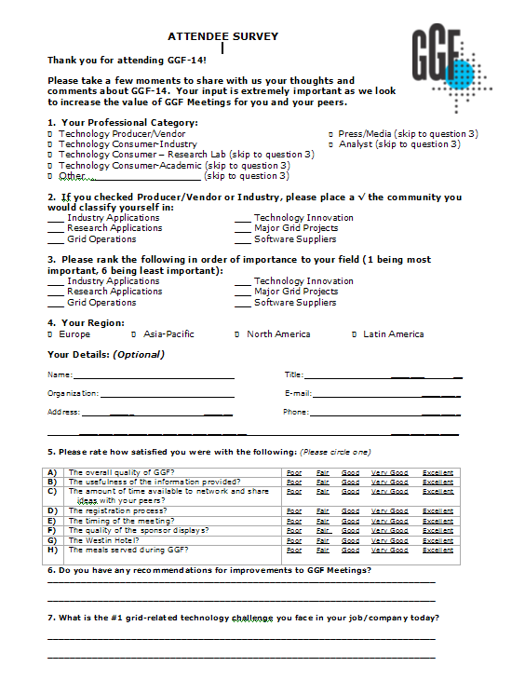
Fill out the GGF14 Survey
ATTENDEE SURVEY
Thank you for attending GGF-14!
Please take a few moments to share with us your thoughts and comments about GGF-14. Your input is extremely important as we look to increase the value of GGF Meetings for you and your peers.
1. Your Professional Category:
ס Technology Producer/Vendor ס Press/Media (skip to question 3)
ס Technology Consumer-Industry ס Analyst (skip to question 3)
ס Technology Consumer – Research Lab (skip to question 3)
ס Technology Consumer-Academic (skip to question 3)
ס Other ____________________ (skip to question 3)
2. If you checked Producer/Vendor or Industry, please place a √ the community you would classify yourself in:
___ Industry Applications ___ Technology Innovation
___ Research Applications ___ Major Grid Projects
___ Grid Operations ___ Software Suppliers
3. Please rank the following in order of importance to your field (1 being most important, 6 being least important):
___ Industry Applications ___ Technology Innovation
___ Research Applications ___ Major Grid Projects
___ Grid Operations ___ Software Suppliers
4. Your Region:
ס Europe ס Asia-Pacific ס North America ס Latin America
Your Details: (Optional)
Name: Title: _______ __
Organization: E-mail: ________
Address: _____ ______ Phone: ________
__________________________________ ______________
5. Please rate how satisfied you were with the following: (Please circle one)
A) | The overall quality of GGF? | Poor Fair Good Very Good Excellent
B) | The usefulness of the information provided? | Poor Fair Good Very Good Excellent
C) | The amount of time available to network and share ideas with your peers? | Poor Fair Good Very Good Excellent
D) | The registration process? | Poor Fair Good Very Good Excellent
E) | The timing of the meeting? | Poor Fair Good Very Good Excellent
F) | The quality of the sponsor displays? | Poor Fair Good Very Good Excellent
G) | The Westin Hotel? | Poor Fair Good Very Good Excellent
H) | The meals served during GGF? | Poor Fair Good Very Good Excellent
Participants eligible for prize drawing
in the appropriate box:
Comments about the GGF Community Program Track:
______________________________________________________________________
______________________________________________________________________
THANK YOU FOR TAKING THE TIME TO COMPLETE THIS SURVEY
RETURN YOUR COMPLETED SURVEY TO THE REGISTRATION COUNTER AND
ENTER THE DRAWING TO RECEIVE A SPECIAL GIFT.
CONGRATULATIONS TO FRANK FALCON, BT, WHO WON AN iPOD FROM THE GGF13 SURVEY DRAWING!

Slide 10
Agenda
Conference Highlights
Progress & Plans
GGF 14
June 27-30 2005
Chicago, USA

Slide 11

Since GGF13 in Seoul, our community has made steady progress
Pervasive Adoption
GGF Community

Slide 12

Even as the pressure for broadly adopted specifications continues to grow
Where is the balance?
What is the standards landscape and roadmap look like?
What is the future directions for OGSA and how do we balance the “O” and the “A” in OGSA
When will the web services infrastructure standards that OGSA relies on stabilize?
“O”
“A”
Interoperability

Slide 13
GGF is pursuing aggressive objectives
Community
Enable active participation & growth for existing Research communities
Pro-actively explore, develop, and establish new Industry communities
Increase community-oriented focus at GGF events
Publish community-driven requirements & best practices
Community Satisfaction
Standards
Publish GGF Standards Roadmap
Publish OGSA v 1.5 Architecture and Profiles
Standards Adoption
Publish, or support the publication of, important Grid specifications
Manage liaisons with standards organizations critical to grid adoption
Operations Efficiency
Operations
Marketing plan that communicates the value of GGF and ongoing contributions
Events plan resulting in increased GGF event satisfaction & financial return
Sponsorship plan resulting in increased sponsor satisfaction and revenue
Revise GGF website while improving GGF document publishing infrastructure
Notes:
Role with BCS Value Creation
Understand current BCS deals
? With BCS
BCS focus?
Same ?
Who gets revenue for x-IGS deals?
Delivery
How to do ?

Slide 14

We have transitioned to new GFSG functions and aligned areas and groups
Community
Standards
Research Applications
Industry Applications
Grid Architectures & Specifications
  (OGSA, DAIS, GridFTP, JSDL)
GGF Liaisons
(e.g. OASIS, W3C, IETF, DMTF, SNIA)
Grid Mega-Projects
Technology Innovations
Grid Operations
Operations
Events
Marketing
Sponsorship
Finance & IT

Slide 15
… established 9 new groups …
New Groups at GGF14
Telecom Research Group (Telco-RG)
Trusted Computing Research Group (TC-RG)
Firewall Interest Research Group (FI-RG)
OGSA-BES Working Group (OGSA-BES-WG)
Production Grid Services-RG (PGS-RG)
ByteIO Working Group (ByteIO-WG)
OGSA-Data Working Group (OGSA-D-WG)
OGSA-Naming-WG (OGSA-N-WG)
Standards Development Organizations Collaboration on Networked Resources Management (SCRM-WG)

Slide 16
… and published 5 new new documents
GFD.44 | Open Grid Services Architecture Glossary of Terms J. Treadwell, M. Behrens, D. Berry, V. Deolaliker, A. Djaoui, I. Foster, A.Grimshaw, O. Hernandez, B. Horn, H. Kishimoto, F. Maciel, D. Milojicic, S. Schaefer, D. Snelling, J. Pruyne, R. Subranamiam, A. Savva, F. Siebenlist, J. Unger
GFD.45 | Resource Management in OGSA F. Maciel, J. Treadwell, L. Srinivasan, A. Westerinen, E. Stokes, H.Kreger, D. Snelling
GFD.46 | Operations for Access, Management, and Transport at Remote Sites R. Moore
GFD.47 | GridFTP v2 Protocol Description I. Mandrichenko, W. Allcock, T. Perelmutov
GFD.48 | Authority Recognition Authors: P. Madsen, D. Chadwick
GGF Document Series

Slide 17
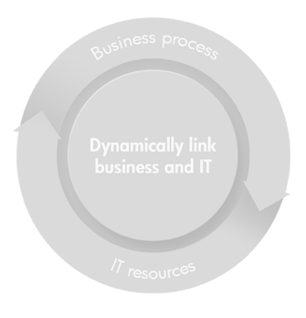
We have early work to share with the community on a GGF Standards Roadmap
DISTRIBUTED
COMPUTING
Scope
Provides context regarding current standards environment (Industry & GGF)
Describes OGSA and related specifications that enable interoperability
Intent
Living document” - approachable summary of the specifications, uses and targeted functions
Estimates time scale for public comment, implementation, interoperability testing
Milestones
Discussion Draft (6/05)
v1.0 Document (10/05)
GRID
COMPUTING
UTILITY
COMPUTING
Applications
Applications
Grid Services
Profiles
Profiles
Distributed Services
Web Services
Profiles
Networked Resources
Resources

Slide 18
… and have the start of a new cross-institutional WG for standards collaboration
GGF has been coordinating discussions during the past year with Standards Development Organizations (SDOs), including DMTF, GGF, IETF, ITU-T, OASIS, SNIA, TMF, W3C, to improve overall collaboration on next generation standards for management of resources
Now forming a cross-institutional workgroup (WG) within GGF to converge common terminology, organize and summarize the interplay of the various specifications.
  “Standards development organizations Collaboration on networked Resources Management” or SCRM (pronounced “scrum”)
GGF provides the infrastructure for SCRM-WG - participating SDOs can equally contribute to and promote SCRM work
The SCRM-WG is a regular public GGF Working Group - anyone with relevant skills, interest and commitment encouraged to participate
Standards Landscape Document
Glossary and Taxonomy Document
Deliverables

Slide 19
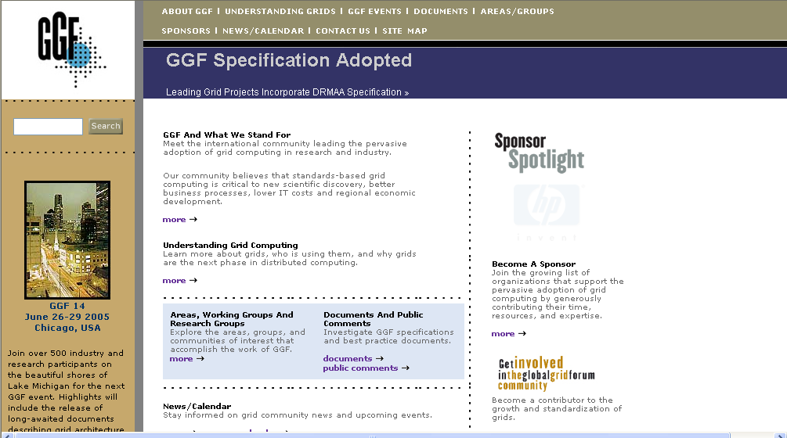
We have enhanced the GGF Website
Navigation bar for fast access to key sections of interest
New “revolving message” area to highlight current topics of interest
“Sponsor Spotlight” area that showcases the sponsors who generously contribute to our efforts
Quick Access to critical GGF event, news, group and document information

Slide 20



… and announced a new Enterprise Event
Premier commercial, educational and technical event for grid computing worldwide
Combines GGF expertise in grid architectures, specifications, best practices and solutions … with IDG’s event marketing and management
Extensive Enterprise Program along with the traditional GGF(15) Community Program and Group sessions

Slide 21

GGF15 at a Glance
Mon
Oct 3
Tue
Oct 3
Wed
Oct 5
Thurs
Oct 6
Community Program
Enterprise Program
Enterprise Program
Community Program
Community Program
Community Program
Group Sessions
Group Sessions
Group Sessions
Group Sessions
Theme: Explore, Adopt and Deploy
Special pricing for GGF members

Slide 22
Our GGF Community has accomplished much over the last several years…
The woods are lovely, dark and deep.
But I have promises to keep,
And miles to go before I sleep,
And miles to go before I sleep
Excerpt from: Robert Frost
Stopping by Woods on a Snowy Evening

Slide 23

Together we can take grid to the next stage of growth and adoption
Help build our international community
  Open dialogue and discourse
  Practical, “crawl, walk, run” approach
Contribute to interoperable software standards
  Eyes on the prize - interoperability, not politics
  Shameless collaboration – it takes “a community”
  Balance the “O” and the “A” in OGSA
Come to GridWorld and tell your friends!

