Slide 1

GIN-GGF19
Status and Future Steps

Slide 2

GIN Status
Celebrating 1 year GIN @ OGF
GIN had a lot of impact
  Interoperability considered a major topic in most Grid efforts
  OGF sees GIN as one of the major sources of influence for future developments
  IGTF trust anchors
  Information system translators and common service map
  BES and JSDL of the HPC-Profile
  SRM and SRB convergence
  (Brave) applications exploring interop in reality
  …
But also many open issues

Slide 3
Revise charter
“The scope of the group is to pursue interoperation on 6-8 month horizons”
“Feb 2007 (GGF-19) Workshop reporting Grid Interoperation Now (GIN) 2006 vintage experience.
Planning and assessment meeting to determine whether to select new areas for 2007 and repeat.
Propose new charter or disband.”

Slide 4
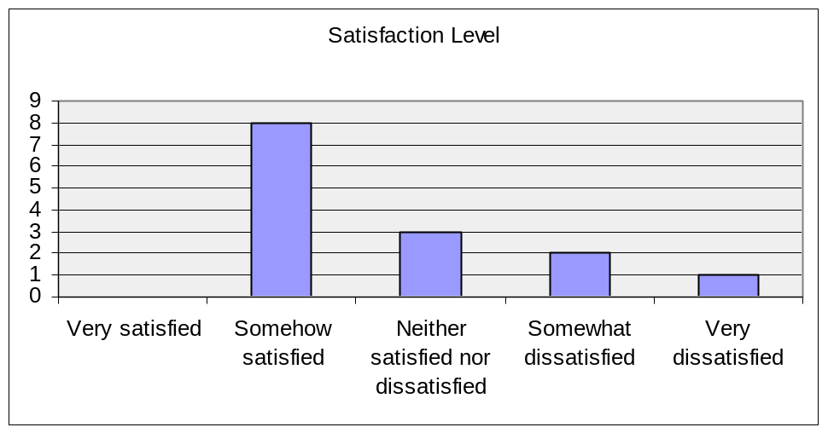
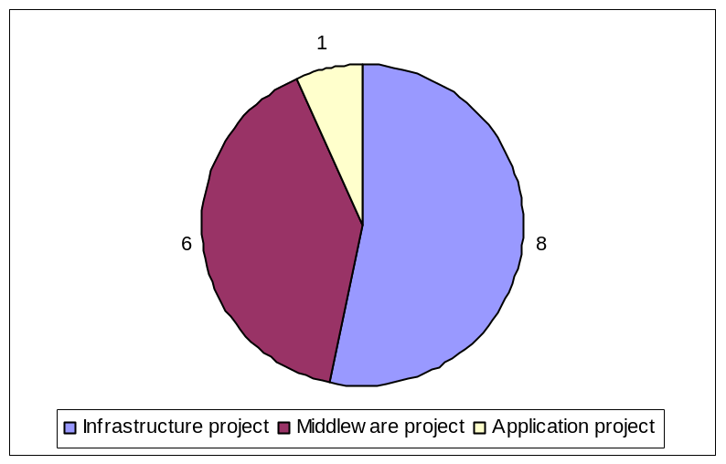
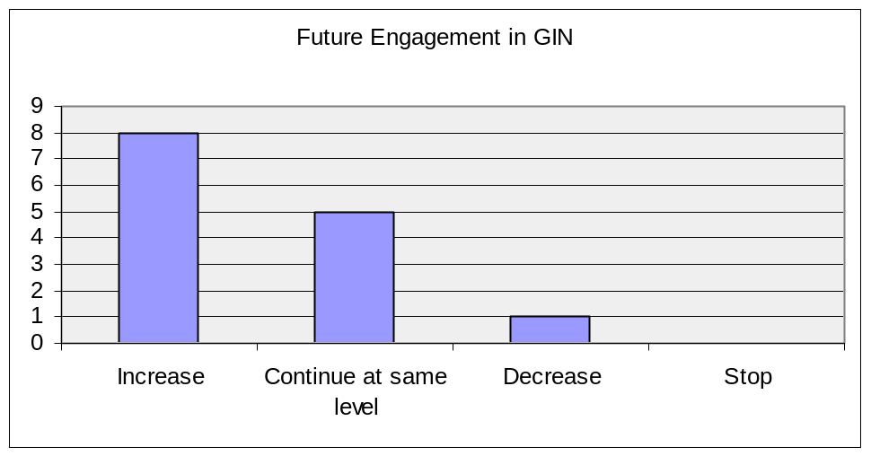
GIN Survey
Survey launched in December 06
13 responses

Slide 5
GIN Survey
 | Critically Important | Important | Not Important
Authorization of users across Grid infrastructures
 | 93% | 7% | 0%
Interoperating information services between Grid infrastructures
 | 43% | 50% | 7%
Bringing together a user community who require cross-Grid services
 | 15% | 62% | 23%
Providing interoperating job submission across Grid infrastructures
 | 29% | 64% | 7%
Bringing together Grid infrastructure providers for collaboration and information sharing
 | 36% | 50% | 14%
Bringing Grid infrastructure providers together with software providers to provide feedback
 | 14% | 79% | 7%
Promoting and supporting a set of open, interoperating services for applications willing to help GIN
 | 14% | 79% | 7%

Slide 6
GIN Survey – Critical points
Not enough discussion on email lists
  Most important discussions off-list
More clear direction
Difficult to get information
Increase impact through better documentation and communication to standards and middleware providers
Involve more different middleware (e.g. UNICORE)

Slide 7
Where Next?
Abandon the activity or continue the activity
Abandon
  Documenting exercise
Continue
  Re-confirm commitment
  Re-charter
  Group leadership and secretary

Slide 8
Examples of standards group interactions
HPCP – Steven Newhouse
DMI – Michel Drescher
GLUE, GSM
Any other groups?

Slide 9
Focus of GIN
Revisit current 5 groups
  Authentication, jobs, data, info, applications
Possible new topics
  Accounting, authorization, …

Slide 10
Output of GIN
Case studies
  Input to standards and mw providers
Best practices
Recommendations
Needs effort to document our work!

Slide 11
GIN retreat?
Before OGF-20
Wednesday, March 14
Location?
  CERN, …

Slide 12
About OGSA-DMI
Ravi Madduri, ANL
James Casey, CERN
Michel Drescher, Fujitsu

Slide 13
Contents
What we want
Mission and Goals
Use Cases
Draft Architecture

Slide 14
We would like …
To get your Use Cases
  VO Use Cases
  Community-based Use Cases
Your contributions
  DMI-WG commitment
  Regular draft reviews
Your implementations
Notes:
Community-driven:
- what’s your definition of “fast”
- what’s your definition of “scheduled”
- what’s your definition of “QoS”
- what’s your definition of “reliabilty”

Slide 15
Mission
Standardisation of:
  Movement of large data sets
  Reliability options
  Performance options
Abstraction of:
  Transport protocol discovery
  Direct movement control

Slide 16
Use cases for DMI
WG participants asked to provide use-case documents describing current data movement architecture
Documents received from:
  UNICORE
  EGEE/WLCG
  LBNL SRM
    http://forge.gridforum.org/sf/docman/do/listDocuments/projects.ogsa-dmi-wg/docman.root.resources.use_case_documents
Globus use cases in CEDPS proposal
  http://www.cedps.net/wiki/index.php/Main_Page

Slide 17
Use cases for DMI
Use cases are at the grid infrastructure level
  More ‘VO level/Community’ use cases would be useful
Also include some outside of the scope of DMI
  Single file movement
  Movement of files inside a site

Slide 18
The primary data movement use case
Each system has some different specifics, but all resolve to:
  “Asynchronously transfer a (possibly large) set of files reliably, securely, and efficiently from one site to another, allowing me or my VO to schedule the transfer, and without me having to worry about transfer protocol negotiation or efficient utilization of the network and storage infrastructure.”

Slide 19
Movement Job Control
Once a movement job has started, it can be
  Cancelled
  Queried for Status
  Re-prioritized

Slide 20
Other use cases
Data Broadcast
  Efficiently send the same set of files to a set of destinations
    Not necessarily implying multicast
Interaction with advanced storage systems
  Be able to efficiently use features like space reservation and staging from tape

Slide 21
Architecture (1)
Source
Source
Service(s)
DMI
Factory
requestTransfer()
create()
User
control()
manage()
DMI
Service
Sink
Service(s)
Sink
Notes:
Green: DMI Interface
Blue: WS-* Interfaces necessary to master a data movement set up and execution
Orange: Concrete data transfer protocol such as GridFTP, FTP, etc.
White: The client to DMI, may be the end user, or an agent acting on her behalf

Slide 22
Architecture (2)
DMI Factory Service
  One or many in a Grid
  Incomplete reach-out to data nodes
  Incomplete transport protocol support
  Competition
    Availability
    Billing
    Coverage

Slide 23
Architecture (3)
DMI Service
  Short-lived
  Individually set up per request
  Moves of one or many resources
  Talks transport level protocols

